Slide 1
Fiducial Reference Measurements
INTRODUCTION.
May 2026 - NPL
ESA EOP-GMQ

Slide 2
Fiducial Reference Measurements
History
The “concept” comes from 2 lines:
Improving the quality and knowledge of measurement → QA4EO, metrology
Programmatic: Copernicus Quality reference, distinction vs in-situ which is not tangible to a funding agency and not (necessarly) precise enough to argue for a validation program
“Concept” and terminology – FRM – was used and presented for the first time in November 2013 at S3VT at ESRIN.
Name and concept was discussed for the 1st time in Oct or Nov 2013 at ESTEC at (after) S3 MAG, where the need for distinguishing from in-situ was clearly expressed.
Discussion Donlon, Ian Robinson and Goryl
Name from Donlon
NB: the name and concept was created in 2013, but FRM existed before → ex: MOBY, MIAMI experiments
Monsieur Jourdain discovering that his everyday speech is called “prose”….(Molière)

Slide 3
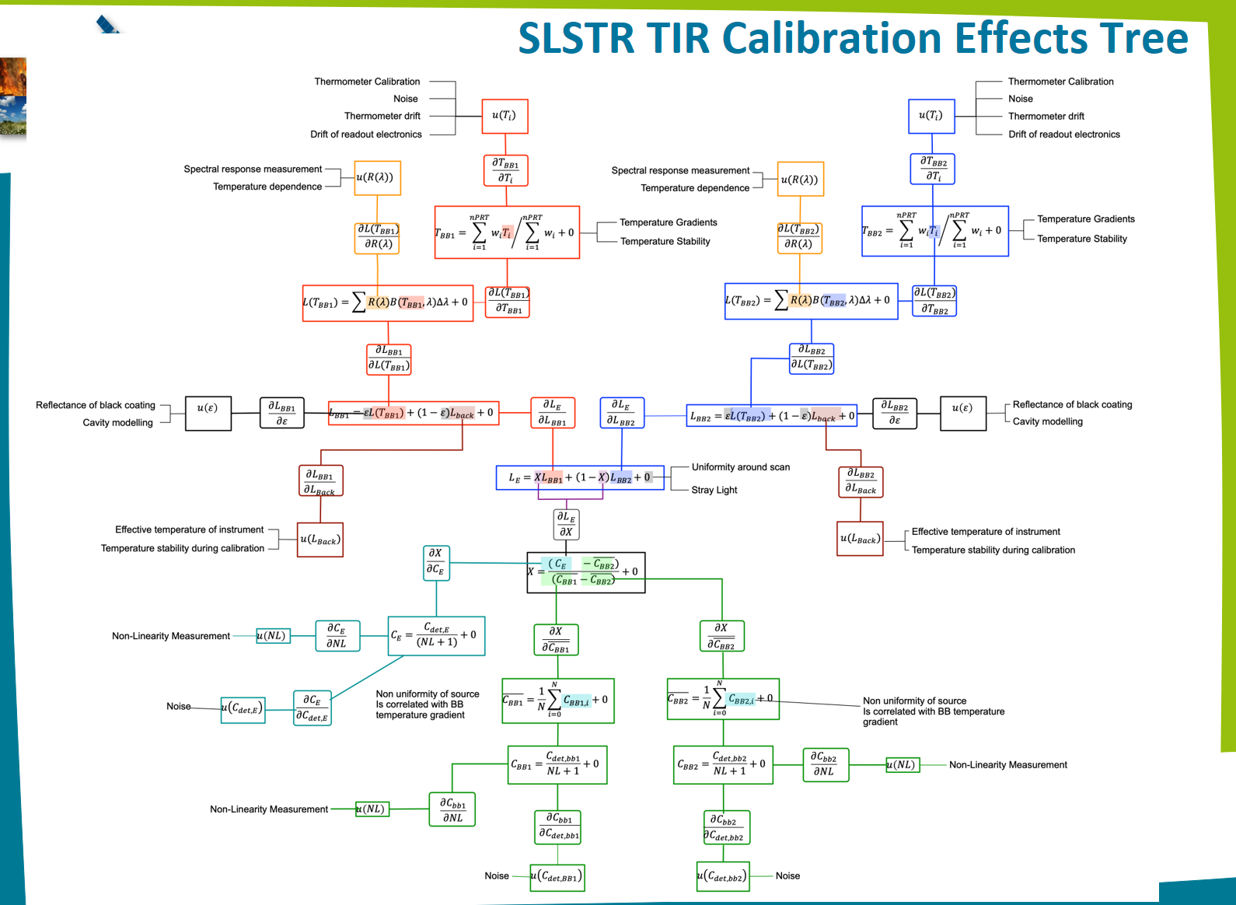

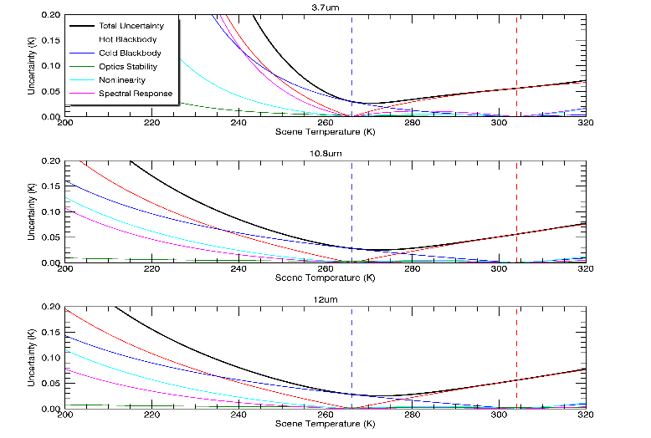
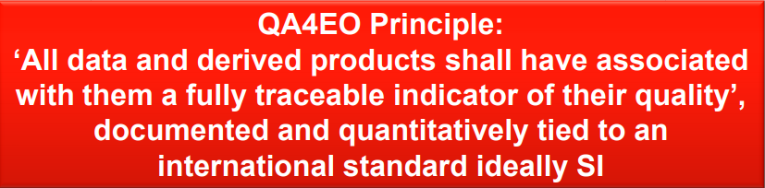
QA4EO
S-3B TIR Uncertainty Budget
Uncertainties vs. Temperature from pre-launch are included in L1 products

Slide 4
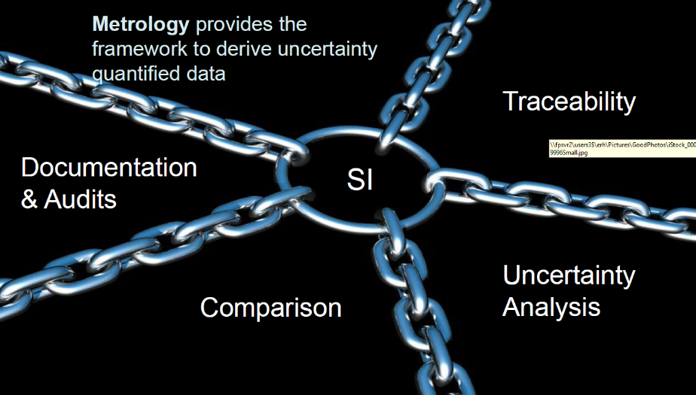
Metrology approach
Obtaining confidence in a measured value requires a quantitative statement of its quality, which in turn necessitates the evaluation of the uncertainty associated with the value.
The basis for the value and the associated uncertainty is traceability of measurement, involving the relationship of relevant quantities to national or international standards through an unbroken chain of measurement comparisons.
Notes:
Obtaining confidence in a measured value requires a quantitative statement of its quality, which in turn necessitates the evaluation of the uncertainty associated with the value. The basis for the value and the associated uncertainty is traceability of measurement, involving the relationship of relevant quantities to national or international standards through an unbroken chain of measurement comparisons.

Slide 5
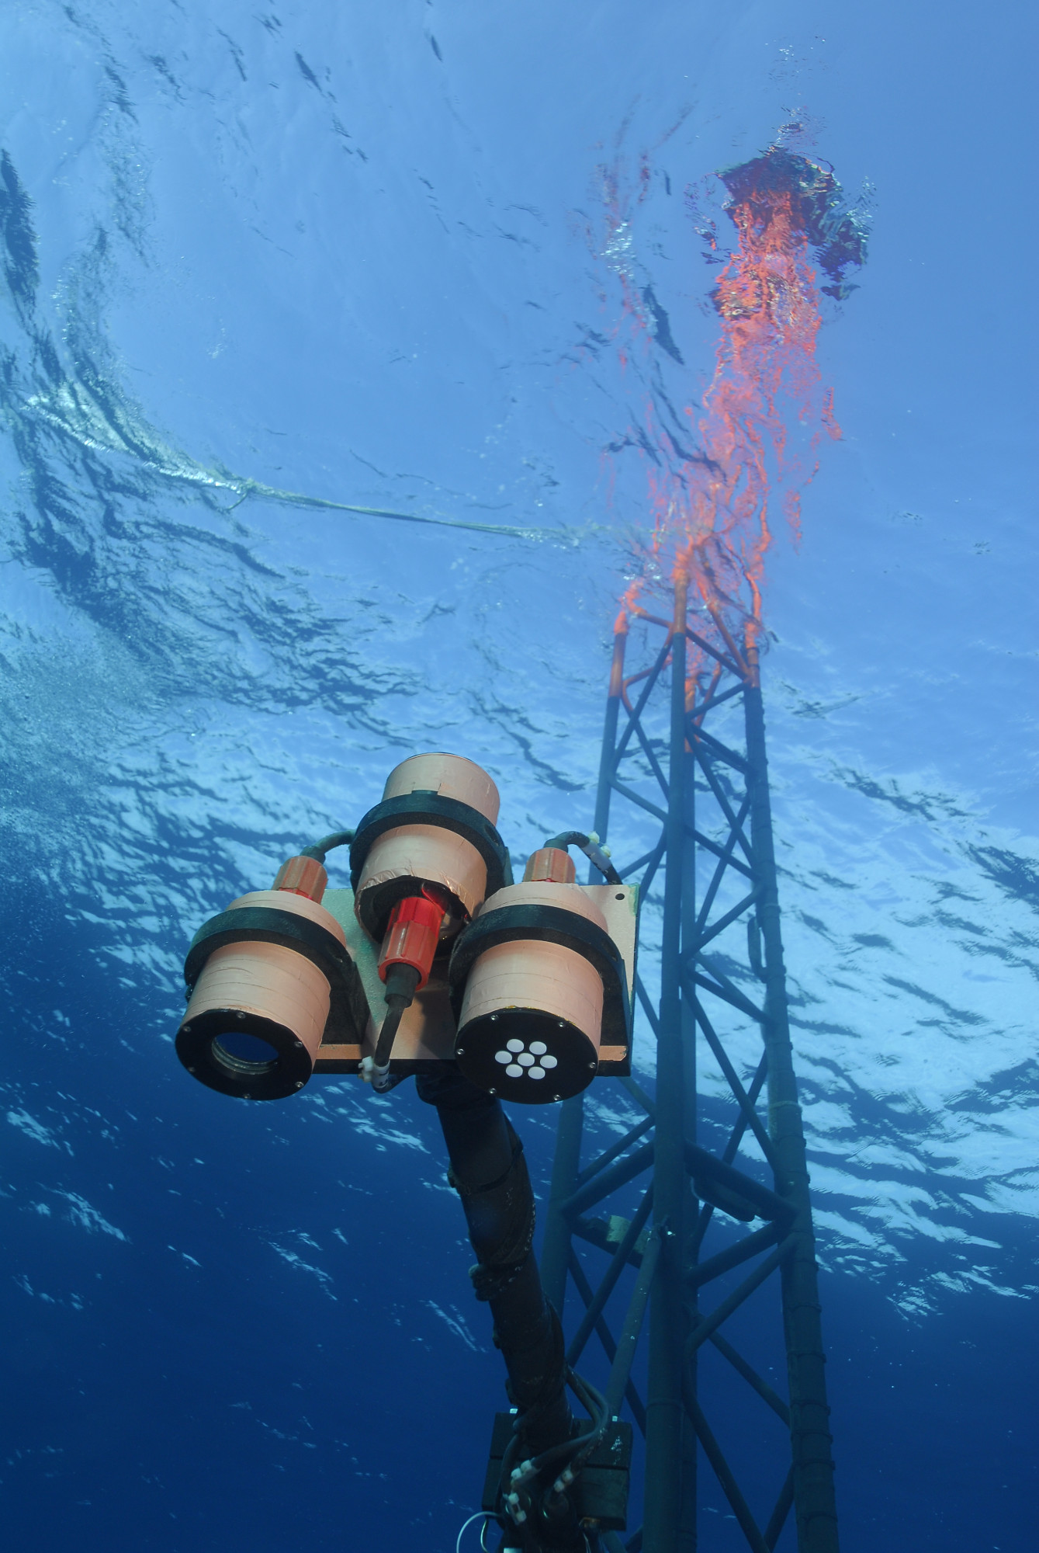
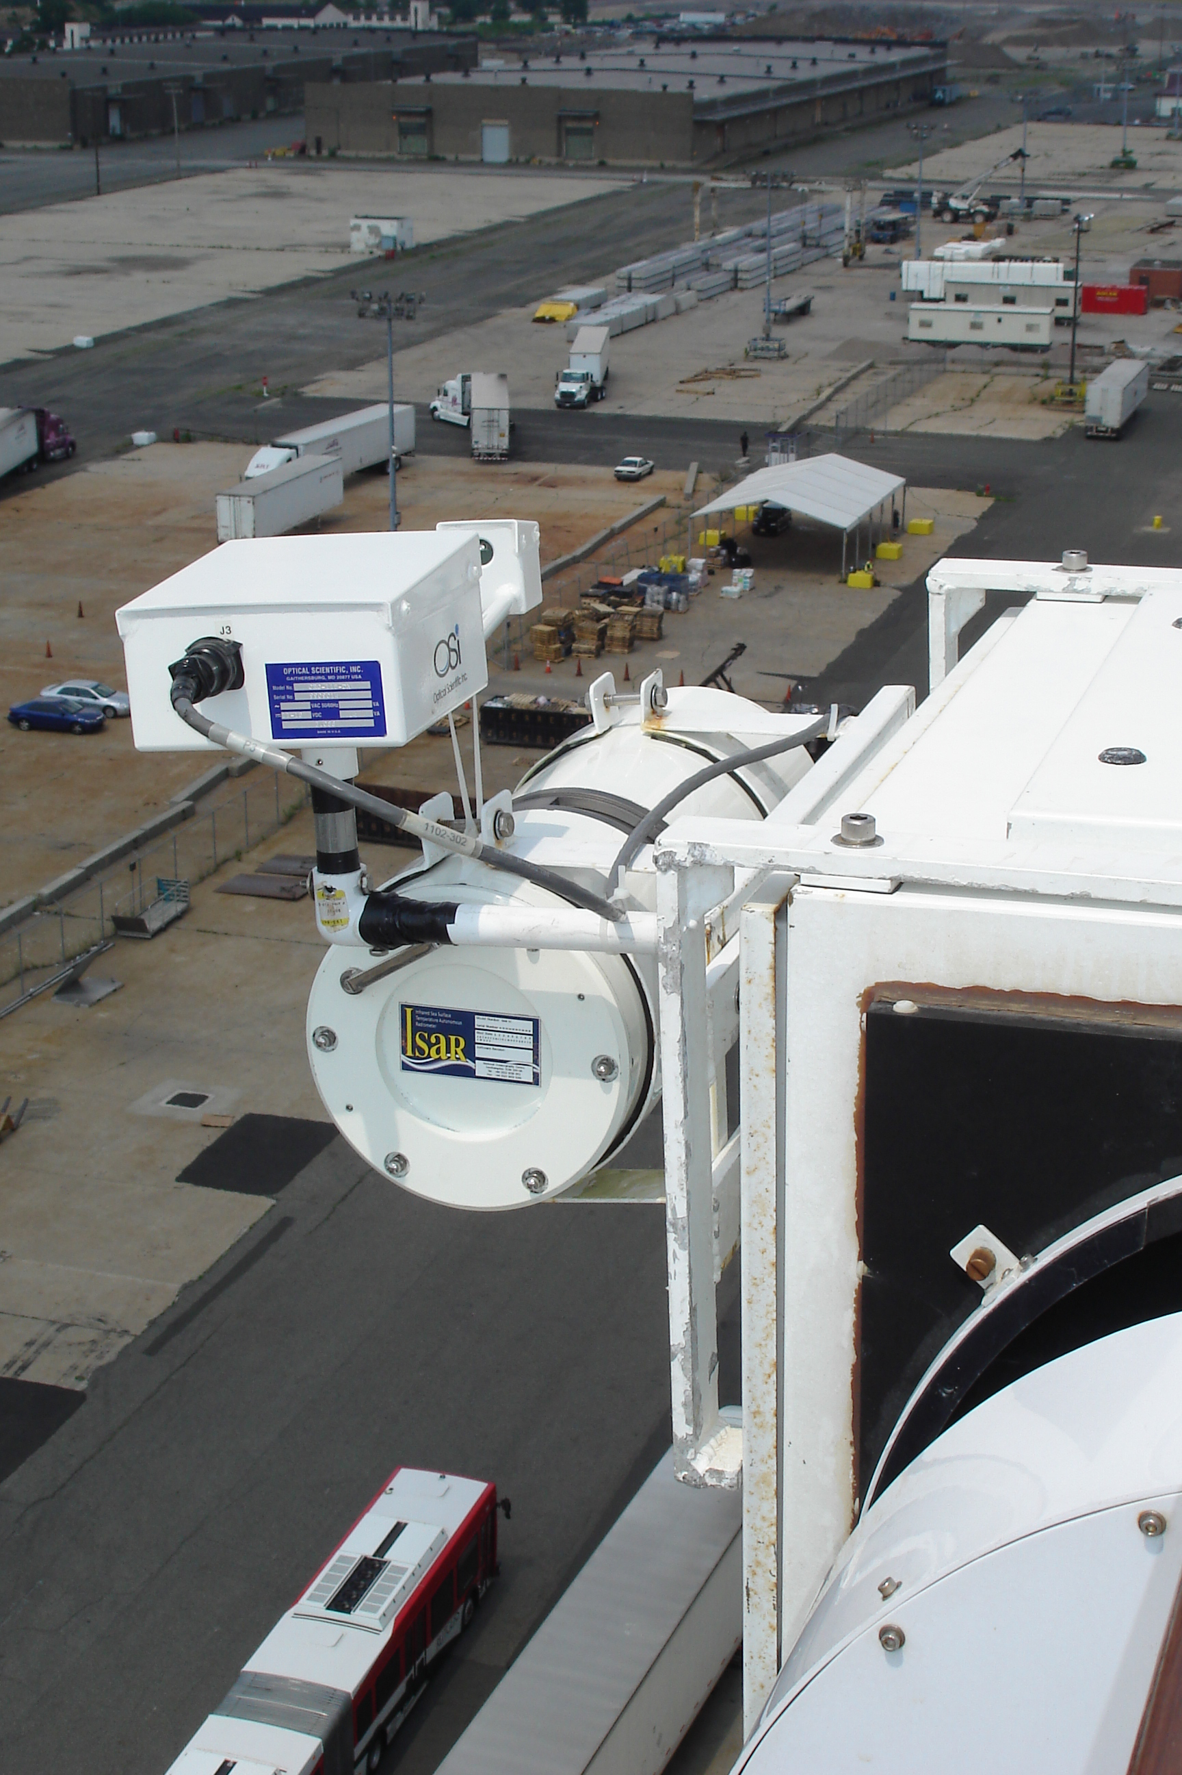
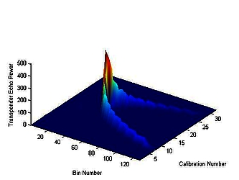
Fiducial Reference Measurements (FRM)
fi·du·cial (adj) Regarded or employed as a standard of reference, as in surveying.
  [Late Latin fiducialis, from Latin fiducia, trust, from fidere, to trust; seebheidh- in Indo-European roots.]
What’s wrong with in situ?
  It means everything to the uneducated
  It’s not tangible to a funding agency
  It is not precise enough to argue for a validation
  program
Sentinel-3 FRM are:
  Linked to the S3 Cal/Val plan activities
  Based on specific requirements
  Forward thinking – long-term vision
  Building on the existing capability
  Have an inclusive approach: FRM are not Mission specific (e.g. S3A, B, C, D… S2A, B, C, D…all need ocean colour FRM…, All Altimeters need transponders for range calibration – and Sigma0…)

Slide 6
Why do we need FRM?
FRM is the suite of ground measurements that provide the maximum Return On Investment (ROI) for the Mission by delivering the required confidence in the data products for users.
  IF we have no FRM then we cannot really use the mission as we have no idea how accurate data products are
  IF we have many FRM this is great scientifically (statistical significance, geographic coverage, robust network…) but incurs additional costs with reducing ROI
There is a balance between these two extremes to deliver a satellite mission with a KNOWN product quality that is “fit for Purpose”

Slide 7
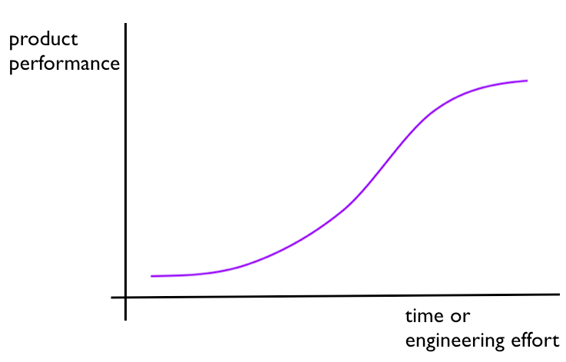
Is a mission product “fit for purpose”?
It depends our knowledge of how “good” it is…
Q: What is the optimal FRM investment?
Initial FRM Investment: Cannot demonstrate performance of products
FRM Investment yields significant benefit: Confidence in product performance increases
Further FRM Investment does not yield significant improvement
A: Sufficient to show that the Mission meets requirements:
A HIGH-IMPACT FRM
Benefit: Confidence in
product performance
Cost: FRM (installation/operation/maintenance)

Slide 8
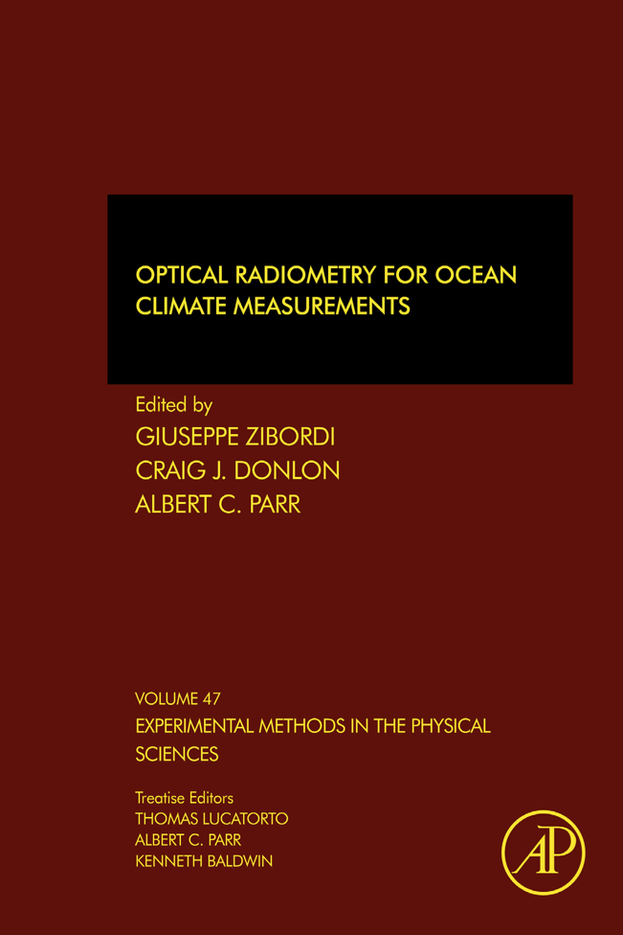
Why do we need FRM?
FRM are the suite of independent ground measurements that provide the maximum scientific utility/return on investment for a satellite mission by delivering, to users, the required confidence in data products, in the form of independent validation results and satellite measurement uncertainty estimation, over the duration of the mission (Donlon et al, 2014)
  IF we have no FRM then we cannot really use the mission as we have no idea how accurate data products are
  IF we have many FRM this is great scientifically (statistical significance, geographic coverage, robust network…) but incurs additional costs with reducing ROI
There is a balance between these two extremes to deliver a satellite mission with a KNOWN product quality that is “fit for Purpose”
We refer to Fiducial Reference Measurements (FRM)
NOT simply in situ data.

Slide 9
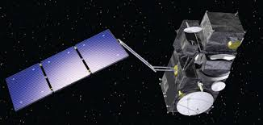
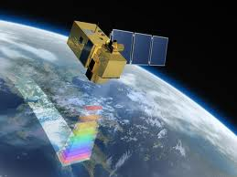
S2A
S3A
S2B
In Europe, we have a lot of Copernicus infrastructure in preparation – will we be able demonstrate its performance?
Can we demonstrate we have met requirements?
Are products “fit for purpose” within Copernicus?
S3B
S2C&D
S3C
S3D

Slide 10
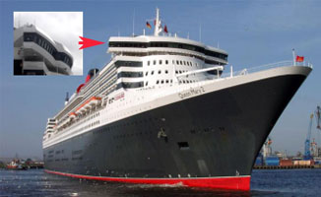
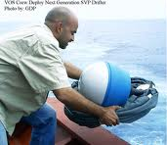
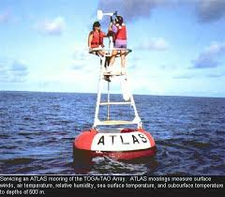
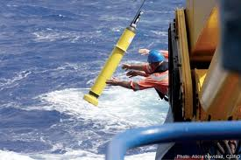
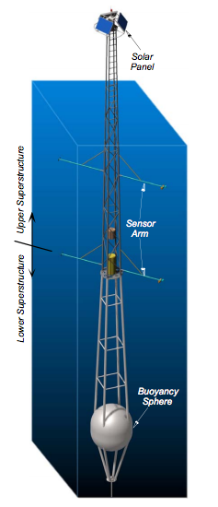
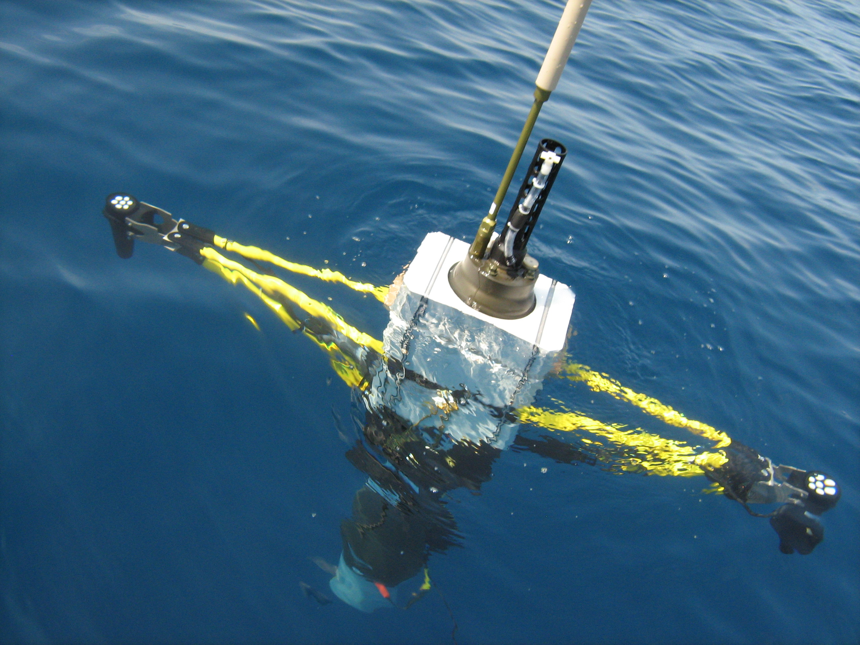
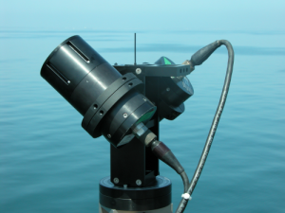
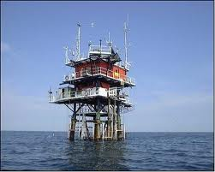
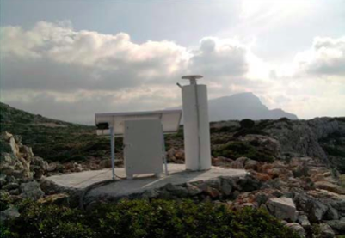
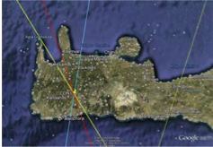
1st Example FRM: S3
Ship-borne radiometers provide skin SST traceable to International standards.
We need FRM to perform vicarious calibration of OLCI - Boussole, Moby, others
Deployment of Transponders (Range and Sigma-0)
high impact FRM

Slide 11
What are Fiducial Reference Measurements (FRM) ?
“The suite of independent tailored and fully characterised measurements that provide the maximum Return On Investment for a satellite mission by delivering, to users, the required confidence in data products, in the form of independent validation results and satellite measurement uncertainty estimation, over the entire end-to-end duration of a satellite mission.”
The defining mandatory characteristics for FRM are:
FRM measurements should ideally have documented SI traceability (e.g. via round-robin characterisation and regular pre-and post deployment calibration of instruments) using metrology standards and/or community recognised best practices;
FRM measurements are independent from the satellite geophysical retrieval process;
An uncertainty budget for all FRM instruments, and derived measurements, is available and maintained;
FRM measurement protocols, procedures and community-wide management practices (measurement, processing, documents, etc.) are defined, published and adhered to by FRM instrument deployments;
FRM are accessible to other researchers allowing independent verification of processing systems;
FRM are required to determine the on-orbit uncertainty characteristics of satellite geophysical measurements via independent validation activities.

Slide 12
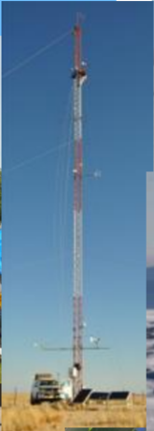
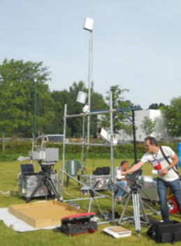
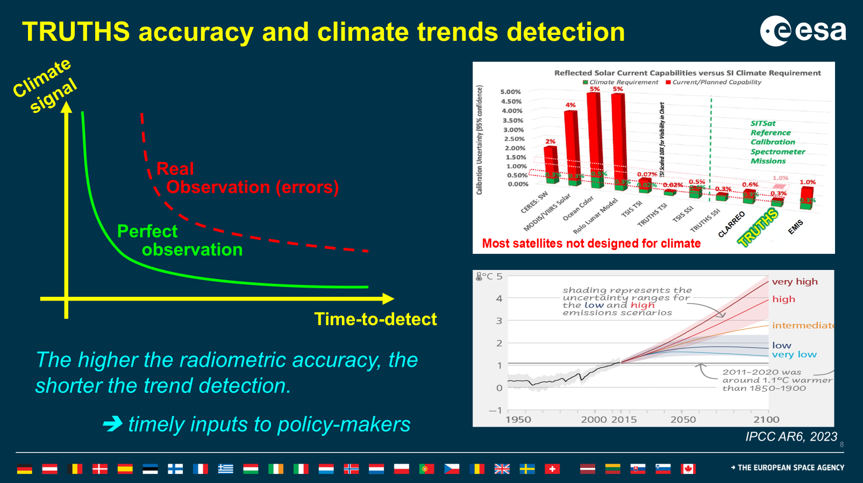
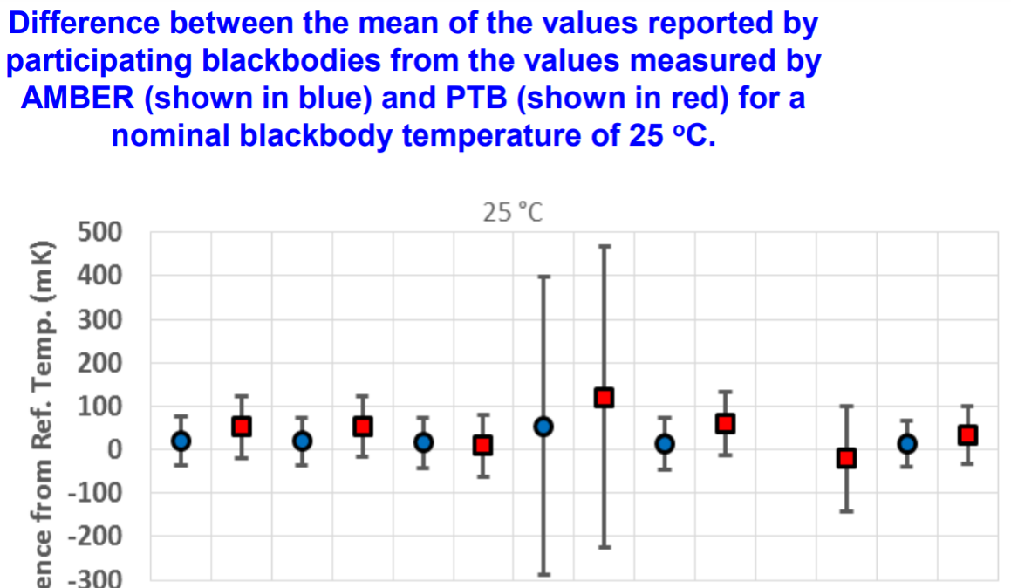
Fiducial Reference Measurements
FRM are based on Metrology approach. 3 principles:
Traceability, Uncertainties and Comparison
FRM gives a reference properly characterised and traceable to standards and/or community best practises on which the Cal/Val results can be anchored.
The understanding of the uncertainties has a long term impact for most EO products and in particular for downstream and climate applications.

Slide 13
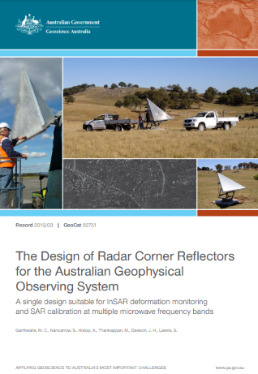
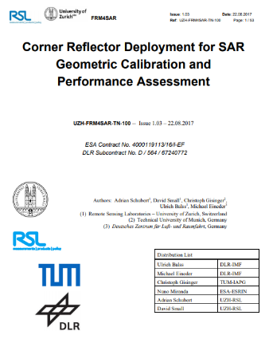
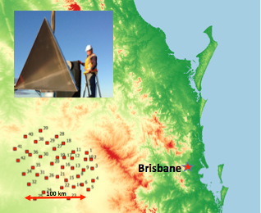
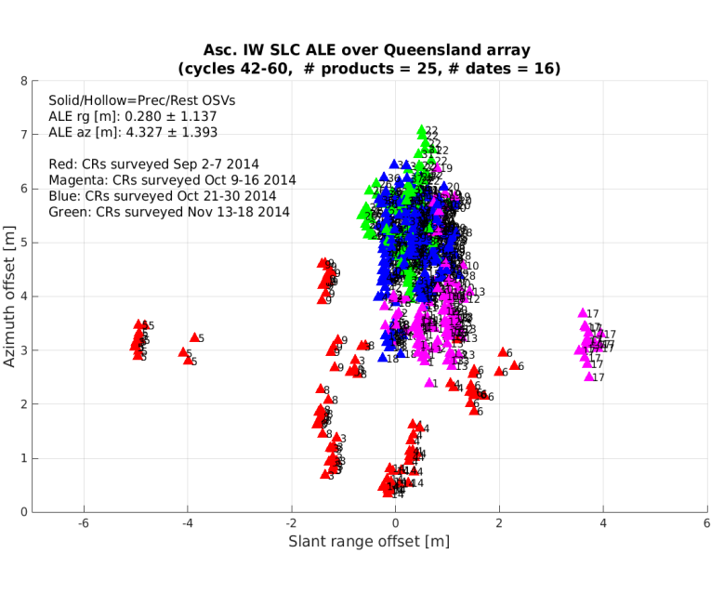
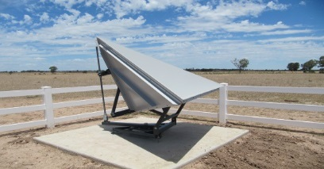
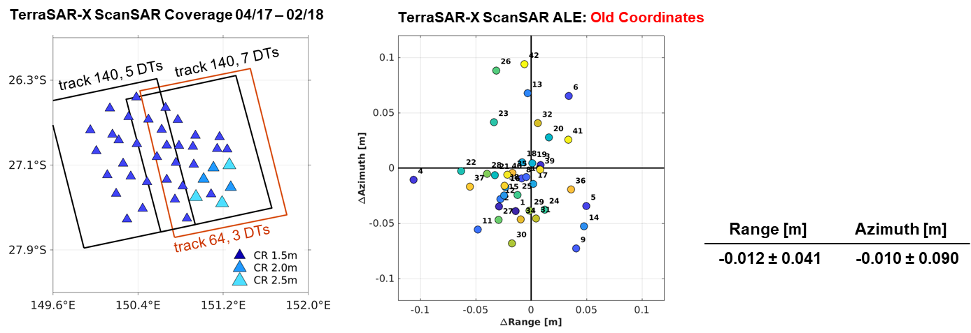
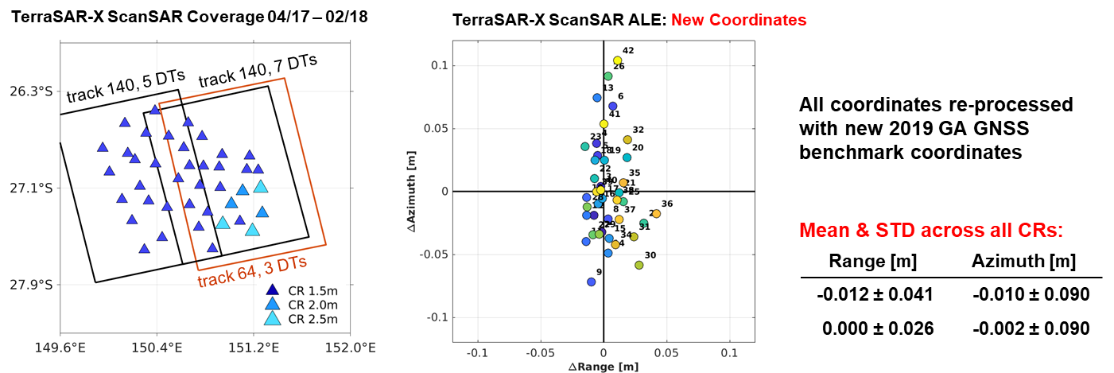
SAR products geometry
FRM: examples
FRM4SAR: multi-mission SAR products geometry
Best practice for deploying a reference site for accurate geometric calibration (and subsequent analysis). Following defined best practice → demonstrate that the Australian site is suitable for the requested accuracy → FRM4SAR (ESA contract with DLR).
Australian site will be maintained in the long term (multi-missions / multi frequencies) as part of the collaboration between ESA/DLR and Geosciences Australia
Validation
Sentinel-1 geolocation analysis
Validation
TerraSAR-X geolocation analysis
Colour code indicates the accuracy vs
deployment dates
Surat basin CR network
Notes:
Geolocation ameliorer grace au best practise qui corrige de plusieurs effet pour localiser les transponders (tectonique, earth tide, atmospheric effect…) → meilleures mesures.
2 blocks correspond to the swath (iw1, iw2) → still largely with spec, inherent to the algo and improving would be to costly (time processing, new algo…etc…)
(3 m in azimuth – while pixel spacing in azimuth about 20 m)

Slide 14
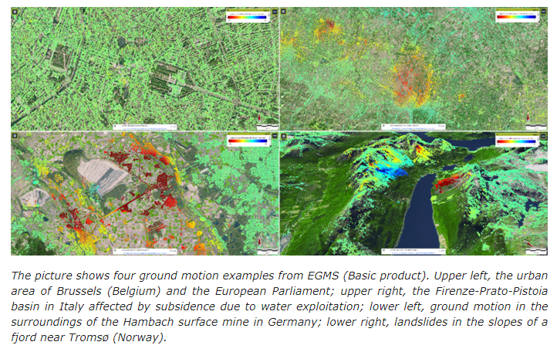
FRM : Impact on Data Quality
Good characterisation
Good quality
Operational and accurate service
Example : Copernicus
European Ground Motion Service

Slide 15

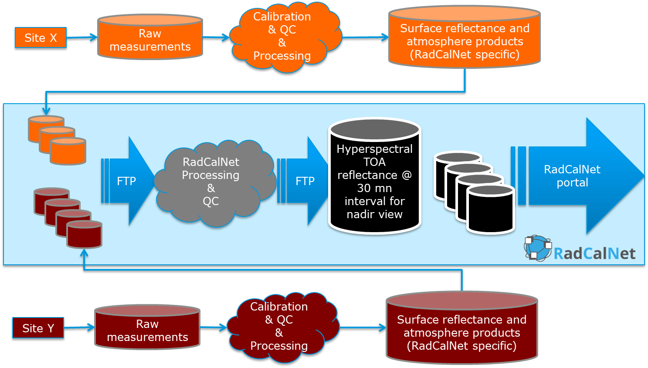
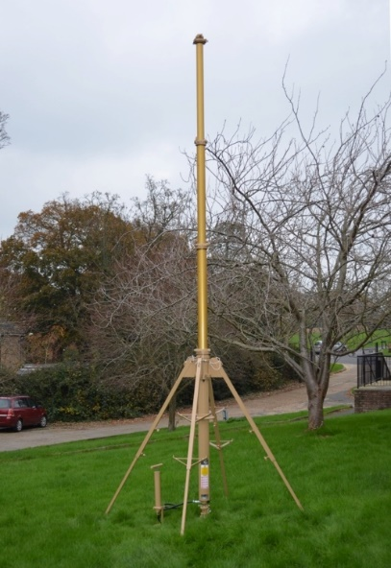
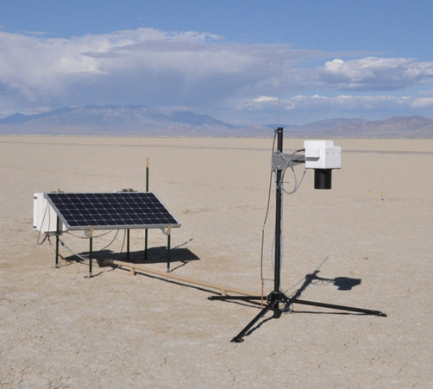
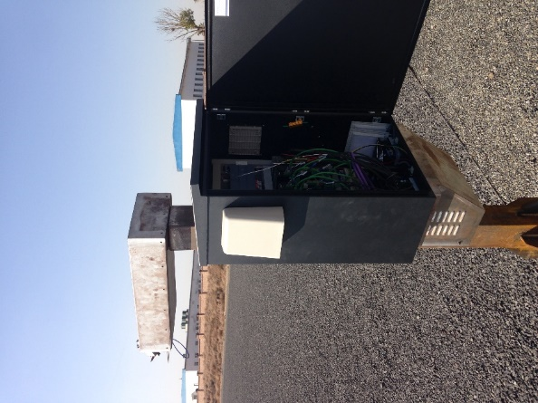
WGCV Reference
Radiometric Reference:
RadCalNet a CEOS WGCV Service
Network of test sites providing, via a common portal, Top Of Atmosphere @ Nadir Ref with uncertainties in range 400 - 2500nm (10 nm band) every 30 mins

Slide 16
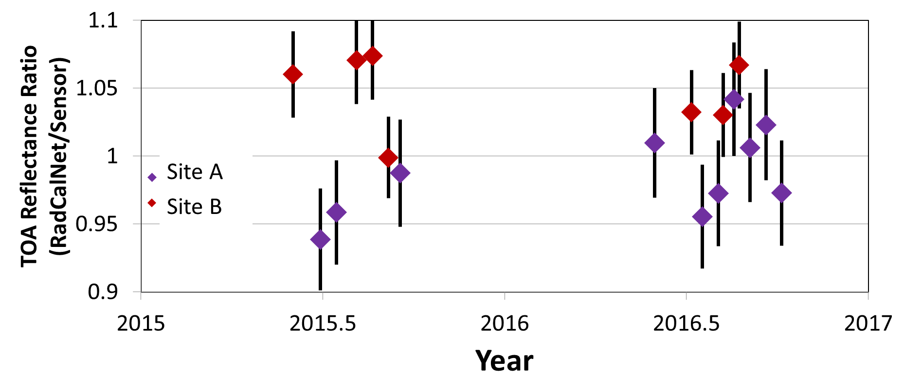
WGCV Reference
RadCalNet: SI-traceability with provided uncertainties is the key
Ensuring SI-traceability of automated data automatically provides comparable results
Test sites have to demonstrate their traceability and uncertainties
RadCalNet processing provides uncertainties for each data point
Several well understood sensors were used to evaluate RadCalNet sites
SI-traceability allows users to combine data from multiple sites with confidence
  Larger number of possible calibrations
  Evaluate temporal changes
RadCalNet provides fiducial reference measurements (incl. for New Space)
CEOS European Coordination meeting – SIT-35
16

Slide 17
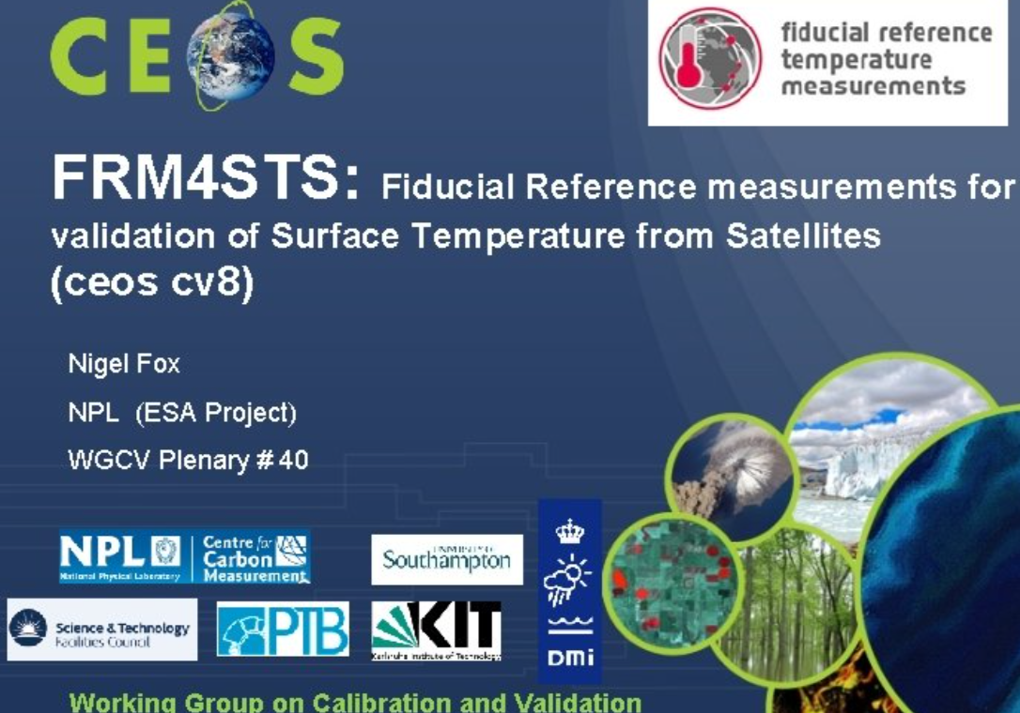
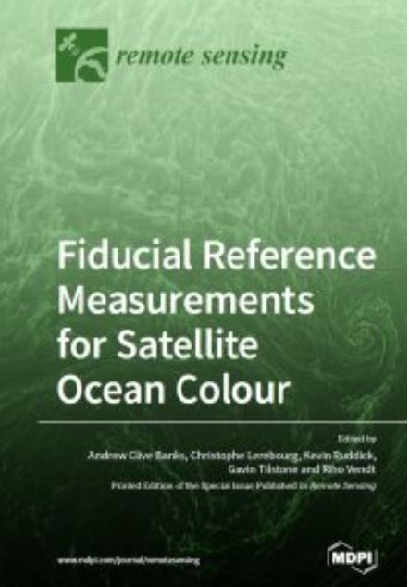
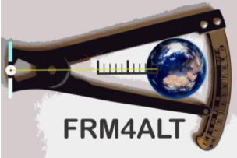
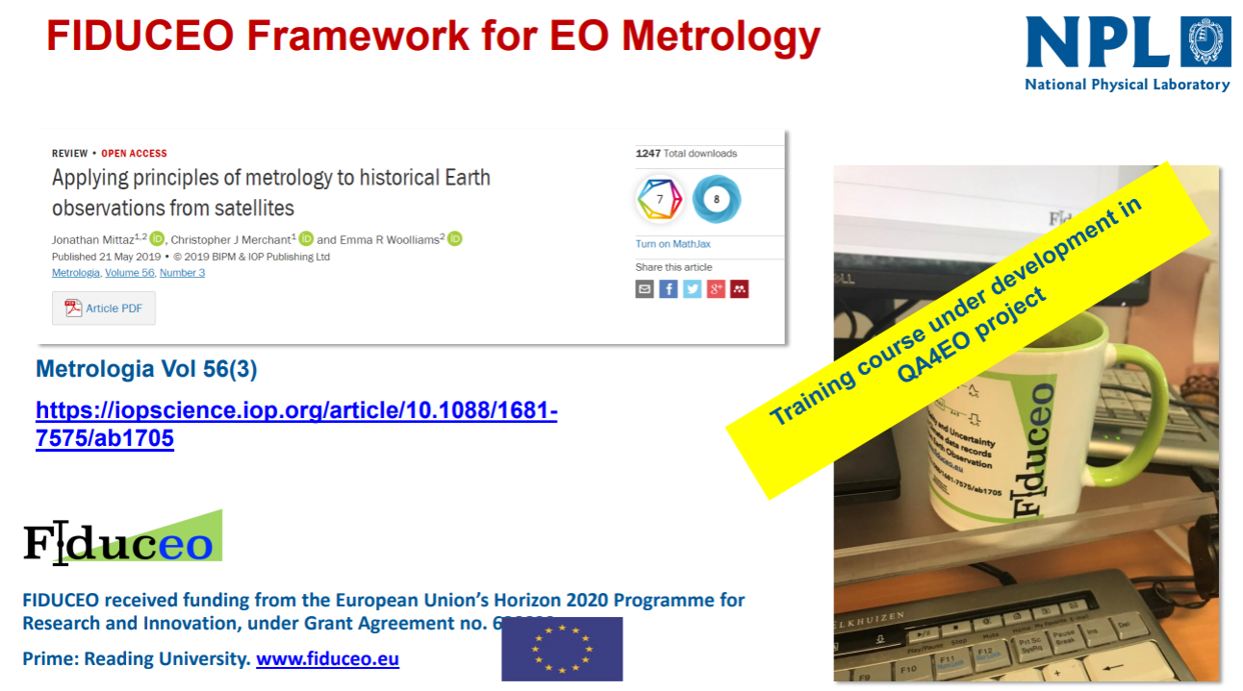
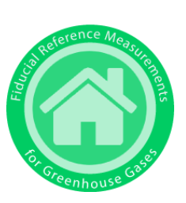

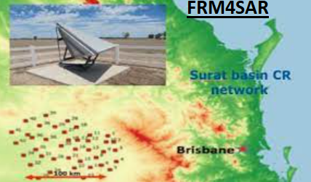

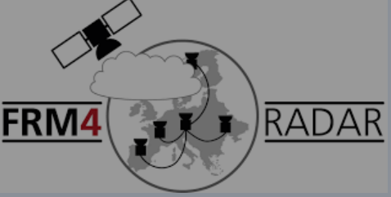
Fiducial Reference Measurement

Slide 18
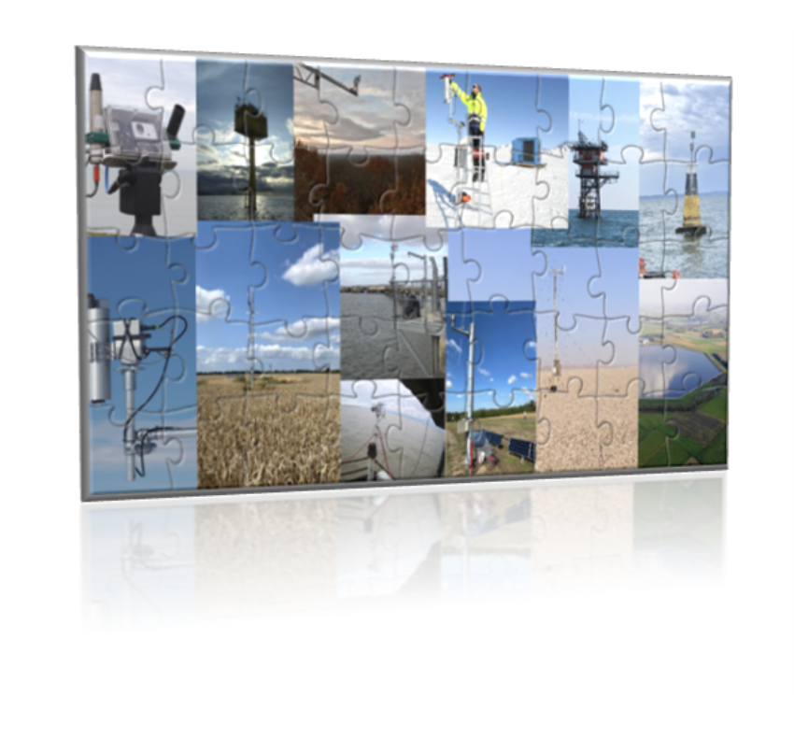
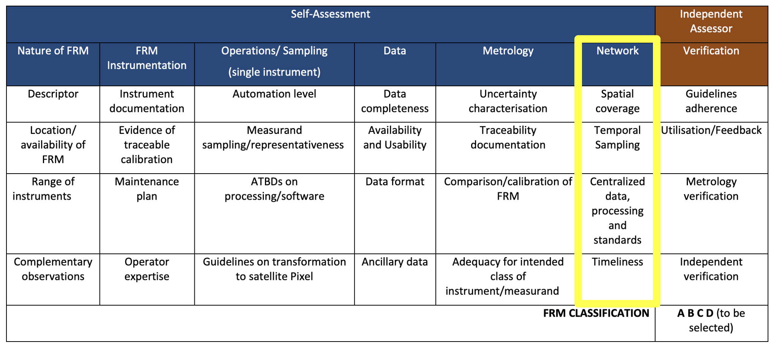
CEOS FRM Assessment framework
Roadmap towards an Assessment Framework for Fiducial Reference Measurements (FRM)- including Guidelines V1: https://calvalportal.ceos.org/web/guest/frms-assessment-framework
Reference Paper 2023: Goryl, P.; Fox, N.; Donlon, C.; Castracane, P. Fiducial Reference Measurements (FRMs): What Are They? Remote Sens. 2023, 15, 5017. https://doi.org/10.3390/rs15205017.
Maturity Matrix tool Updates (according to WGCV-53-ACT-13)
- New exercise reports: Brewer for NO2 (Henri Dièmoz ARPA, BAQUNIN), FRM4GHG (EM27/SUN) measurements* – Martine De Maziere (BIRA) – (self-assessment for the FTIR data and tools that we are developing in the Topical Centre for reactive trace gas remote sensing (CREGARS) in ACTRIS – PGN (Pandonia Global Network) - Stefano Casadio (Serco) - RadCalNet (Radiometric Calibration Network) - Marc Bouvet (ESA/ESTEC) - ICOS (Integrated Carbon Observation System – Ecosystem Component) - Fabrizio Niro (Serco) - FRM4DOAS (Ground-Based DOAS Air-Quality Observations) - Michel Van Roozendael and Jean-Christopher Lambert (BIRA) - BAQUNIN (PREDE-POM LUNAR) – Stefano Casadio (Serco) - CSIRO (DION) –Janet Anstee and Matt Garthwaite (CSIRO) - Brewer Spectrometer - NO2 Vertical Column Densities (VCDs) Measurements - Henri Diémoz (ARPA Valle d’Aosta) – BAQUNIN project, FRM4GHG 2.0 project –COCCON (EM27/SUN) XCO₂, XCH₄, and XCO data. – Mahesh Kumar Sha (BIRA) - FRM4GHG team…..etc….etc…..

Slide 19
FRM actors
FRM: from concept to operations
Like any element of a space programme (satellite, ground segment, data products), FRMs follow a process ranging from concept and research, to development, operations, maintenance and evolution.
FRM
Concept and
research
Development
and qualification
Operations
Maintenance and evolution
The space agencies (ESA, EUMETSAT, national space agencies) are funding those initial steps, using their own R&D activities (e.g. FutureEO Programme at ESA).
Pre-operations are also often funded by space agencies.

Slide 20
Example with Sentinel-5P
Concept &
research
Development
& qualification
Operations
Maintenance and evolution
FRM R&D: concept, research, development, qualification + pre-operations
ESA missions (e.g. Earth Explorers)
QA4EO frame
CINDI-2 campaign
FRM4DOAS
Atmospheric chemistry (S5p)
Atmosphere S5P FTIR TCCON/Max DOAS
FRM4GHG
COCCON
FRM4AQ
POp: Pandonia ground-based operations
EUMETSAT missions (e.g. Metop)
National contributions (e.g. DLR FTIR Cal/Val, NSO, …)

Slide 21
FRM: from R&D to Operations
→ Evolution of science with Quality Standard and Reference
As part of the its R&D budget (EOEP/FutureEO programmes), ESA has started several activities to qualify validation measurements as FRM:
As part of the its “operation” budget (Copernicus/mission programmes), ESA supports some FRM operation
The principles are simple:
    Validation instruments are characterised and intercalibrated in laboratories where the reference instrument are characterised and traceable to standards (metrology institutes (like NPL))
    Measurements protocols are established
    Field in-situ measurements (on sea, land, etc.) following protocols. Uncertainties budget are derived
    Analysis and intercomparison between measurements
    Workshop and Publications
FRM4STS
FRM4SOC
FRM4ALT
FRM4SAR
FRM4GHG
FRM4DOAS
FRM4VEG
FRM4SM
FRM4FLUO
FRM4RADAR
FRM4AQ
…etc….
(list not exhaustive)
+ International participation and CEOS coordination
RadCalNET
Hypernet
TCCON
PANDONIA
TIRCALNET
ST3TART
BOUSSOLE (past)
…etc….
(list not exhaustive)
+ International participation and CEOS coordination
Support can be in :
supporting an instrument/station
Supporting the processing / qc
Supporting the data distribution
Supporting the algorithm
Improving timeliness
…etc….

Slide 22
FRM Networks
FRM and networks
FRM can be provided from a single location (e.g. transponders, corner reflectors) or from multiple locations (equipped with the qualified on-ground instrumentation).
FRM originating from multiple locations, i.e. FRM networks, are often the result of a coordinated effort in between multiple organisations, generally at global level (CEOS and WMO have been fundamental for triggering such activities). Examples are the CEOS RadCalNET (CNES, NASA, China ), the Pandonia Global Network (AQ mini-spectrometer network for satellite AQ validation - NASA, ESA, EPA), FTIR networks dedicated to the satellite GHG validation (large effort by Germany).
We need to find the correct mechanisms to fund part of those FRM in the R&D and for the operations, as these are critical for the mission characterisations (noting the interest and investment of several Member States). Sustainability is the biggest issue….
Coordination / Cooperation with EEA – Copernicus In-situ component is fundamental
not all in-situ networks are FRM networks!
Coordination / Cooperation with ERIC – European Research Infrastructure Consortium - is important
  ICOS, ACTRIS, ARGO

Slide 23
Some thoughts
The concept of FRM has been successful (used every where – China, USA, Australia…etc…
It reinforces (reinforced) satellite Cal/Val programme
It helps (helped) improving the trust in the data and facilitate interoperability
It helps improving the quality of data / mission
REFERENCE is requested (GSCIS main topic → find a reference)
FRM concept is easy, but questions remain….
  FRM concept is extending
    FRMSAT (TRUTHS like) but what about Satellite or dataset ??? (Landsat), Model ? In-situ ? (not for satellite)
  FRM should be fit for purpose (FRM for SST…etc…)
  What is a FRM, what do we call FRM – ex: RADCALNET is a FRM or a network of FRM or is it the photometer or the photometer / site / protocols……
  Comparison (between satellite and FRM) is fundamental – see workshop Wednesday. We can have a perfect in-situ measurement (FRM) and poor comparison (weak protocols or algorithm)….
  We can have project called FRM4 that does not lead necessary to full FRM (step toward FRM), sometime it creates confusions. We have or will have interesting case – FRM4LC for example. Challenging….
  Qualification of FRM (by CEOS) has evolved: now the FRM is not black or white, It can be grey…(scale). Is it fully objective ?
- The concept is powerful, it is good if it is extending (FRMSAT), but we should also be careful of not loosing the relevance.

Slide 24
Conclusion
There are a growing number of public and commercial providers of Earth Observation data. Key to using data from these new sources is a good understanding of their characteristics, how they are calibrated, and their quality and technical capabilities.
Interoperability between satellites/products will allow to extend dramatically the opportunities for global applications (agriculture, water use, forest and vegetation monitoring, pollution monitoring…etc…but also for climate applications).
The data can be used together only if we can trust its accuracy and characterisation. Therefore harmonisation in Calibration and Validation approaches are fundamental.
Global Earth Observation System of System can work if Quality Standard and Reference are put in place
From R&D to Operations, ESA provides a coherent and comprehensive system for data quality
Increasing the reliability of data → Quality Reference
Facilitating Sensor to sensor interoperability by establishing Cal/Val reference (FRM)

Slide 25
ESA FRM Workshop
List of ESA Projects
ESA-FRM Workshop
18-22 May 2026

Slide 26

FRM4DOAS (https://frm4doas.aeronomie.be)
Project start/end
2016/ to date
FRM4DOAS 1.0 2016/2021
FRM4DOAS 2.0 2021/2026
Project Objectives
Develop a centralized near-real-time (NRT) processing system for global MAX-DOAS observations
Harmonize worldwide MAX-DOAS measurements
Deliver harmonized atmospheric products including: total O₃ column, trop. and strat. NO₂ column and profile, trop. HCHO column , later extensions toward aerosols, cloud products and BrO.
Produce Fiducial Reference Measurements (FRM) for validation of ESA atmospheric satellite missions.
Expected Outcomes
Harmonized international MAX-DOAS reference network for atmospheric composition monitoring
Operational delivery of quality-controlled datasets to: NDACC Rapid Delivery and EVDC
Open challenges
The network is made of several different instruments, some of which are in-house developed; furthermore, the calibration of the instruments is the responsibility of the PIs.
Scaling the infrastructure from demonstration level to sustained operational service handling many more stations and products.
Improving difficult retrievals for: clouds, aerosols, urban NO₂, stratospheric BrO, and additional trace gases.
Achieving full CEOS FRM compliance (Metrology aspects)

Slide 27

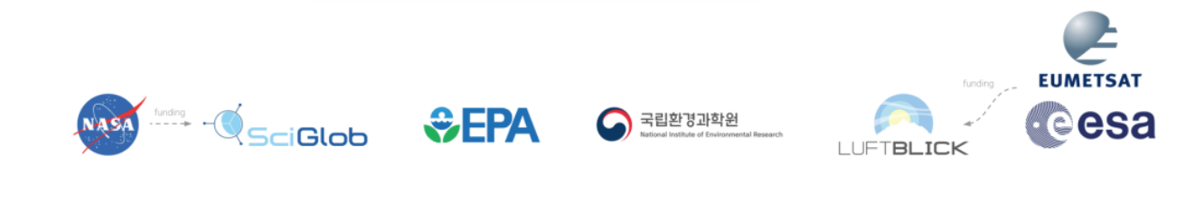
FRM4AQ and POp (https://www.pandonia-global-network.org)
Project start/end
2013/ to date
ESA Pandonia Operations (POp) since 2018 and
R&D (FRM4AQ) for instrument and algorithm evolution
Project Objectives
Achieve long, uninterrupted, well-maintained, homogeneously calibrated time-series of ground-based remote sensing atmospheric measurements, target products:
total & tropospheric column: O3, NO2
additional products: SO2, HCHO, aerosol,…
Produce Fiducial Reference Measurements (FRM) for validation of ESA atmospheric satellite missions.
In POp there is no instrumental and algorithmic development part, which is the responsibility of FRM4AQ.
Expected Outcomes
POp: Pandonia Global Network Instrument Support; Network Central Processing and Web Services; Network Operation Reporting; Instrument Evolution; Scientific Algorithm Development and Evolution; Validation Guidelines and Network Characterisation; PGN Training, Workshops and Project Outreach
FRM4AQ: Instrument and Processing Evolution; Scientific Algorithm Development & Evolution; Validation Guidelines and Network Characterisation;
Open challenges
Long-term sustainability and funding of globally distributed validation stations.
Extending coverage in undersampled regions
Achieving full FRM maturity and traceable uncertainty budgets

Slide 28
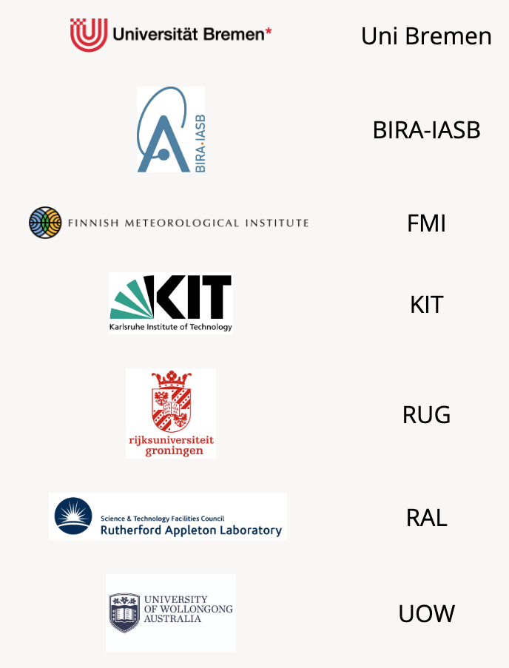

FRM4GHG (https://frm4ghg.aeronomie.be/)
Project start/end
2016/ to date
FRMGHG 1.0 2016/2021
FRMGHG 2.0 2021/2026
Project Objectives
Intercomparison of instruments and harmonization of retrievals and products from collocated new and established GHG observation ground-based instrumentations to get Fiducial Reference Measurements (FRMs) for Greenhouse Gases (GHGs).
Dataset used for validation of satellite missions targeting: carbon dioxide (CO₂),methane (CH₄), carbon monoxide (CO) and other climate relevant trace gases
Expected Outcomes
FRM4GHG1.0
Inter-comparison of ground based transportable
FTIR systems with reference to TCCON – measurement campaign in Sodankyla/Finland
Provide a guideline for further development of new observation sites to complement the TCCON network
Target Products: CO, CO2, CH4, (HCHO)
FRM4GHG2.0
Improve instruments of low-resolution spectrometers; Evolve algorithms; Address network harmonization (TCCON and COCCON)
Open challenges
Achieving full FRM maturity with rigorously traceable uncertainty estimates across all observing systems.
Maintaining long-term calibration stability and instrument consistency
Harmonization between networks (TCCON, NDACC, COCCON)
Ship measurements over the ocean

Slide 29
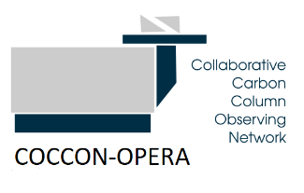


COCCON
(https://www.coccon.kit.edu/index.php)
Project start/end
COCCON PROCEEDS: 2017 – 2023
COCCON OPERA: 2023 – 2027
Project Objectives
Build a low-cost, standardized FTIR-based network for greenhouse-gas column measurements.
Provide Fiducial Reference Measurements (FRM) for: CO₂ and CH₄
Support validation of atmospheric satellite missions
Harmonize instruments and retrievals across distributed stations by: using common spectrometer configuration standards, standardized calibration procedures, centralized processing (e.g., COCCON Central Facility).
Enable dense spatial sampling not covered by high-end networks like TCCON.
Expected Outcomes
COCCON PROCEEDS:
FTIR EM27/SUN – Prototype for centralised data collection and processing facility
CO, CO2, CH4 Spectra generation from the raw interferograms
Perform a quality screening for discarding invalid spectra
Demonstration of the validity of the workflow and of the generated spectra by performing a quantitative spectral analysis
COCCON OPERA: 2023 – 2027
Network processing Operations, including:
central processing, network operation and reporting,
data dissemination to EVDC, COCCON Web services,
set up of ca 6 EM27/SUN instruments in Spain (collaboration AEMET)
R&D: COCCON instrument evolution
Open challenges
Network is growing fast, important:
Ensuring long-term instrument calibration stability across many distributed stations.
Harmonizing data quality across heterogeneous operators
Scaling data processing and QA/QC
Ensuring traceable uncertainty propagation comparable to higher-end systems like TCCON.
Long-term sustainability of operations (beyond ESA project funding cycles).
Achieving full FRM maturity with rigorously traceable uncertainty estimates across all observing systems.

Slide 30









FRM4FLUO
JB Hyperspectral Devices GmbH, NPL, FZJ, Unimib, University of Twente, CNR, iTUBS
January 2025 – May 2026
Instrument characterisation & calibration (Jan–Apr 2025)
Field campaigns – Grosseto, May & Jun 2025 (FloX, AirFloX, HELiPOD)
Data analysis & protocol refinement (Jul 2025 – May 2026)
Final meeting March 2026, ESRIN
Project Objectives
Establish FRM protocols for ground-based SIF and surface reflectance measurements in support of ESA FLEX Cal/Val
Characterise and intercompare multi-platform instrumentation (ground, UAV, airborne) with SI-traceable uncertainty budgets
Deliver open, standardised datasets and processing tools (PyFLOX) for the SIF community
Expected Outcomes
FRM protocol documents (D1C) for SIF & reflectance
Multi-platform campaign datasets (Grosseto 2025) & data format specs (D2C2)
PyFLOX processing pipeline with uncertainty-quantified SIF retrievals
Open challenges
Spatial representativity of ground-based SIF measurements for airborne and satellite footprints
Spatial upscaling strategies for photosynthesis parameters (L2C) from point to FLEX pixel size/scale

Slide 31


St3TART FO
Sentinel-3 Topography mission Assessment through Reference Techniques Follow-On https://sentinel3-st3tart.noveltis.fr
May 2024 – June 2028
Build on St3TART (2021-2023)
Set up phase of FRM sites (May/Dec 2024)
Rehearsal phase to demonstrate operational readiness (Jan/Apr 2025)
Routine Operational phase to provide FRM for altimetry L2 Hydro-Cryo validation
Project Objectives
Operationally provide FRM to support the validation activities and foster exploitation of the Sentinel-3 SAR altimeter Hydro-Cryo thematic data products over Inland Waters, Sea Ice and Land Ice.
Expected Outcomes
Establish and operate FRM super and opportunity sites and opportunity sites
Develop operational plans for FRM provision;
Acquire, process and deliver FRM data for Cal/Val activities, including uncertainty characterization;
Foster new initiatives and community engagement
Contribute to future Altimetry missions by developing a roadmap.
Open challenges
Continuity of FRMs in polar regions
Standardize and harmonized data processing across national networks

Slide 32


CRISTAL IN-PROVA
CRISTAL IN-FLIGHT LEVEL-2 PRODUCTS VALIDATION PLAN https://cristal-inprova.noveltis.fr
Oct 2024 – Oct 2026
Provision of roadmap for Cal/Val activities and FRM needs for the validation of CRITSAL L2 Hydro-Cryo data products
Project Objectives
To provide a roadmap for the calibration and validation of the CRISTAL Level-2 data products, covering cryosphere (sea ice, icebergs, land ice) and inland water domains.
To provide tools to preliminarily assess the effectiveness of the proposed validation methods and measurements,
Expected Outcomes
Definition of Cal/Val methods and protocols
Assessment of FRM sensor needs for CRISTAL L2 Hydro-Cryo
Cross-validation methodologies
Validation strategies in synergies with Copernicus Expansion Missions
Open challenges
Continuity of FRMs in polar regions
Standardize and harmonized data processing across national networks
Multi-mission Cal/Val synergies

Slide 33


FRM4ALT
Fiducial reference measurements for altimetry https://www.frm4alt.eu
2016– 2018
Continued in SeRAC project and currently part of S3ALT MPC
Define, maintain and support the absolute satellite altimeter calibration during the Operational and Commissioning Mission Phases
Project Objectives
Transponder operations and routine calibration of altimetry missions (Sentinel-3A/B)
Sigma0, datation, absolute range bias comutation
Expected Outcomes
FRM methodologies for Altimetry calibration
Guidelines and protocols for the Calibration of Altimetry missions
Routine calibrations during mission opertions
Open challenges
Maintenance of calibration sites
Automatization of calibration acquisition and data processing process
Multi-mission Cal/Val synergies

Slide 34
Calibration of CryoSat’s Range and Interferometric Phase using Transponders isardSAT, Technical University of Crete
2014-Dec. 2028
Long standing project for CryoSat cal/val based on transponder
Perimeter of activities extended with time (additional transponders and tide gauges)
Project Objectives
To provide continuous monitoring of SIRAL and L1 products quality
To assess long-term trends in SIRAL parameters
To provide cal/val of CryoSat Products by sea surface measurements
Expected Outcomes
Assess performance in range, datation and phase difference by intercomparison with different equipments (transponders, tide gauges) and exploiting different calibration tools as well as auxiliary information
Open challenges
Identify the source of residual biases to properly compensate
Harmonization of calibration results from different transponders and processing techniques, with particular focus on phase difference

Slide 35


FRM4SM
https://earth.esa.int/eogateway/activities/frm4sm-fiducial-reference-measurements-for-soil-moisture
2021 - 2027
Project Objectives
Develop FRM concept for soil moisture
R&D on validation
QA4SM Platform maintenance
Expected Outcomes
Improve methods
Identify gaps in FRM coverage
Develop validation good practice guidelines
Open challenges
Long term funding
FRM site tailored for satellite soil moisture validation

Slide 36


FRM4Radar
2018 - 2027
Phase 1 – 2018 - 2020
Phase 2 – started in 2025
Project Objectives
Establish a cloud radar network
Develop radar data processing tools
Cal/Val of EarthCARE CPR data with radar network
Expected Outcomes
Processed and quality controlled radar data publicly available
Calibration of radars with disdrometers
Separation of clouds and precipitation using Doppler velocities
Open challenges
Challenges with disdrometer operation and calibration
Operation of radars beyond the project end

Slide 37






FRM4Biomass
Project Schedule
Phase I: 2024 - 2026
Phase II: 2026 – 2028 (currently under implementation)
Project Objectives
1. Develop the protocols and processors for Forest Biomass FRMs
2. Implement a web portal to openly share Forest Biomass FRMs
Outcomes (Phase I)
1. Database of Forest Biomass FRMs from Airborne and Terrestrial lidar scans and forest mensuration data
https://data.geo-trees.org/map/geotrees
2. Processors for the FRM generation https://github.com/umr-amap/BIOMASS
Open challenges
1. Long term funding

Slide 38











FRM4 Surface Temperature from Satellites, https://www.frm4sts.org
Project 2014-2017 but really series from ~1995
Activities became part of FRM4SST
Project Objectives
- Establishing traceability and degree of consistency of worlds validation capabilities.
- Best practices on making measurements
- What is State of the art
Outcomes:
- protocols on how to do comparisons
- Results of consistency of surface temp validation: Land/Water/Ice/Lab
- Confidence in validation capabilities and satellite performance
Open challenges
Replicating range of real world conditions in cost effective manner
Wide range of Ts needed
Assessing representativeness

Slide 39





FRMsat: establishing FRM in space
Project Start: 2023 (CEOS & GSICS)
Concept and satellites: TRUTHS ~2000 CLARREO ~2013
Project Objectives
- To create a means to harmonise at climate quality EO system of systems
- Encourage development for all technology domains
- Demonstrate value/necessity
Outcomes on going:
- Formal Definition
- International collaboration to create vision
- Means to evidence SI-traceability and performance
- Strategy to utilise
Open challenges
Funding to take forward
Demonstrating the added value for non climate applications
Clarity on FRMsat and FRMs from space

Slide 40


FRM4Veg
National Physical Laboratory (NPL), University of Southampton & EOLab (Univ. of Valencia)

Slide 41


FRM4Fire https://frm4fire.org/
2024-2026
Project Objectives
Developing field measurement protocols for validating earth observation-based fire products. The project team is applying airborne data collected in a field campaign in September 2024 over Canada to compile uncertainty information will support confidence in Sentinel-3 fire observations.
Expected Outcomes
Developing methods to validate fire radiative power (FRP) measurements obtained via satellite Earth observations, including establishing reliable validation standards for active fire and FRP data
Open challenges
Building a community-agreed protocol and quality assurance practices

Slide 42


FRM4DRONE AQUATIC , VITO / NPL https://remotesensing.vito.be/services/frm4drones-aquatic
Project Q1 2025 / end 2025
CCN1 / continuation in preparation
Project Objectives
•Review state of the art; identify "reuse" items from FRM4VEG & FRM4SOC that are applicable to water Cal/Val with drones, review existing uncertainty estimates; identify gaps and community needs through expert consultation and collaborative workshops ; build roadmap
Expected Outcomes
•The initial phase focused on community awareness, gap analysis, and defining a roadmap toward FRM-compliant UAV aquatic reflectance. Next phases will implement the roadmap through intercomparison campaigns, validation activities, and development of harmonized protocols, uncertainty workflows, metadata standards, and FAIR data practices for drone-based satellite Cal/Val.
Open challenges
•Drone technology has strong potential for satellite Cal/Val of water quality, but harmonized guidance and protocols are still lacking. Key gaps include SI-traceable calibration, standardized acquisition methods, validated glint/atmospheric/BRDF corrections, uncertainty budgets, FAIR metadata standards, and UAV–satellite match-up guidance..

Slide 43
TIRCALNet Preparation Study, University of Leicester, KIT & RAL
Project Nov 2023/Q3 2027
TIRCALNet Architecture Design Phase
Project Objectives
-Sensitivity Study of ToA uncertainty
- TIRCALnet site design
- Definition of an operational network service
Expected Outcomes
A network to aid ToA radiometric calibration/validation of thermal sensors
Open challenges
- Biggest challenge for land-based site is an accurate characterization of the site surface throughout the year
- Full uncertainty chain to ToA
- Development of operational concept from prototype sites

Slide 44
HYPERNET
Lead: Royal Belgian Institute of Natural Sciences (RBINS) www.hypernets.eu
H2020 HYPERNETS
Feb 2018 –April 2023
ESA Hypernet-POP
2022-April 2027
continuation in preparation
Project Objectives
To have a fully operational data processing and distribution system, taking near real-time (e.g. daily) data from multiple validation sites, deployed worldwide, performing processing to a) water reflectance and b) land surface reflectance with associated uncertainties and providing data publicly via a) WATERHYPERNET and b) LANDHYPERNET web site data portals.
Expected Outcomes
Hyperspectral quality-controlled high-quality data from Panthyr and Hypstar systems
Open challenges
Sustainability
•Characterisation of the site spatial and angular variability
•Extension of spectral range to 2.5 micron

Slide 45

SARCalNet (https://www.sarcalnet.org)
Initiative of SAR subgroup of CEOS WGCV
Project start/end
2022, to date
Project Objectives
Standardize cal/val and facilitate collaboration between sensors.
Provide reference data and tools.
Provide cal/val guidelines and standards.
Define requirements for natural and artificial targets.
Define “certification” procedures for calibration sites.
Curate sites and provide information to the community
Expected outcomes
SARCalNet Web-portal up and running.
SARCalNet DB online and accessible.
SARCalNet DB includes (May 2026): 381 targets in 56 Calibration Sites over 15 Countries. It is ever expanding.
Definition of “requirements” and “guideline” documents is ongoing.
Curation and endorsement process is ongoing.
Evolution: Active Transponders; CR angle dependent RCS; Accuracy for RCS determinate via electromagnetic simulation; Automatic data analysis and reference results.
Open challenges
Part of the curation and endorsement process based on best efforts.
Involvement of data providers and users.

Slide 46


Pilot-Mission Exploitation Platform (Pi-MEP) Salinity
www.salinity-pimep.org
2019 - 2026
Project Objectives
Web-based environment to visualize, validate, monitor, assess and exploit Satellite Salinity data
R&D on validation domain
Expected Outcomes
Matchup database
Satellite Salinity validation report
Scientific publication
Open challenges
Long term funding

Slide 47
WORKSHOP OBJECTIVES
Share information on Fiducial reference measurements / metrology
Review / list all the ESA funded projects
Address open points / open questions / challenges related to FRM
To identify gaps and priorities
Shape FRM future road map
--> Workshop report
--> Publication (letter or paper)
--> Communication and outreach
--> Communication within ESA management and delegations

Slide 48


The seed questions (1/2)
Compliancy | What is the shared and accepted definition of FRM and the relevance of the prefix ‘CEOS’, what evidence and minimum requirements are needed to claim CEOS-FRM status, and how can this concept be translated in a consistent and systematic manner across different missions? Is the understanding of ‘class ABCD’ of CEOS-FRM compliance understood and useful? Are these definitions/concepts applicable to all primary levels of products (e.g. Level-1 and Level-2)?
Inter-consistency | How can we ensure coherence, comparability and transparency of CEOS-FRMs across different missions, domains and projects? How should inter-consistency be addressed in FRM-related activities, in terms of systematically planning cross-checks e.g. comparisons and improving visibility and coordination of parallel FRM efforts?
Awareness | How and what CEOS-FRM activities, datasets and best practices be centralised and communicated to improve awareness and uptake across the wider community, including centralised information resources and better exploitation of lessons learned, to inform future CEOS-FRM development and operations? Should missions explicitly require CEOS-FRM compliance for Cal/Val activities?
Gaps & Needs | What are the key gaps and challenges in establishing, sustaining, and prioritising CEOS-FRMs across technical, organisational, financial, and representativeness dimensions, and how should future investments balance consolidation of existing CEOS-FRM initiatives with the development of new sites, regions, domains?

Slide 49
The seed questions (2/2)
Standards & Harmonisation | How should FRM compliance categories within the CEOS FRM framework be strengthened (covering maturity assessment, uncertainty requirements, QA and comparison practices, publication, measurand definition, and cross-domain consistency) while remaining fit for purpose across different application domains and to support consistent FRM implementation? Should there be minimum requirements for categories such as achievable uncertainty?
Synergies & Partnerships | How can synergies and partnerships be strengthened across agencies, industry, and the wider CEOS-FRM international community to improve coordination, consistency, participation, and long-term sustainability, including appropriate incentives and funding pathways for both public and commercial missions, and to ensure a coordinated and sustainable CEOS-FRM development and use that meets the Cal/Val needs of the missions?
Impact | How can the impact of CEOS-FRM be demonstrated? What metrics and verification procedures are needed to systematically assess the impact of CEOS-FRMs on Cal/Val activities, mission performance, and downstream services?
Other points | an and should the CEOS-FRM framework evolve to extend its value beyond space applications, engaging non-space user communities, and encompassing different historic quality-assurance approaches? Is there a value in a FRM classification and/or label beyond space applications e.g. WMO networks and Copernicus in situ, and how can this relate to CEOS-FRM? Is it largely just removing the ‘explicit space requirements’ in the criteria?

Slide 50
The seed questions (2/2)
Standards & Harmonisation | How should FRM compliance categories within the CEOS FRM framework be strengthened (covering maturity assessment, uncertainty requirements, QA and comparison practices, publication, measurand definition, and cross-domain consistency) while remaining fit for purpose across different application domains and to support consistent FRM implementation? Should there be minimum requirements for categories such as achievable uncertainty?
Synergies & Partnerships | How can synergies and partnerships be strengthened across agencies, industry, and the wider CEOS-FRM international community to improve coordination, consistency, participation, and long-term sustainability, including appropriate incentives and funding pathways for both public and commercial missions, and to ensure a coordinated and sustainable CEOS-FRM development and use that meets the Cal/Val needs of the missions?
Impact | How can the impact of CEOS-FRM be demonstrated? What metrics and verification procedures are needed to systematically assess the impact of CEOS-FRMs on Cal/Val activities, mission performance, and downstream services?
Other points | an and should the CEOS-FRM framework evolve to extend its value beyond space applications, engaging non-space user communities, and encompassing different historic quality-assurance approaches? Is there a value in a FRM classification and/or label beyond space applications e.g. WMO networks and Copernicus in situ, and how can this relate to CEOS-FRM? Is it largely just removing the ‘explicit space requirements’ in the criteria?
Subgroup breakout discussion to:
Meet and discuss on the seed questions
Each group will report their summary during the plenary on Wed 20 May

Slide 51
Comparison workshop
When: Wed 20 May, PM session
How: Just come on stage and present your validation/comparison results (please pre-send the slides to Emma to easy the process)
Who: All the good scientists and validation lovers in the room

Slide 52
Thank you!

