Slide 1

FRM4Veg: Key outcomes from Phase 1 and 2
Harry Morris, Morven Sinclair, Chloe Randall, Niall Origo, Joanne Nightingale, Fernando Camacho, Jorge Sanchez-Zapero, Enrique Martínez-Sanchez, Jadu Dash, Somnath Paramanik, Luke A. Brown, Yves Govert, Vincent Leroy, Marta Luffarelli, Valentina Boccia

Slide 2








FRM4Veg Project partners
Funded by:
Project partners:
In partnership with:

Slide 3
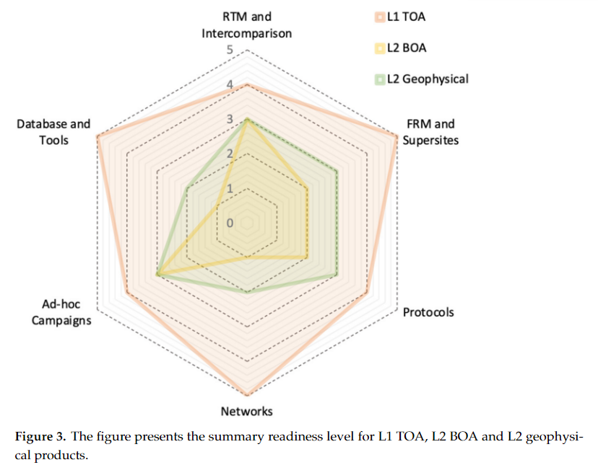





FRM4Veg Objective
Support the validation of key European satellites and vegetation biophysical variables: surface reflectance (SR), fraction of absorbed PAR (fAPAR) and canopy chlorophyll content (CCC)
FRMs have the following qualities:
  Documented SI traceability (or conform to appropriate international community standards)
  Independent from the satellite geophysical retrieval process
  Accompanied by an uncertainty budget for all instruments and derived measurements
  Adhere to community-agreed, published and openly-available measurement protocols/ procedures and management practices
  Accessible to other researchers allowing independent verification of processing systems
  Concept of a CEOS FRM (2024)
Notes:
Importantly although FRM4Veg is focused on Copernicus missions the recommendations and protocols can be applied to all satellites

Slide 4

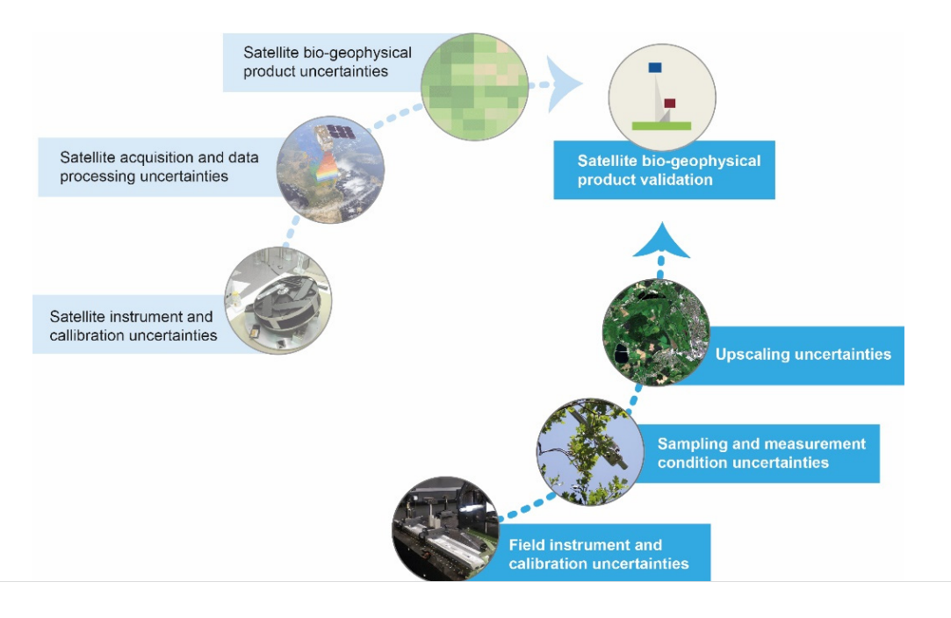
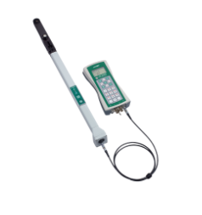
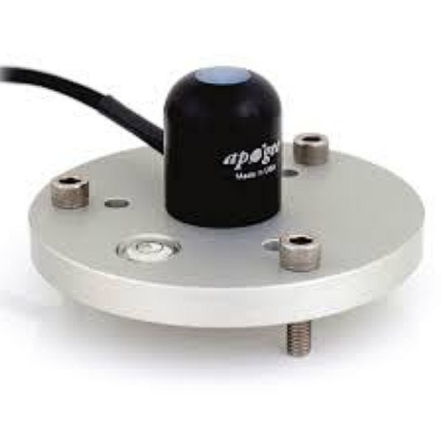
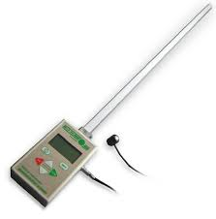
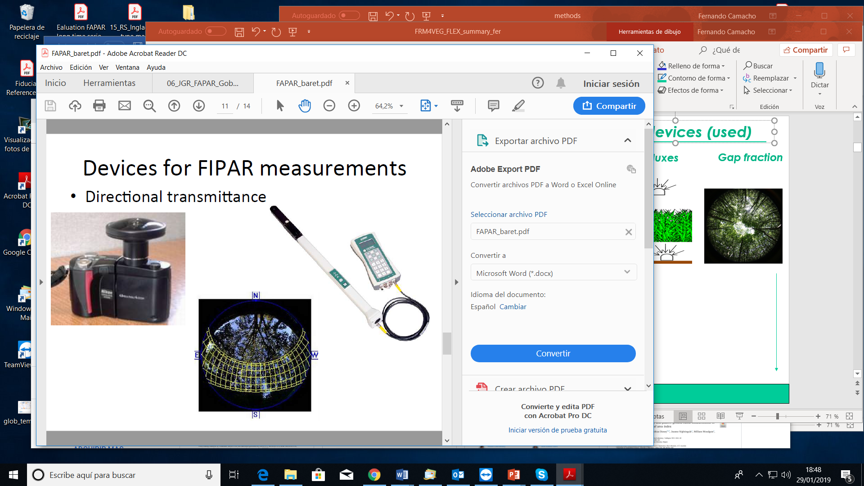
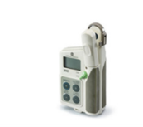
FRM4Veg Objective
FRM4Veg aims at developing protocols for measuring fiducial references of surface reflectance, FAPAR and CCC (includes LAI) for the validation of Copernicus optical missions (Sentinel-2, PROBA-V, Sentinel-3).
eee
Fraction of Absorbed PAR (FAPAR) can be estimated either from PAR sensors (4-fluxes), Ceptometers (2-fluxes) (FIPAR), Gap Fraction (SZA) (FIPAR).
PAR sensors
Ceptometers
AccuPAR LP-80
Digital Hemispherical Photo (DHP)
LAI-2200
Canopy Chlorophyll Content (CCC) is estimated as
Leaf Chlorophyll Content (LCC) x Leaf Area Index (LAI)
LAI estimated from Gap Fraction (DHP, LAI-2200)
Fiducial References
Chlorophyllmeter
SPAD-502 for LCC

Slide 5
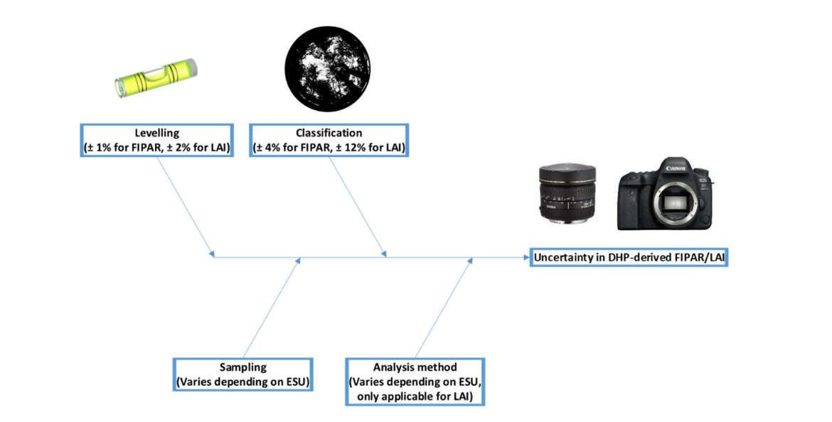
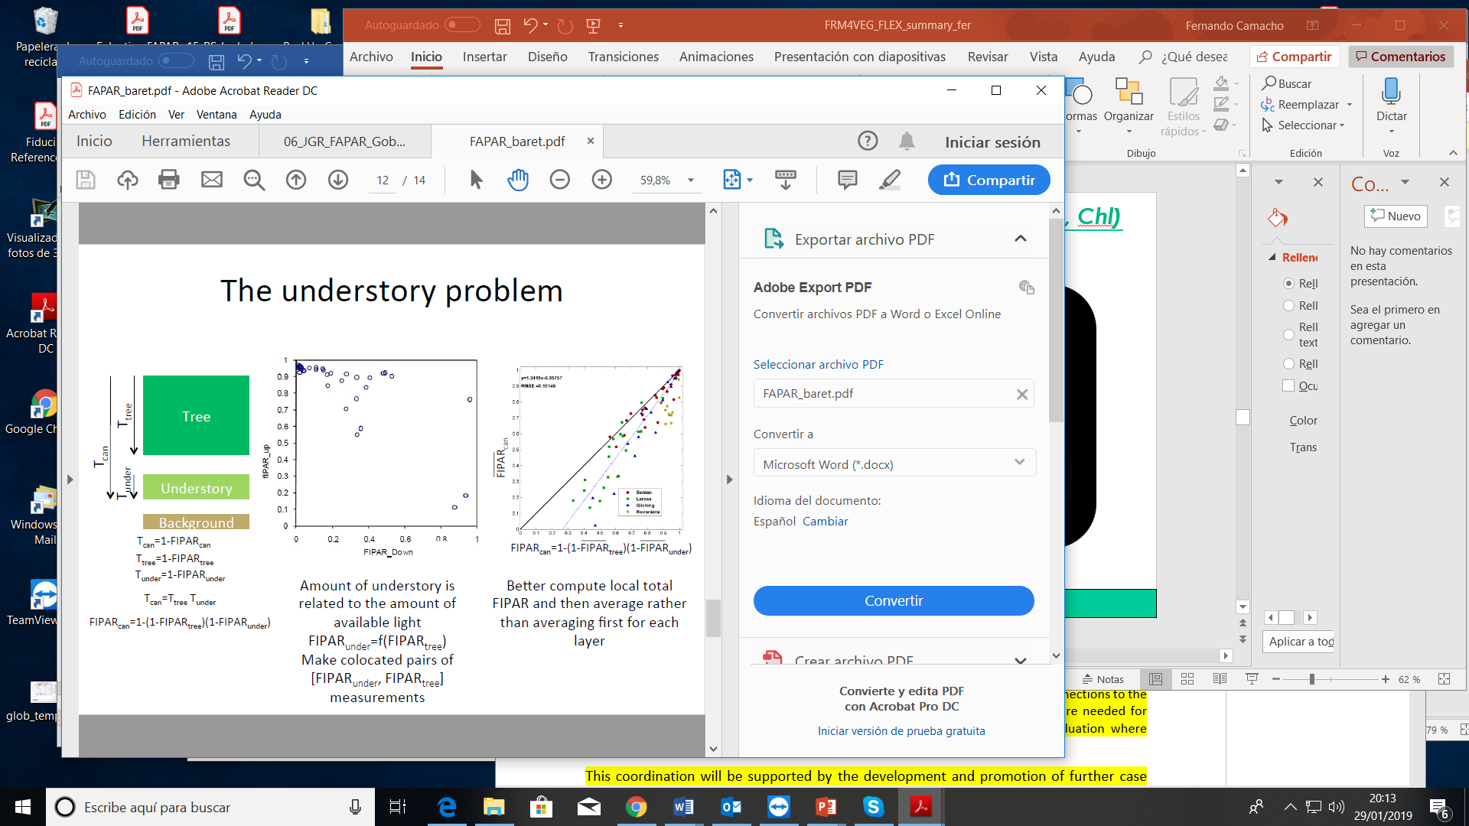
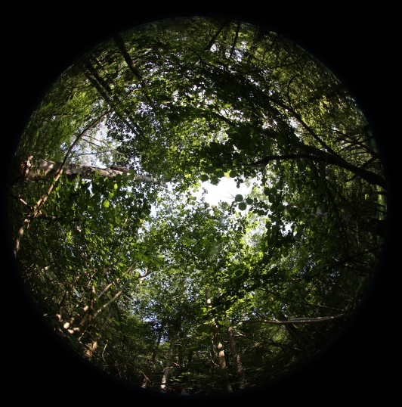
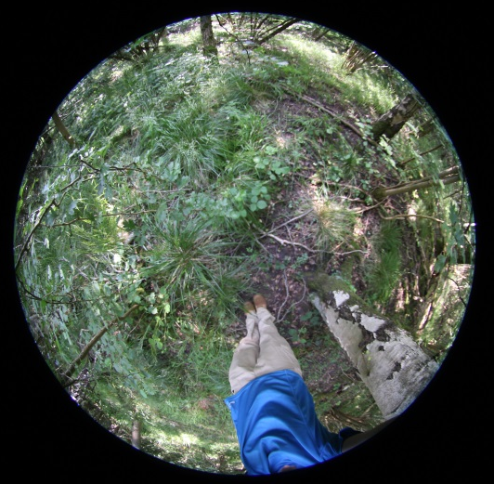
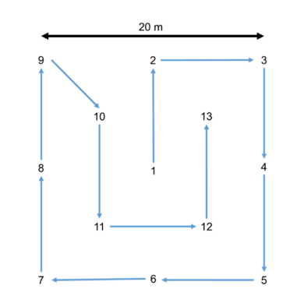
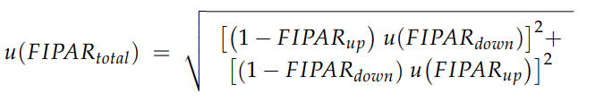
ESA FRM4Veg – Vegetation parameters
Protocols and Procedures
eee
Forest Canopies
Origo et al., 2017
fAPAR_{canopy}= fAPAR_{up}+(1- fAPAR_{up}) fAPAR_{down}
Crops/Grass

Slide 6
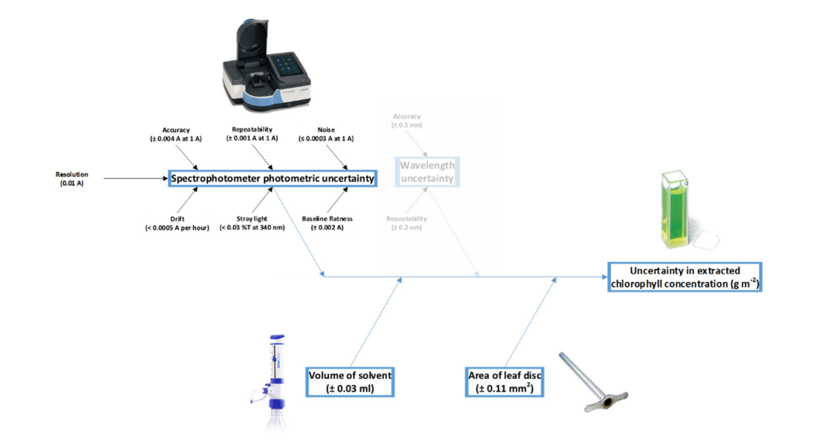
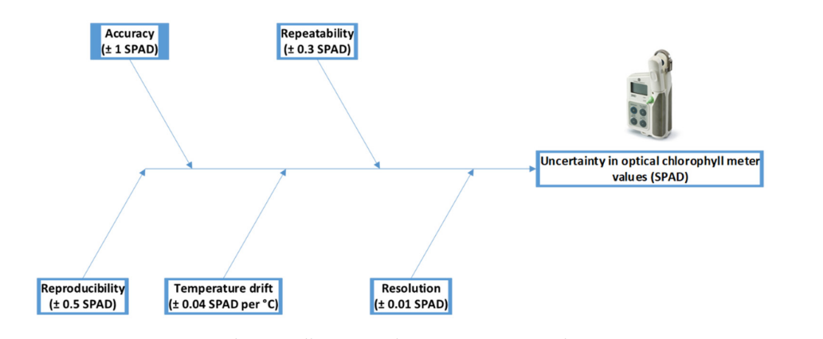
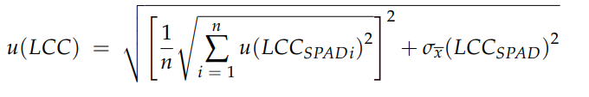
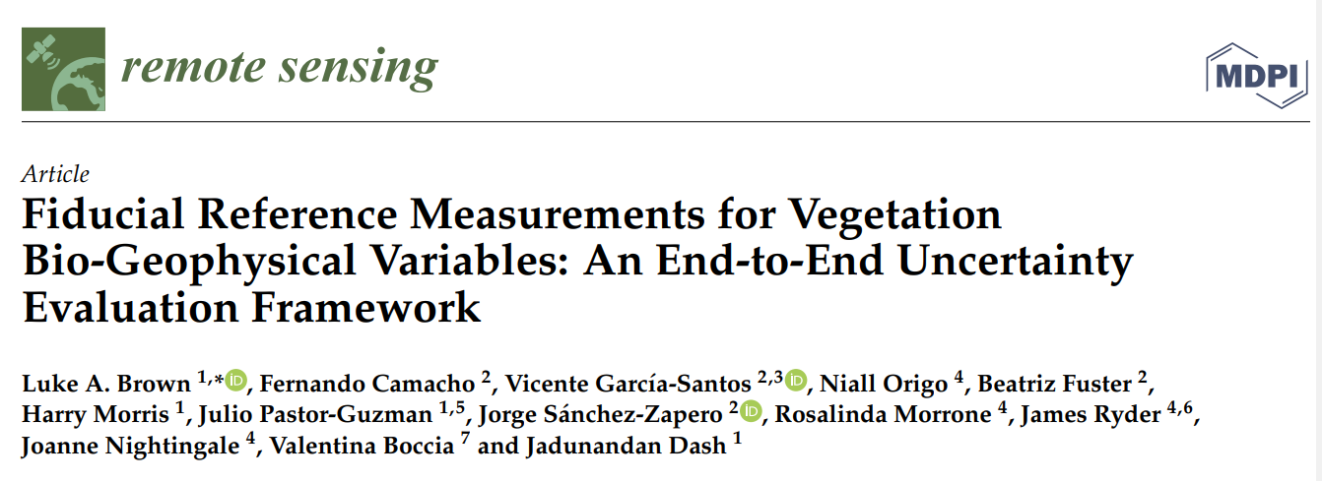

ESA FRM4Veg – Vegetation parameters
Protocols and Procedures

Slide 7
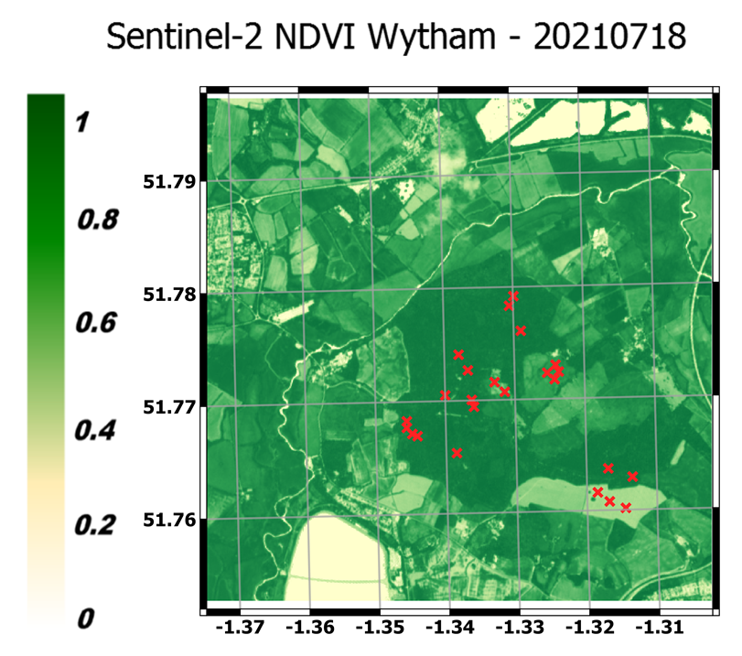
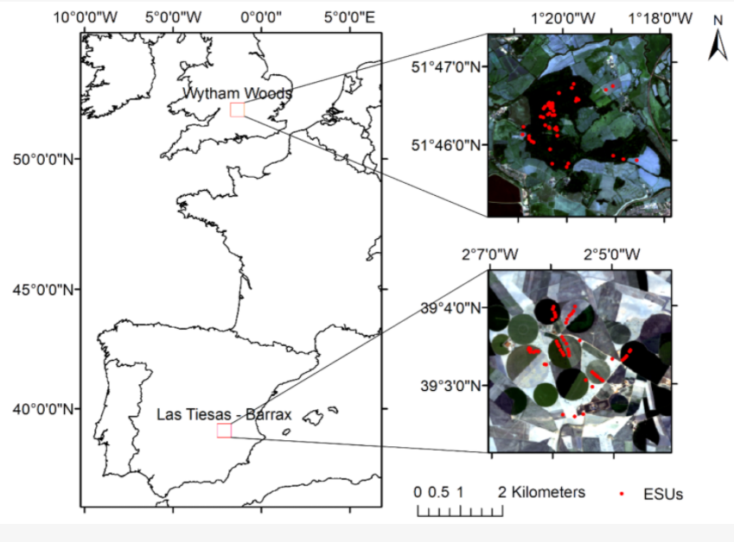
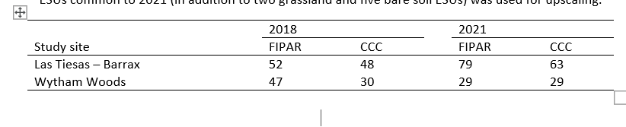
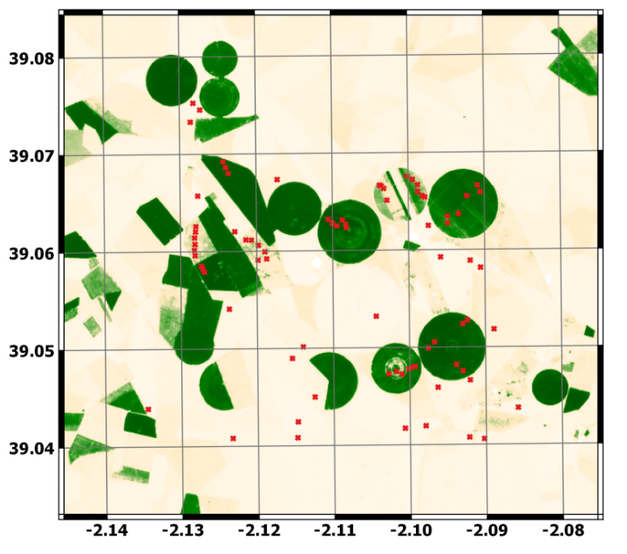
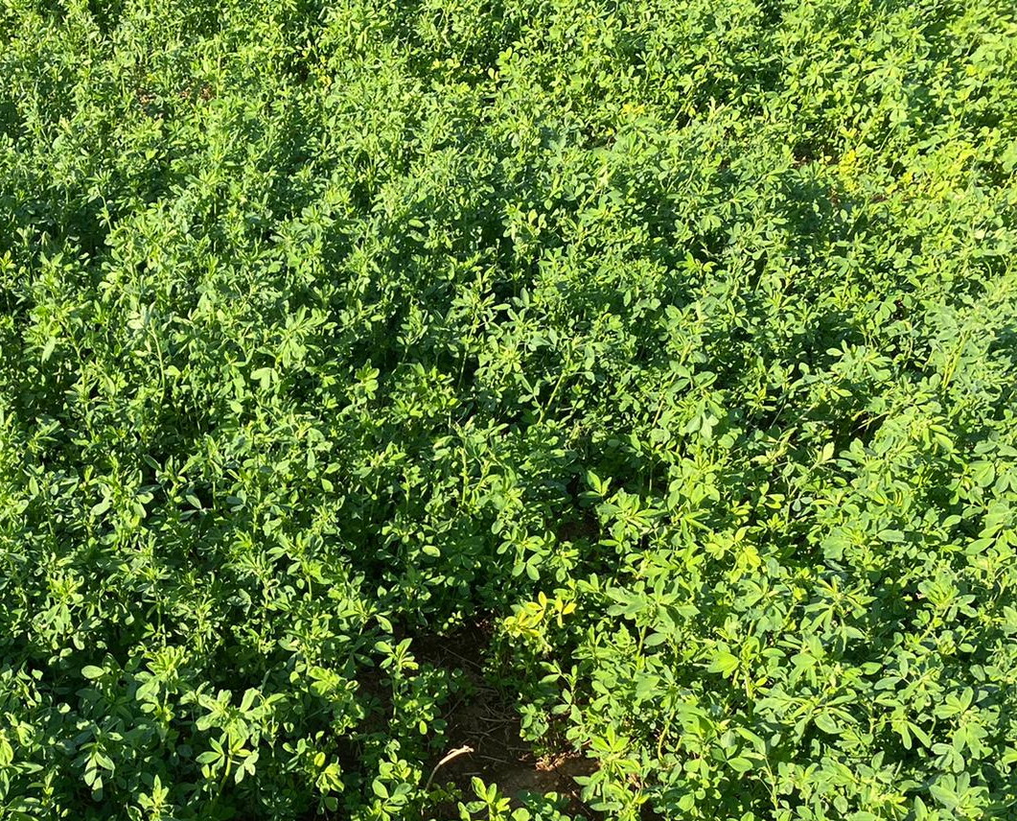
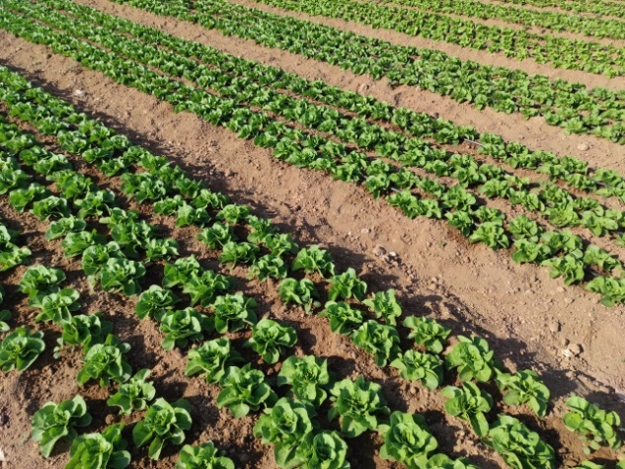
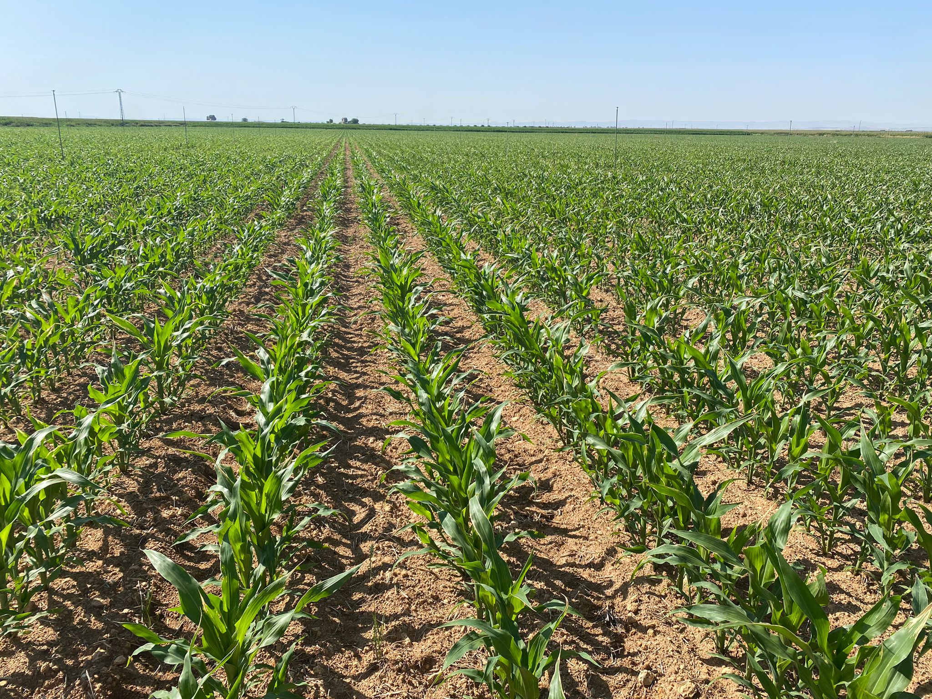
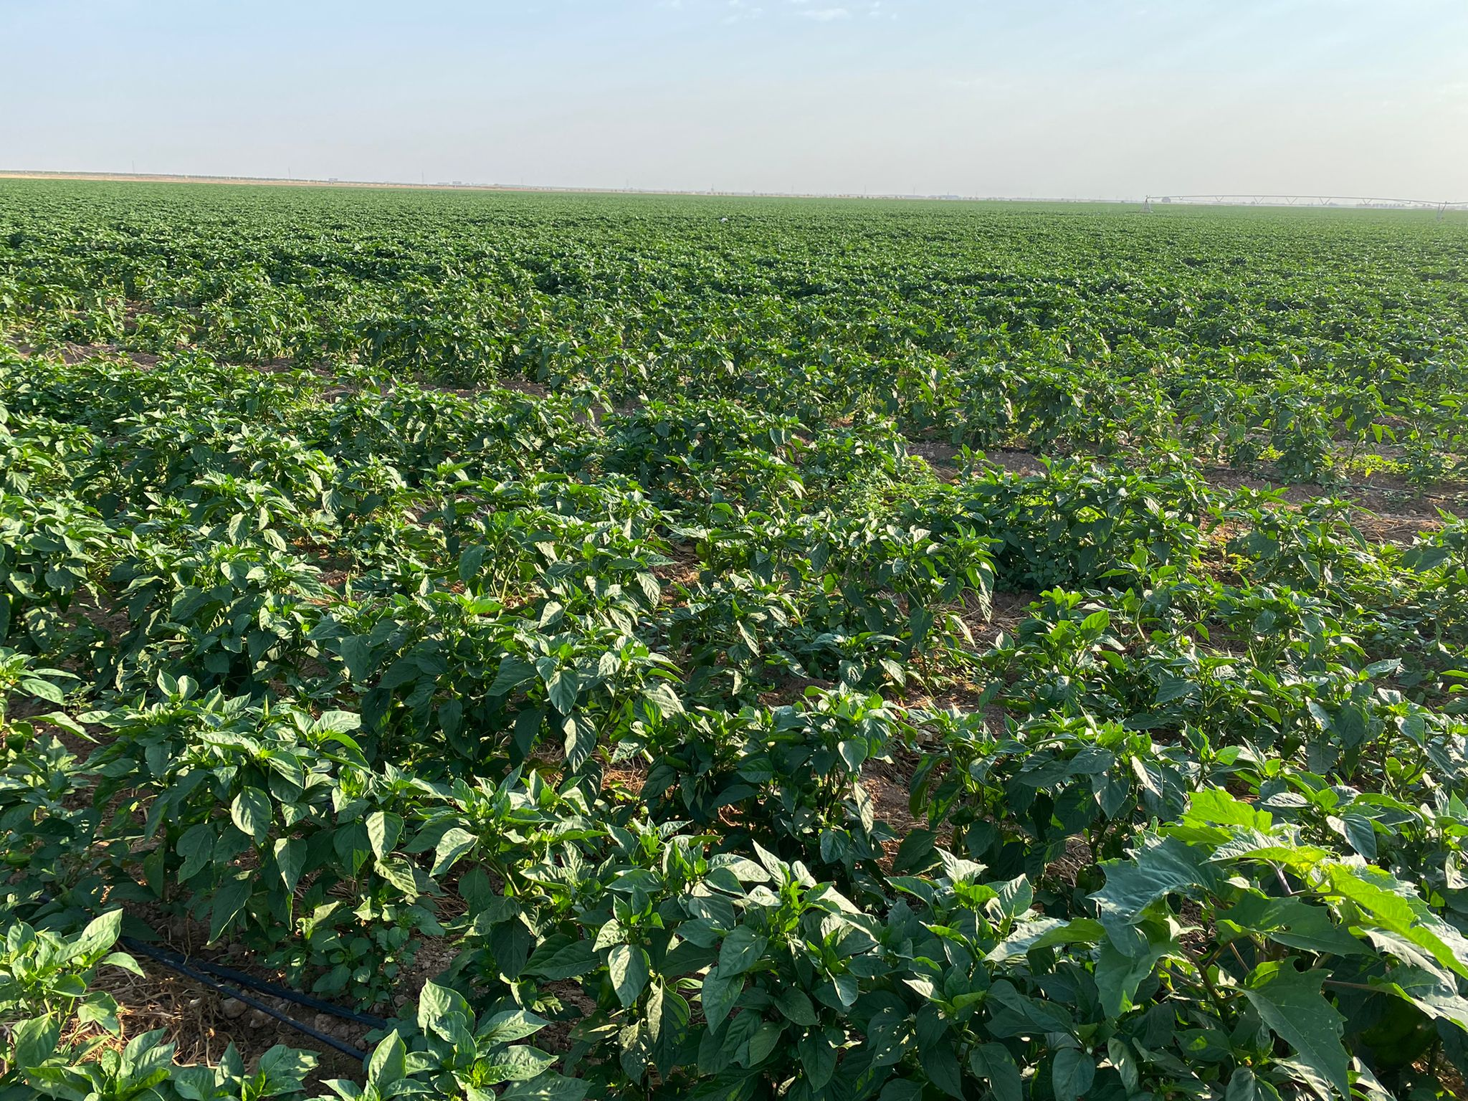
ESA FRM4Veg – Vegetation parameters
FRM4Veg Campaigns
Wytham Woods (UK), deciduous forest
  July 2018 and July 2021
  Random sampling in the forest
Barrax (Spain), agriculture
  June 2018 and July 2021
  Stratified sampling per crop type: Alfalfa, Corn, Lettuce, Pepper, Onion

Slide 8
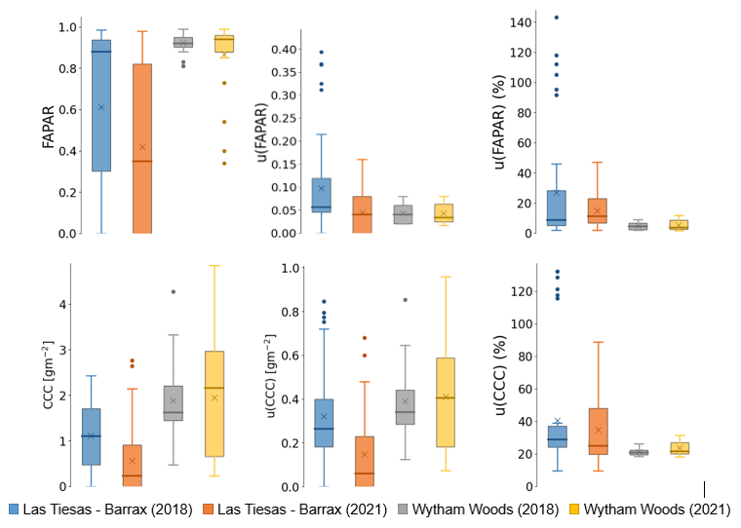
ESA FRM4Veg – Vegetation parameters
FRM data (V2)
FRM uncertainties
Median values around 5% for Wytham and 10% for Barrax
ESA FRM4Veg
Median values around 20% for Wytham and 25% for Barrax
Coverage factor k=2 (i.e, aprox. 95% confidence level)

Slide 9
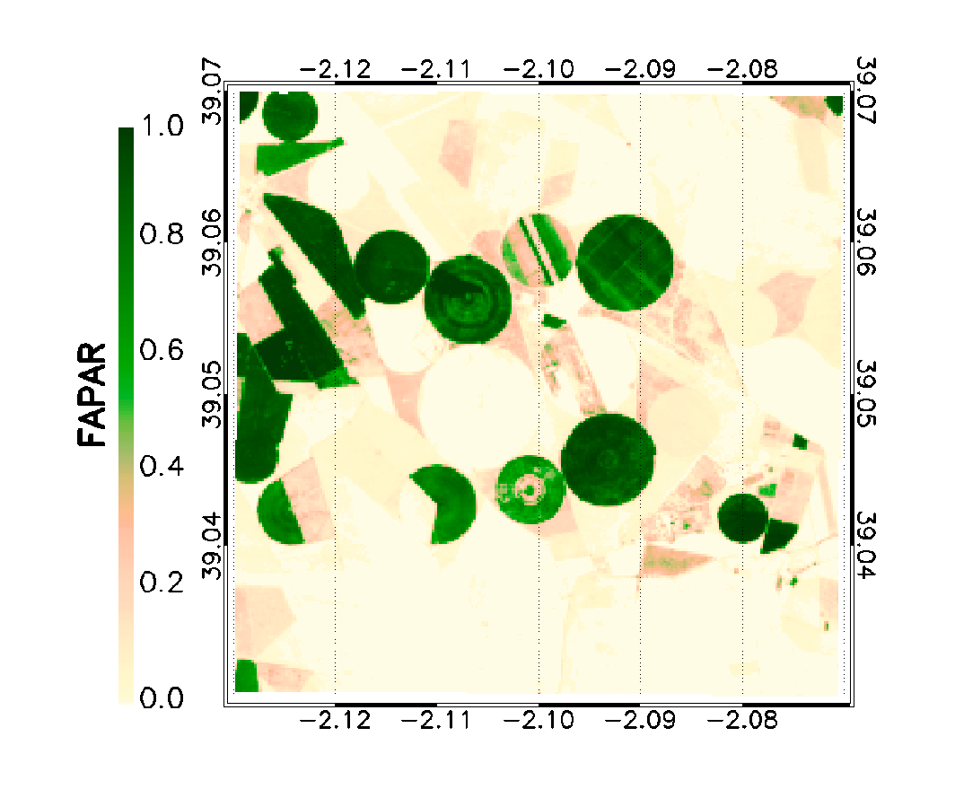
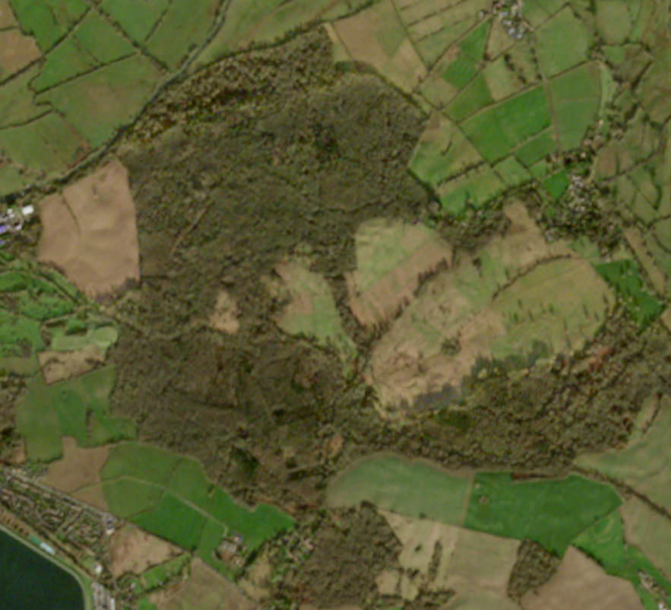
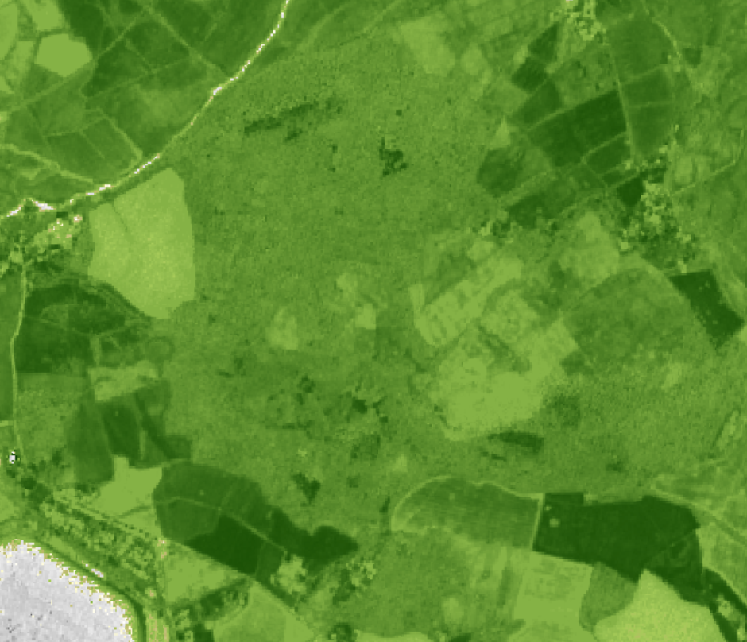
ESA FRM4Veg – Vegetation parameters
FRM RM’s
S2 FRM-based
Aggregated (S3)
• Correlation coefficient (R)
– indicates linear
association
• Root mean square
difference (RMSD) –
indicates overall accuracy
• Mean error (B) – indicates
bias
• Standard deviation of
residuals (S) – indicates
precision
• Number of samples (N)
• Slope and intercept of
Major Axis Regression
(MAR)
• Conformity Testing
ODR Regression
Aggregation
Statistical analysis
S2 L1C
Vegetation Indices
S2 RUT
S3 Product
Upscaling based on ODR considering uncertainties using Sentinel-2
FRM-based maps aggregated using PSF of S3 to validate
Notes:
Sentinel-2/MSI L1 data + uncertainties (S2-Radiometric Uncertainty Tool) (Gorroño et al., 2017)
S2 L1 Vegetation Indices + uncertainties collocated with FRM data
Regression using Orthogonal Distance Regression (ODR) to account for uncertainties.
Uncertainty propagation
Quality flag based on convex hull technique
Outcome: Per-pixel information over 5 km x 5 km area: biophysical value, uncertainty, and quality flag

Slide 10
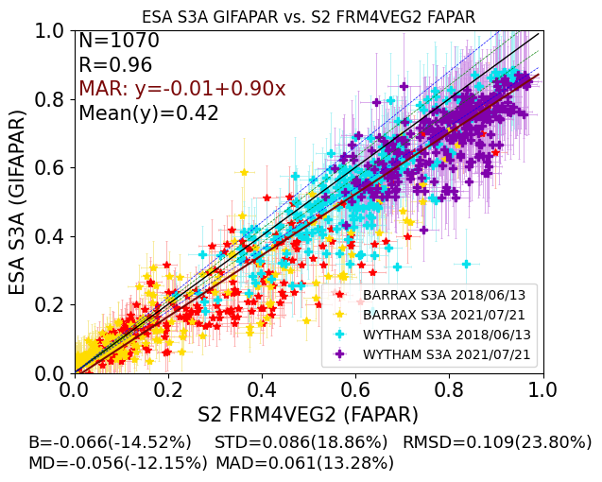
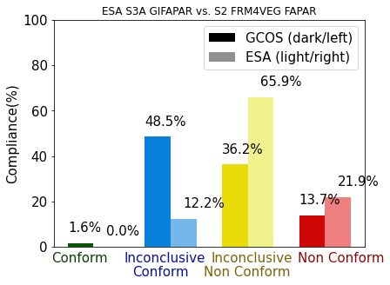
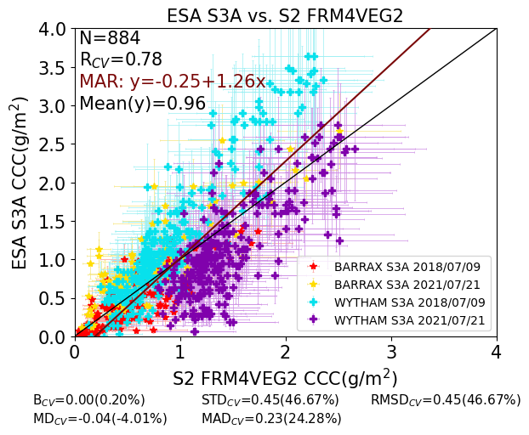
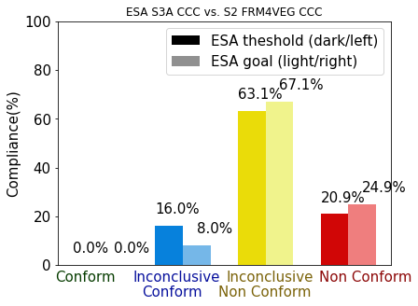
Conformity Testing of S3 GI-FAPAR & CCC (OTCI)
GIFAPAR
S3 Mission Requirements (OTCI/OGVI): 5% Optimal, 10% Threshold
- GCOS requirements: Max (0.05,10%) (*recently updated to Max(0.005,10%))
CCC (OTCI-calibrated)
Notes:
Results produced for both S3A and S3B and broken down by site and overall.
Strong agreement for both fAPAR and CCC, 0.96 and 0.9, respectively.
RMSD of 0.1 and 0.28 gm⁻² for fAPAR and CCC
No samples are conclusively conforming to the Sentinel-3 mission requirements for both fAPAR and CCC.
Uncertainty associated with the satellite product can be larger than the mission requirements leading to inconclusive results.

Slide 11
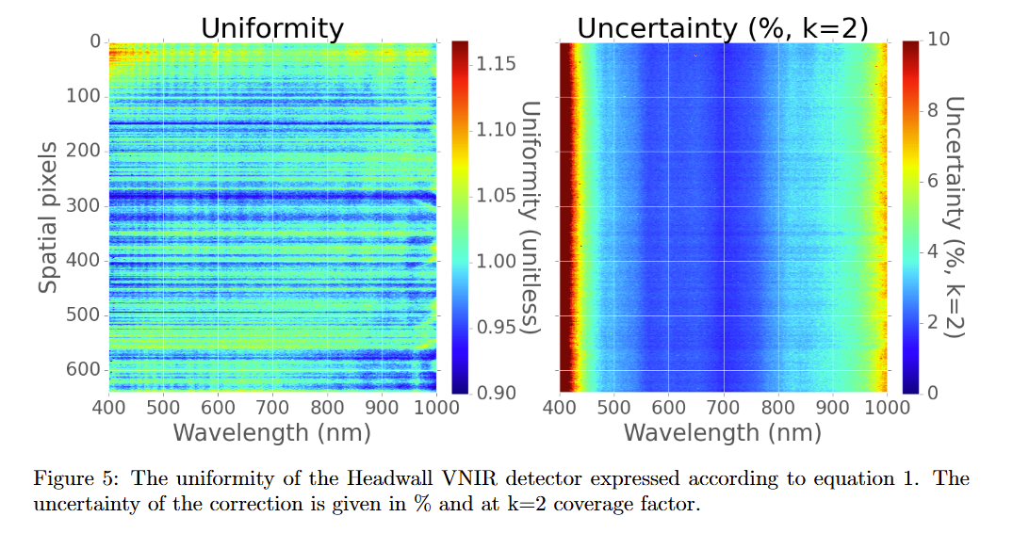
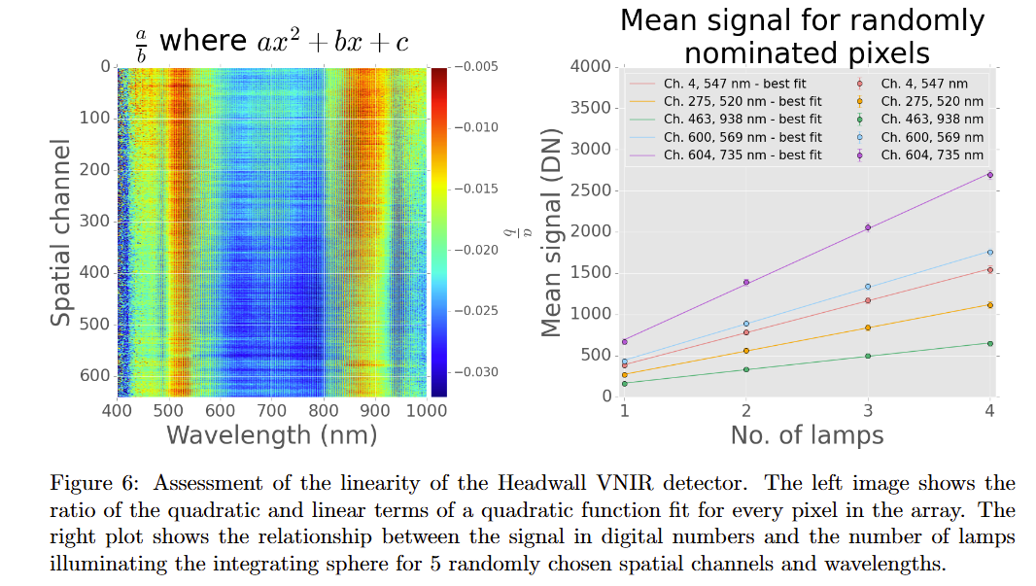
ESA FRM4Veg – Surface Reflectance
Why UAV’s
Sampling time
Damage to target
Access to the inaccessible
Full sampling potential
Sensing characteristics much closer to satellite
Barrax Site Characteristics
Large maize field in Spain (near Albacete)
Homogeneous (as much as possible)
Irrigated
Measurement campaign conducted on 22nd July 2022
Validation of S2 SR (HCRF)

Slide 12
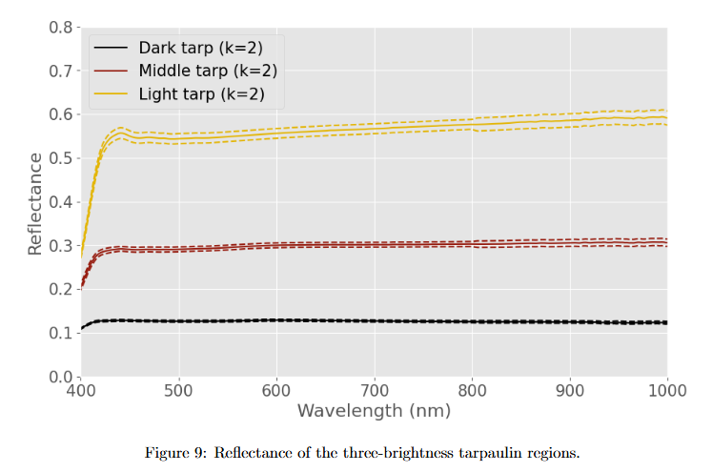
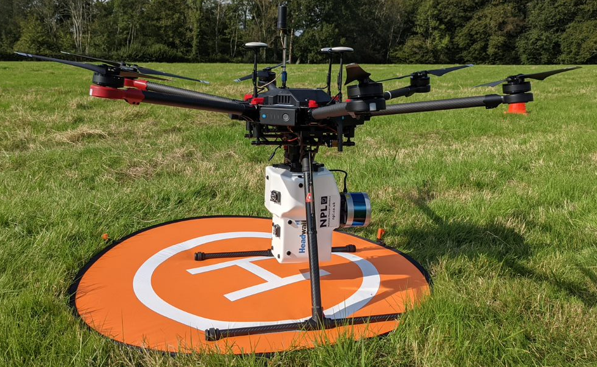
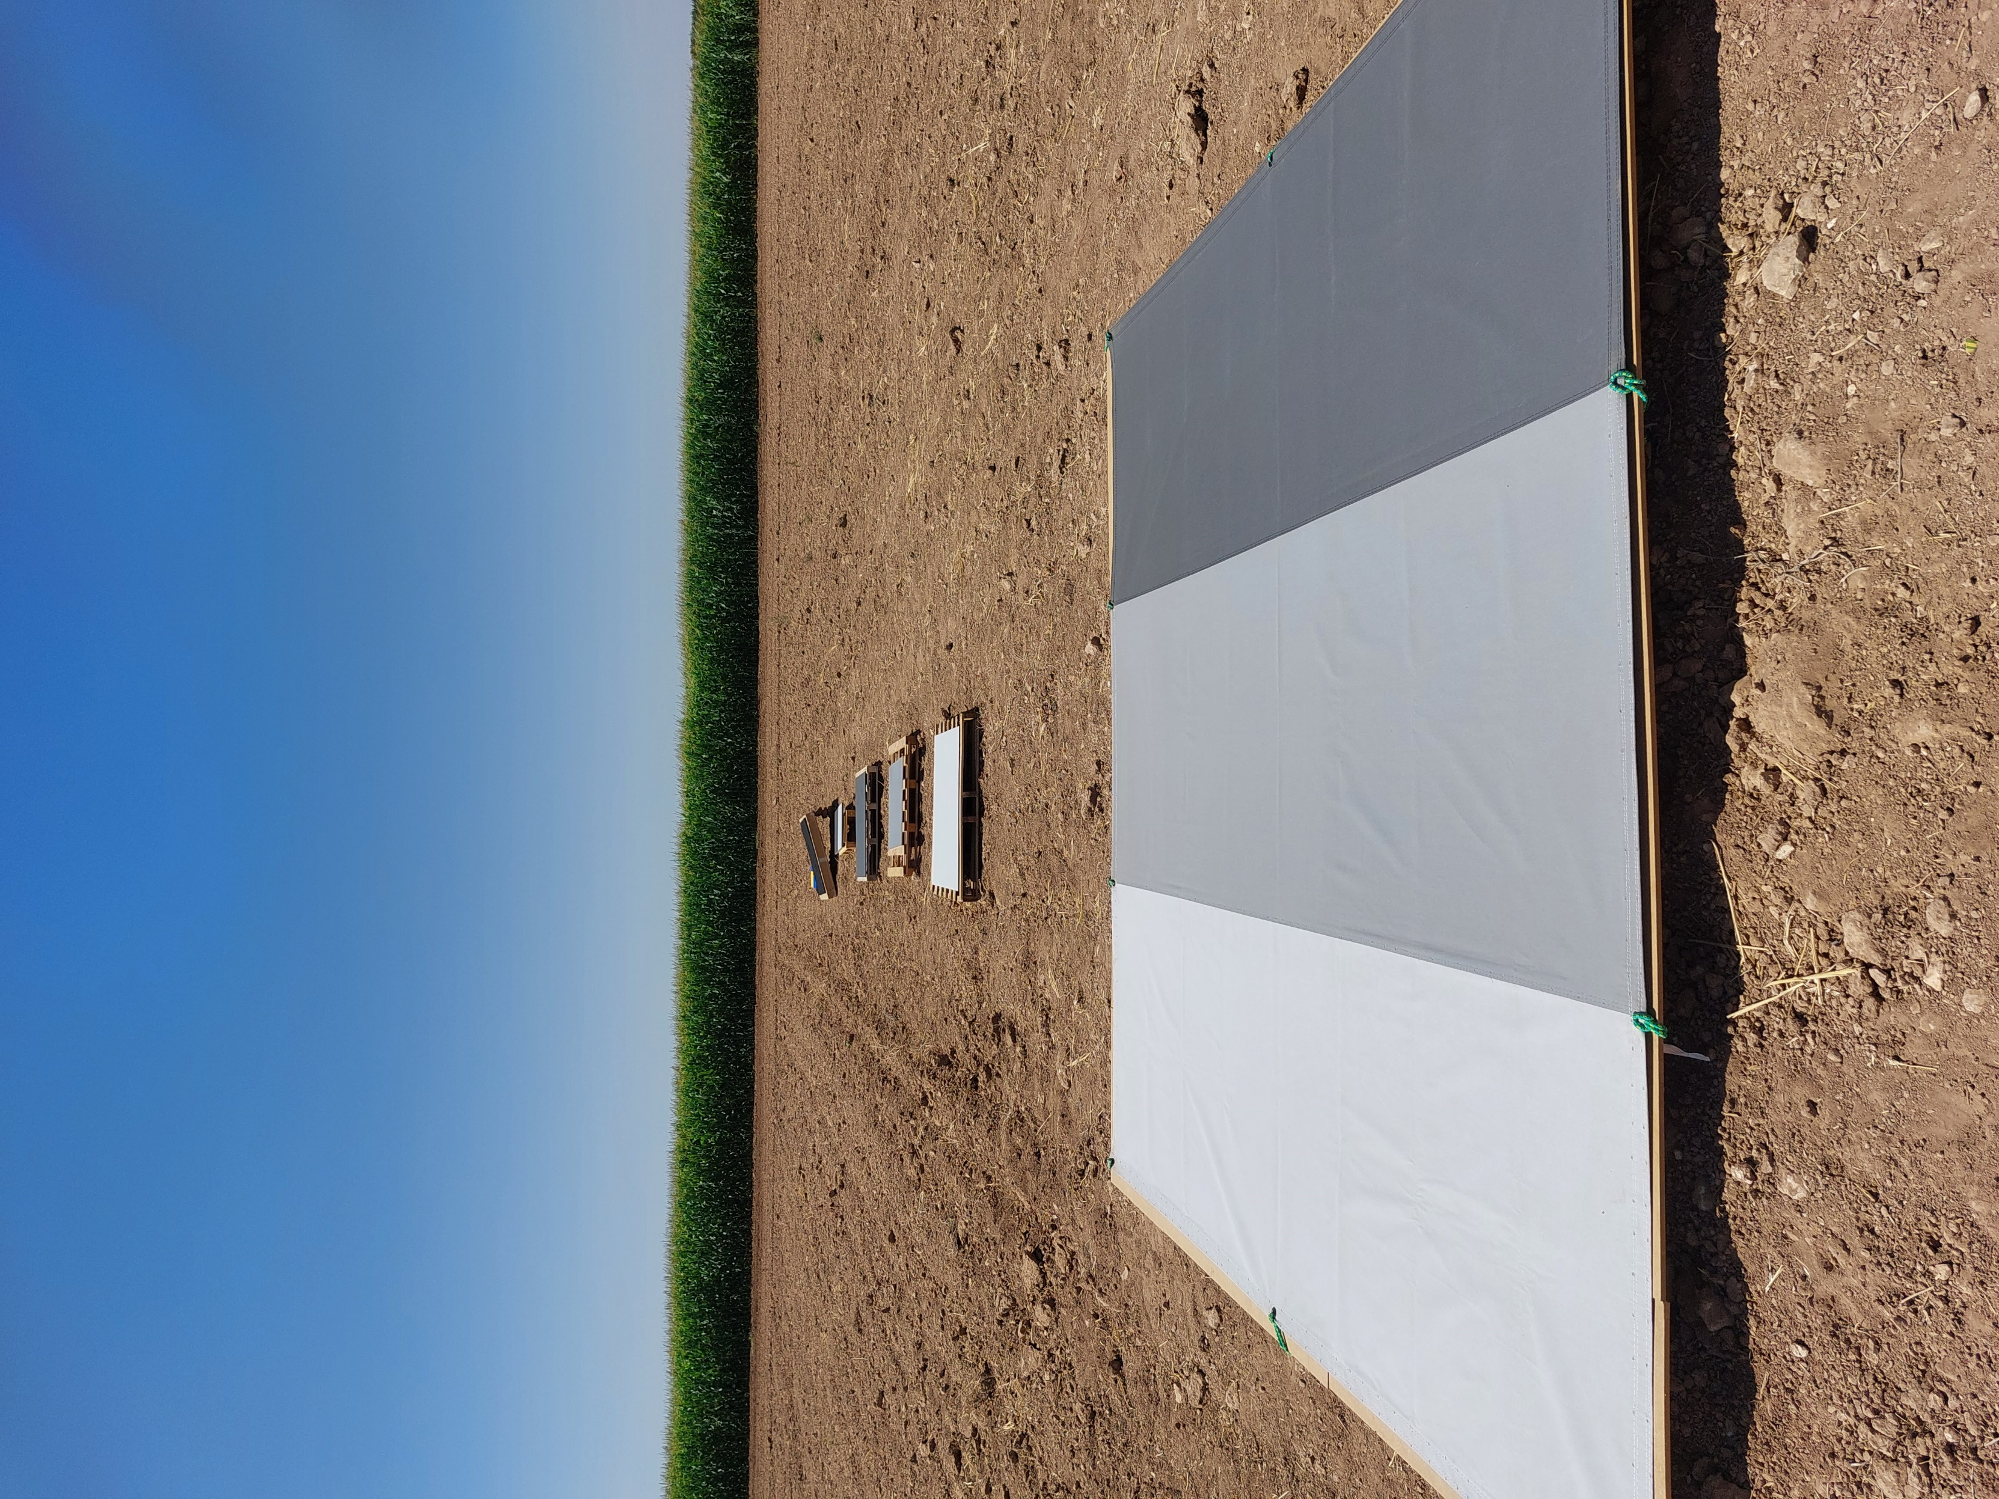
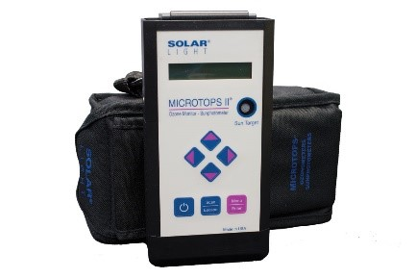
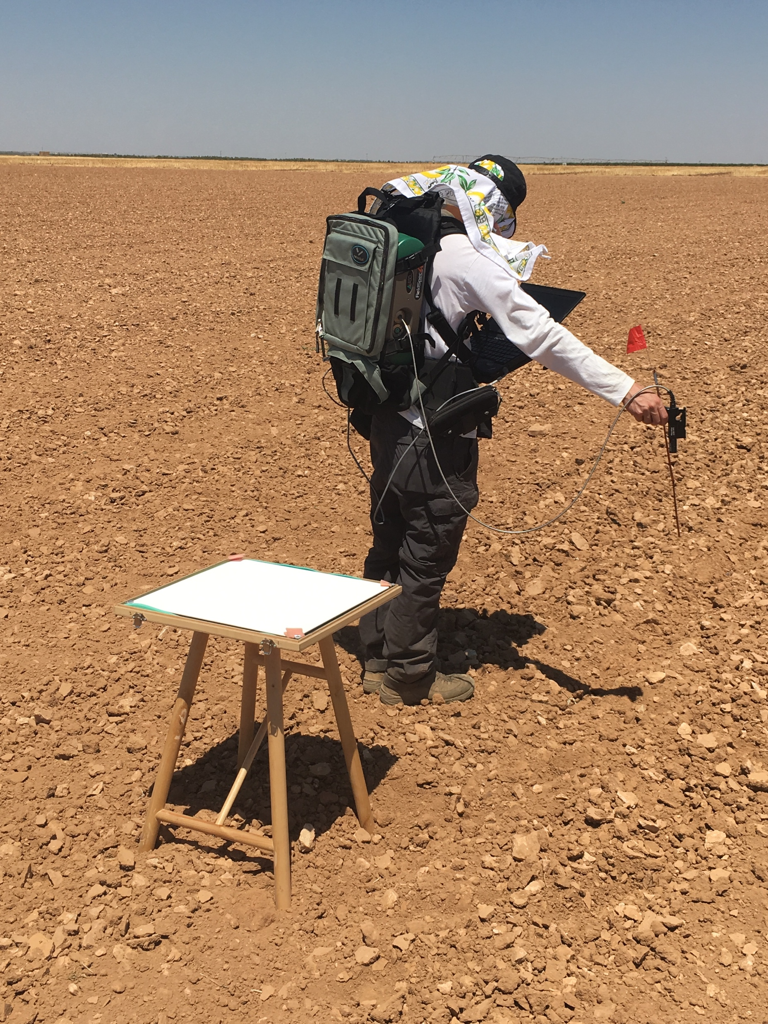
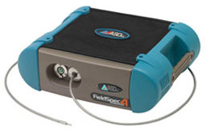
ESA FRM4Veg – Surface Reflectance
Co-aligned VNIR-SWIR Headwall:
HCRF reflectance
~21° AFOV (~0.03° per pixel)
Hyperspectral (543 bands 400 – 2500 nm)
SI

Slide 13
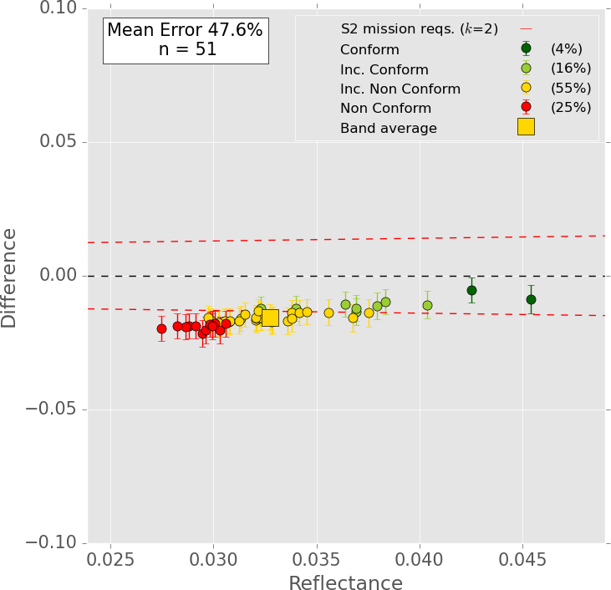
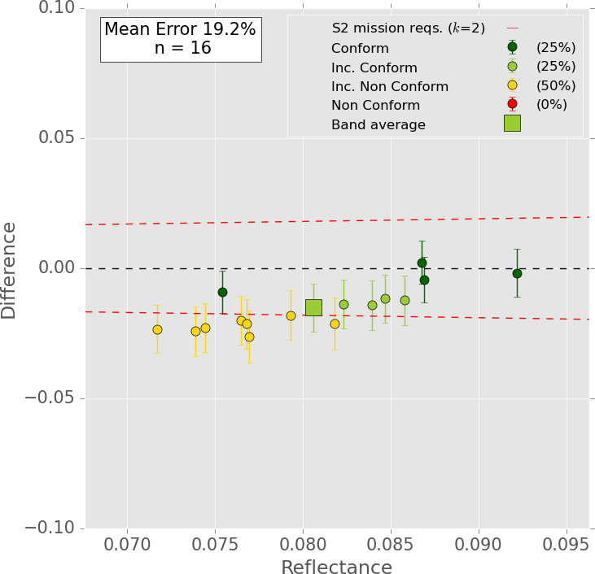
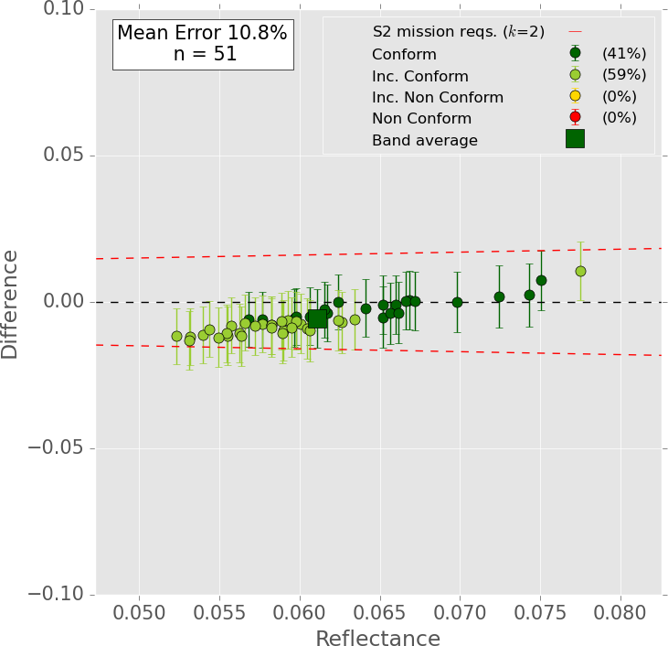
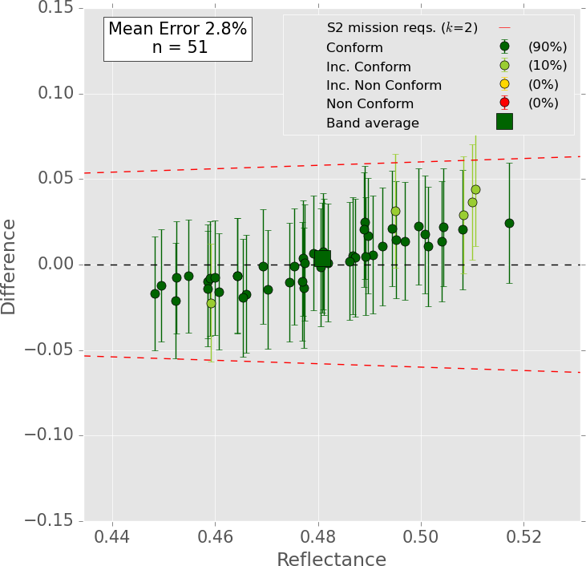
ESA FRM4Veg – Surface Reflectance
75% of pixels validated were conforming
  Non-conforming pixels restricted to bands 4 and 5 which have lower reflectance and larger relative uncertainties
Slight positive correlation between the difference and reflectance.
Total uncertainty in comparisons dominated by satellite uncertainty, drone uncertainty reduced due to spatial and spectral averaging.
Future work to focus on the synergy between permanent and autonomous surface reflectance infrastructure and UAV-based hyperspectral.
Band 4 Band 5
S2 L2A pixel requirements (5% + 0.005) (k = 1)
Band 3 Band 8A

Slide 14
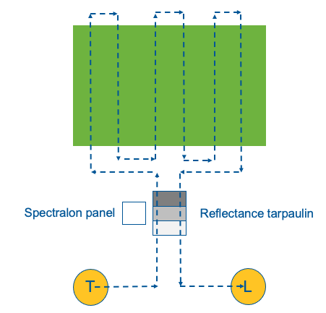
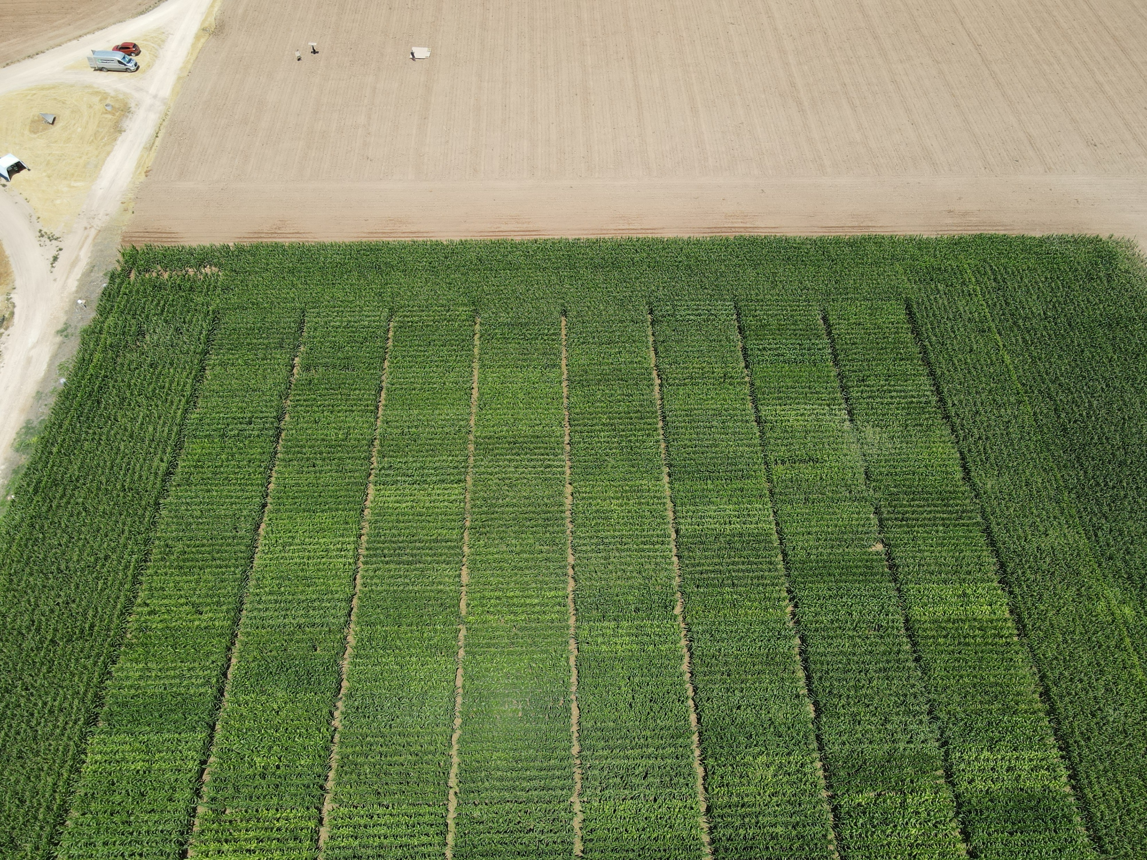
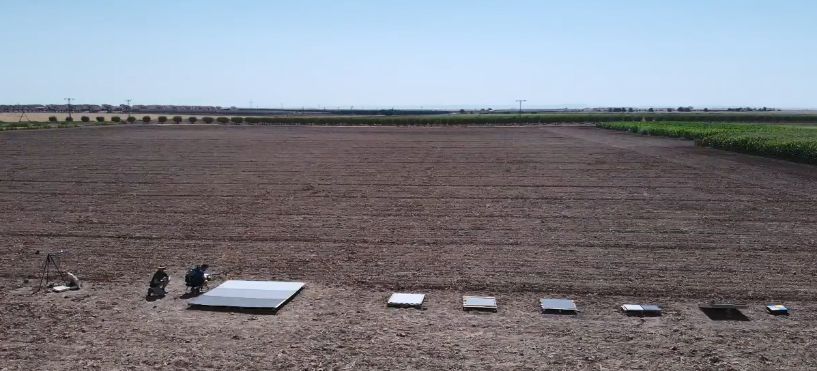






SRIX4VEG (1)
Protocols around this are yet to be developed and lots of people are developing different things (some more systematically than others)
The idea of SRIX4Veg was to assess the variability associated with different teams conducting the same validation work
Then move towards a community-agreed protocol to reduce this variability
Funded by:
Two experiments:
SR validation data collected as participants would do it given some pre-defined information
SR validation data collected by participants following a pre-defined initial protocol (developed by the SRIX4Veg team, CSIRO, USGS and GA)
Endorsed by:
In collaboration with:
In partnership with:
Project partners:

Slide 15
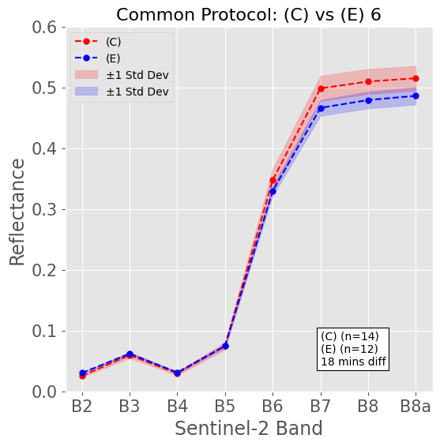
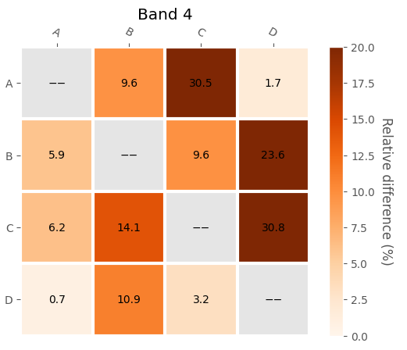




SRIX4VEG (2)
$Rel diff (\%)=\left(\frac{\left|{Team}_{A}−{Team}_{B}\right|}{\frac{{Team}_{A}−{Team}_{B}}{2}}\right)∗100$
Limited number of comparisons (n = 6)
  Temperatures exceeding 40°C led to data corruption
H&S of drone flying meant concurrent measurements not feasible
Common protocol leads to a smaller difference (on average) than user-defined protocol
User Defined
Common

Slide 16

GPG for UAV SR validation
The protocol is designed for surface reflectance validation datasets with UAVs (not general surface reflectance measurements)
Document is structured into a condensed version (i.e. quick reference; chapter 5) and long-version (chapter 6)
  Sensor
  UAS
  Environmental conditions
  Flight planning
  Post processing
Requirements must be followed to be CEOS-FRM complaint
Recommendations are best practice agreed by the community
Intention is that the protocol is sensor-agnostic
Aims to remain adaptable to future scientific improvements
Current Activites | CEOS | Committee on Earth Observation Satellites

Slide 17





Key Takeaways from FRM4Veg
FRM4Veg delivers an uncertainty-aware validation framework for vegetation products (CCC, fAPAR and SR)
S2 meets SR requirements (~75%), but S3 compliance remains inconclusive
Standardised FRM protocols are critical for future satellite validation
Moving toward standardised, continuous FRM monitoring
  https://frm4veg.org/

