Slide 1





The Fiducial Reference Measurements for Fire (FRM4fire) Project – phase 1
Bernardo Mota¹, Martin Wooster², Farrer Owsley-Brown², Gareth Roberts³ and Dirk Schüettemeyer⁴
⁽¹⁾ National Physical Laboratory ⁽²⁾ Kings College London ⁽³⁾ Southampton University ⁽⁴⁾ European Space Agency
FRM workshop, 18th -20nd May 2026 – National Physical Laboratory

Slide 2
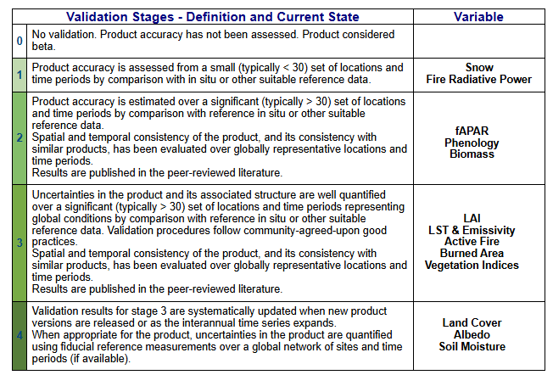
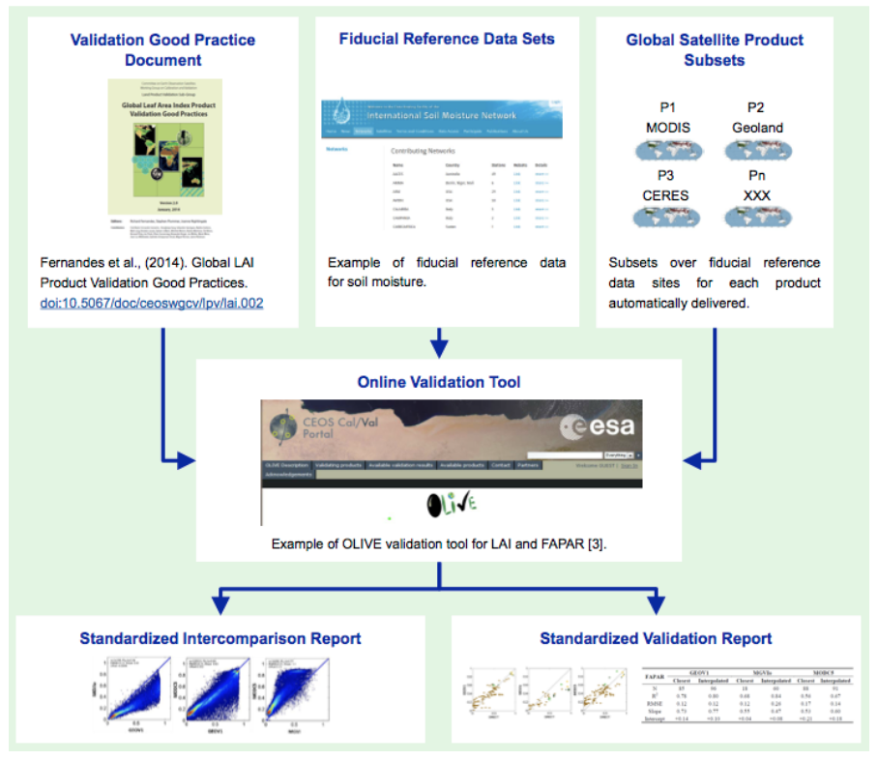

Status of Fire products validation stage (CEOS -LPV)
Results
Project
Need for reference data classed as
Fiducial Reference Measurement
(FRM)
FRM
Validation
«FRP Validation at stage 1: The main challenge to validate fire products is the generation of reference data due to the ephemerity of the phenomenon to be mapped and the current revisiting times of moderate-high spatial resolution observing systems. Therefore, reference data samples are scarce and not coincident with product estimates.»
In-situ generated reference data
Coincident measurements currently are not routinely available, even opportunistic experiments used airborne thermal imaging systems.
A field experiments scarce and limited to controled environments
Motivation
Fiducial Reference Measurements for Fire (FRM4fire) FRM Workshop – May 2026

Slide 3
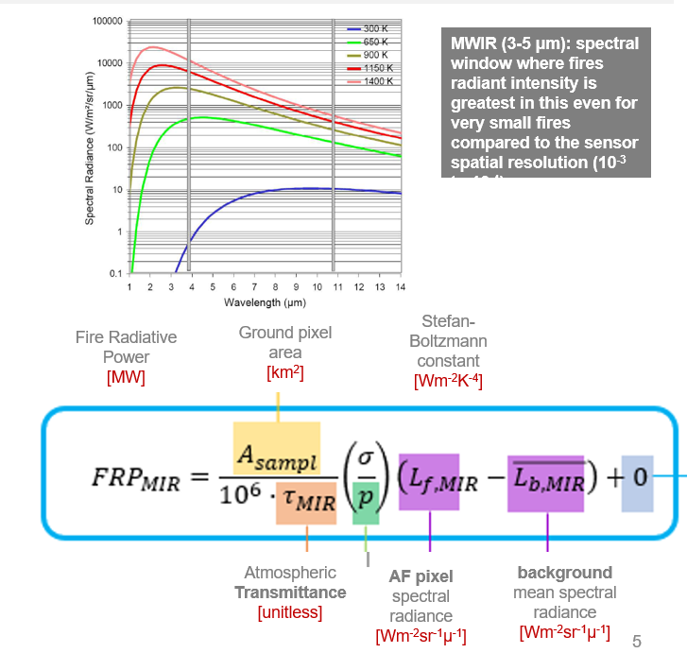
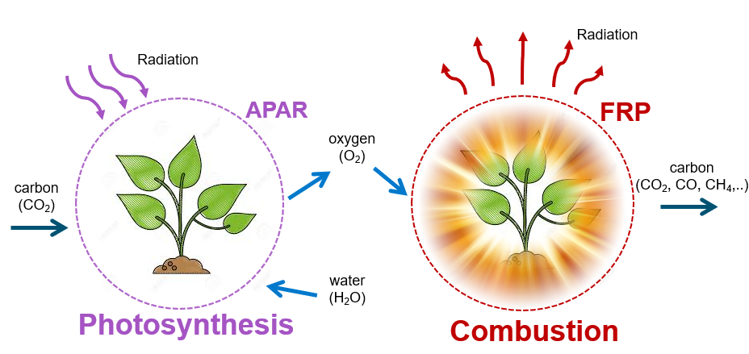
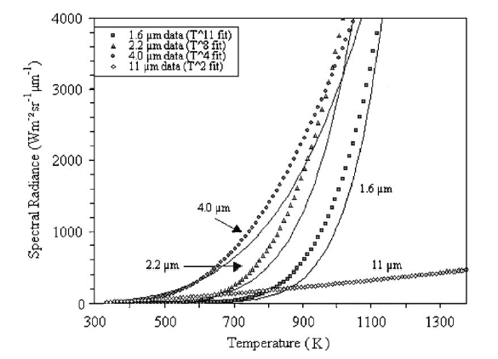
What is Fire Radiative Power (FRP)?
Results
Project
FRM
Validation
It’s the measure of the rate of energy that is being emitted by an ongoing fire.
approximation Plank’s radiation law to the Stefan-Boltzmann law
Motivation
Fiducial Reference Measurements for Fire (FRM4fire) FRM Workshop – May 2026

Slide 4
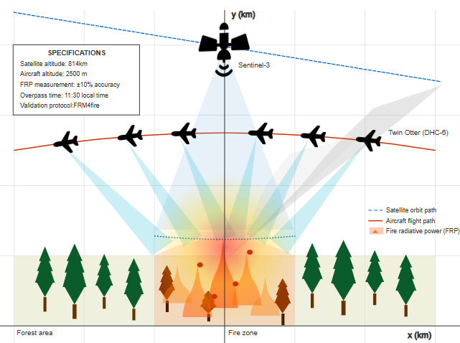
1.Airborne Platform
3.Planning
4.Fly over fire
Results
Candidate fire
Satellite overpass(es)
Project
Enables large-scale data collection Fixed-wing aircraft, such as the BAS De Havilland Twin Otter deployed in Canada
Cloud free
5.Preprocessing
FRM
2.Instrumentation
Plan survey
Thermal sensor deployed should match spectral channel of the satellite sensor being validated
have sufficient dynamic range
Navigation data required to georeference airborne EO data
Georeference using navigation data and per pixel view vectors (from geometric calibration of optics)
Apply atmospheric correction
Validation
InfraTec ImageIR 8300 hp mounted on Twin Otter
Motivation
Validation of spaceborne FRP retrievals
Using airborne reference data
Sentinel-3 SLSTR S7
Courtesy of Farrer Owsley-Brown, KCL

Slide 5
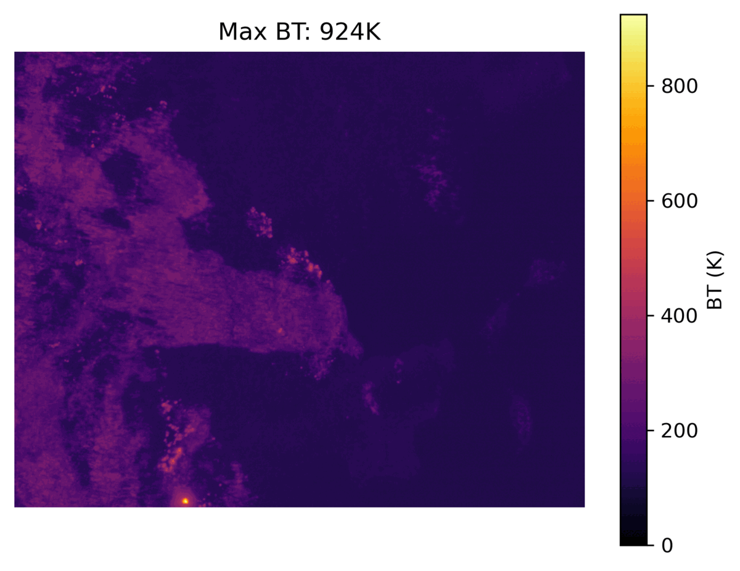
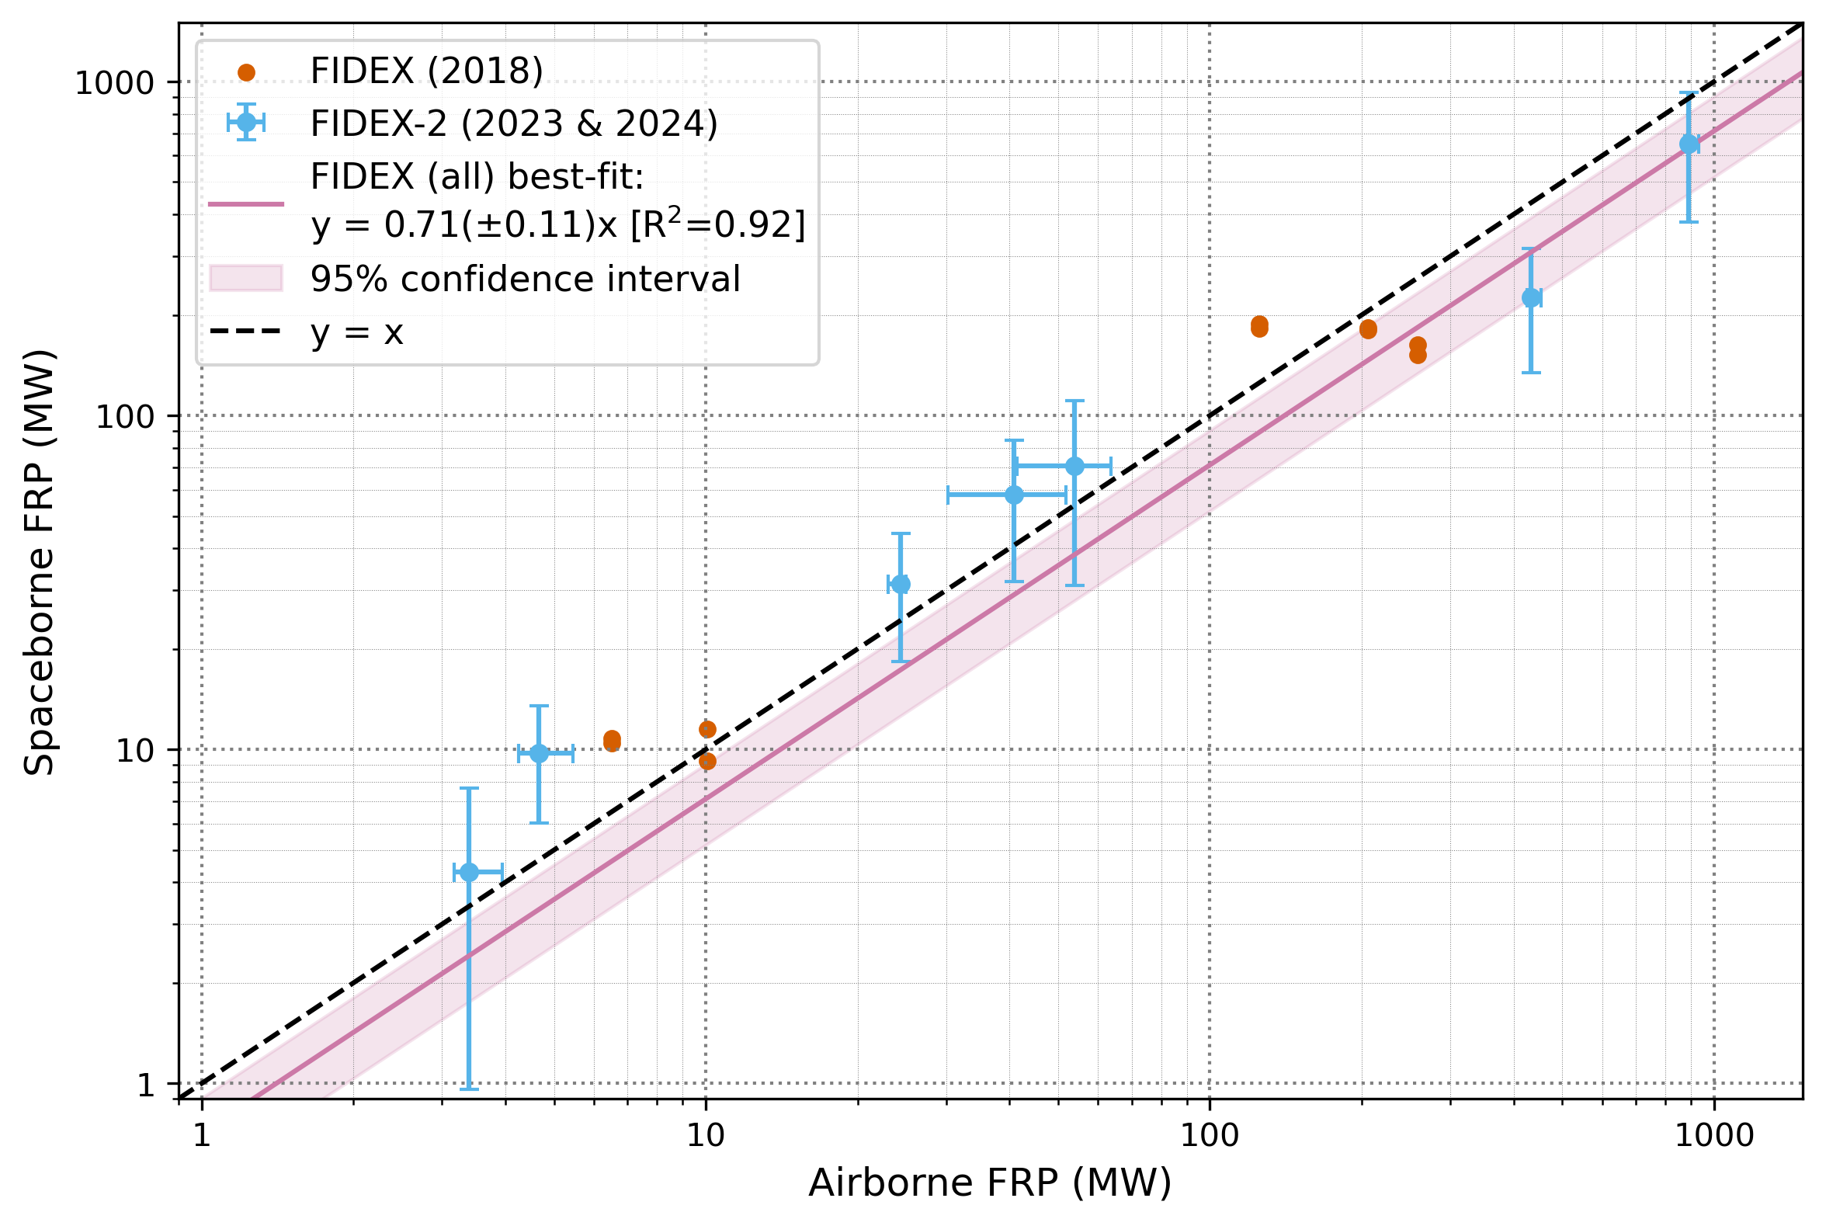
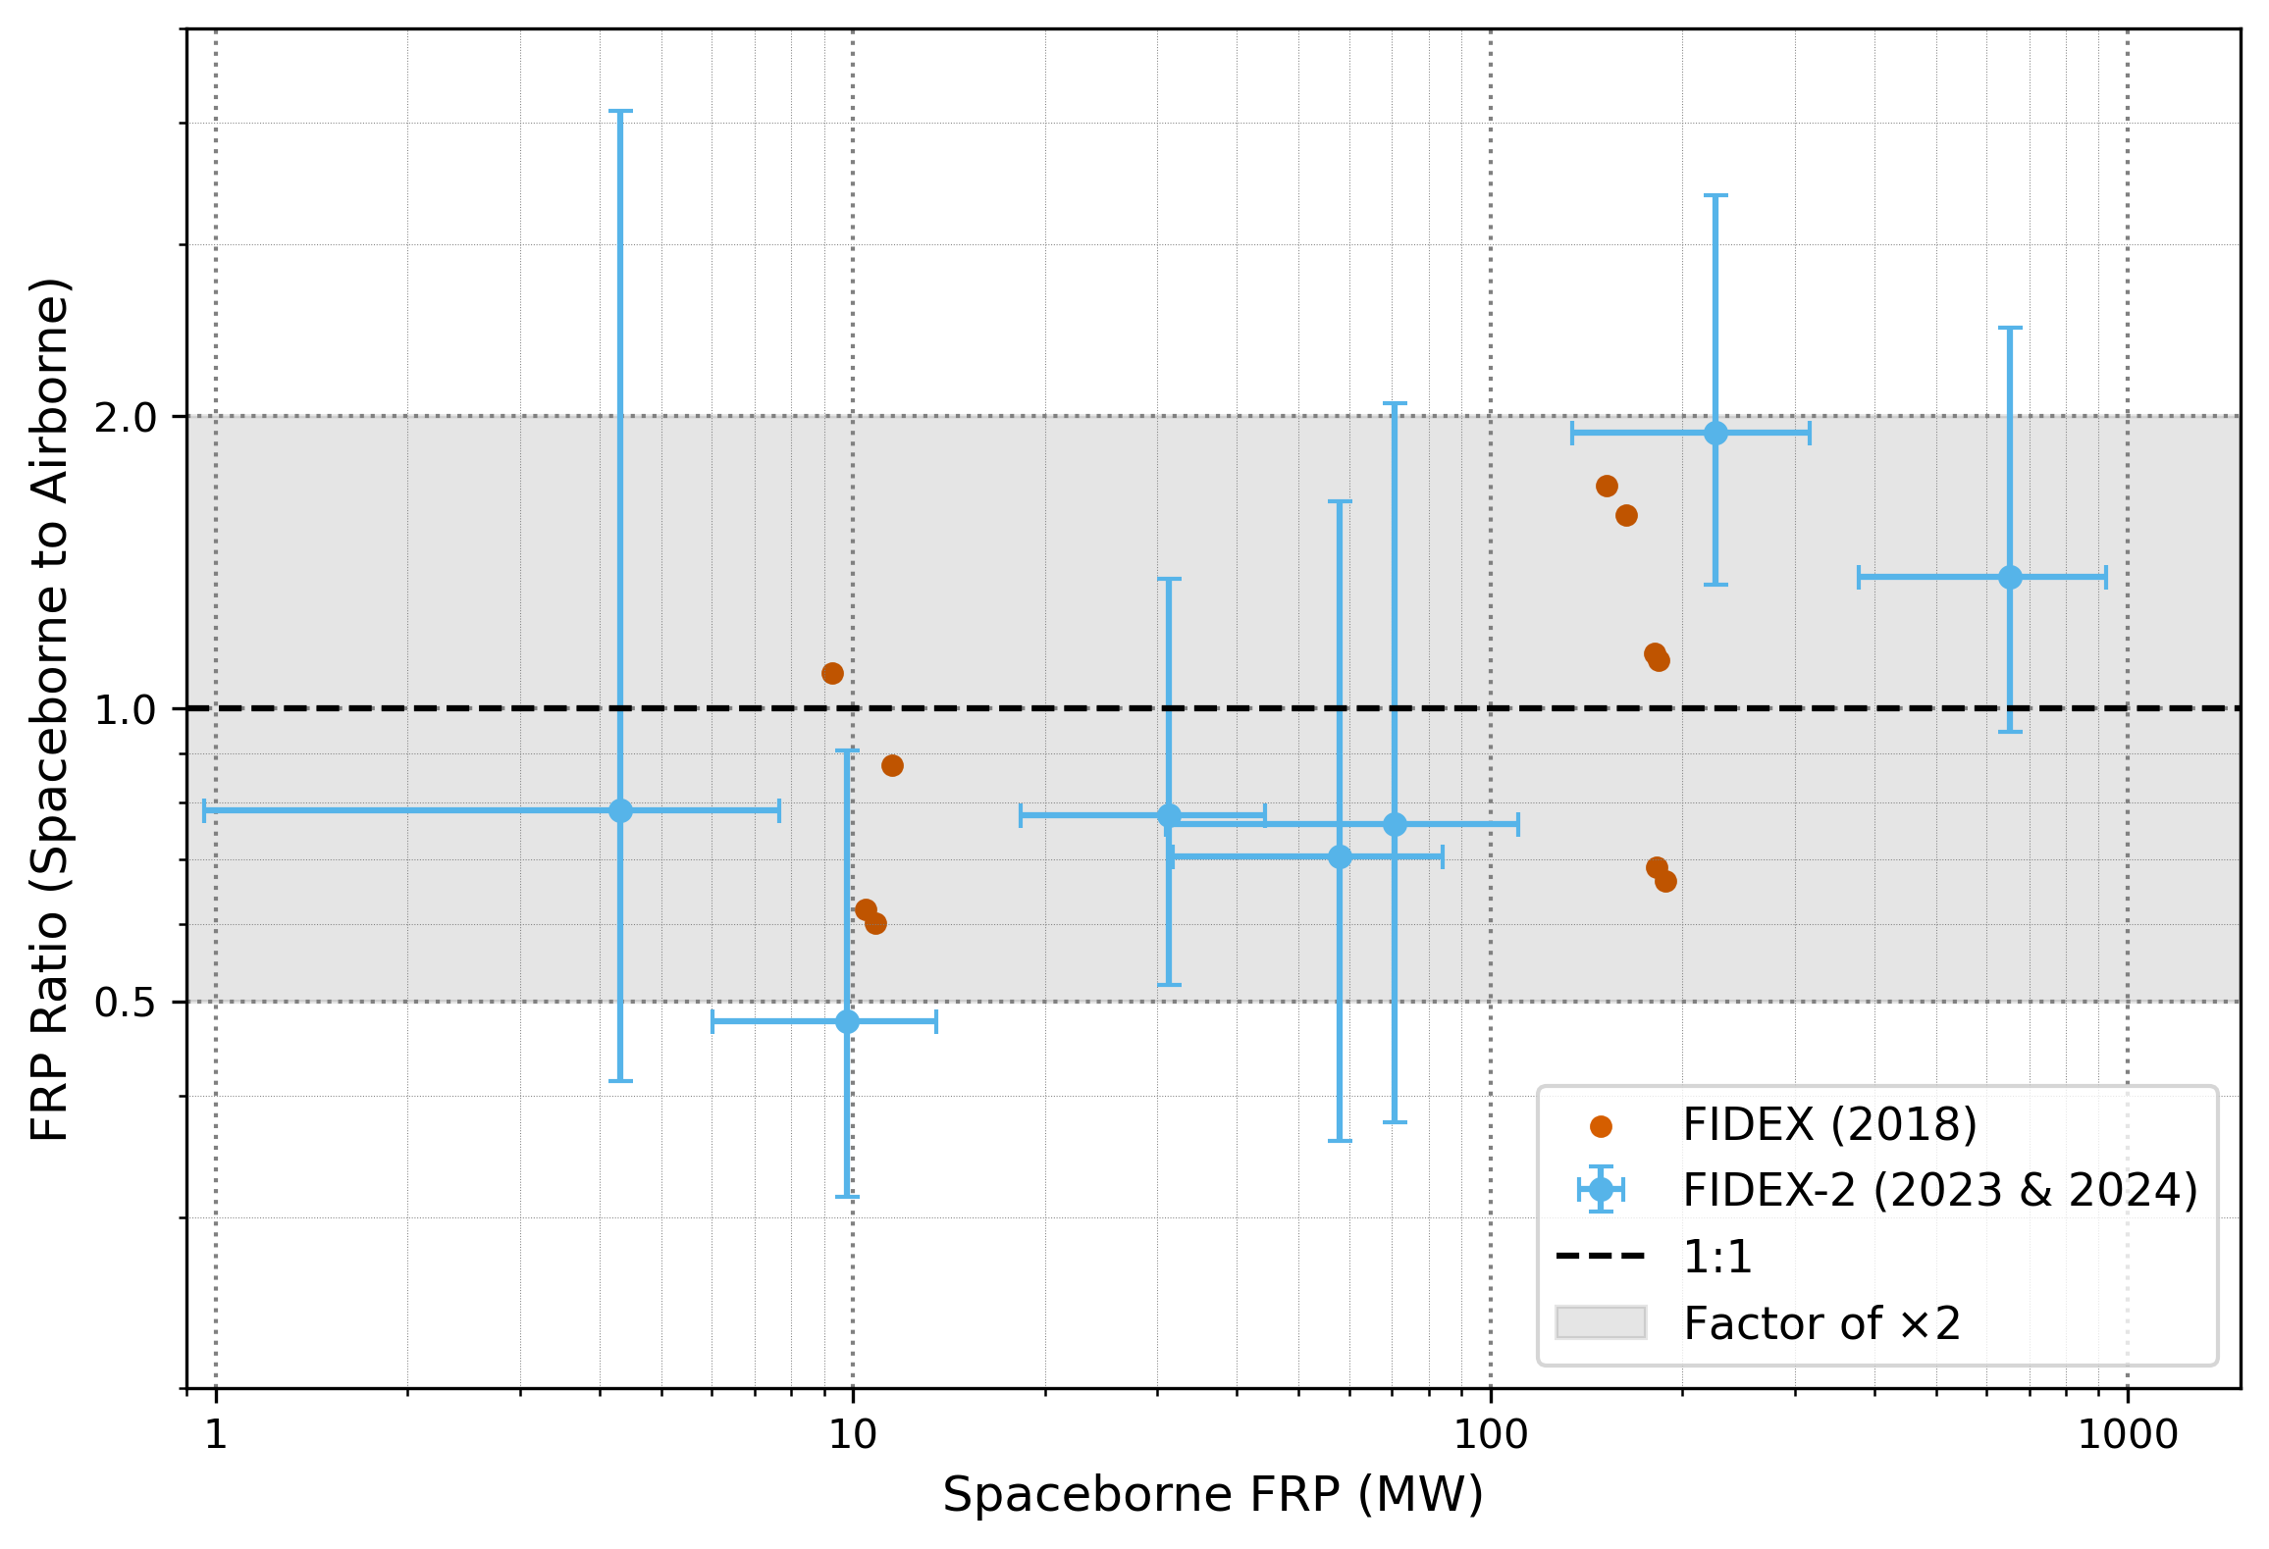
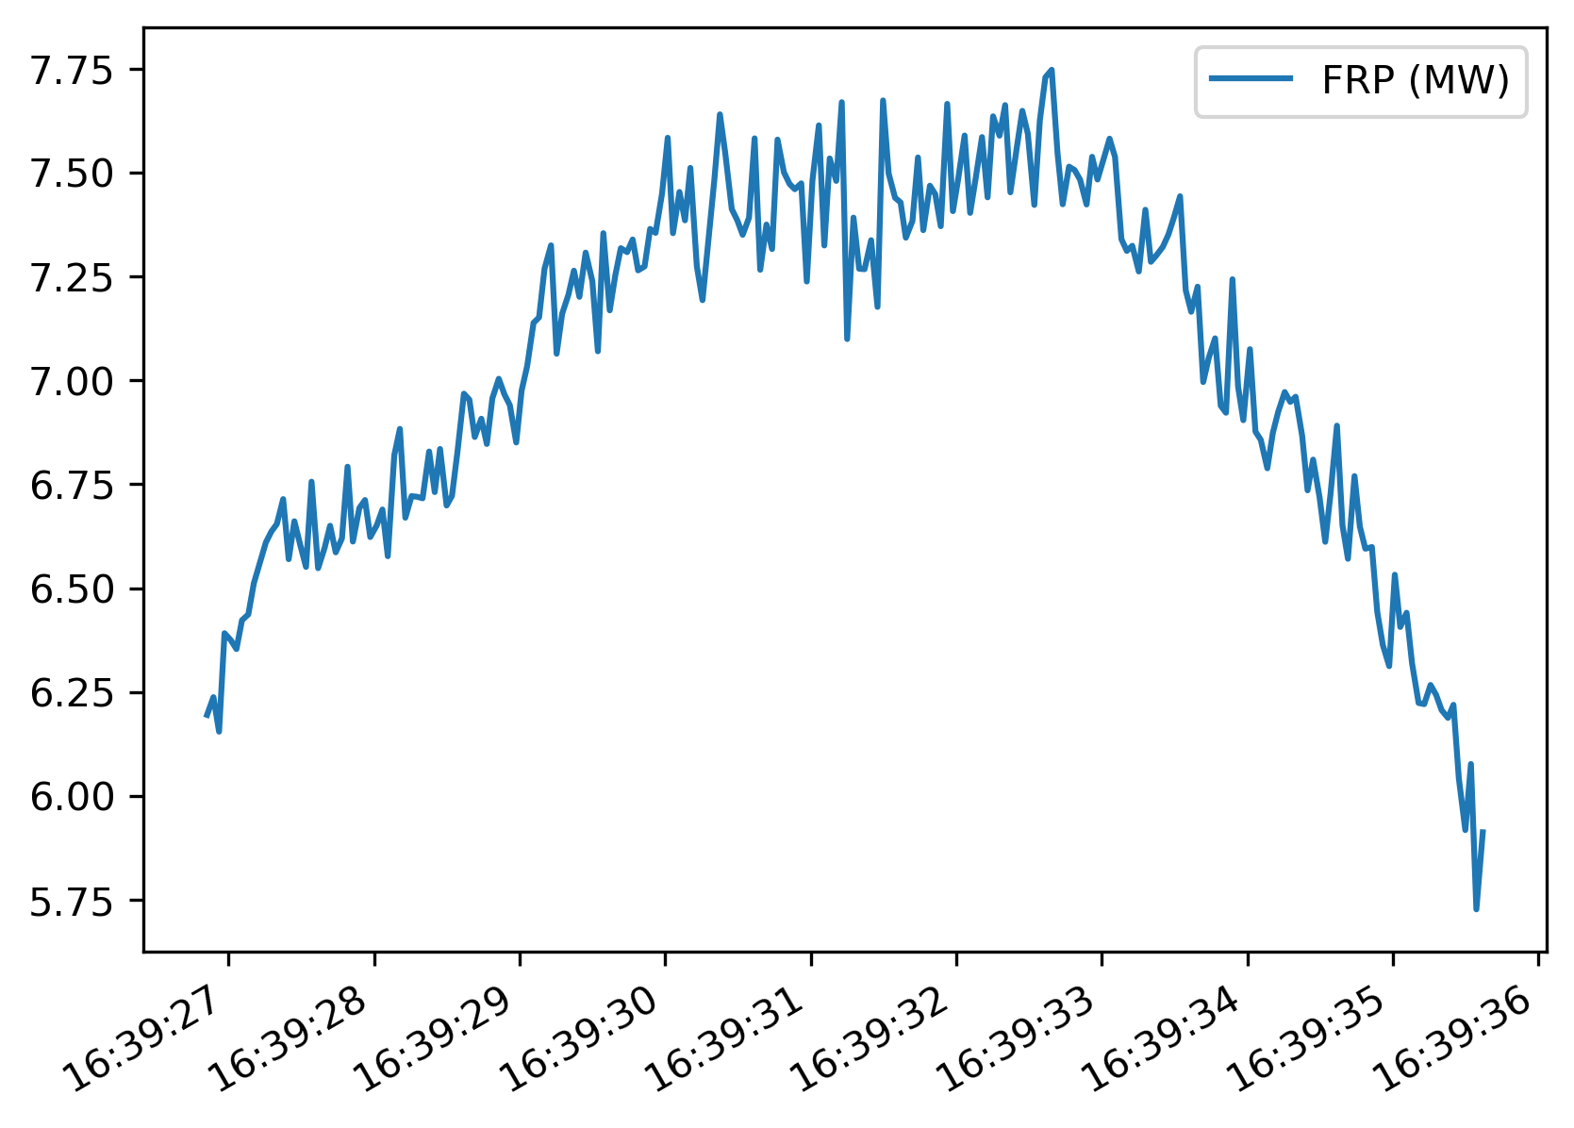
Results
FIDEX (2018) & FIDEX-2 (2023) – Ontario, Canada Matchup with S3A&B:
  All points collected within the ‘factor of x2’ uncertainty resulting from the PSF and overlapping pixels of SLSTR
  Higher airborne-derived than satellite-derived FRP for >200MW fires
  Suggests future campaigns should investigate large fires, possibly by flying higher
Project
Courtesy of Farrer Owsley-Brown, KCL
FRM
Validation
Motivation
Fiducial Reference Measurements for Fire (FRM4fire) FRM Workshop – May 2026

Slide 6
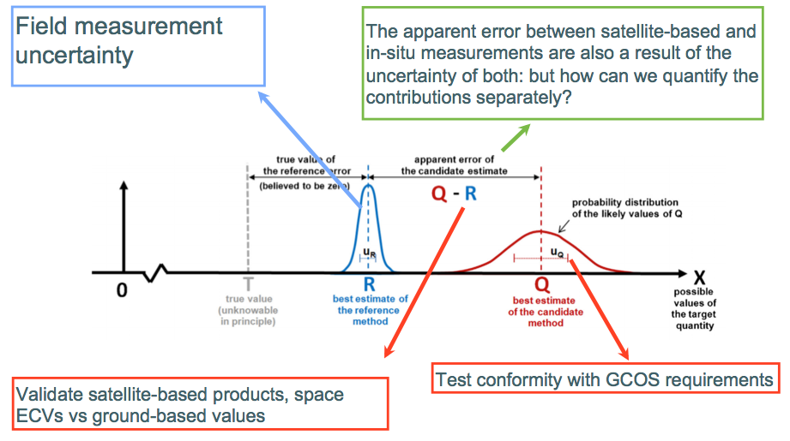


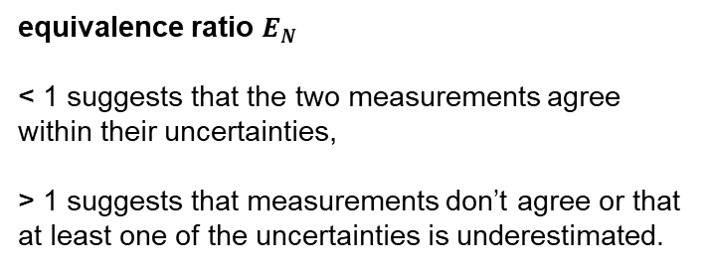
Results
The role of metrology in validation
Project
equivalence ratio $E_{N}$
< 1 suggests that the two measurements agree within their uncertainties,
> 1 suggests that measurements don’t agree or that at least one of the uncertainties is underestimated.
FRM
Validation
Widlowski, 2015
Motivation
Fiducial Reference Measurements for Fire (FRM4fire) FRM Workshop – May 2026

Slide 7
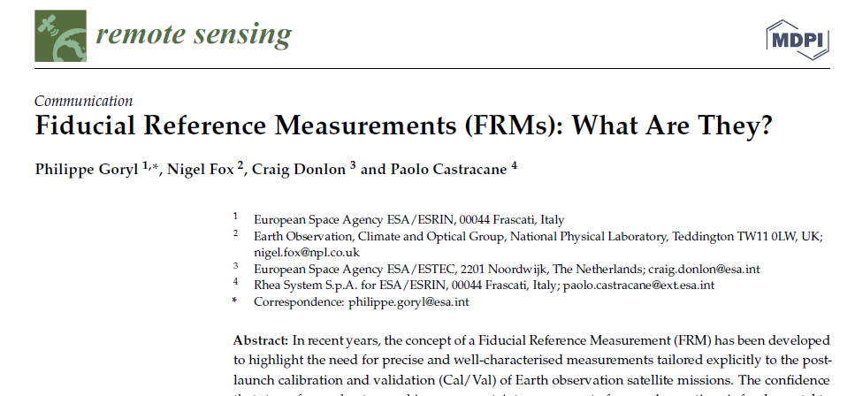
Results
Fiducial Reference Measurements (FRM)
Project
characteristic | description
Traceability | documented evidence of their traceability to a community agreed reference ideally tied to the International System of units, SI
Independence | measurements are independent from the satellite geophysical retrieval process
Uncertainty budget | comprehensive uncertainty budget for all instruments and processed measurements (transformation of the measurand to match the measurand of the satellite product)
Documented protocols | measurement protocols, procedures and community wide quality management practices (measurement, processing, archive, documents, etc.) are defined
Accessibility | datasets, including metadata and reports documenting processing, are accessible to other researchers, allowing independent verification of processing
Representativeness | representativeness of the FRM to that of the satellite observation as well as the satellite to FRM comparison process are thus required to be documented and the uncertainty assessed
Adequacy of Uncertainty | uncertainty of the FRM, including the comparison process, must be commensurate with the requirements of the class of satellite sensor they are specified to support
Utility | are designed to apply to a class of satellite missions. They are not mission-specific
FRM
“a suite of independent, fully characterised, and traceable (to a community agreed reference, ideally SI) measurements, tailored specifically to address the calibration and validation needs of a class of satellite borne sensor and that follow the guidelines outlined by the GEO/CEOS Quality Assurance framework for Earth Observation (QA4EO).”
Validation
Motivation
Fiducial Reference Measurements for Fire (FRM4fire) FRM Workshop – May 2026

Slide 8
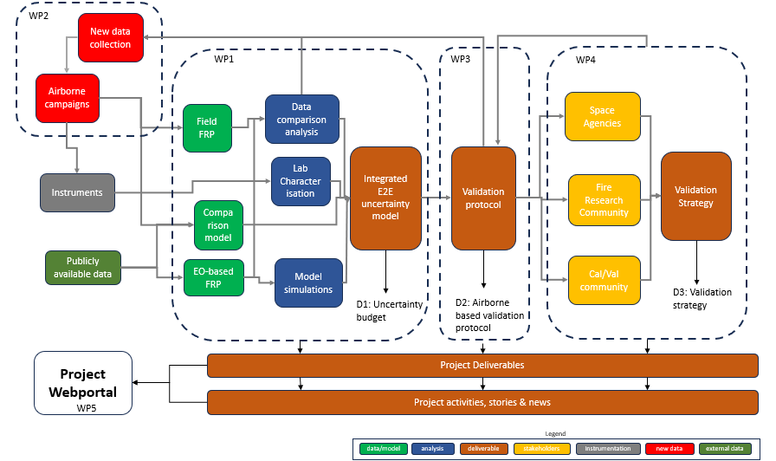
FRM4Fire project framework – phase 1
Results
Project
FRM
Validation
Motivation
Fiducial Reference Measurements for Fire (FRM4fire) FRM Workshop – May 2026

Slide 9
Results
WP1.1
QA4EO characterization
Framework
WP1.2
Characterization through sensitivity and comparison analysis
WP1.3
Characterization through Modelling
WP1.1
Lab based calibration and unc. characterization
Review of the S3 FRP retrieval algorithm and airborne based measurements approaches for validation purposes [T1.1.1]
uncertainty tree diagram and effects tables for the Sentinel-3 L2 FRP product [T1.1.2]
uncertainty tree diagram and effects tables for the airborne based measurements [T1.1.3]
uncertainty tree diagram for the validation comparison model [T1.1.4]
combined uncertainty propagation model [T1.1.5]
Define pathway for algorithm improvement based on sensitivity study on uncertainty reductions [T1.1.6]
temporal mismatch between EO and airborne data for the S3 overpasses time using geostationary FRP retrievals [T1.2.1]
Characterise S3 active fire detection envelope with respect to fire size using high resolution [T1.2.2 ]
Exploit Sentinel 3 tandem mission data for FRP to accounting for any known issues with radiometry outside of the calibration ranges [T1.2.3]
Characterise angular and geometrical effects using SLSTR oblique and nadir view data, to account for the sensor's point spread function [T1.2.4]
Comparison of contemporaneous FRP from SEVIRI and SEVIRI IODC over thermal anomalies viewed by both sensors [T1.2.5]
spectral response function and waveband Selection [T1.3.1]
fire location within a pixel using SEVIRIs PSF [T1.3.2]
impact of vegetation structure and land surface heterogeneity on FRP using RTM [T1.3.3]
DART model to simulate smoke plumes and their impact on FRP retrieval [T1.3.4]
sensitivity analysis on the FRP retrievals in the presence of smoke plumes to give an indication of errors associated with concentration levels [T1.3.5]
diurnal variability of surface temperature on FRP retrievals an impact on sensor intercomparisons [T1.3.6]
angular effects stemming from the location of the fire within the swath and evaluate its influence in SLSTRs image acquisition [T1.3.7]
atmospheric gases and band averaged transmission vs. actual transmission on FRP [1.3.8]
Using simulated data, investigate the detectable fire size for the range of fire temperatures and surface conditions [T1.3.9]
Documented operational and processing chains [T1.4.1]
Calibration and operation procedure review [T1.4.2]
Geometric Calibration of the MWIR imager through a collimator at different integration times and temperature setpoints [T1.4.3]
KCL support to NPL Lab Characterisation of MWIR Imager [T1.4.4]
Characterization of the MWIR imager PSF and MTF using a collimator at different integration times and temperature setpoints [T1.4.5]
A calibration validation of the MWIR imager at a single temperature setpoint for the 4 operating integration times [T1.4.6]
Characterisation of the MWIR spectral response function [T1.4.7]
Project
FRM
Validation
Motivation
Space SENSOR
ENVIRONMENT
Airborne SENSOR
OBSERVATIONAL
Fiducial Reference Measurements for Fire (FRM4fire) FRM Workshop – May 2026

Slide 10
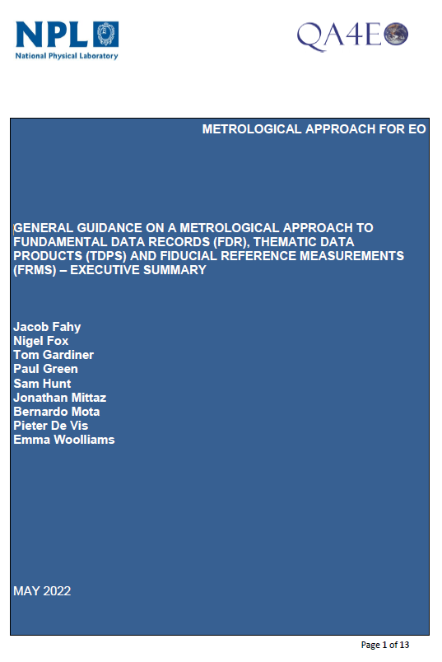


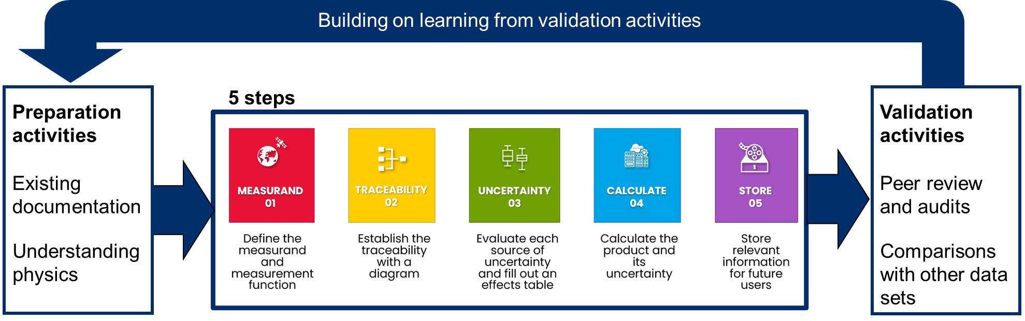
Results
QA4EO Five Steps to an Uncertainty Analysis
Built on the JCGM Guide to the Expression of Uncertainty in Measurement (GUM)
Project
FRM
Validation
Motivation
Fiducial Reference Measurements for Fire (FRM4fire) FRM Workshop – May 2026

Slide 11
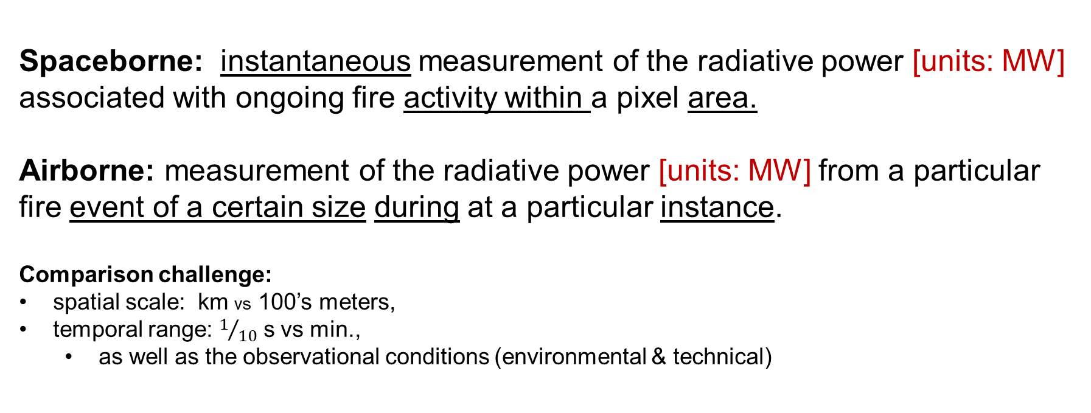
Results
FRP validation using airborne-based reference measurements
Project
Spaceborne: instantaneous measurement of the radiative power [units: MW] associated with ongoing fire activity within a pixel area.
Airborne: measurement of the radiative power [units: MW] from a particular fire event of a certain size during at a particular instance.
Comparison challenge:
spatial scale: km vs 100’s meters,
temporal range: $1/{10}$ s vs min.,
  as well as the observational conditions (environmental & technical)
FRM
Validation
Motivation
Fiducial Reference Measurements for Fire (FRM4fire) FRM Workshop – May 2026

Slide 12
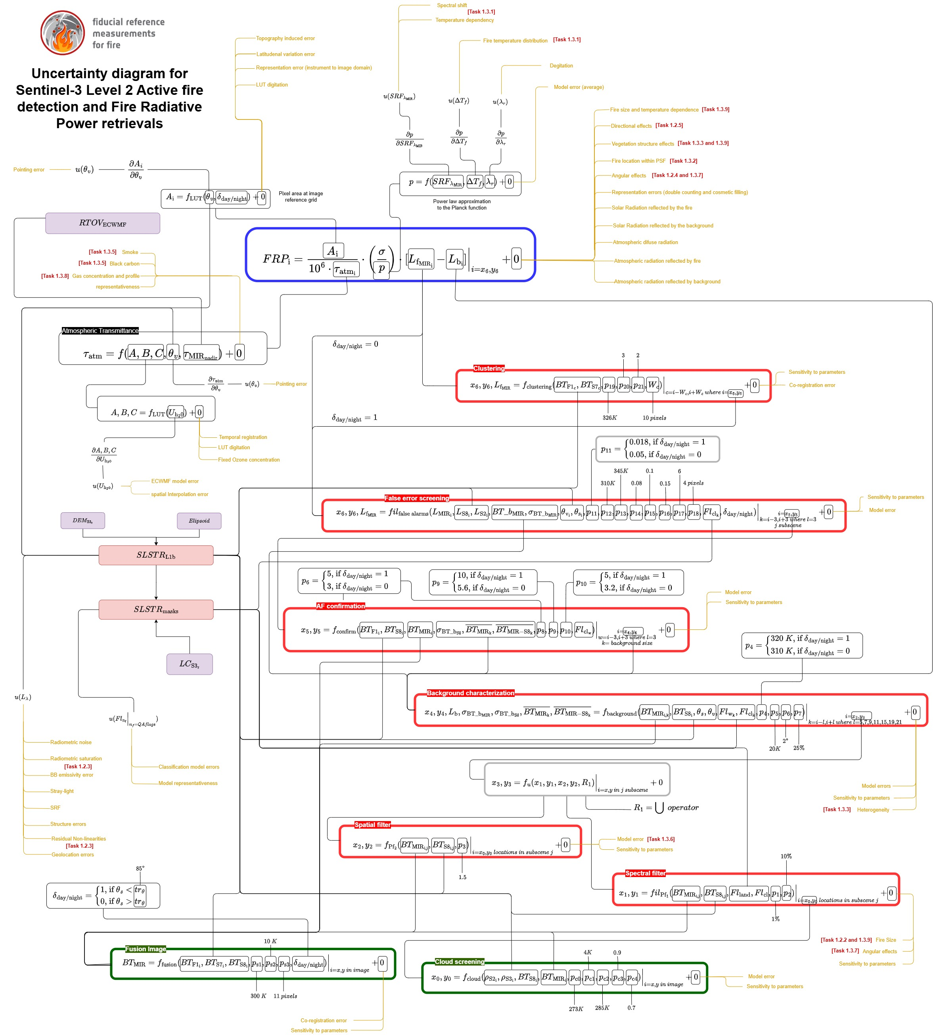
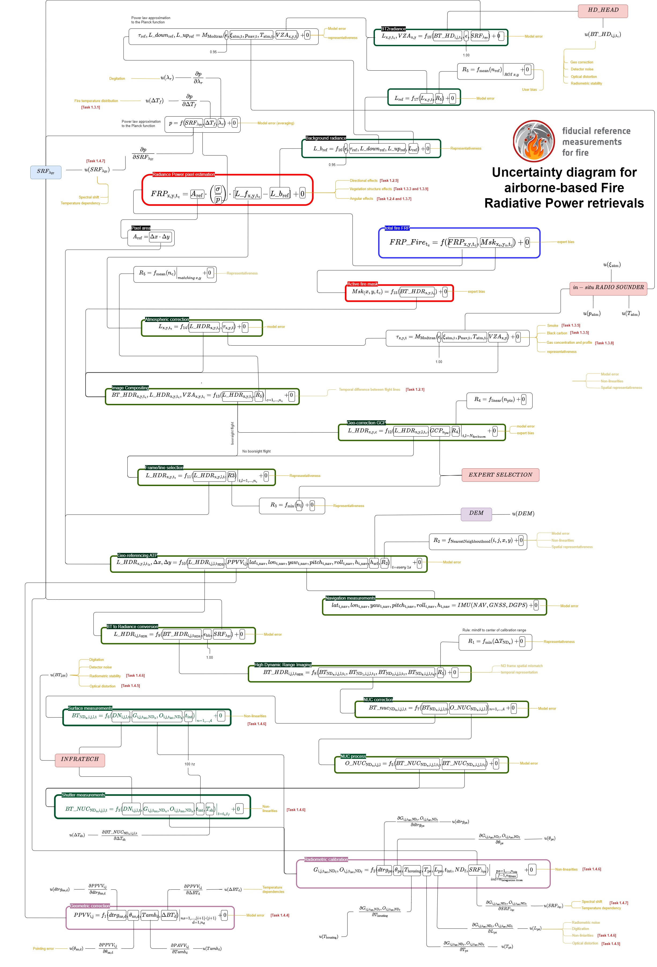
Uncertainty Characterization
Results
Spaceborne
Airborne
Project
FRP measurement function
FRM
AF detection processor
Validation
Motivation
Data pre-processor
Pre-flight calibrations

Slide 13
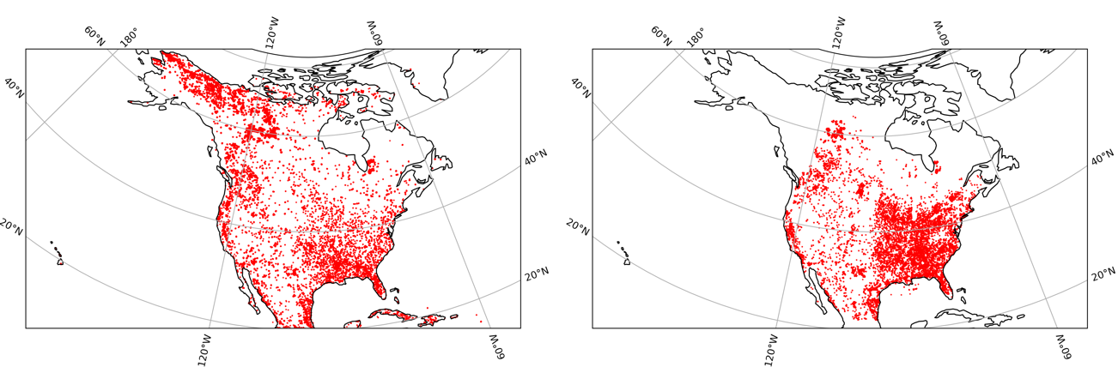
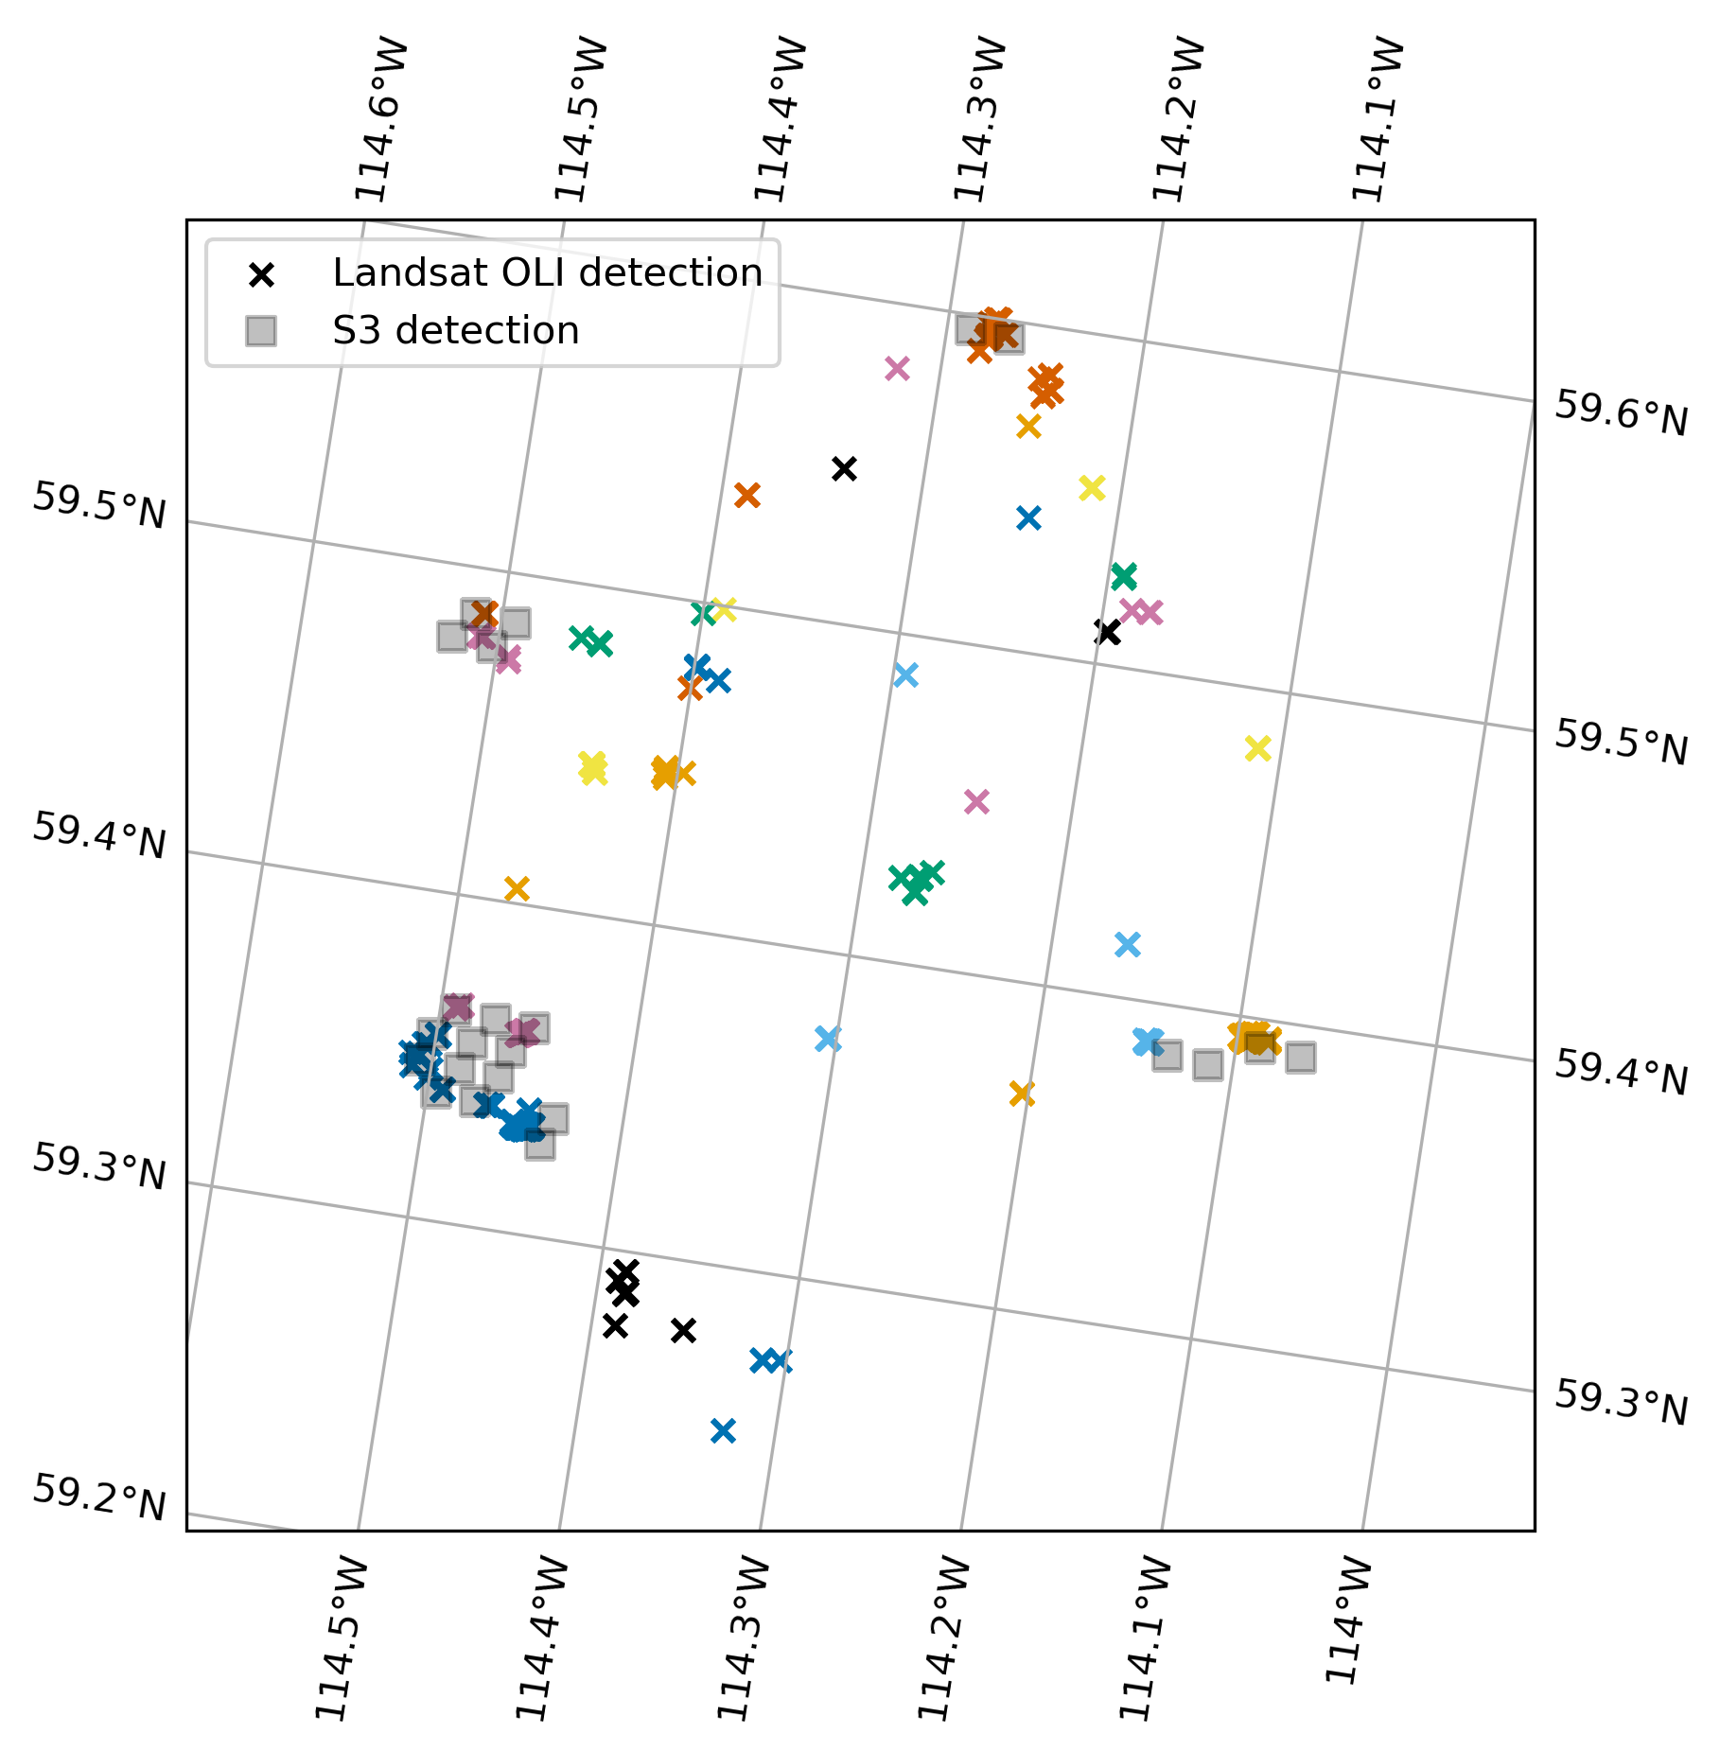
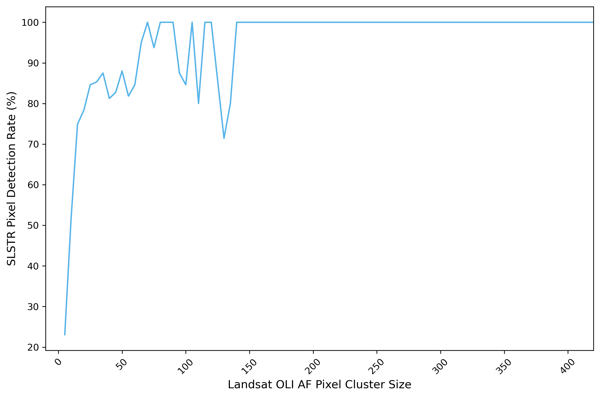
Results
Fire size to achieve detection
(pre-deployment planning)
Comparison between Sentinel 3/SLSTR and Landsat 8/OLI active fire detection over North America
Project
S3 detection rate | # Landsat pixels | S3 pixel size
~50% | 8 | ~1%
~82% | 50 | ~5%
100% | 150 | ~15%
FRM
Validation
Motivation
Fiducial Reference Measurements for Fire (FRM4fire) FRM Workshop – May 2026

Slide 14
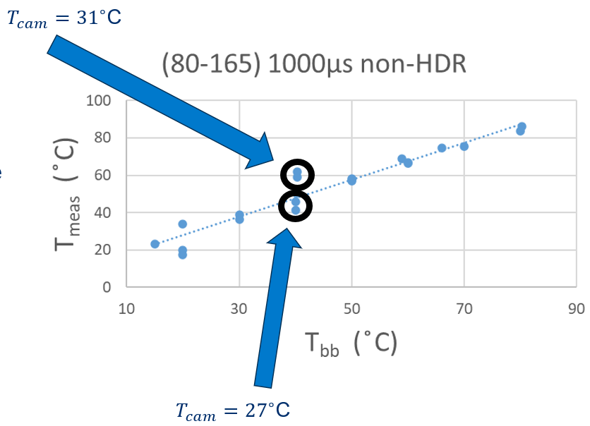
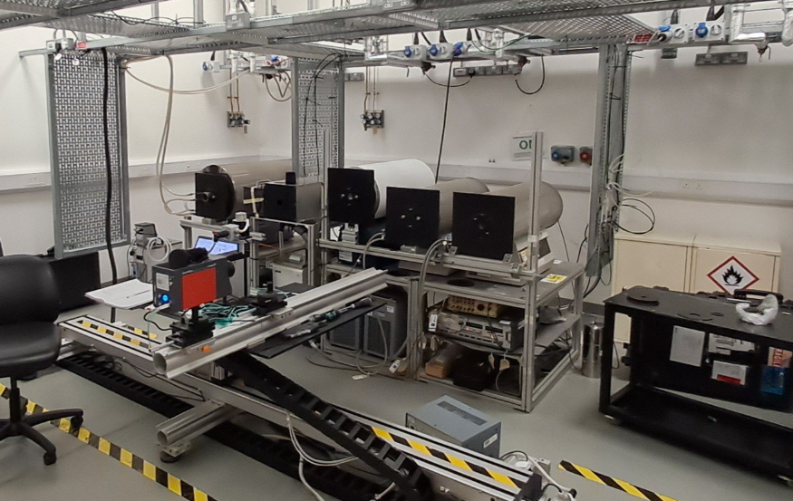
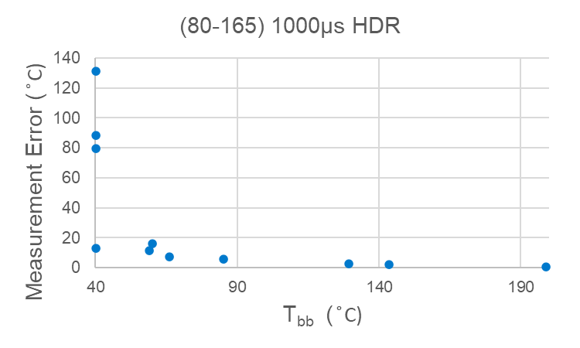
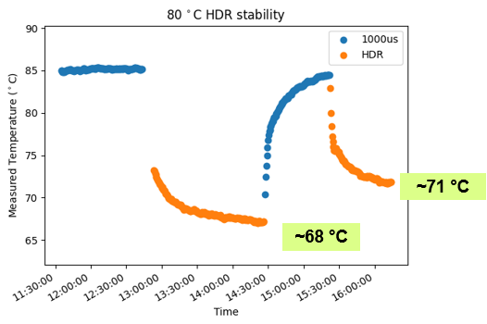
Results
Lab-based measurements for thermal camera temperature Evaluation
(instrument calibration)
Validation setpoints taken to ensure device is behaving within specifications (HDR mode within or better 2% accuracy)
Measurements were taken with thermal imager to determine how low device can measure to enable better background temperature measurements
Carried out investigations to better understand impact of various factors on uncertainties
Project
FRM
Validation
Motivation
HDR mode not suitable for background temperature measurements
(T>100 ̊ C ~ 2 ̊ C bb)
Fiducial Reference Measurements for Fire (FRM4fire) FRM Workshop – May 2026

Slide 15
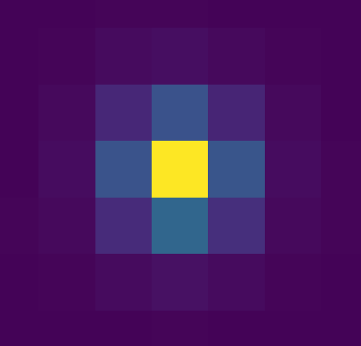
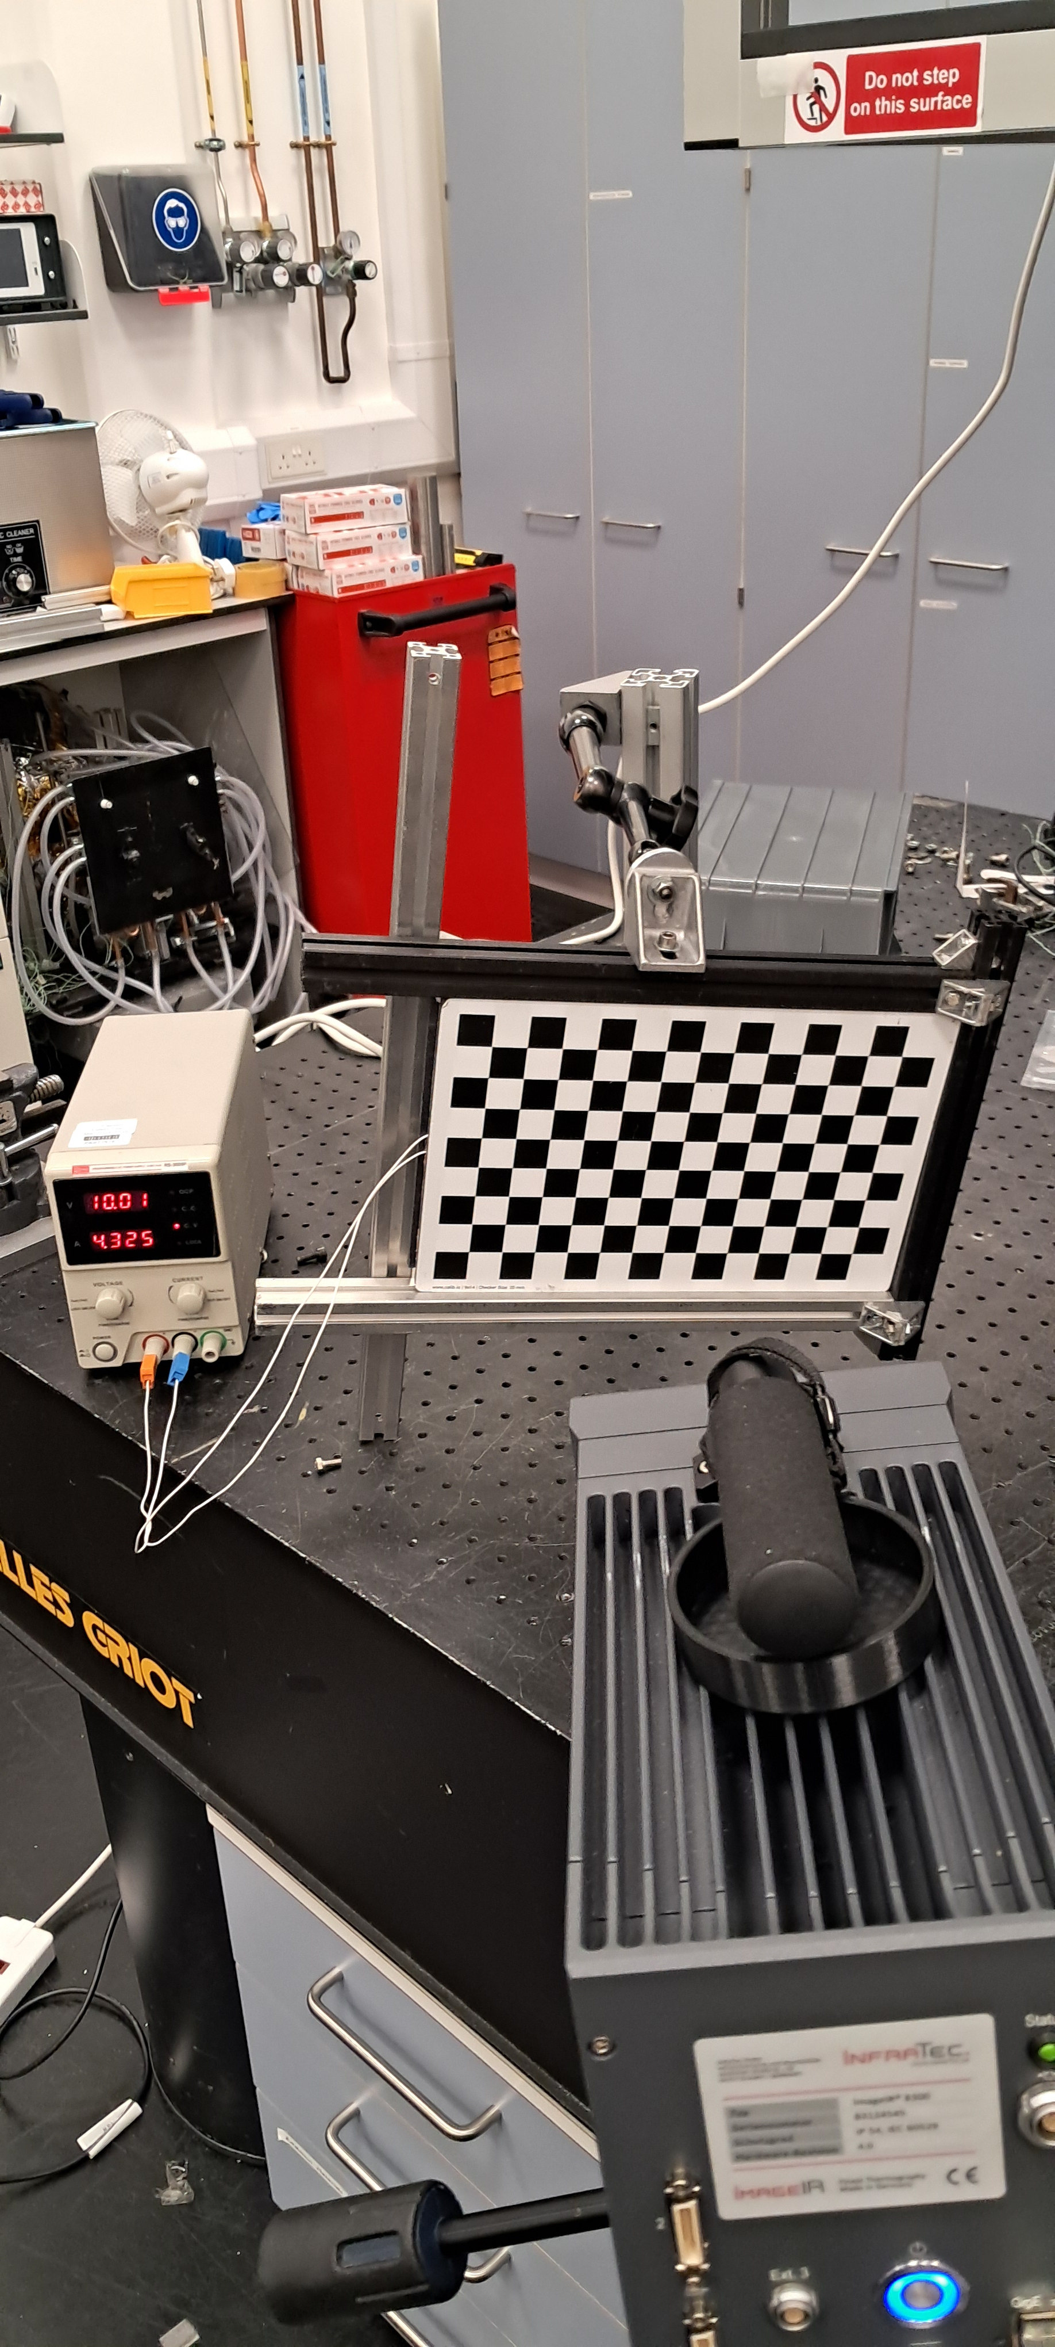
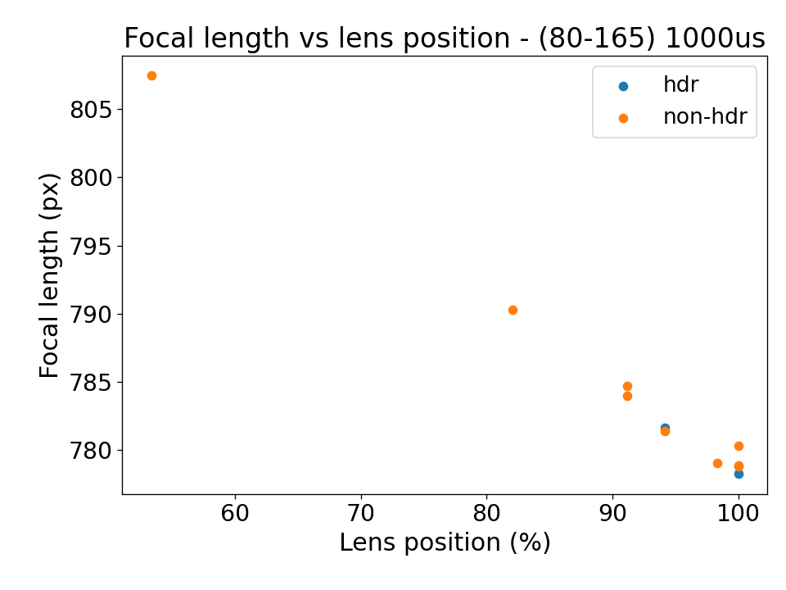
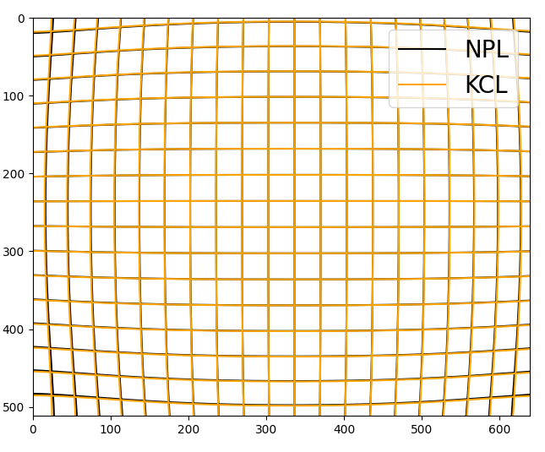
Results
Geometric Calibration and PSF
calibration performed to better characterize camera intrinsic parameters and calculate more accurate per pixel viewing vectors (PPVV)
Measurements carried out to calculate point spread function (PSF) of device
Project
Pinhole aperture approach, scanning across in small steps0.5mm aperture at 1.5m (~10% of a pixel) at 0.02mm steps up to 95% of infinity
FRM
Validation
Motivation
  300×200 mm checkerboard target back heated to temperature ~55 ̊C
Fiducial Reference Measurements for Fire (FRM4fire) FRM Workshop – May 2026

Slide 16
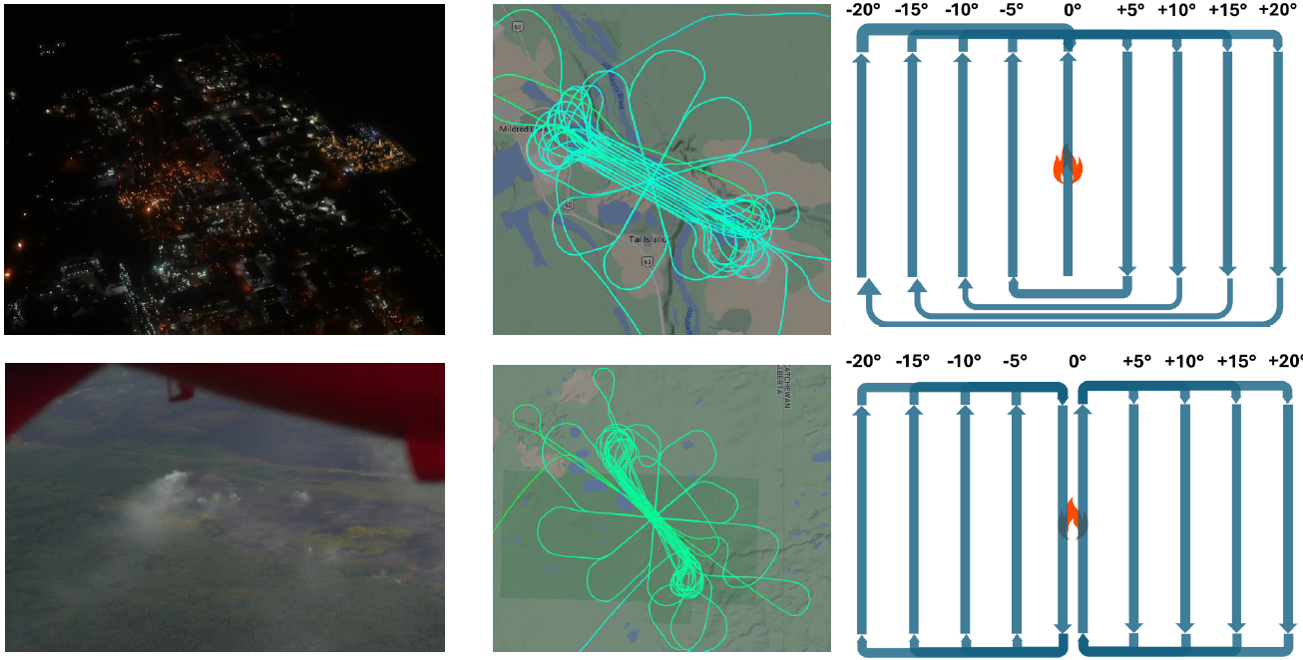
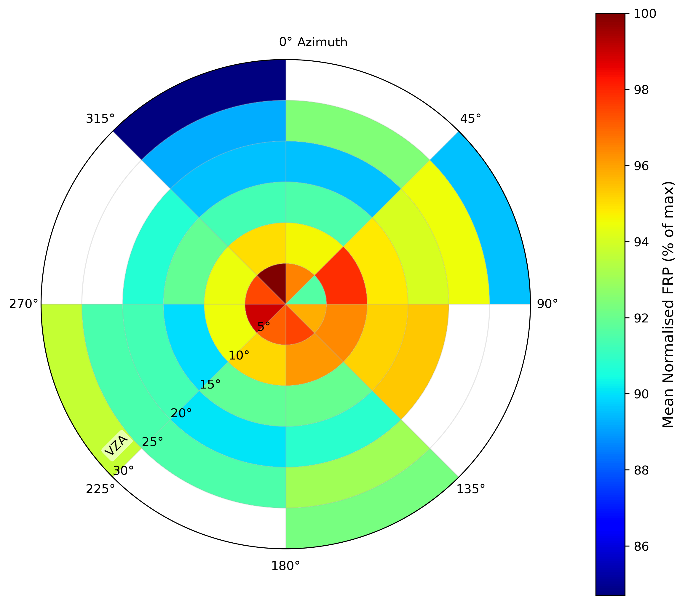
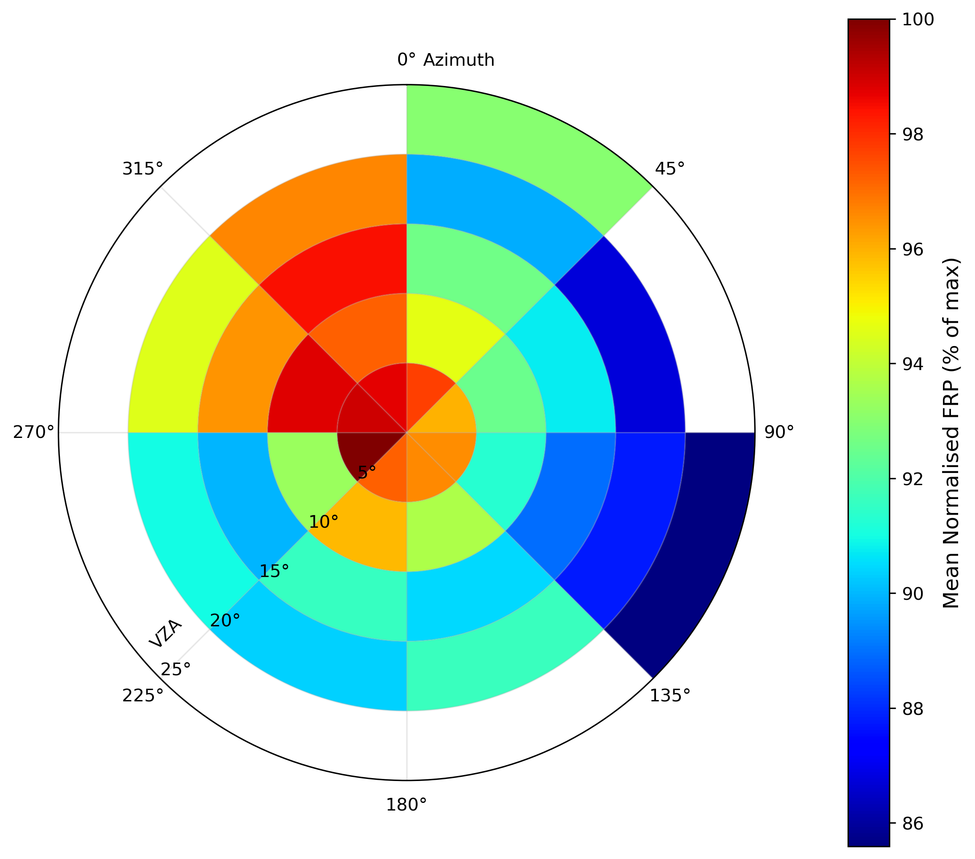
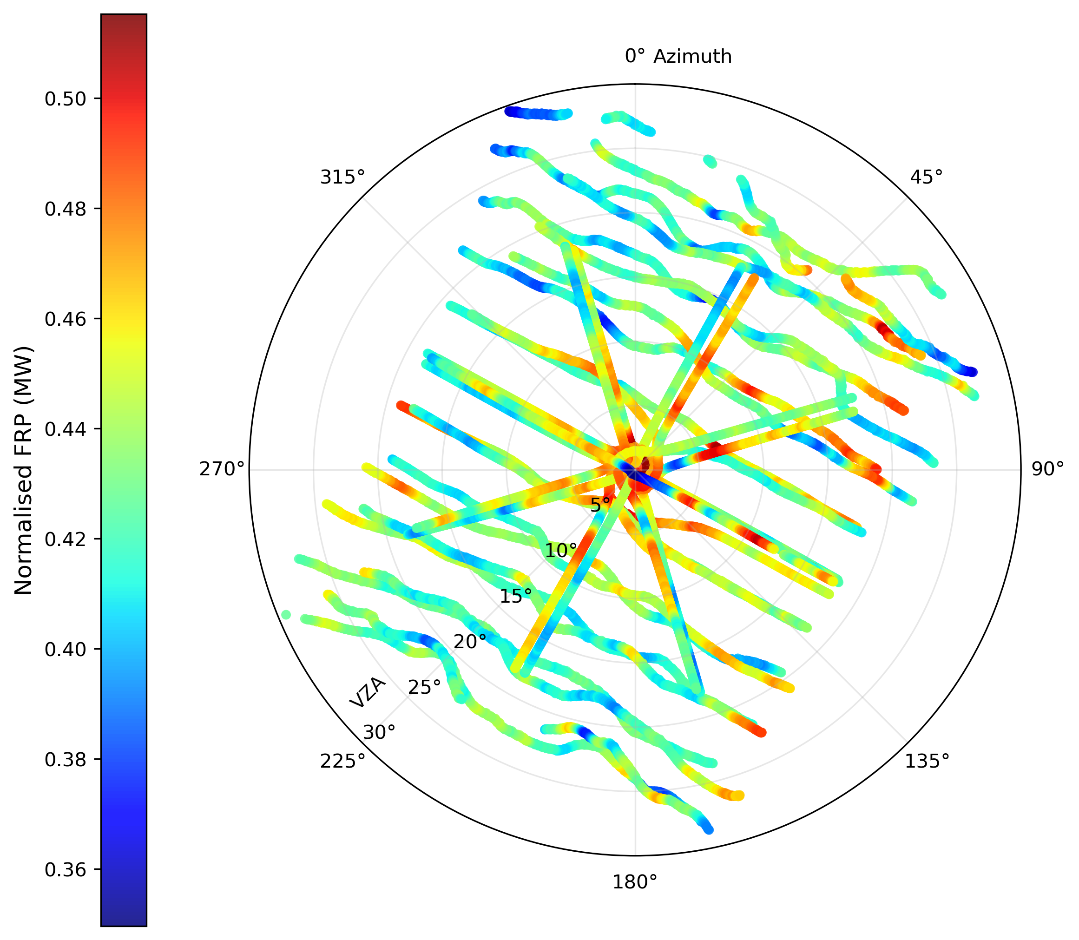
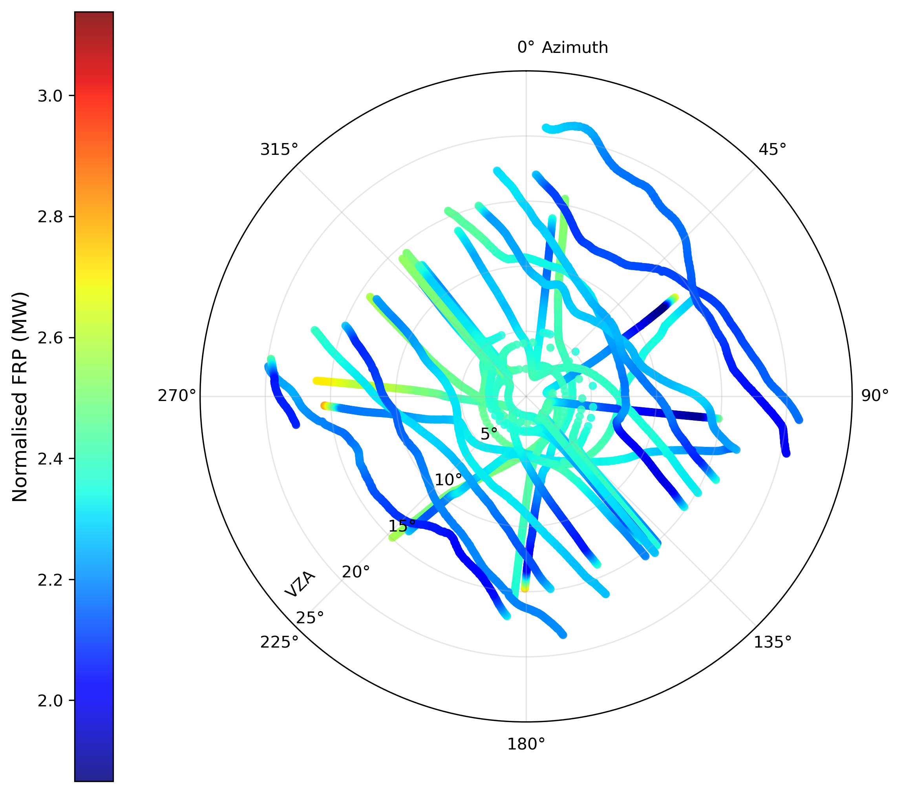
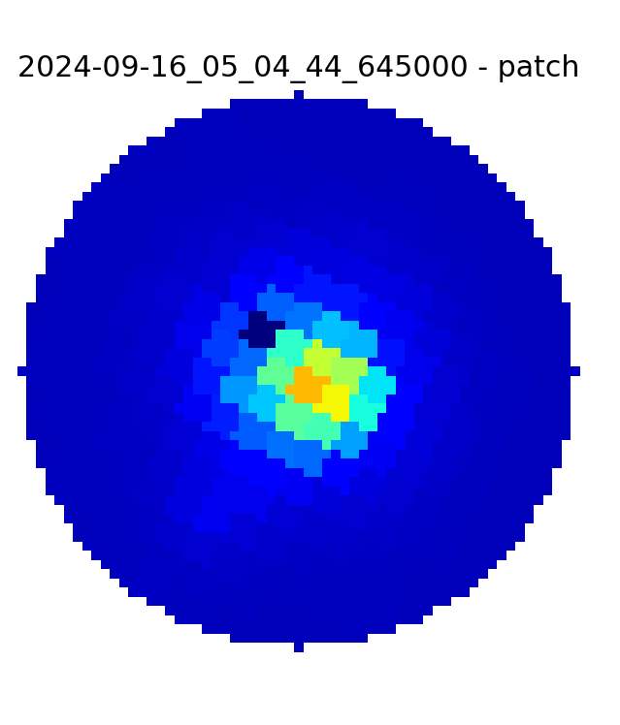
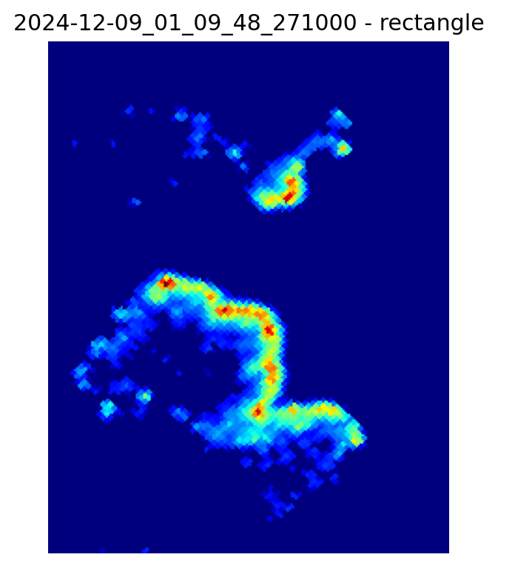
Opportunity for gathering new data
Results
Tagged along the CarbonARA campaign (Sep 2024) over Alberta Canada, to measure FRP over gas flares and a wildfire to assess angular effects (vegetation and sensor)
Created flightplans: Star/sunflower patterns (view target from all azimuth angles)
Parallel lines (view target across FOV/all VZAs)
Project
Gas Flare
Wildfire
FRM
Validation
Motivation
Fiducial Reference Measurements for Fire (FRM4fire) FRM Workshop – May 2026

Slide 17
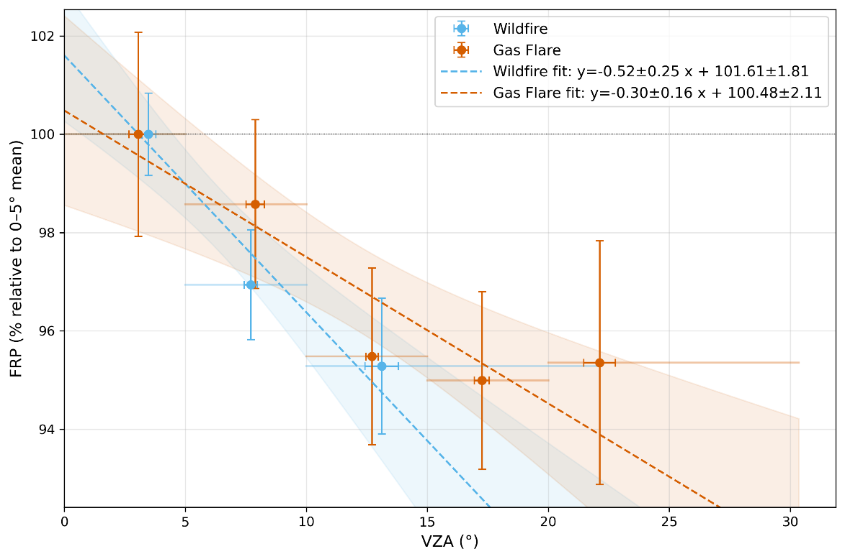
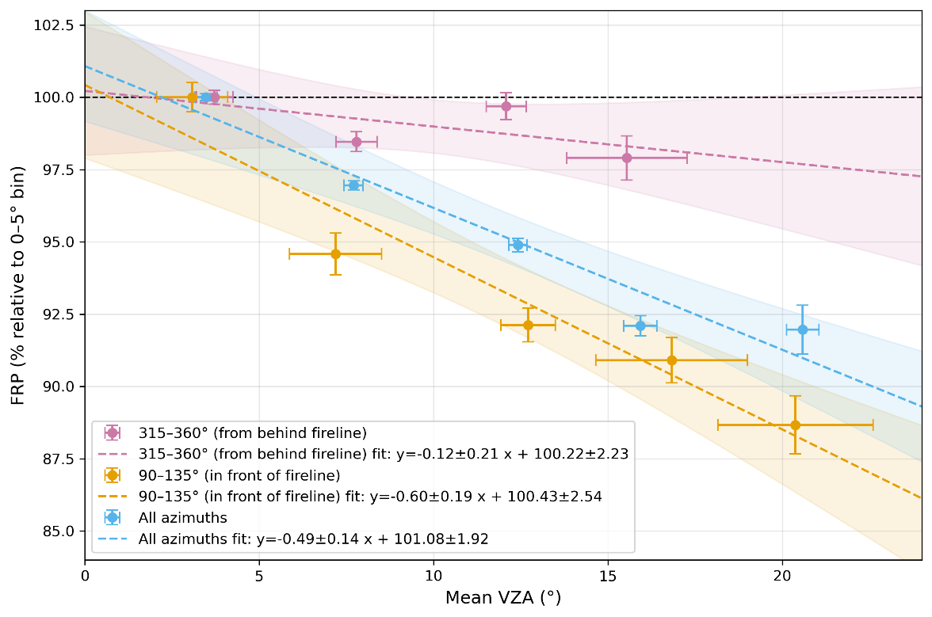
Results
Directional effects
Project
VZA-FRP relationship for the wildfire, by azimuth sector.
Mean VZA-FRP relationship for the gas flare and wildfire, averaged over all azimuth angles.
FRM
Validation
Motivation
Fiducial Reference Measurements for Fire (FRM4fire) FRM Workshop – May 2026

Slide 18
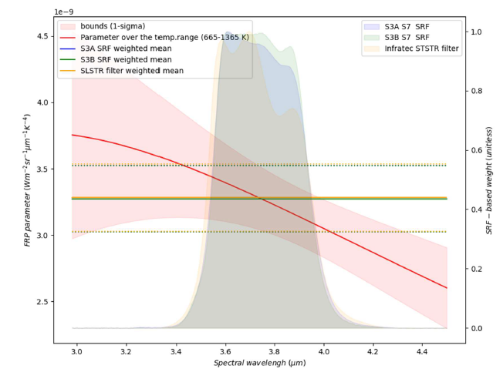
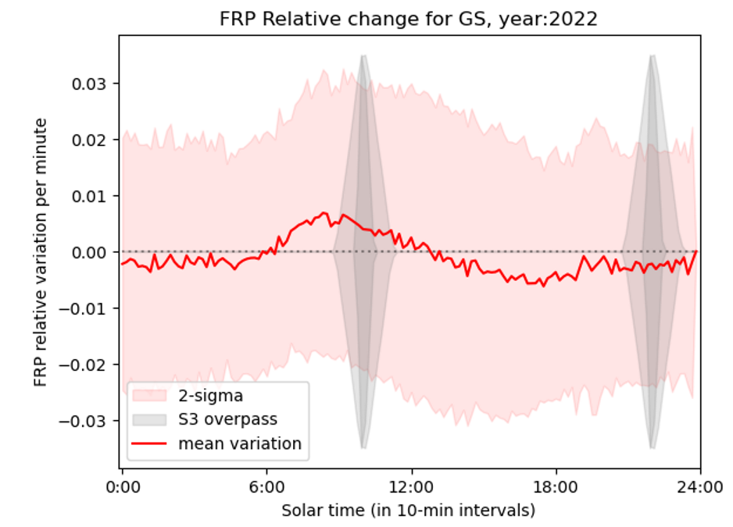
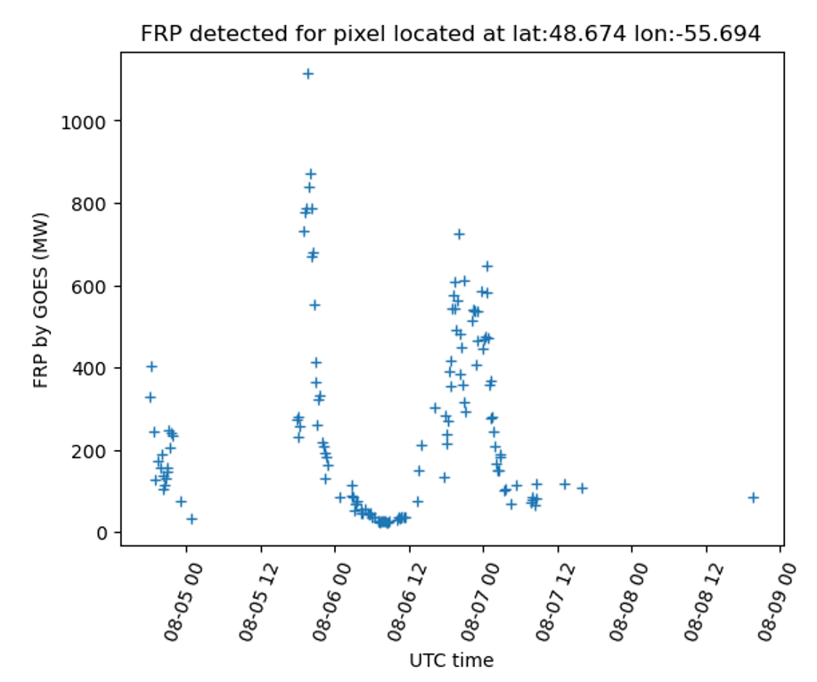

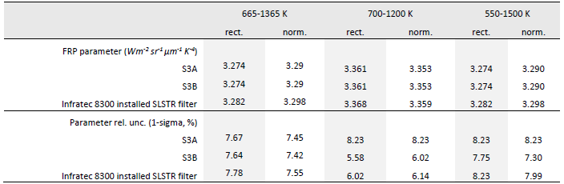
Temporal mismatch
Results
Spectral response function and waveband Selection
extract rate of change of FRP as detected from geostationary satellite sensor
Temporal interpolation is assumed linear within the sat detections
Sat detection information aggregated by solar cycle
Project
FRM
±2%/min
Validation
note: plane takes 2 min to turn around
Motivation
Fiducial Reference Measurements for Fire (FRM4fire) FRM Workshop – May 2026

Slide 19
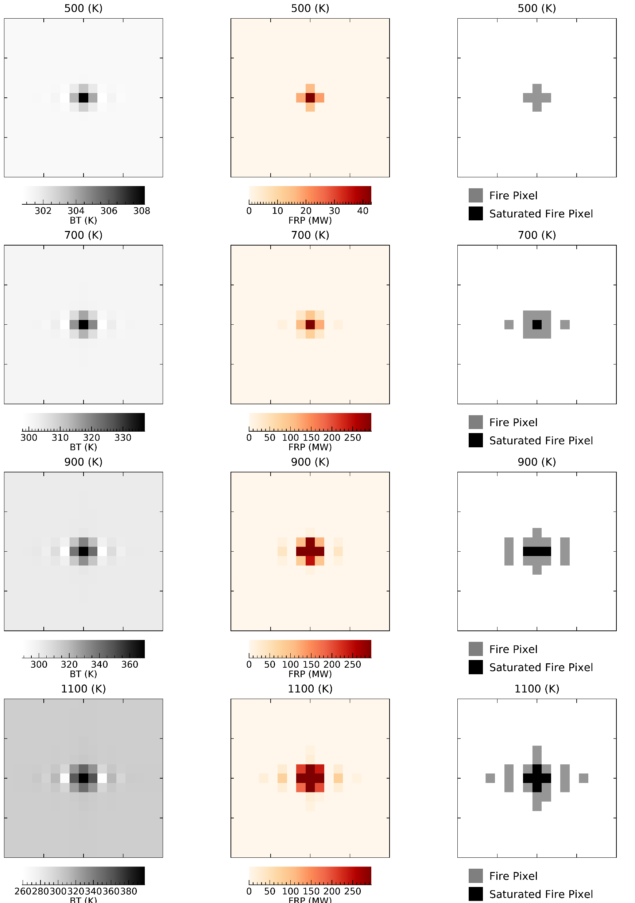
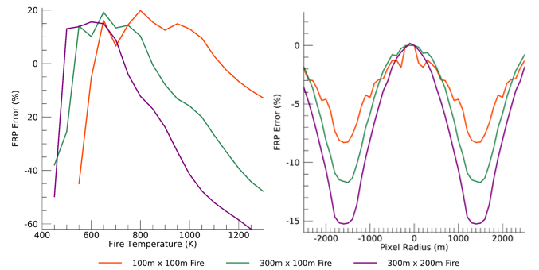
Impact of fire’s location in IFOV
(using MSG PSF model)
Simulated
Results
Pixel
Detections
MWIR BT
FRP
Simulated this effect using SEVIRI imaging characteristics for 3 fire sizes (1, 3 and 6 ha) and fire uniform temperatures (500 K - 1300 K)
Distribution of fire emitted radiance into neighbouring pixels evident
Project
FRM
9.9%
(no saturation)
Validation
-11.7%
(inc. saturation)
-5.2%
(dif to nadir)
Motivation
Fiducial Reference Measurements for Fire (FRM4fire) FRM Workshop – May 2026

Slide 20
Project outcomes
Results
QA4EO framework approach to characterized uncertainties provided a useful insight on the identification and the role uncertainties play, and the base to develop an uncertainty propagation model and a Validation Protocol for Spaceborne FRP retrievals using airborne measurements that is F4P.
The lab-based characterisation of the MWIR thermal camera: improved geometrical correction (PPVV’s) and understanding of its operational limits for the measuring fire and background temperatures.
Unaccounted uncertainty related to the satellite pixel area as is currently processed (~5% contribution).
PSF simulations of location of the fire within a pixel can introduce significant errors (~-5.2%)
FRP parameter (p) defined using certain assumptions about temperature range and distribution that need to be standardised (Including sensor SRF) to enable meaningful comparisons and ensure interoperability -> community-agreed estimation standard.
Uncertainty due to temporal differences between satellite and airborne overpass (up to 2% per minute) Identification of a minimum size of fire-affected area of the size ~170 Landsat OLI pixels to ensure 100% detection by Sentinel-3 STSTR (over North America).
Directional effects were identified in airborne-based observational FRP retrievals linked with environmental factors such as vegetation occlusion and the three-dimensional geometry of hotspots.
Project
FRM
Validation
Motivation
Fiducial Reference Measurements for Fire (FRM4fire) FRM Workshop – May 2026

Slide 21
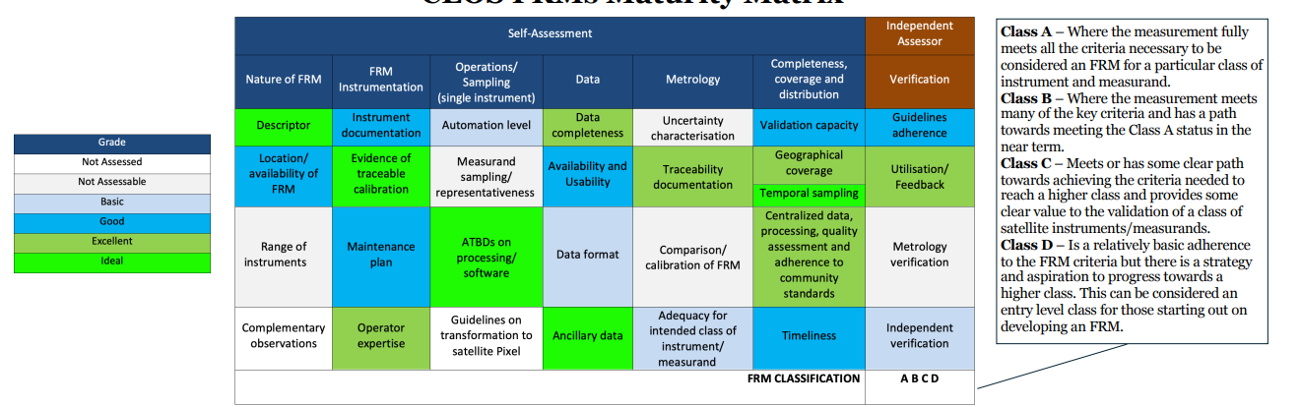
Long-term strategy (thinking of next phase)
Results
Illustrative example
Goryl et al., 2024
Project
FRM
Validation
Phase 1
Phase 2
Roadmap for improvements to improve FRM maturity class of FRP Retrieve
provide feedback to Cal/Val community of the proposed guidelines (validation constrains for fire FRMs) to be endorsed by CEOS
Motivation
Fiducial Reference Measurements for Fire (FRM4fire) FRM Workshop – May 2026

Slide 22
Results
FRM4fire Phase-2 plan
Further improve the E2E uncertainty propagation model taking account additional sources of uncertainties
  Sensitivity to algorithm parameters in the AF detection phase
  Characterising background temperature uncertainties
  Impact of vegetation and smoke on FRP retrieval
  Pixel area uncertainty
Potential improvements in validation protocols
  Spectral range exploration – can LWIR data can be used accurately? Experiment with combustion chamber to assess the impact of different smoke concentrations and path lengths
Tandem Phase preparedness
Interoperability with other missions, including 3rd party missions (future space)
Identified 2 potential airborne campaigns to tag along
Project
FRM
Validation
Motivation
Fiducial Reference Measurements for Fire (FRM4fire) FRM Workshop – May 2026

Slide 23

Results
Project
Thank you
(bernardo.mota@npl.co.uk)
FRM
Validation
Motivation
Fiducial Reference Measurements for Fire (FRM4fire) FRM Workshop – May 2026

