Slide 1
Ground-Based Observation For Validation
FRM Workshop – 18th May 2026
  R. Grousset¹, C. Lerebourg¹, J.-S. Carrière¹, G. Bai¹, J. Dash², S. Paramanik², F James², Z. U. Nisa², G. Mulualem², L. Brown³, A. Perez-Hoyos⁴, D. Ghent⁵, J. Anand⁵, R. Shukla⁵, J.-P. Muller⁶, R. Song⁷, M. Clerici⁸, N. Gobron⁸
  ¹ACRI-ST - ² University of Southampton - ³ University of Salford - ⁴Albavalor - ⁵University of Leicester - ⁶Blue Sky Imaging - ⁷University of Oxford - ⁸ Joint Research Centre

Slide 2



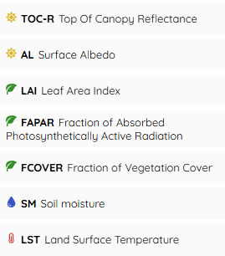
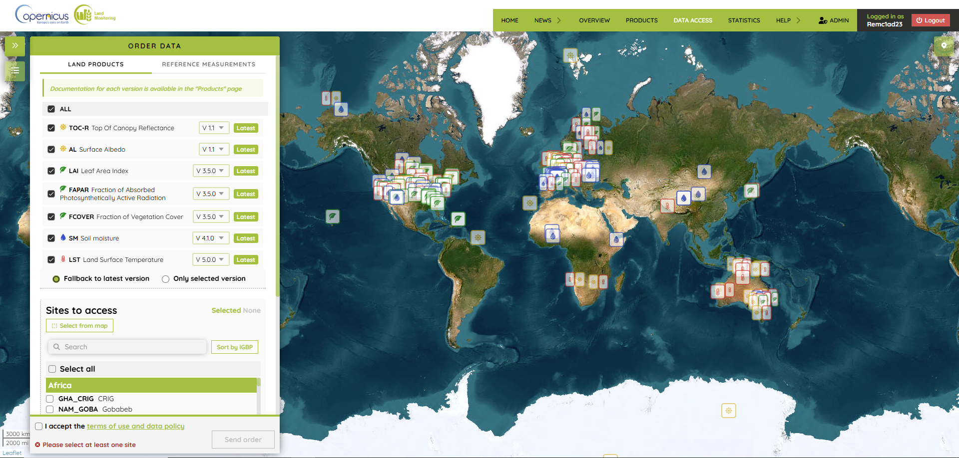
Ground-Based Observation for Validation
General Presentation
Part of the Copernicus Land Monitoring Service
Funded by the European Commission
Objectives :
Production of qualified validation dataset for routine CLMS products validation:
GBOV V2 Land Products
GBOV V3 New Products
GPP Gross Primary Production
NPP Net Primary Production
LSP Land Surface Phenology
ET Evapotranspiration
Make these products available via the data portal (https://gbov.land.copernicus.eu/):
Notes:
Décrire le CLMS et les produits à valider

Slide 3
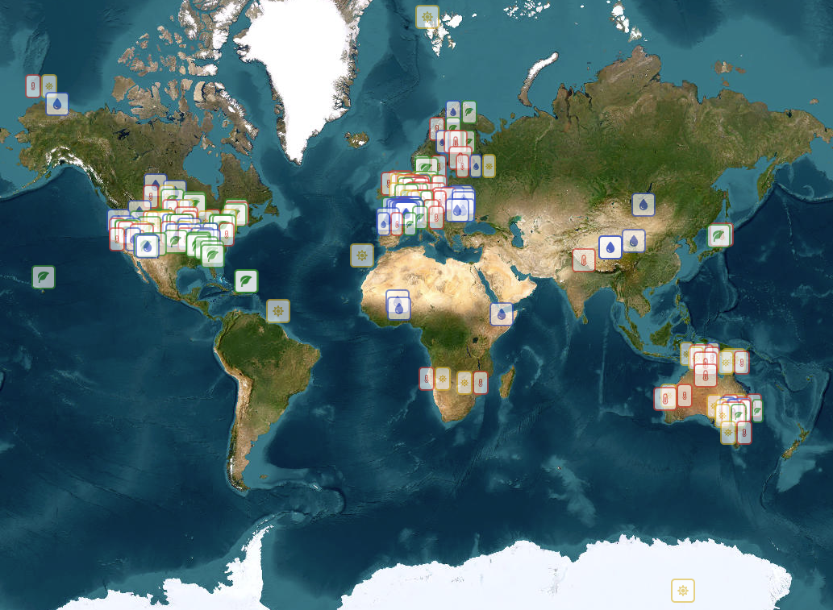







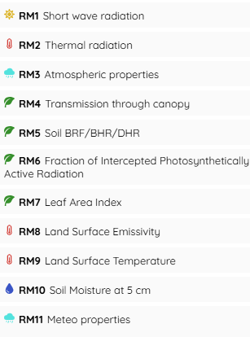
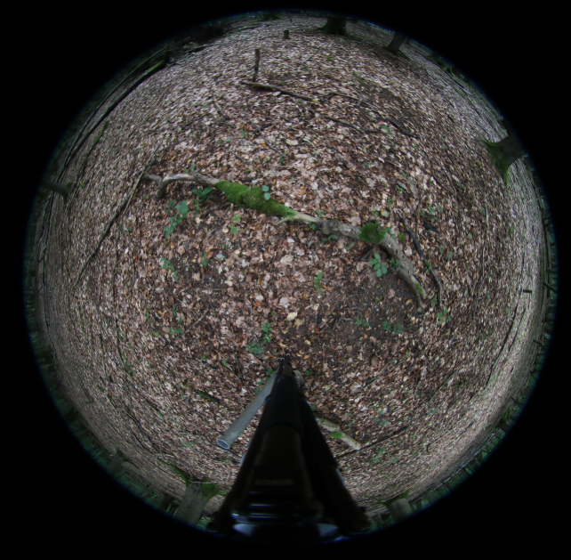
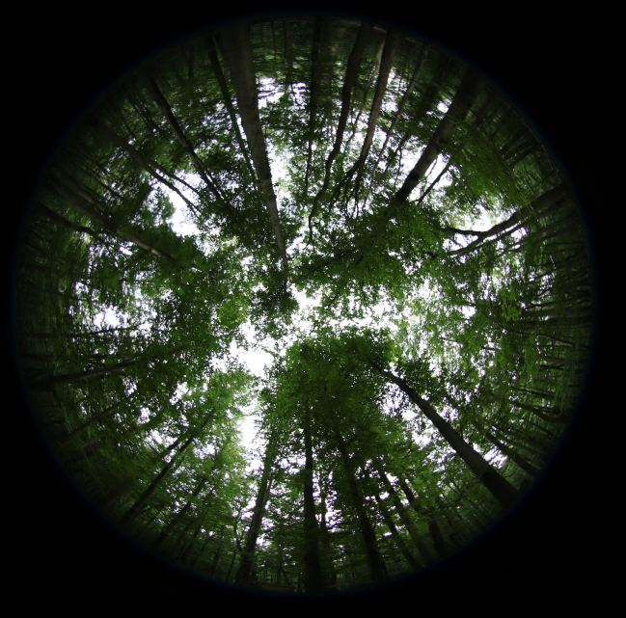
Component 1
Collection of ground-based measurements across the widest possible range of biomes through partner networks or GBOV sites (Component 2)
TERN, SurfRad, NEON, USCRN, ARM, ICOS, ISMN, BSRN, FluxNet
Harmonization and processing of ground-based data (Reference Measurements)
Short Wave Radiation
*and from this year RadCalNet and HyperNet data
DHPs (or PPFD)
Long Wave Radiation
Soil Moisture
Precipitations

Slide 4

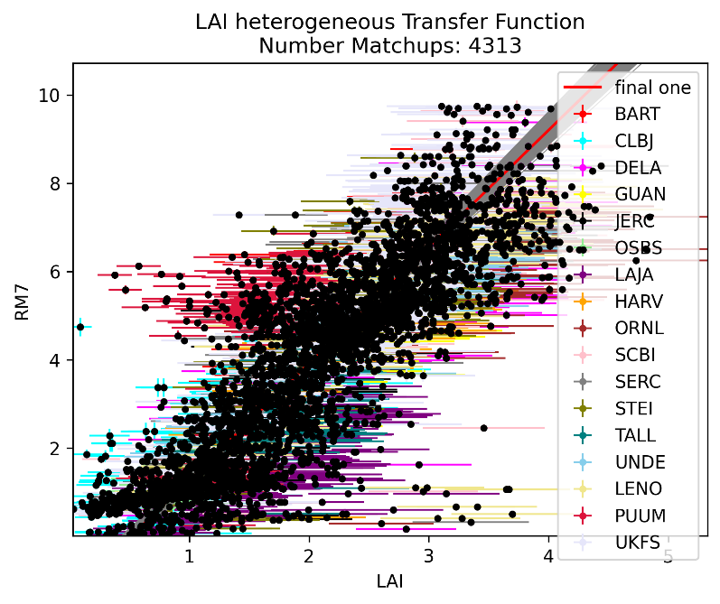
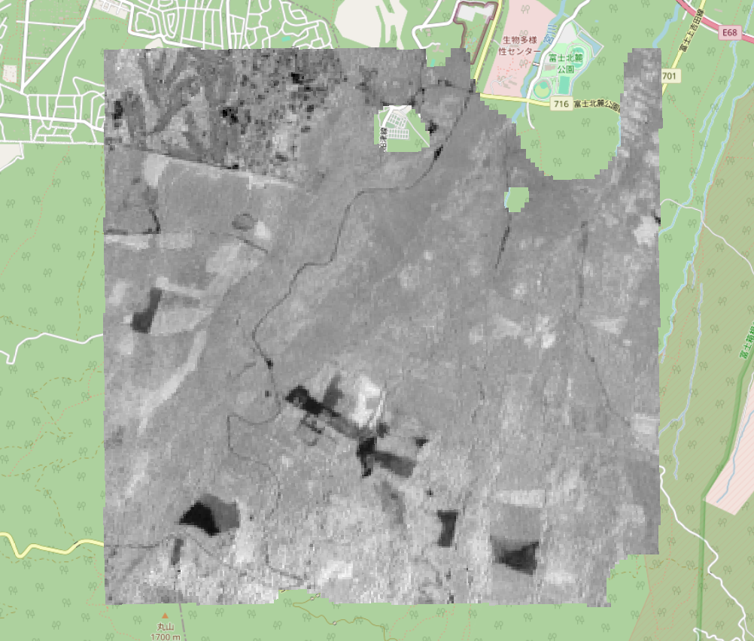
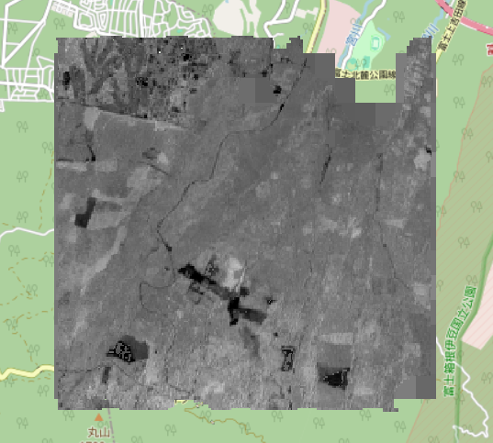
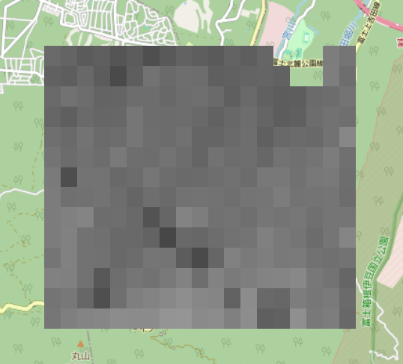
Component 1
Ground-based measurements upscaling (Land Products)
Upscaling
Intermediate resolution satellite products
Different from those used in the CLMS products (ESA-CCI LST, S2 SL2P, S3 LST, …)
RM
Point-based or high-resolution
LP
CLMS products resolution (300m, 1km, …)
Example: vegetation products (LAI, FAPAR, FCOVER)
One transfer function per vegetation type and land product
The transfer function must express all the Reference Measurements variability
SL2P data
RM
~20m by 20m ESU
Transfer function
LP 20m
Aggregation
LP 300m (CLMS resolution)
SL2P* data
20m resolution
processed on S2GM products
Notes:
Parler de l’amélioration continue des procédures car celles-ci sont très souvent perfectibles

Slide 5
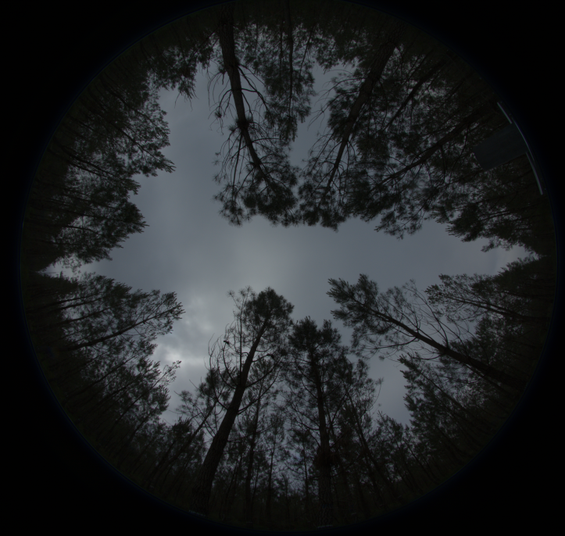
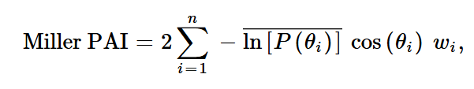
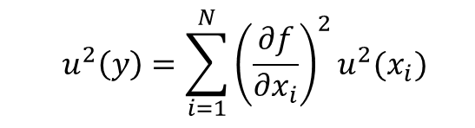
Component 1: focus on LAI LP uncertainties
Reference Measurements computation¹
10°
Vegetation pixel when $ExG−ExR>0,$
$$ExR=1.4 {DN}_{red}−{DN}_{green}$$
Where
$$ExG=2{ DN}_{green}−{DN}_{red}−{DN}_{blue}$$
10°
3
𝑃(𝜃𝑖) uncertainties is analytically propagated through those equations
SL2P computation²
SL2P is composed of two separate neural networks for each variable:
A neural network predicting the biophysical variable from Sentinel-2 Level-2 reflectance bands and observation geometry.
trained using a PROSAIL-simulated dataset.
A neural network predicting the expected retrieval uncertainty.
trained using the retrieval errors produced by the first neural network on the simulated dataset.
¹Brown, L. A., Morris, H., Leblanc, S., Bai, G., Lanconelli, C., Gobron, N., Meier, C., & Dash, J. (2023). HemiPy: A Python module for automated estimation of forest biophysical variables and uncertainties from digital hemispherical photographs. Methods in Ecology and Evolution, 14, 2329–2340. https://doi.org/10.1111/2041-210X.14199
²M. Weiss and F. Baret, S2ToolBox Level 2 Products: LAI, FAPAR, FCOVER, 1.1. Avignon, France: Institut National de la Recherche Agronomique, 2016.
³J. Miller. A formula for average foliage density, Aust. J. Bot., vol. 15, no. 1, pp. 141– 144, Apr. 1967

Slide 6
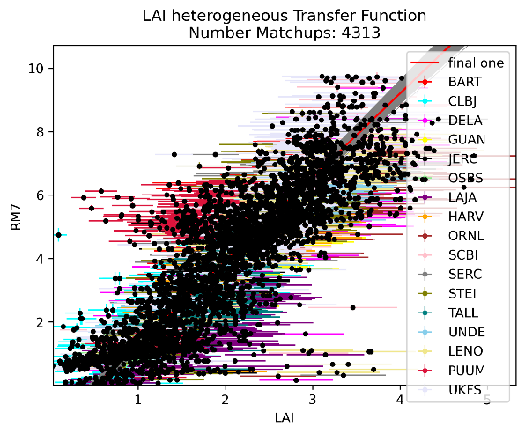
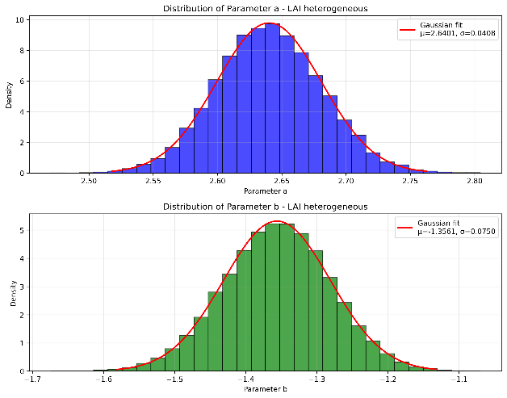


Component 1: focus on LAI LP uncertainties
Uncertainty propagation
Computation of the transfer function coefficients uncertainty using GUM Supplement 1 approach¹
Transfer function format:
$$Y_{RM}=A∗X_{SL2P}+B$$
Analytical propagation of the uncertainties through the equations
$${u\left(X_{LP}\right)}^{2}={ \left(\frac{∂f}{∂A_{X}}\right)}^{2}{\left.{u\left(A\right.}_{X}\right)}^{2}+{ \left(\frac{∂f}{∂X_{S2}}\right)}^{2}{u\left(X_{S2}\right)}^{2}+{ \left(\frac{∂f}{∂B_{X}}\right)}^{2}{\left.{u\left(B\right.}_{X}\right)}^{2}$$
$$u\left(X_{LP}\right)= \sqrt{{X_{S2}}^{2}.{\left.{u\left(A\right.}_{X}\right)}^{2}+{A_{X}}^{2}{.u\left(X_{S2}\right)}^{2}+{\left.{u\left(B\right.}_{X}\right)}^{2}}$$
¹Joint Committee for Guides in Metrology (JCGM), “Evaluation of measurement data — Guide to the expression of uncertainty in measurement”, Sep. 2008.
Notes:
Parler de l’amélioration continue des procédures car celles-ci sont très souvent perfectibles

Slide 7
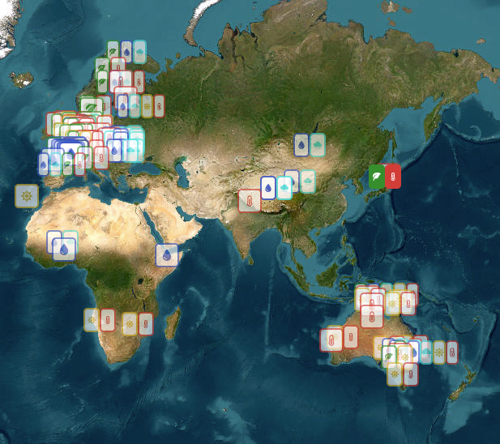
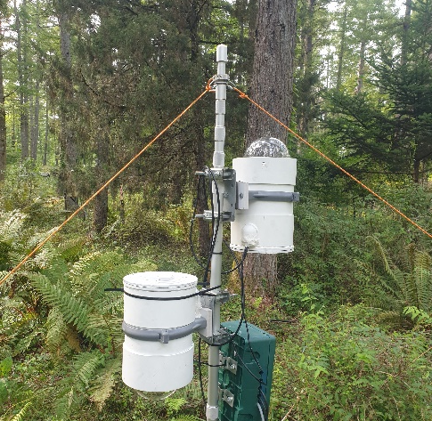
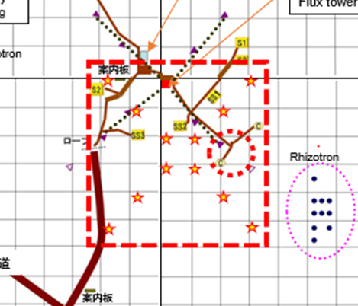
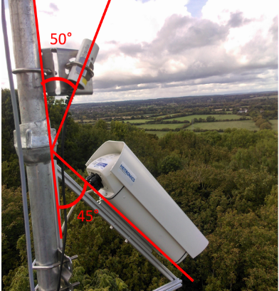
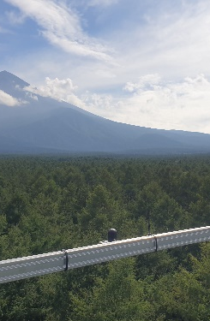
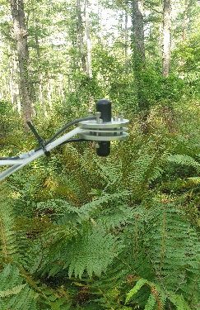
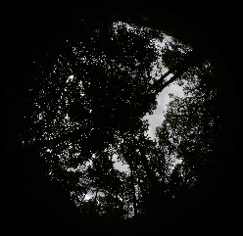
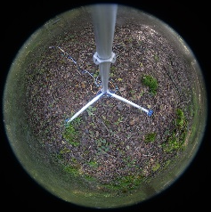
Component 2
Installation of sensors and data acquisition funded by GBOV and carried out in partnership with the measurement stations
LST Sensors
Fuji Hokuroku (2025)
Litchfield (2025)
…
DHP Sensors
Fuji Hokuroku (2024)
Fontainebleau (2024)
Hainich (2020)
Valencia (2019)
…
PAR Sensors
(development in progress)
Fuji Hokuroku (2024)
Fontainebleau (2024)
Hainich (2020)
…
Apogee
Heitronics

Slide 8

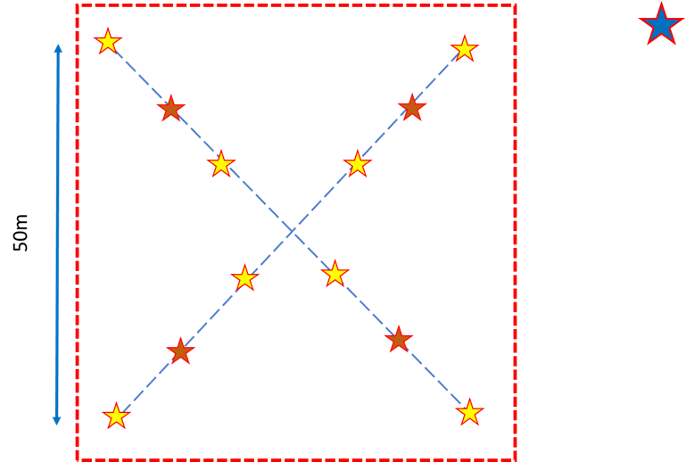


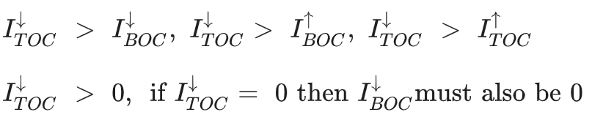


Component 2
Funding of the development of a PAR network data processing method¹ by J. Dash and S. Paramanik from University of Southampton
Data processing (overview):
Pre-processing:
QC:
Resample to 5min and computation of uncertainty
Cloud flagging
FAPAR computation:
Sensors displayed in Elementary Sampling Unit (Hainich station)
¹S. Paramanik, H. Morris, R. Grousset, G. Bai, C. Lerebourg, E. Lopez-Baeza, A. Pérez-Hoyos, D. Garcia-Rodriguez, D. Culvenor, A. Knohl, A. Klosterhalfen, F. Tiedemann, C. Lanconelli, M. Clerici, N. Gobron, L. A. Brown, F. James, S. Maier, F. Niro, J. Dash, “Automated and continuous estimation of FAPAR from distributed wireless PAR sensor networks”, Agricultural and Forest Meteorology, Volume 376, 2026, 110904, ISSN 0168-1923, https://doi.org/10.1016/j.agrformet.2025.110904.

Slide 9
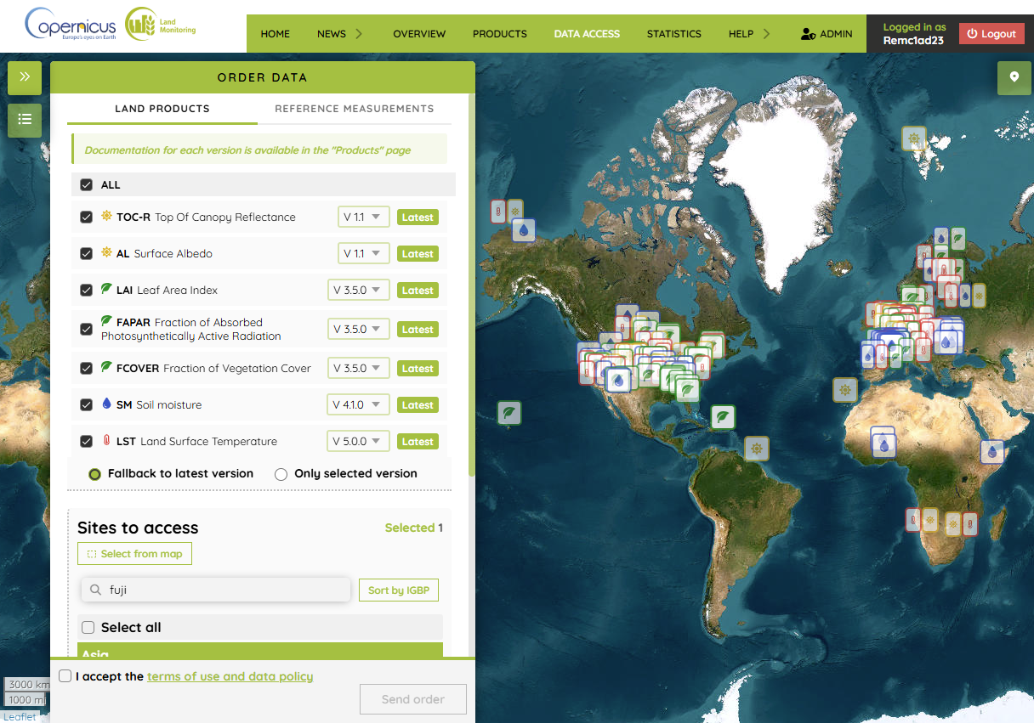
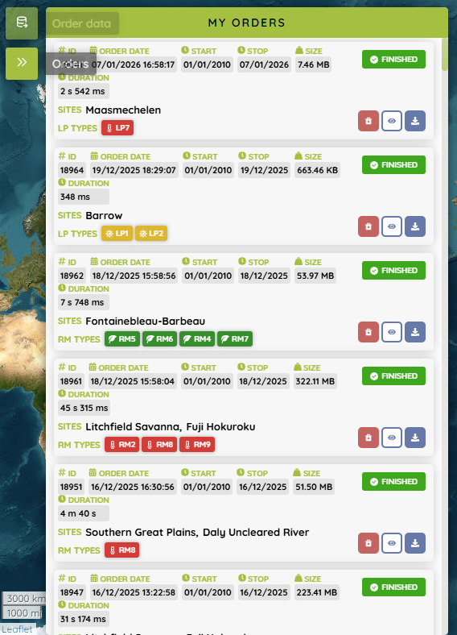

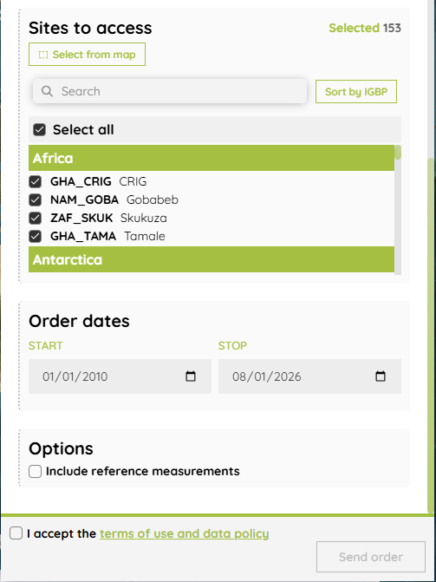
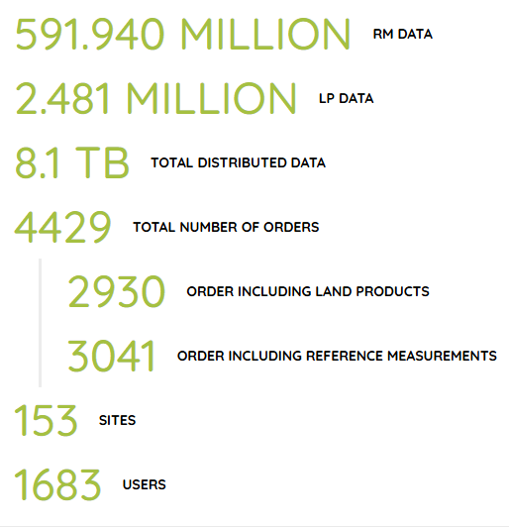
Component 3
Development and maintenance of a data portal
https://gbov.land.copernicus.eu/products

Slide 10





Scientific Partners
Energy
Products:
RM1: Short Wave Radiation
LP1: Top of Canopy Reflectance
LP2: Albedo
J.-P. Muller,
R. Song
Thermal
Products:
RM2: Thermal Radiation*
RM8: Land Surface Emissivity
RM9: Land Surface Temperature
LP7: Land Surface Temperature
D. Ghent,
J. Anand,
R. Shukla
Vegetation
Products:
RM4: Transmission Through Canopy
RM5: Soil BRF/BHR/DHR
RM6: FIPAR
RM7: LAI
LP3: LAI
LP4: FAPAR
LP5: FCOVER
J. Dash,
S. Paramanik,
F. James
Soil Moisture
Products:
RM10: Soil Moisture
RM11: Precipitations
LP6: Soil Moisture
A. Perez-Hoyos
V3 Products
Products:
RM12: Phenophase
RM13: Eddy Covariance
RM14: TBD
RM15: TBD
LP8: GPP
LP9: NPP
LP10: LSP
LP11: Evapo-transpiration
Z. U. Nisa
J. Dash,
G. Mulualem
* Replaced by Land Surface Radiance in V3
Notes:
Mentionner aussi les partenaires dans les stations de mesures terrain

