Slide 1
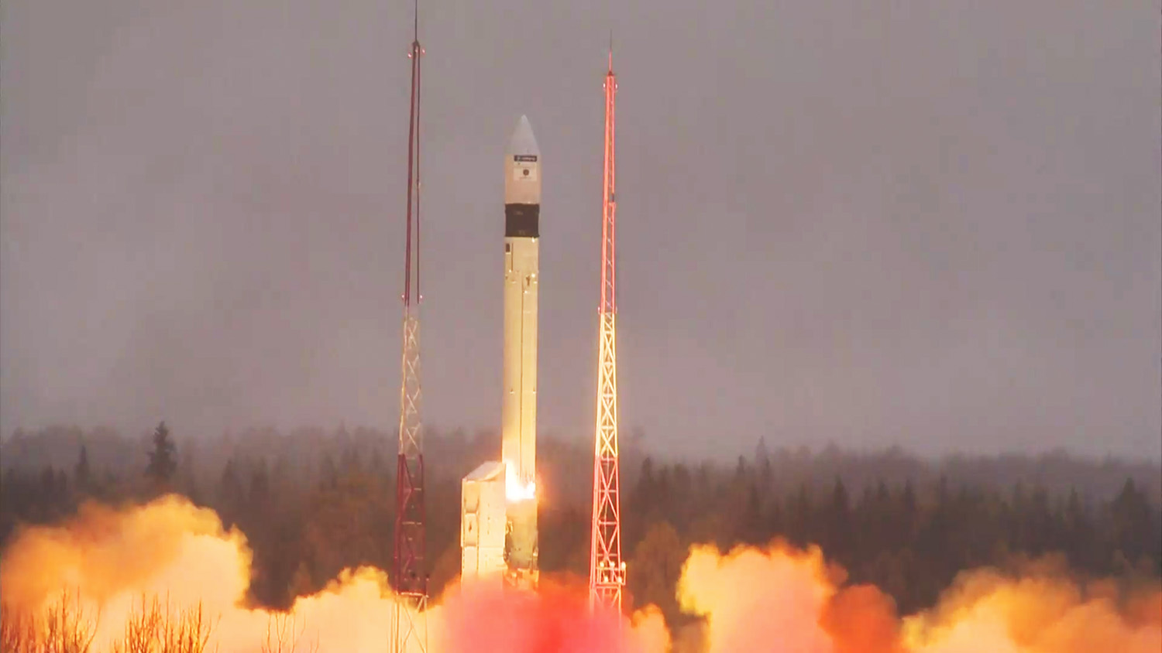

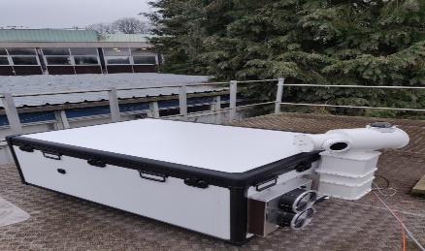
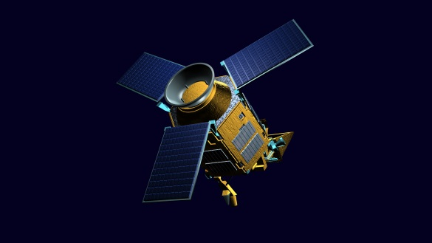
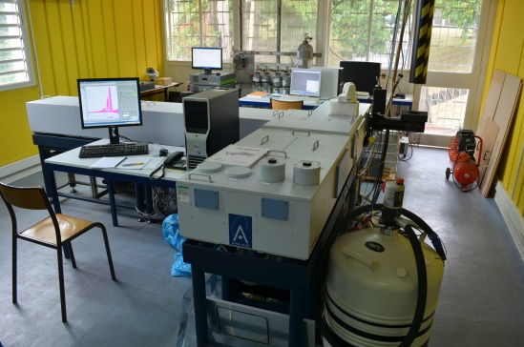



FRM4GHG
to
COCCON
Mahesh Kumar Sha*, Justus Notholt, Martine De Mazière, Filip Desmet, Nicolas Kumps, Bavo Langerock, Corinne Vigouroux, Christof Petri, Jamal Makkor, Winfried Markert, Huilin Chen, Steven van Heuven, David W. T. Griffith, Nicholas Jones, Frank Hase, Benedikt Herkommer, Darko Dubravica, Rigel Kivi, Tomi Karppinen, Hannakaisa Lindqvist, Damien Weidmann, Neil A. Macload, Angelika Dehn
*Royal Belgian Institute for Space Aeronomy (BIRA-IASB); mahesh.sha@aeronomie.be

Slide 2
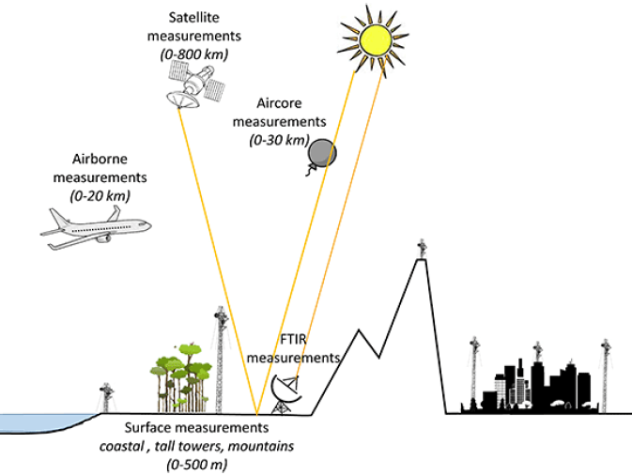
Atmospheric GHG measurement techniques and their complementarity
Ground-based in-situ measurement network (surface air sampling, tower ~500 m)
    Derived fluxes are accurate but are affected by surface exchange and vertical transport
    – highly variable but poorly simulated in global models
    High precision and inter-calibration accuracy
    Limited / no column measurements which limits its use for satellite validation
In-situ aircraft (0 – 20 km) / AirCore (0 – 30 km ) measurements
    Derived fluxes are accurate, measurements are possible at several altitudes, but are currently very sparse
    High precision and inter-calibration accuracy
Ground-based remote sensing measurement networks (0 – top of the atmosphere)
    Column and / or profile measurements of GHGs
    High precision and inter-calibration accuracy
    Direct solar absorption measurements are advantageous over the satellite measurements recording the solar reflectance from the Earth’s atmosphere. Limited number of sites do not provide a complete global picture
    Ideal for calibration / validation of satellite instruments and model columns and carbon cycle science
    Column measurements of GHGs in the near-IR using portable, low cost FTS (e.g., EM27/SUN, Vertex70/80, IRcube, …)
  Satellite remote sensing measurements (0 – top of the atmosphere)
    Provides global measurements of total and / or partial columns of GHGs
    Significant improvements in measurement and retrieval techniques over the last 22 years
    Future improvements are expected to further improve the data quality and space-borne data to become more important for carbon cycle research
    High quality reference data needed for detection and calibration of biases and / or temporal drifts in the sensors

Slide 3
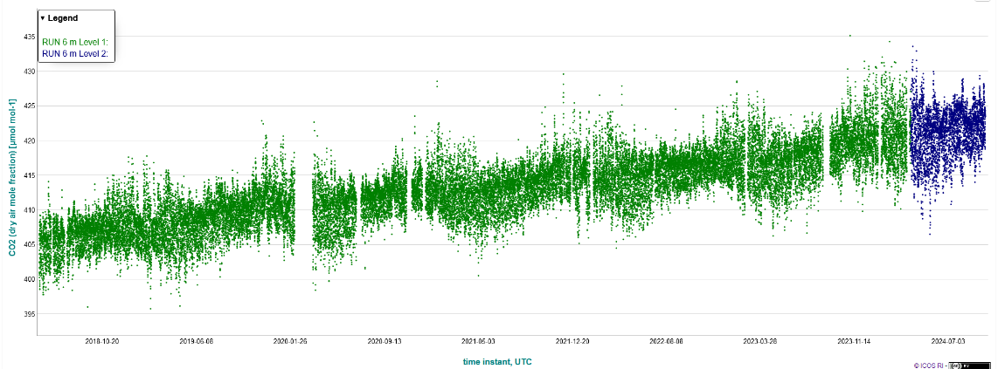

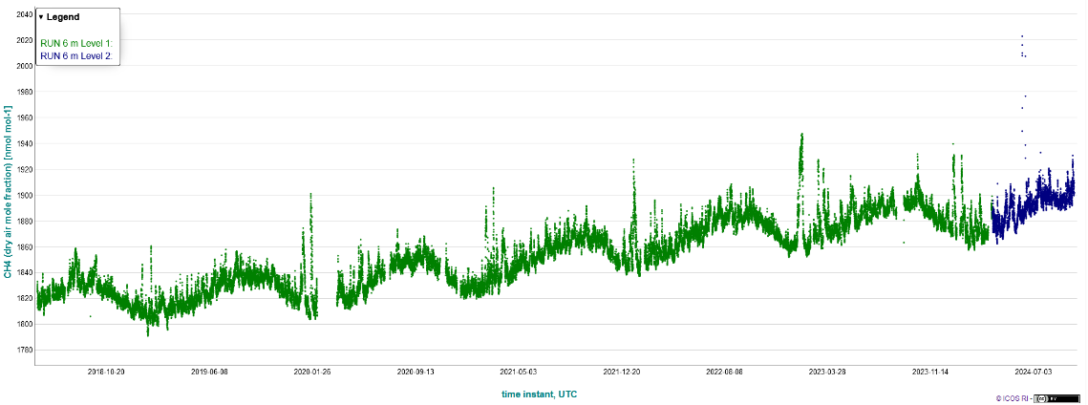
Remote sensing measurements of atmospheric concentration of GHGs
CO2
2018/06
2024/10
CH4
Concentrations of both gases are on the rise measured at the background site
2018/06
2024/10
Ground-based in-situ measurement network (surface air sampling, tower ~500 m)
Integrated Carbon Observation System (ICOS) – the European research infrastructure dedicated to produce standardized, high-precision and long-term observations and facilitate research to understand the carbon cycle and to provide necessary information on GHGs.
https://www.icos-cp.eu/; https://data.icos-cp.eu/
Contact: mahesh.sha@aeronomie.be

Slide 4
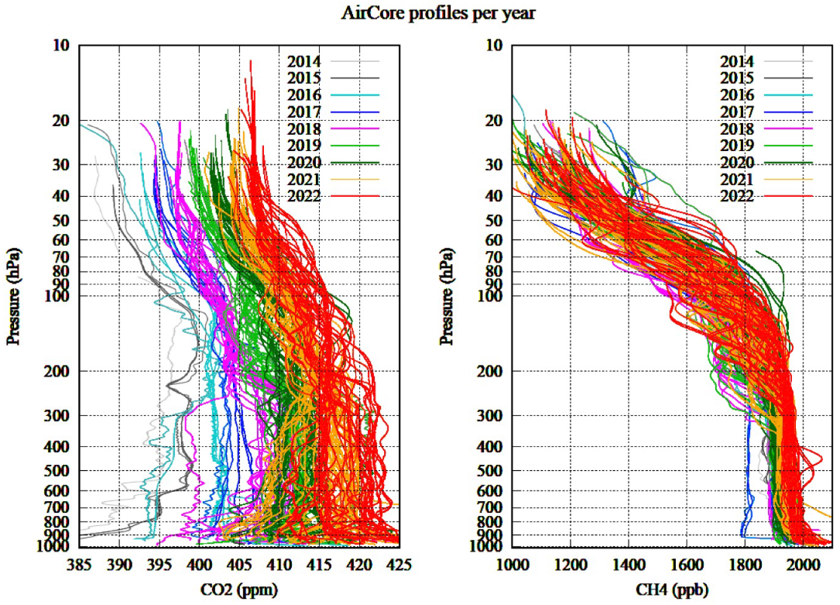
Remote sensing measurements of atmospheric concentration of GHGs
Crevoisier et al., 2023, IWGGMS-19
In-situ measurements performed using airborne platforms (Aircraft based, AirCore based, Drone based) provides vertical profiles of target gases
Contact: mahesh.sha@aeronomie.be

Slide 5

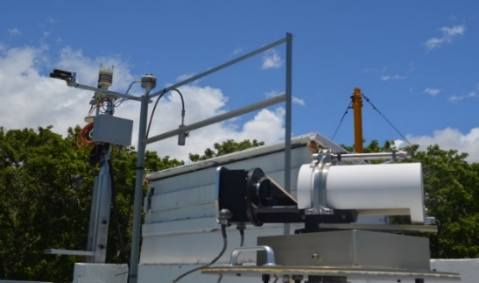
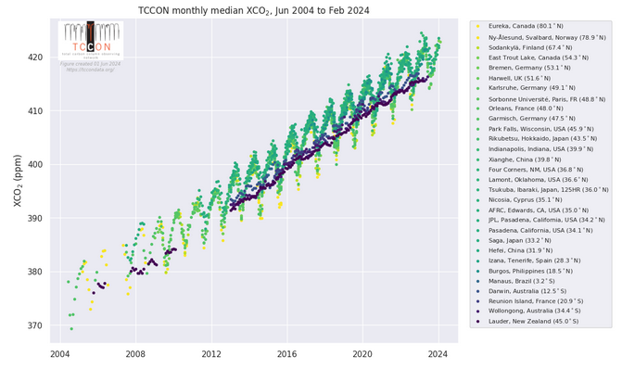

Remote sensing measurements of atmospheric concentration of GHGs
Sun as the source
Sun tracker + Fourier transform infrared (FTIR) spectrometer
Meteorological sensors
Total Carbon Column Observing Network (TCCON) and Infrared Working Group of the Network for the Detection of Atmospheric Composition Change (NDACC-IRWG) are reference networks providing total and / or partial column measurements of GHGs and other climate relevant gases. BIRA-IASB operates several FTIR sites and contributes to international networks.
Meteo station
https://tccon-wiki.caltech.edu/

Slide 6
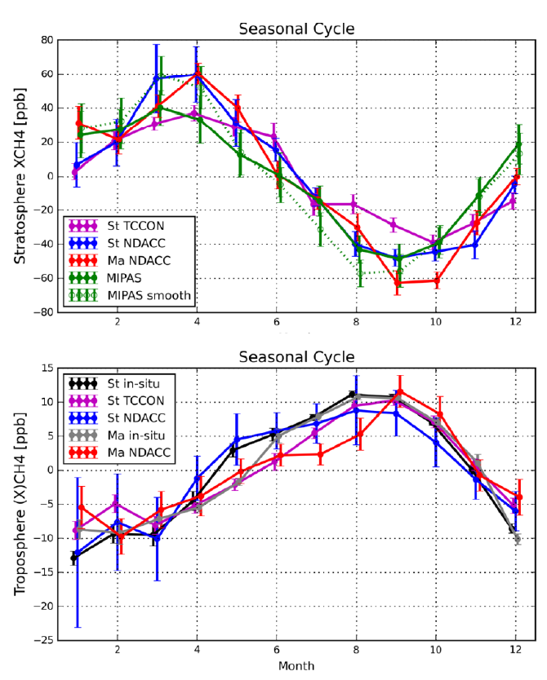
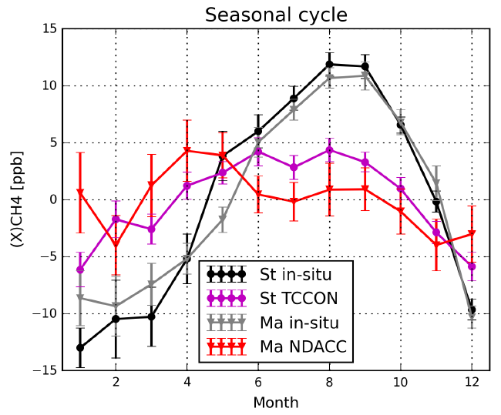
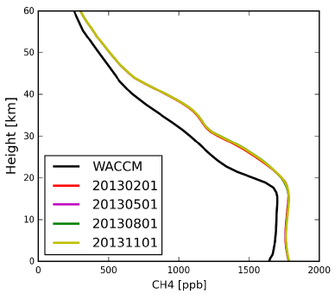
In-situ vs remote sensing comparison – Methane
Total column remote sensing component layer: Surface – TOA
Tropospheric layer: Surface – 16.5 km
Stratospheric layer: 16.5 – TOA
Zhou et al., ACP 2018; https://doi.org/10.5194/acp-18-13881-2018

Slide 7
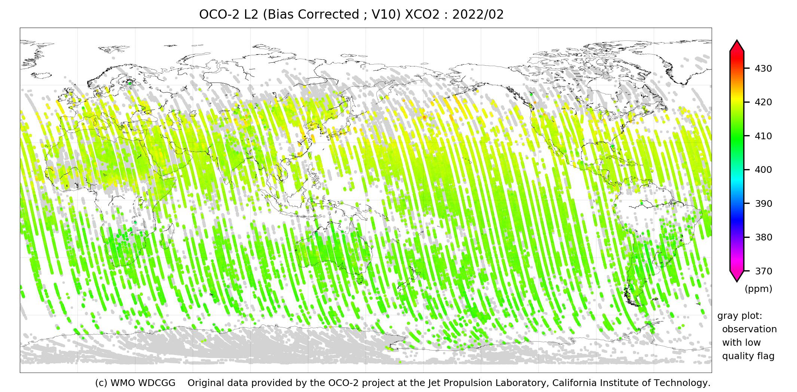
Remote sensing measurements of atmospheric concentration of GHGs
Satellites provide total and / or partial columns of GHGs
An example of monthly map of XCO₂ estimates derived from NASA’s OCO-2 measurements for February 2022
World Data Center for Greenhouse Gases https://gaw.kishou.go.jp/satellite/

Slide 8
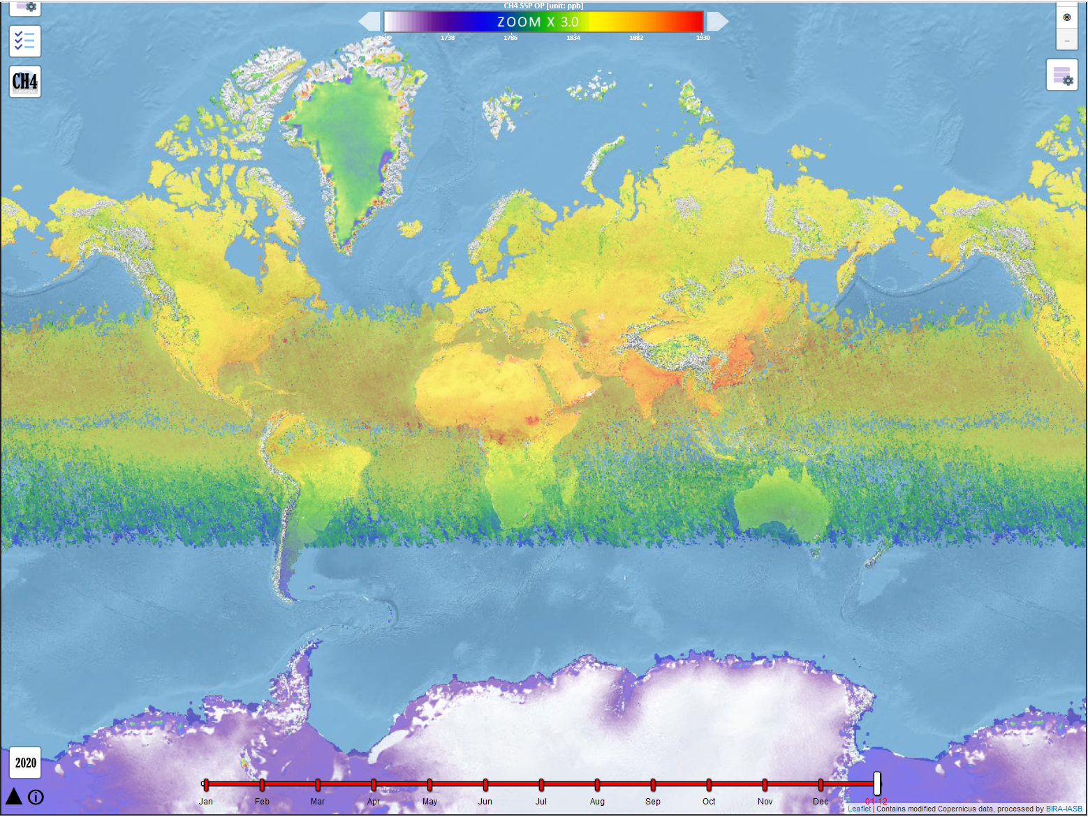
Methane (CH₄) measured by Sentinel-5 Precursor from space
Operational product

Slide 9
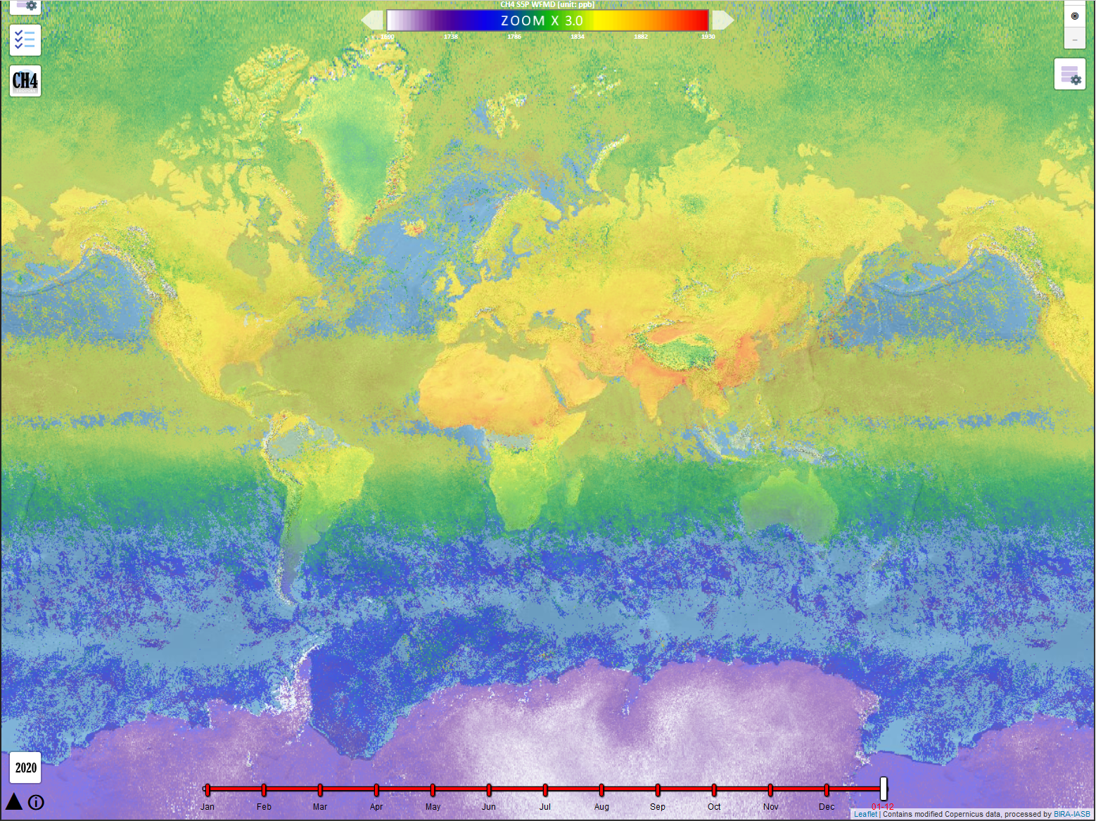
Methane (CH₄) measured by Sentinel-5 Precursor from space
Scientific product
Validation of the satellite products is very important for the proper use of the data
Dependence of the products on influential parameters
Albedo – ground reflectivity
Aerosol
Humidity
A priori – information on the vertical distribution of the gas in the atmosphere
Clouds
Surface conditions
…

Slide 10
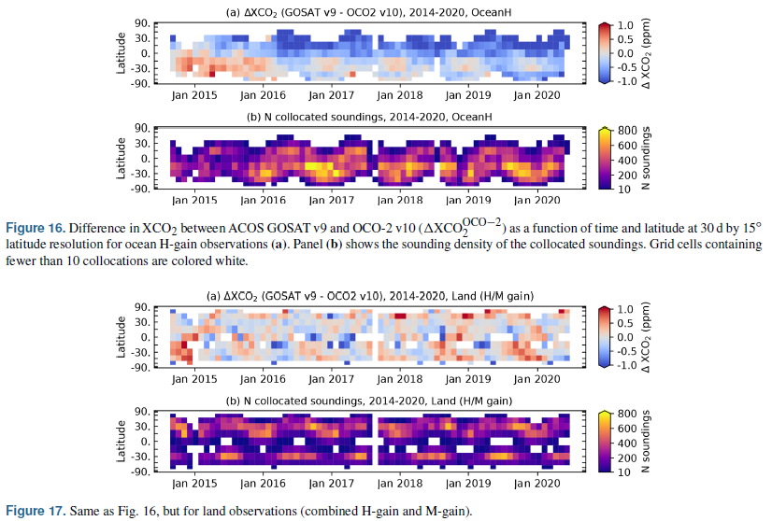
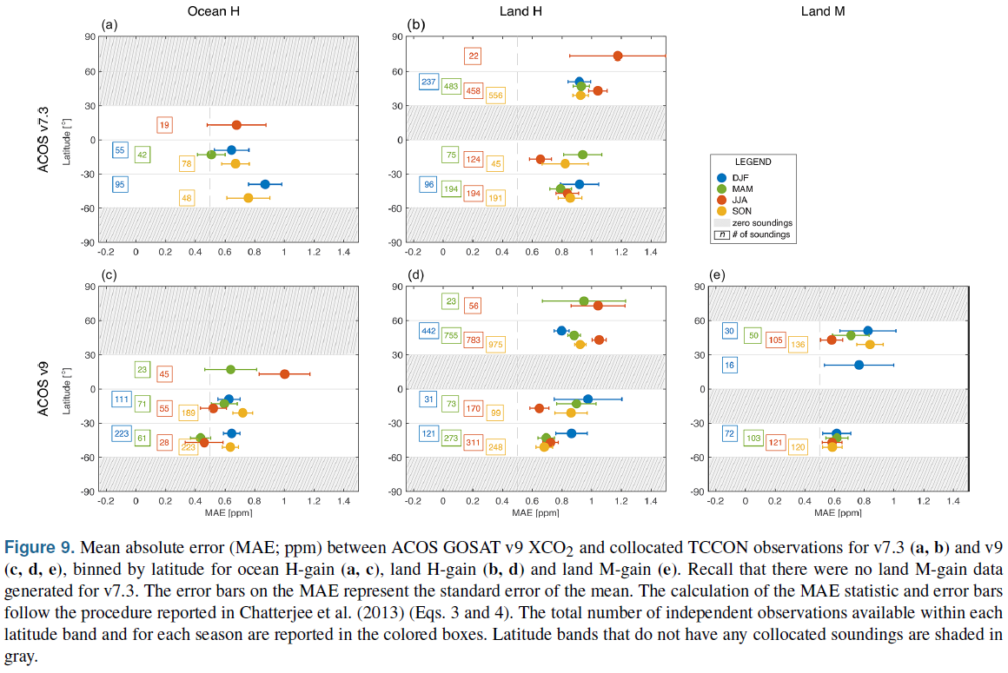
Satellite data product – challenges – CO₂ from GOSAT & OCO-2
Taylor et al., ESSD 2022; https://doi.org/10.5194/essd-14-325-2022

Slide 11

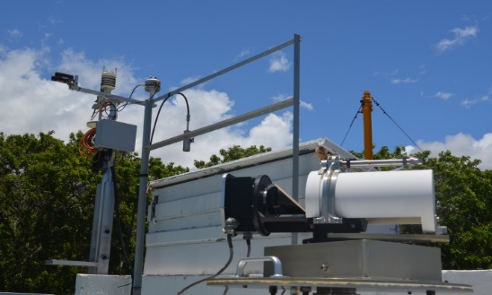

NDACC IRWG
TCCON
Bruker IFS 120HR/125HR
Resolution 0.0036cm⁻¹
Spectral range: SWIR, MIR and TIR
Profile retrievals (DOF 1 to 5 depending on the species, independent atmospheric altitude layers)
https://www2.acom.ucar.edu/irwg
Bruker IFS 125HR
Resolution 0.02cm⁻¹
Spectral range: SWIR
Profile scaling retrievals
tccon.org

Slide 12
NDACC IRWG
TCCON
Bruker IFS 120HR/125HR
Resolution 0.0036cm⁻¹
Spectral range: SWIR, MIR and thermal IR
Profile retrievals (DOF 1 to 5 depending on the species, independent atmospheric altitude layers)
Targets: O3, CH4, N2O,
(CO2, HCHO, SF6, CFCs, HCFCs, H2O, HDO not official)
CO, HNO3, HCl, HF, HCN, C2H6, CLONO2
(C2H2, PAN, OCS, CH3OH, NH3, HCOOH, NO2 not official)
Retrieval software: SFIT or PROFFIT
Measurements every ±10’
~ 26 stations worldwide
Measurement protocol, no central processing, QA/QC for selected targets in CAMS operational validation
Bruker IFS 125HR
Resolution 0.02cm⁻¹
Spectral range: SWIR
Profile scaling retrievals
(profile retrievals are in development)
Targets: CO2, CH4, N2O, H2O, HDO, CO, HF
Retrieval software GGG
Measurements every ~ 3’
~ 30 stations worldwide
central QA/QC

Slide 13
What are FRM and what is FRM4GHG (https://frm4ghg.aeronomie.be/)
Fiducial Reference Measurements (FRM) are a suite of independent, fully characterized, and traceable (to a community agreed reference, ideally SI) measurement of a satellite relevant measurand, tailored specifically to address the calibration/validation needs of a class of satellite borne sensor and that follow the guidelines outlined by the GEO/CEOS Quality Assurance framework for Earth Observation (QA4EO) – CEOS-FRM definition, Goryl et. al., 2023
European Space Agency (ESA) initiated the FRM for GreenHouse Gases (FRM4GHG) project in 2016 with the aim to create high quality reference measurements of greenhouse gases for supporting satellite validation
As part of this project several portable low-cost instruments have been tested and their data products compared against reference Total Carbon Column Observing Network (TCCON; for gases retrieved in the near-infrared spectral range) and Infrared Working Group of the Network for the Detection of Atmospheric Composition Change (NDACC-IRWG; for gases retrieved in the mid-infrared spectral range) and AirCore
The multi-year campaigns (2017 – 2019 – phase I; 2020 – 2026 – phase II) proved to be greatly beneficial for several of the tested instruments which improved significantly during the campaign, for some other instruments improvements are still ongoing for bringing them to the level of FRM

Slide 14


FRM4GHG projects https://frm4ghg.aeronomie.be/
FRM4GHG 1.0
Characterization of various portable low-resolution spectrometers for GHG measurements
Inter-comparison w.r.t. reference TCCON data and collocated AirCore observations
Suitability for campaign deployment or for long-term measurements from any site
Results were excellent, some of the investigated portable low-resolution spectrometers offer the capability to further complement the TCCON while others need further improvements
Expand the global coverage of ground-based FRM of the target GHGs
FRM4GHG 2.0
Further improve the low-resolution instruments with respect to hardware and software (alignment, portability, precision of solar tracking, noise characterization, …) and of the AirCore observations
Improve the associated data analysis algorithms, optimization of retrievals of additional species (OCS, HCHO, N₂O, CH₄), develop additional AirCore observations (N₂O, OCS)
Further establish the links with TCCON and complementary COllaborative Carbon Column Observing Network (COCCON)

Slide 15
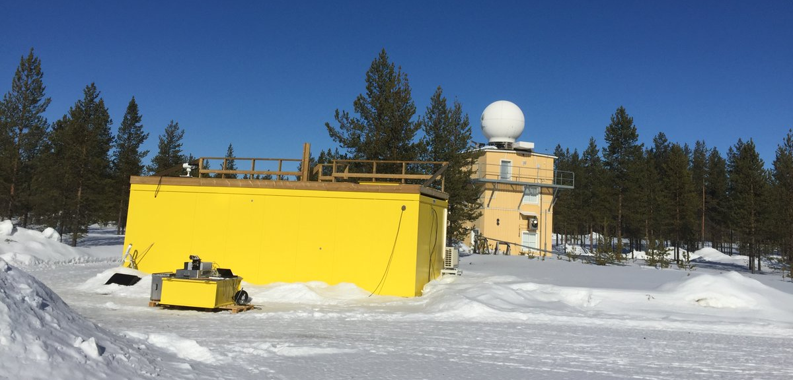
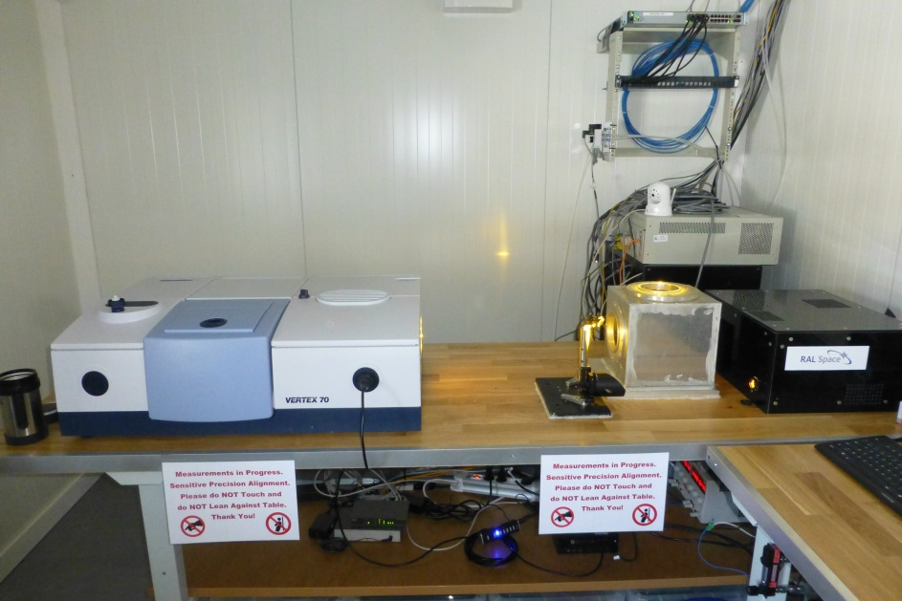
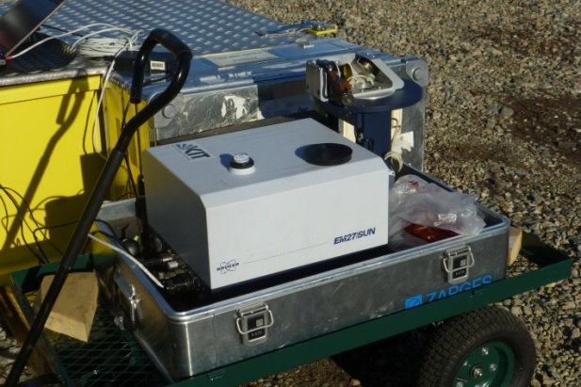
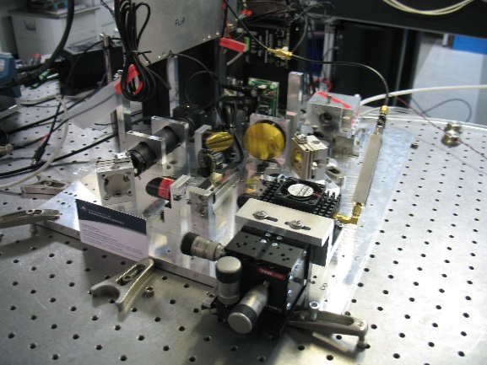
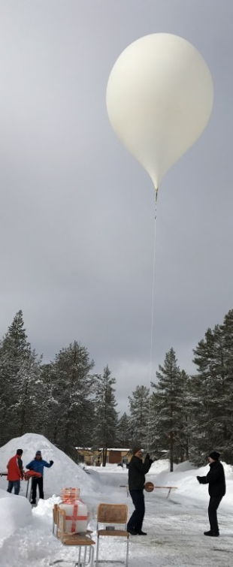
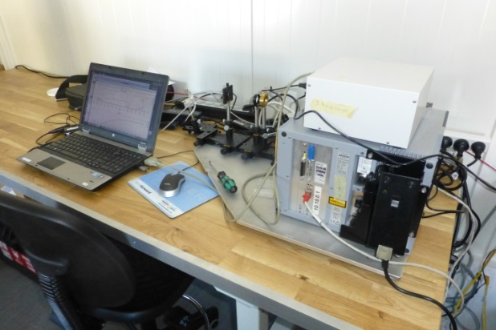
FRM4GHG campaign – characterizing low-resolution FTIRs
TCCON
Vertex 70
Fiducial
Reference
Measurements
For
Greenhouse
Gases
FRM4GHG container
AirCore launch
EM27/SUN with suntracker
Instrumentation used during the ESA funded FRM4GHG project
frm4ghg.aeronomie.be
Details in Sha et al., 2020, https://doi.org/10.5194/amt-13-4791-2020
IRcube
LHR optical breadboard

Slide 16
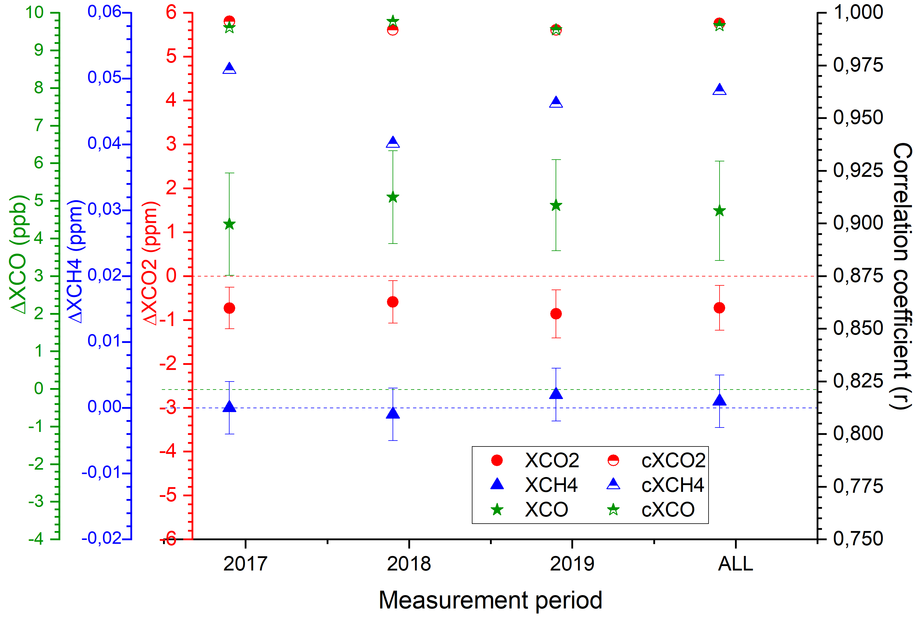
Long-term stability of low-resolution FTIRs – COCCON
TCCON precision requirements: XCO₂: < 0.25% ~ 1 ppm
XCH₄: 0.5% ~ 0.009 ppm; XCO: < 4% ~ < 4 ppb
The bias values are very close to each other and the small diffeence seen from year-to-year is due to the data representative issue.
Year-to-year variability (this study – 3 y @ Sodankylä)
XCO₂ – 0.137 ppm (0.03%) with 1σ (0.5 ppm)
XCH₄ – 0.001 ppm (0.05%) with 1σ (0.004 ppm)
XCO – 0.363 ppb (0.4%) with 1σ (1.32 ppb)
Year-to-year variability (Frey et al. 2019 – 3.5 y @ Karlsruhe)
https://doi.org/10.5194/amt-12-1513-2019
XCO₂ – 0.02 ppm (0.005%) with 1σ (0.6 ppm)
XCH₄ – 0.001 ppm (0.05%) with 1σ (0.004 ppm)
Sha et al., 2024; https://doi.org/10.3390/rs16183525
The constant bias will be scaled following the strategy developed in COCCON

Slide 17
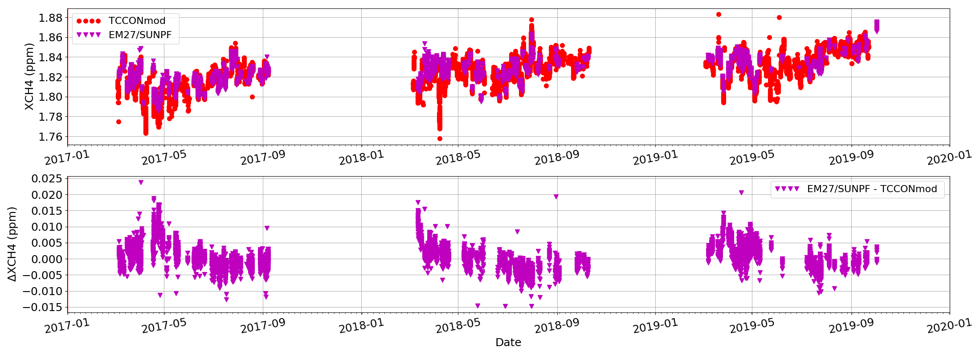
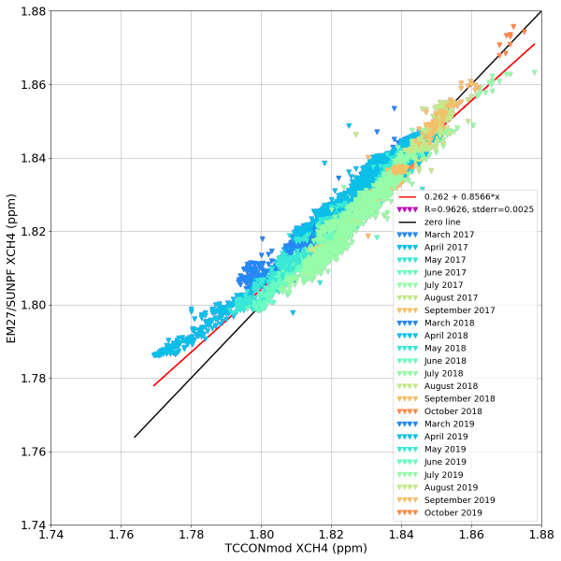
Lessons learned from FRM4GHG
Details in
Sha et al., 2024
https://doi.org/10.3390/rs16183525
XCH₄
TCCON priori used for both retrievals
Seasonality seen in the bias. About 10 ppb during spring polar vortex conditions – not so usual for standard TCCON site, ~ 3 – 5 ppb bias during the summer – Autumn period ➔ significant ~ the accuracy requirement (0.2%) of TCCON.
Seasonal bias between TCCON and low-resolution (LR) EM27/SUN is not a drawback. It is understood – due to different instrument sensitivities (averaging kernels – AKs) and the a priori difference from the true atmospheric state. As the satellite sensors tend to use low resolution, the sensitivity match is better and therefore the smoothing error in the validation is smaller for the LR spectrometer.

Slide 18
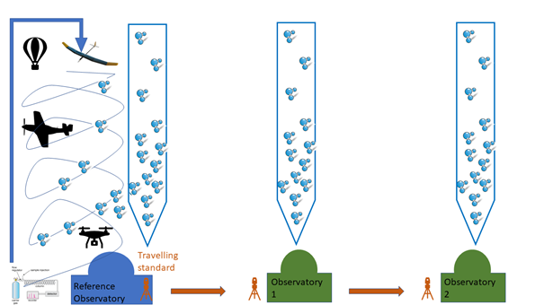
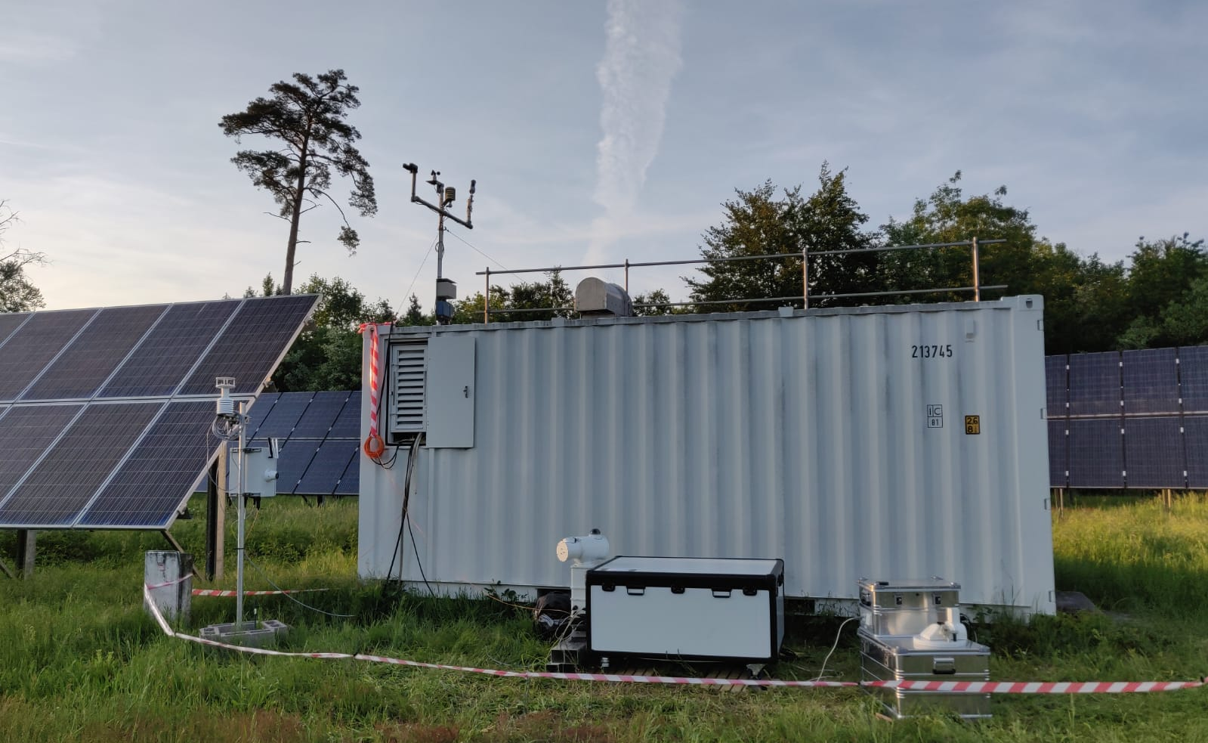
Calibration of remote sensing measurement traceable to WMO scale
Ground-based remote sensing measurements are then used for cal/val of satellite-based remote sensing measurements performing similar integrated column measurements of trace gases
TCCON at KIT, Germany
INVENIO and EM27/SUN

Slide 19

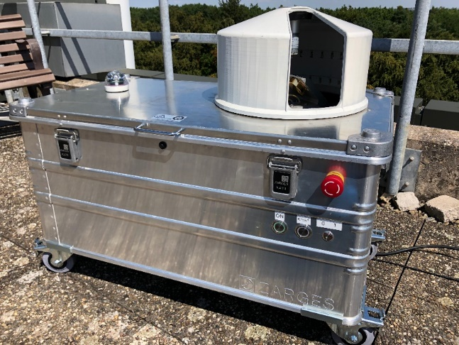
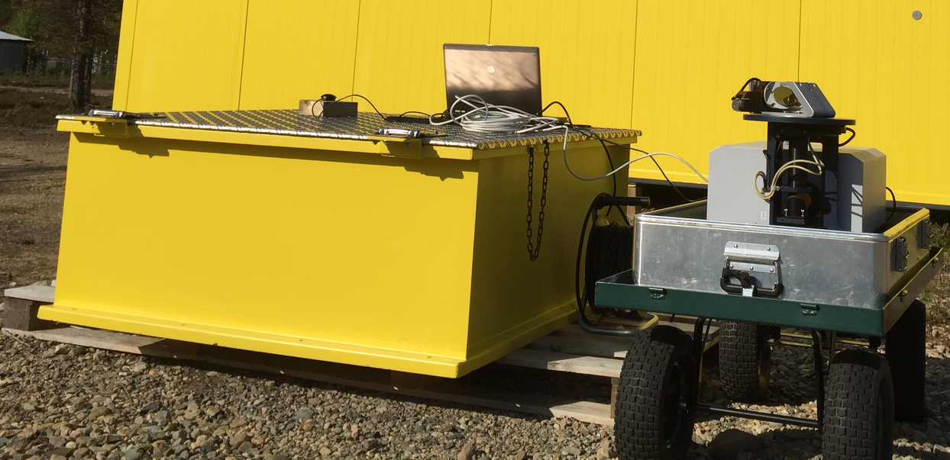

EM27/SUN – COCCON providing FRM quality data
https://www.coccon.kit.edu/
Main species: XCO₂, XCH₄, XCO, XH₂O at 0.5 cm⁻¹; data processing following COCCON recommendations
Excellent agreement with TCCON
Manual operation at majority of sites, setting it up in the morning and bringing it back to the shelter at the end of the day, data acquisition is automatic.
Automatic operation, remote control, protection against rain/snow, rain sensor, heating & cooling systems – developed or under development by several groups
Selected as travelling standard (FRM4GHG-2) for visiting TCCON stations (Europe, America, Asia-Oceania)

Slide 20
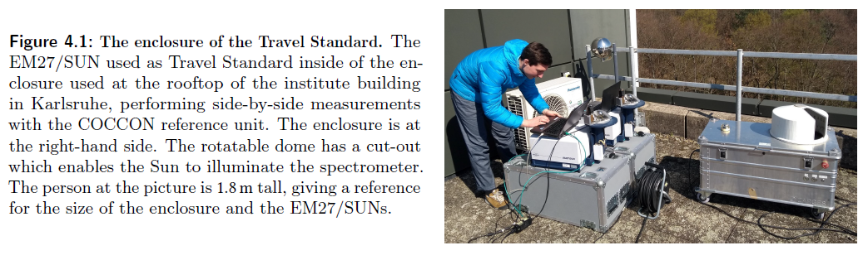
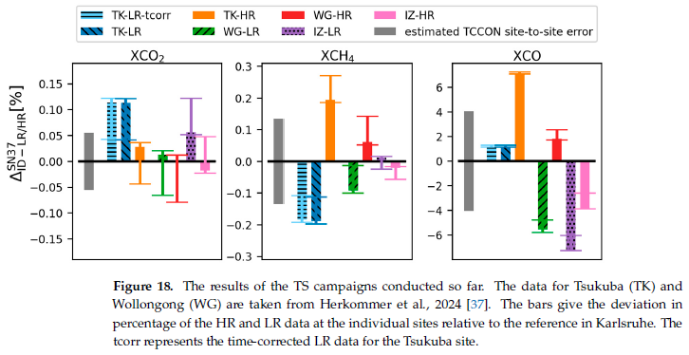
Building a Travel Standard
Using a portable FTIR spectrometer to evaluate the consistency of TCCON measurements on a global scale
Herkommer et al., 2024;
https://doi.org/10.5194/egusphere-2023-3089
Sha et al., 2024; https://doi.org/10.3390/rs16183525

Slide 21
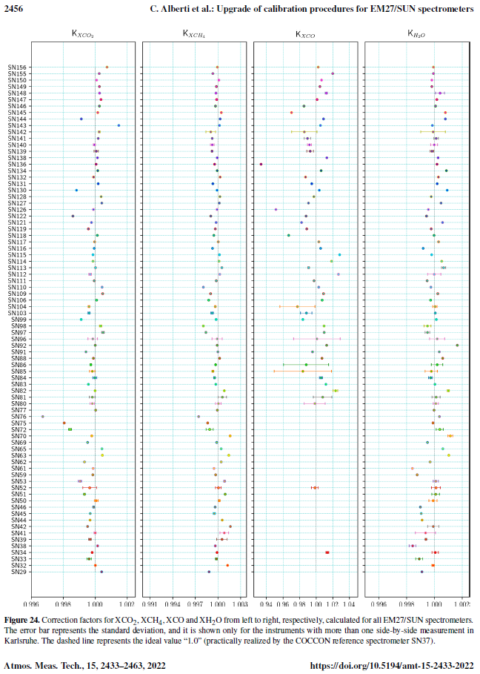
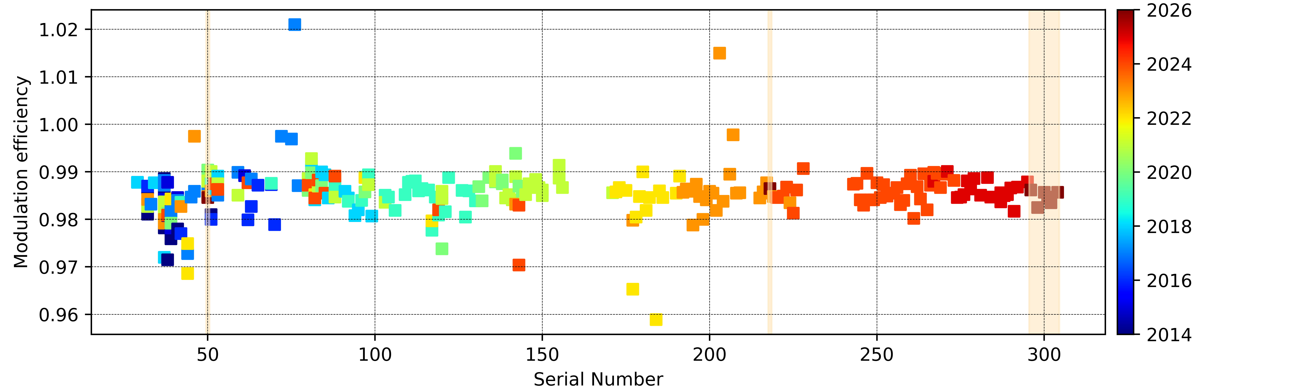
COCCON operational services
Calibration of new and refurbished spectrometers before commissioning
Characterization of instrumental line shape of the spectrometers (open path, gas cells)
Side-by-side measurements w.r.t. TCCON and reference EM27/SUN maintained at KIT, Karlsruhe, Germany
Determination of Xgas scaling factors to establish the indirect traceability to the WMO via TCCON
Central data handling and processing facility for several sites hosted by KIT, Germany
Training possibility for new operators
COCCON operations (and some research) activities are funded through ESA

Slide 22
COCCON as FRM data provider for LR-NIR
COCCON data is hosted at EVDC (ESA Validation Data Center); a DOI is minted per site
Working with site PIs towards publishing more sites – meticulous job, to verify the processing chain, data quality check, etc. assistance provided by Darko Dubravica darko.dubravica@kit.edu; Frank Hase frank.hase@kit.edu or me
The version 1 of the COCCON data is currently used for validation of Sentinel-5 Precursor (BIRA-IASB), OCO-2 (JPL) and GOSAT (NIES).
Possible to expand the usage of COCCON data to other GHG satellites (traditional and new space missions)

Slide 23
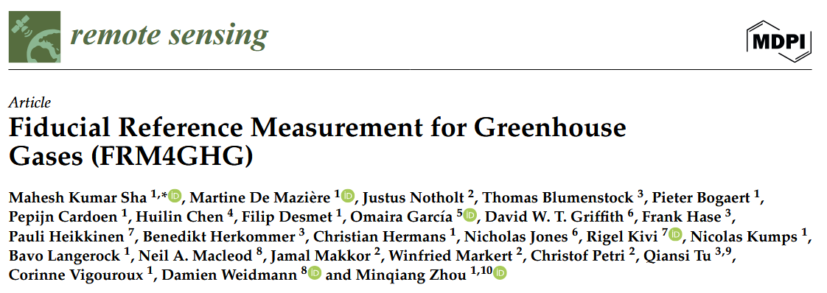
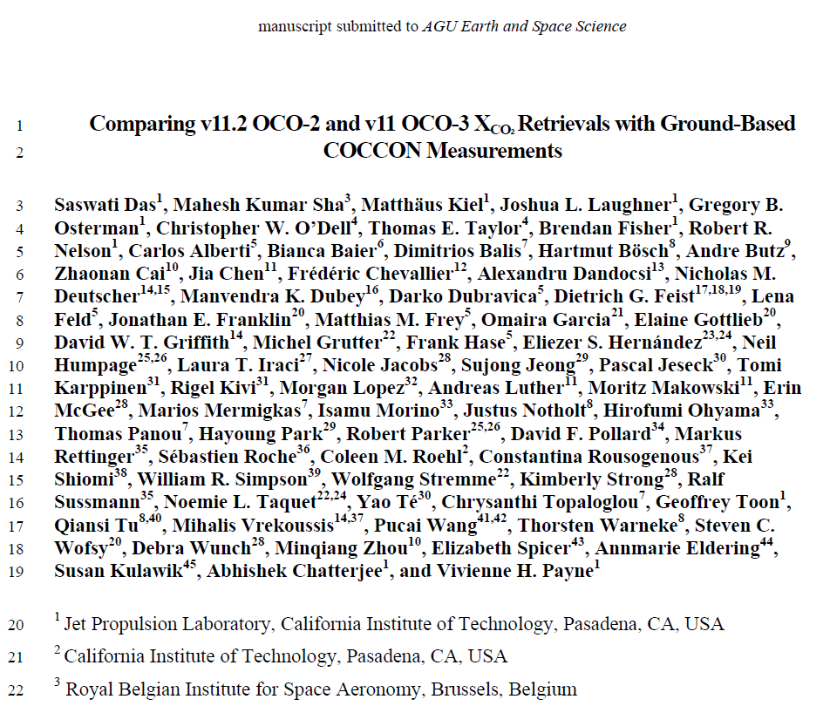
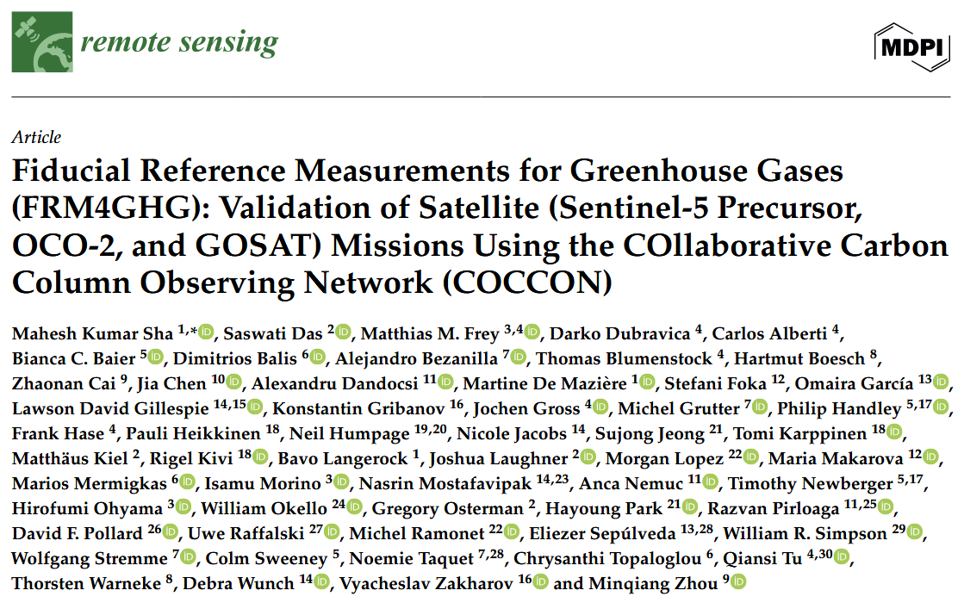
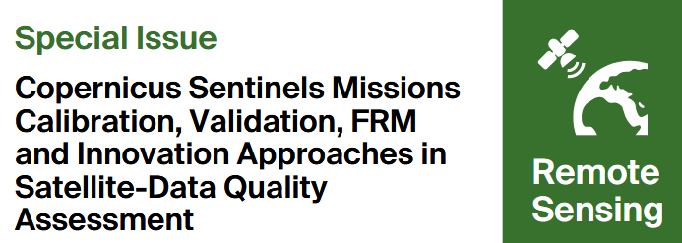
COCCON self-assessment of CEOS-FRM
CEOS-FRM self-assessments done for COCCON as provider of GHG column data
Application of COCCON data for GHG satellite validation

Slide 24
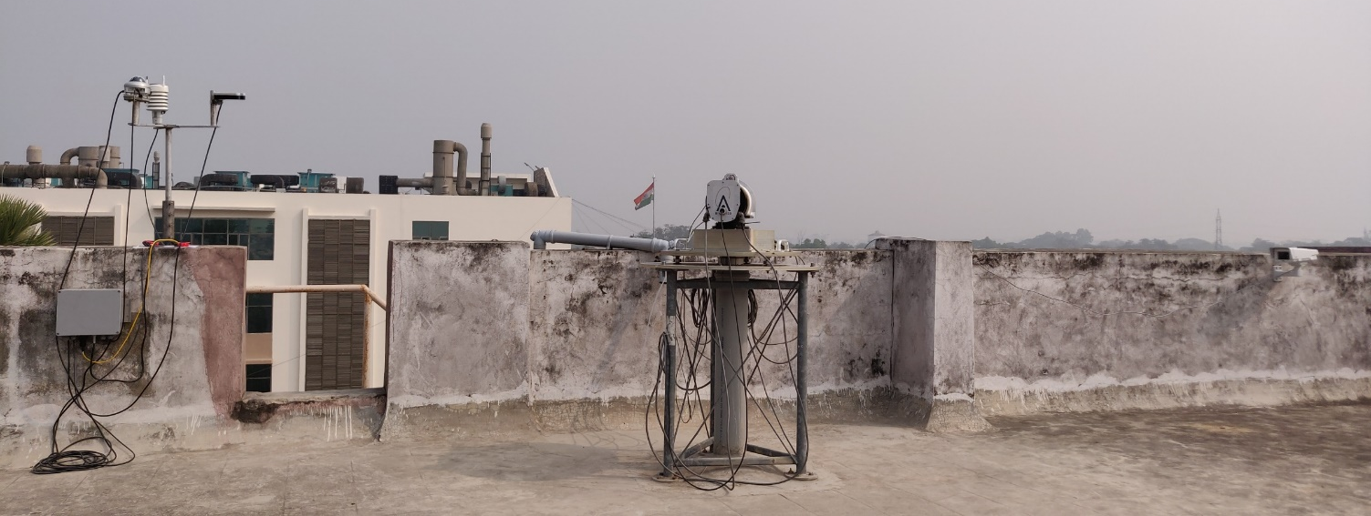
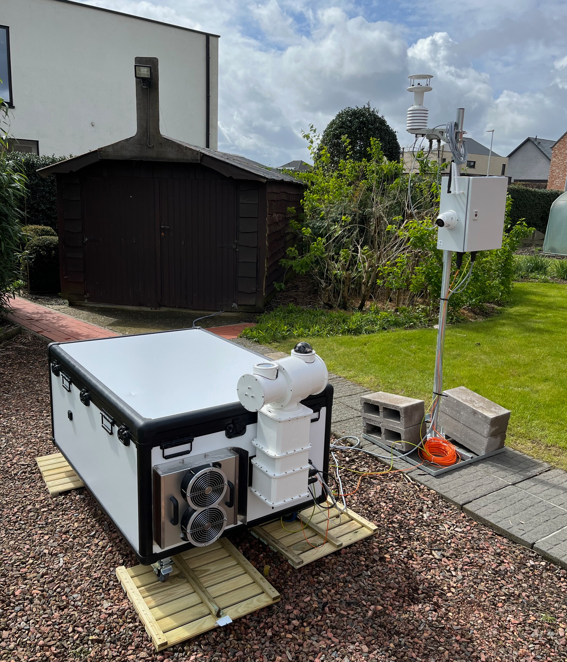
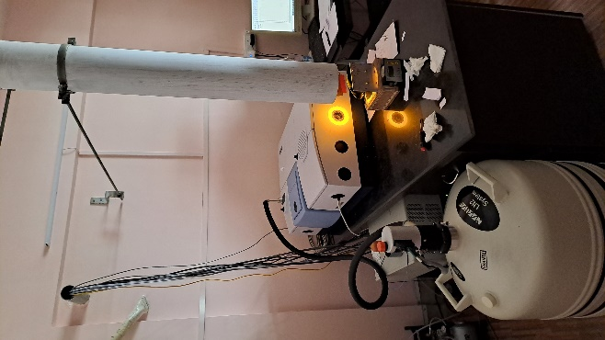
Vertex70 / Invenio – COCCON providing FRM quality data
Solar beam path from the roof to the FTIR lab in Kolkata, India
Details in Sha et al., 2024
https://doi.org/10.3390/rs16183525
Meteo station
Vertex70 / Invenio in an automated enclosure system with mini-solar tracker
Automatic operation, remote control, protection against rain/snow, rain sensor, heating & cooling systems
VERTEX70 – FTIR

Slide 25
Vertex70 / Invenio – COCCON providing FRM quality data
Automatic operation, remote control, optimized during FRM4GHG campaign
Follow COCCON strategy for data analysis
Dual detector option InGaAs (RT) + InSb (LN2); TE-MCT (under test):
InGaAs – XCO₂, XCH₄, XCO, XH₂O at 0.2 cm⁻¹
InSb – filter 1 – 3900 – 5200 cm⁻¹; filter 2 – 2400 – 3500 cm⁻¹
Measurements frequency = 52 sec
OCS (total), HCHO (total), N₂O (tropospheric, total), CH₄ (total) at 0.2 cm⁻¹ (published); NH₃, O₃, C₂H₆, NO₂ (under investigation)
Perform side-by-side measurements at COCCON central facility at KIT, Karlsruhe for NIR data calibration similar procedure as also applied to the EM27/SUNs
Proposed to perform side-by-side measurements at NDACC-IRWG sites to study the variability of the MIR data retrieved by the Vertex70/Invenio spectrometers

Slide 26
Was/Is/Will the FRM4GHG project useful?
YES! Very useful! Thanks to ESA for funding this project during phase 1 and 2 and its continuation in the future.
Work carried out under FRM4GHG was to characterize portable Fourier transform spectrometers complementing established networks like TCCON and NDACC-IRWG – successfully done so far for EM27/SUN and Vertex70/Invenio type of spectrometers
They have reached a level of FRM maturity
Starting of COllaborative Carbon Observing Network (COCCON) – operational services and operation, travel standard NIR
Further improvements of retrieval algorithm and inter-comparisons will improve the data for future applications
Optimization and characterization of other instruments to reach the level of FRM maturity and be part of COCCON
Retrieval of additional species in the MIR and possibility of travel standard to tie the network(s)
Fill data gaps in critical regions where deployment of traditional high-spectral resolution FTIRs are difficult/if not impossible
Reach higher FRM levels to serve the user community

Slide 27
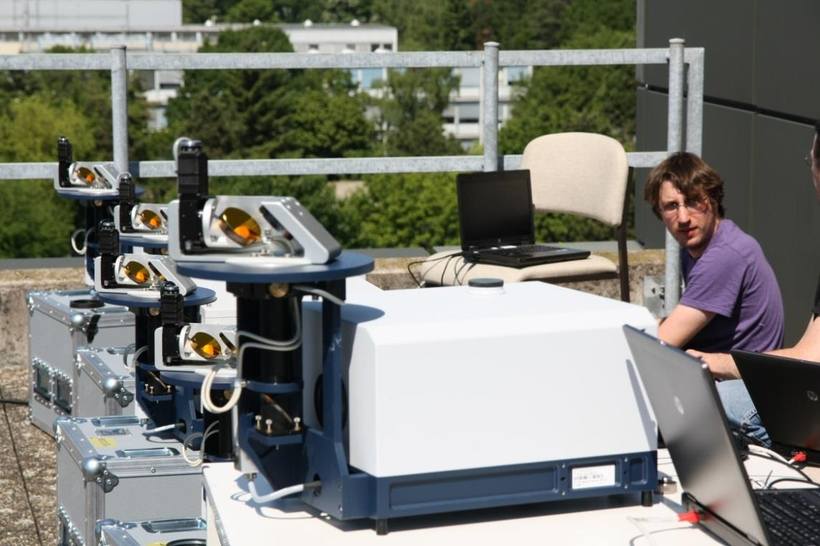
NDACC IRWG
TCCON
COCCON
Bruker IFS 120HR/125HR
Resolution 0.0036cm⁻¹
Spectral range: SWIR, MIR and TIR
Profile retrievals (DOF 1 to 5 depending on the species, independent atmospheric altitude layers)
https://www2.acom.ucar.edu/irwg
Bruker IFS 125HR
Resolution 0.02cm⁻¹
Spectral range: SWIR
Profile scaling retrievals
tccon.org
Bruker EM27/SUN and Vertex70/INVENIO
Resolution 0.5 and 0.2 cm⁻¹
Spectral range: SWIR
Profile scaling retrievals
http://www.imk-asf.kit.edu/english/COCCON.php

Slide 28
NDACC IRWG
TCCON
COCCON
Bruker IFS 120HR/125HR
Resolution 0.0036cm⁻¹
Spectral range: SWIR, MIR and thermal IR
Profile retrievals (DOF 1 to 5 depending on the species, independent atmospheric altitude layers)
Targets: O3, CH4, N2O,
(CO2, HCHO, SF6, CFCs, HCFCs, H2O, HDO not official)
CO, HNO3, HCl, HF, HCN, C2H6, CLONO2
(C2H2, PAN, OCS, CH3OH, NH3, HCOOH, NO2 not official)
Retrieval software: SFIT or PROFFIT
Measurements every ±10’
~ 26 stations worldwide
Measurement protocol, no central processing, QA/QC for selected targets in CAMS operational validation
Bruker IFS 125HR
Resolution 0.02cm⁻¹
Spectral range: SWIR
Profile scaling retrievals
(profile retrievals are in development)
Targets: CO2, CH4, N2O, H2O, HDO, CO, HF
Retrieval software GGG
Measurements every ~ 3’
~ 30 stations worldwide
central QA/QC
Bruker EM27/SUN and Vertex70/INVENIO
Resolution 0.5 and 0.2 cm⁻¹
Spectral range: SWIR
Profile scaling retrievals
Targets: CO2, CH4, CO, H2O
Retrieval software PROFFAST
Measurements every ~ 1’
> 150 instruments worldwide (some fixed sites, mostly for campaigns operations)
central calibration & processing facility at KIT, Germany
EM27/SUN as travelling standard within TCCON, COCCON can complement TCCON, support by ESA for COCCON-PROCEEDS and follow-up crucial for current capabilities of COCCON
VERTEX70/INVENIO spectrometers give the possibility to retrieve additional species in the MIR– with higher spectral resolution (FRM4GHG project https://frm4ghg.aeronomie.be)

Slide 29
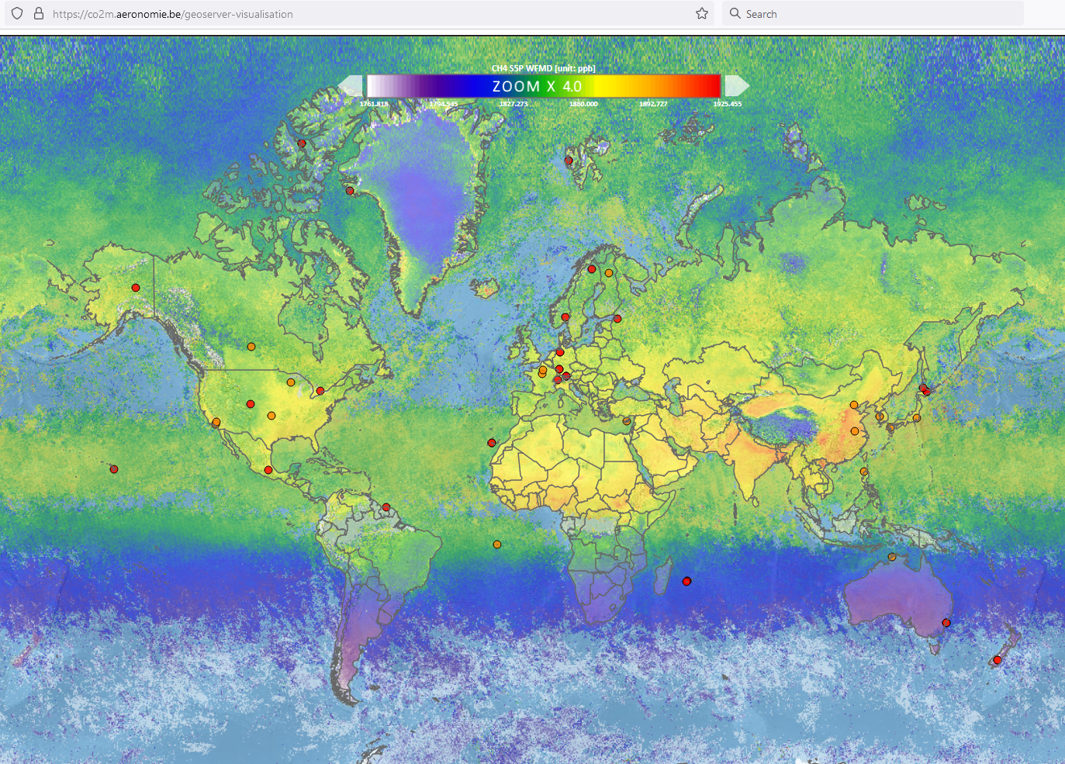
E.g. – FTIR sites operational (purple) and upcoming (red) in collaboration with local partners
MUCCNet – 5 instruments
COCCON Spain – 12 instruments
UK network – 10+ instruments
French network – 10+ instruments
…
Brussels
Invenio
COCCON
North Sea
EM27 TIR
SEMPAS
Ahmedabad
Invenio
COCCON
Bhopal
Invenio
COCCON
Xianghe
IFS125 HR
TCCON/NDACC
Kolkata
IFS 125HR TCCON/NDACC &
Vertex70
COCCON
Porto Velho
IFS125 HR
TCCON/NDACC
Morocco
Invenio
COCCON
Mbandaka
Invenio
COCCON
Yangambi
Invenio
COCCON
St. Denis & Maido
IFS125 HR
TCCON/NDACC

Slide 30
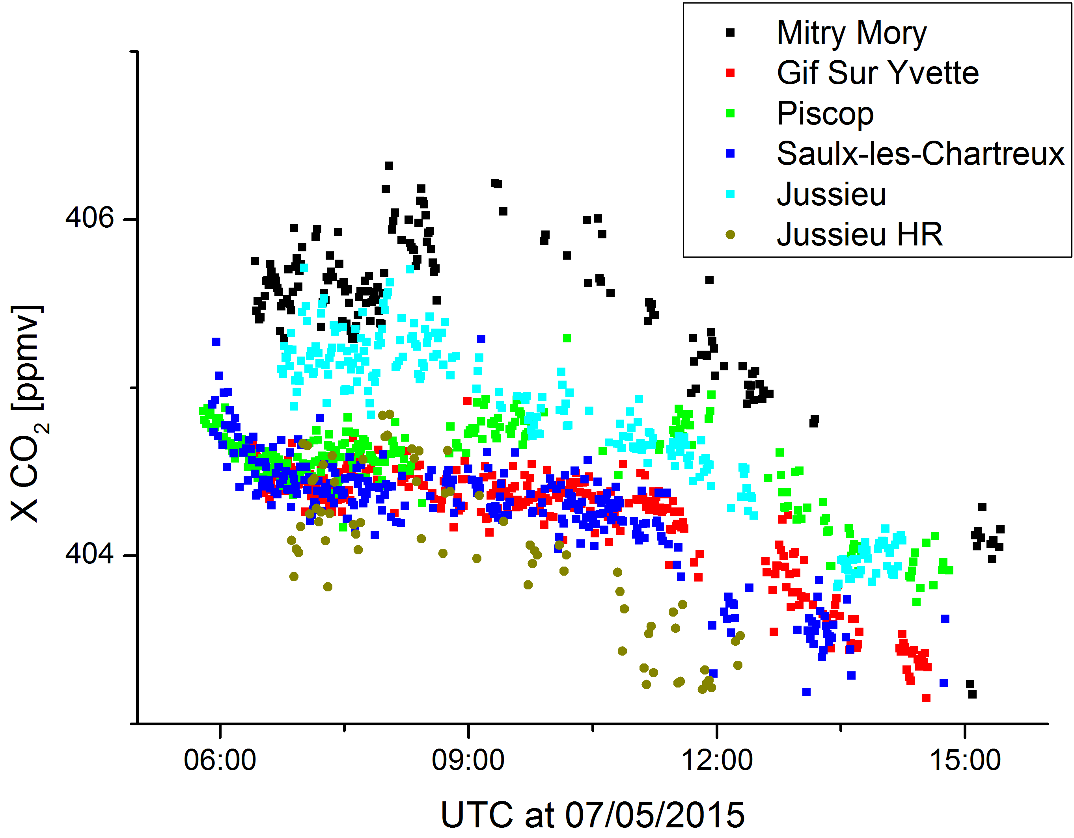
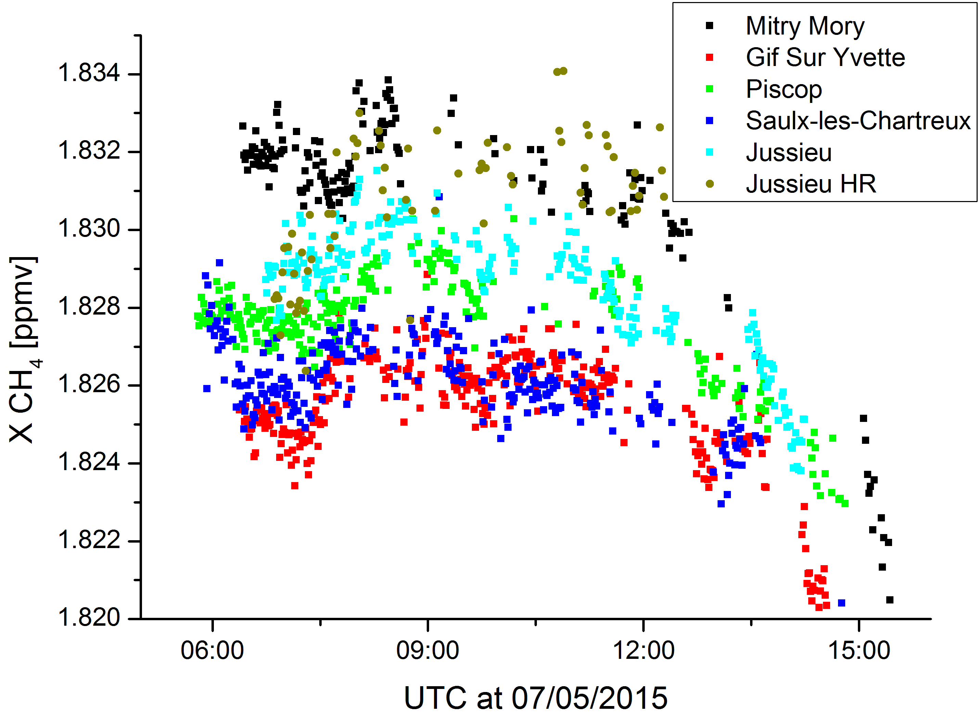
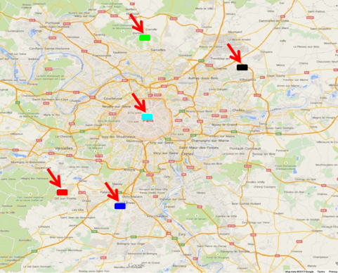
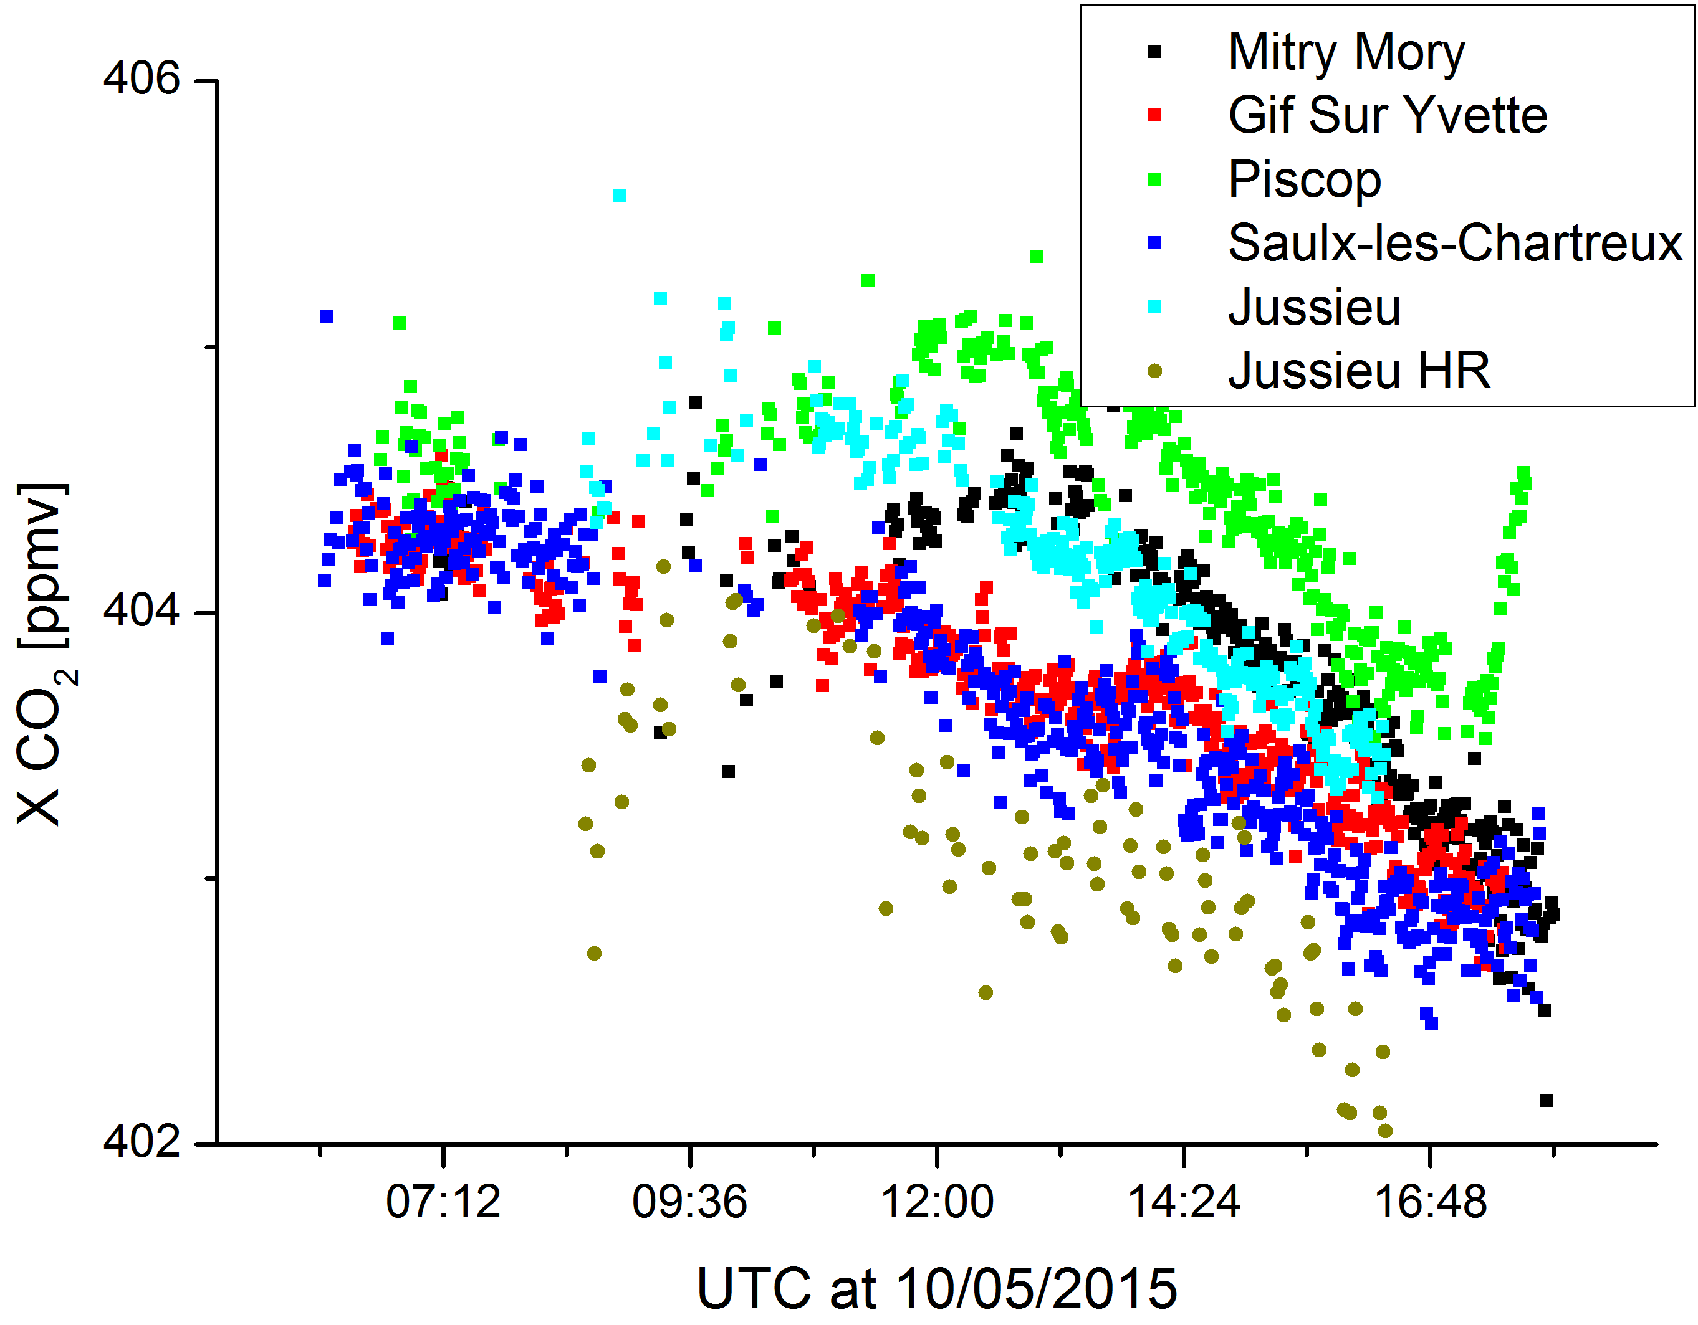
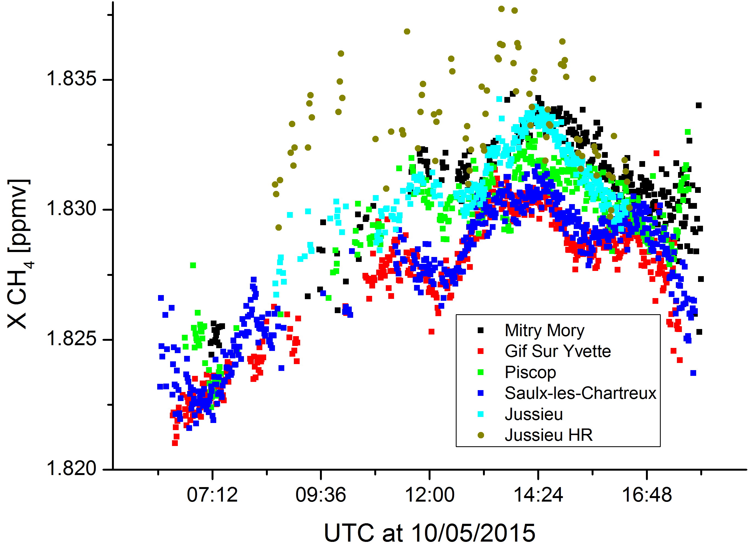
Tracking city emissions – Paris May 2015
Vogel et al., 2015; https://doi.org/10.5194/acp-19-3271-2019
F. Hase et al.: “The portable EM27/SUN FTIR spectrometer for GHG measurements”

Slide 31


Validation of Greenhouse gas (CH₄) model data
stratosphere
troposphere
Validation of CAMS reanalysis GHG model data: https://www.ecmwf.int/en/research/climate-reanalysis/cams-reanalysis
High resolution FTIR data can be used to validate model profile shape: stratospheric vs tropospheric
Need to improve accuracy of observed profiles

Slide 32
Thank you for your attention!
Questions / comments to mahesh.sha@aeronomie.be

