Slide 1

Status of the Radiometric Calibration Network: RadCalNet
M. Sinclair on behalf of M. Bouvet and the RadCalNet WG (CEOS/WGCV/IVOS)

Slide 2

What is RadCalNet?
Calibration
& QC
& Processing
Surface reflectance and atmosphere products
(RadCalNet specific)
Raw measurements
Site X
Hyperspectral TOA reflectance @ 30 mins interval for nadir view
RadCalNet portal
FTP
RadCalNet
Processing
&
QC
FTP
Calibration
& QC
& Processing
Surface reflectance and atmosphere products
(RadCalNet specific)
Raw measurements
Site Y

Slide 3
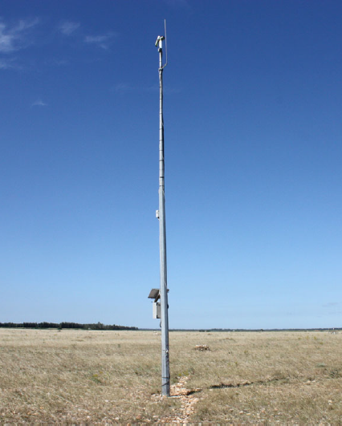
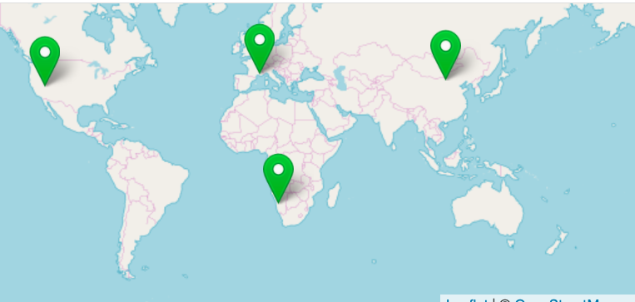
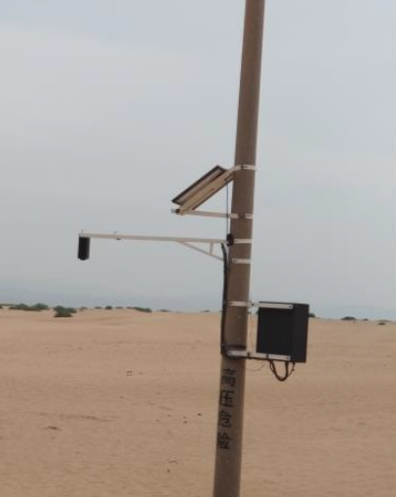
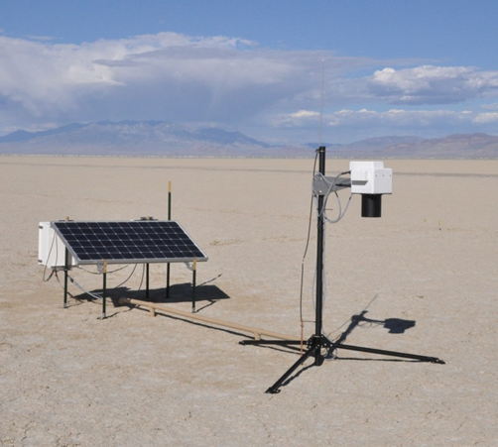
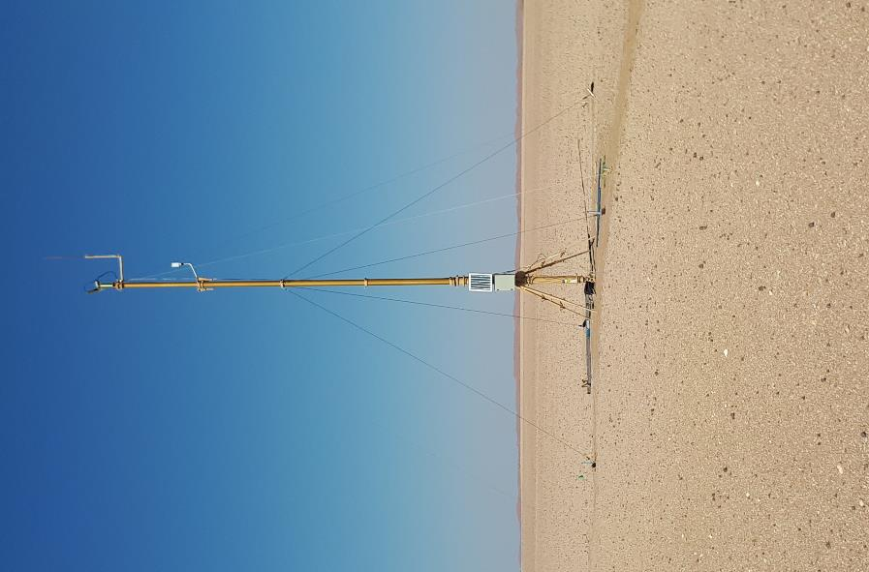
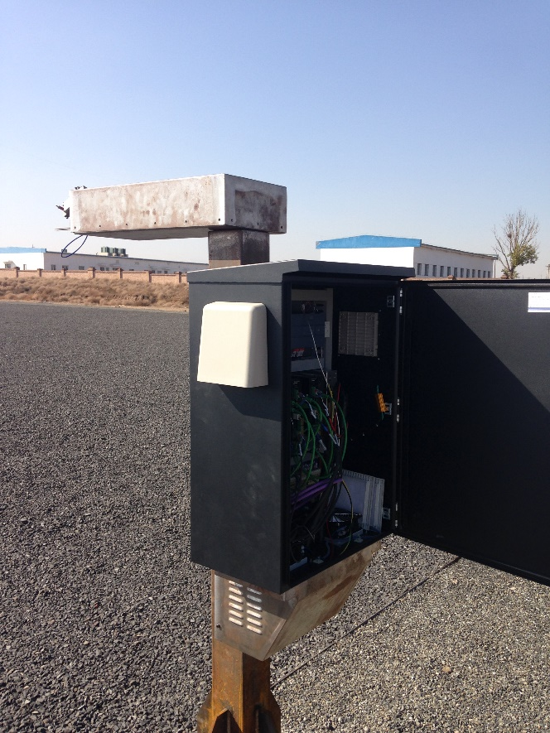
The RadCalNet sites
BTCN + BSCN
RVUS
LCFR
GONA
Today 5 sites (+ more in preparation)

Slide 4
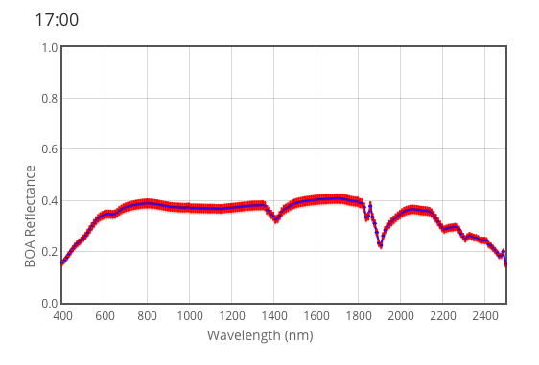
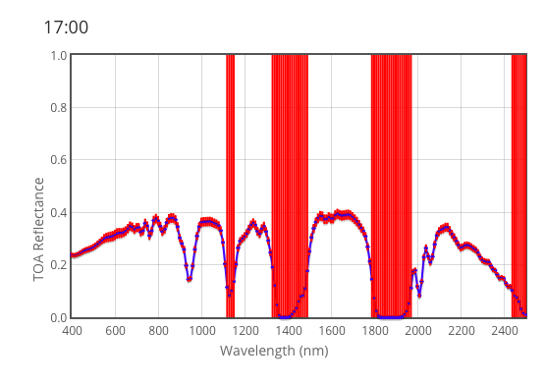
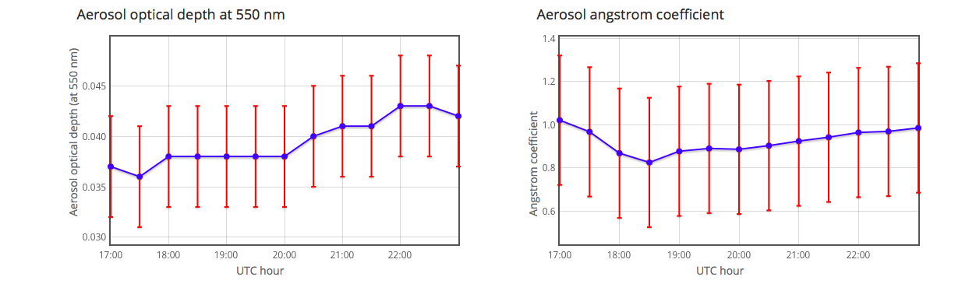
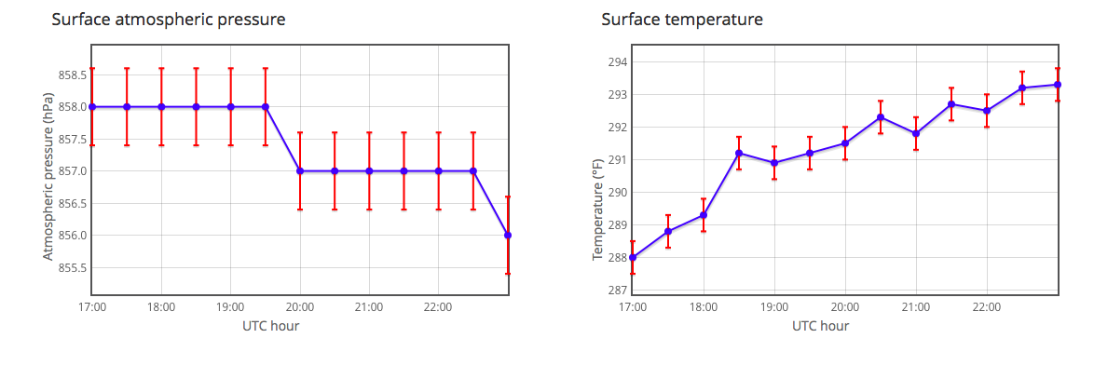
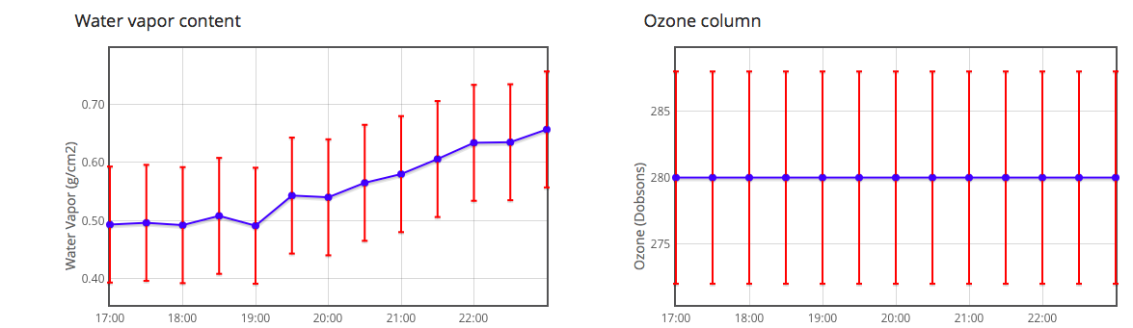
The data processing
Surface reflectance
TOA reflectance
RadCalNet
Processing (RTM)
Atmospheric measurements

Slide 5
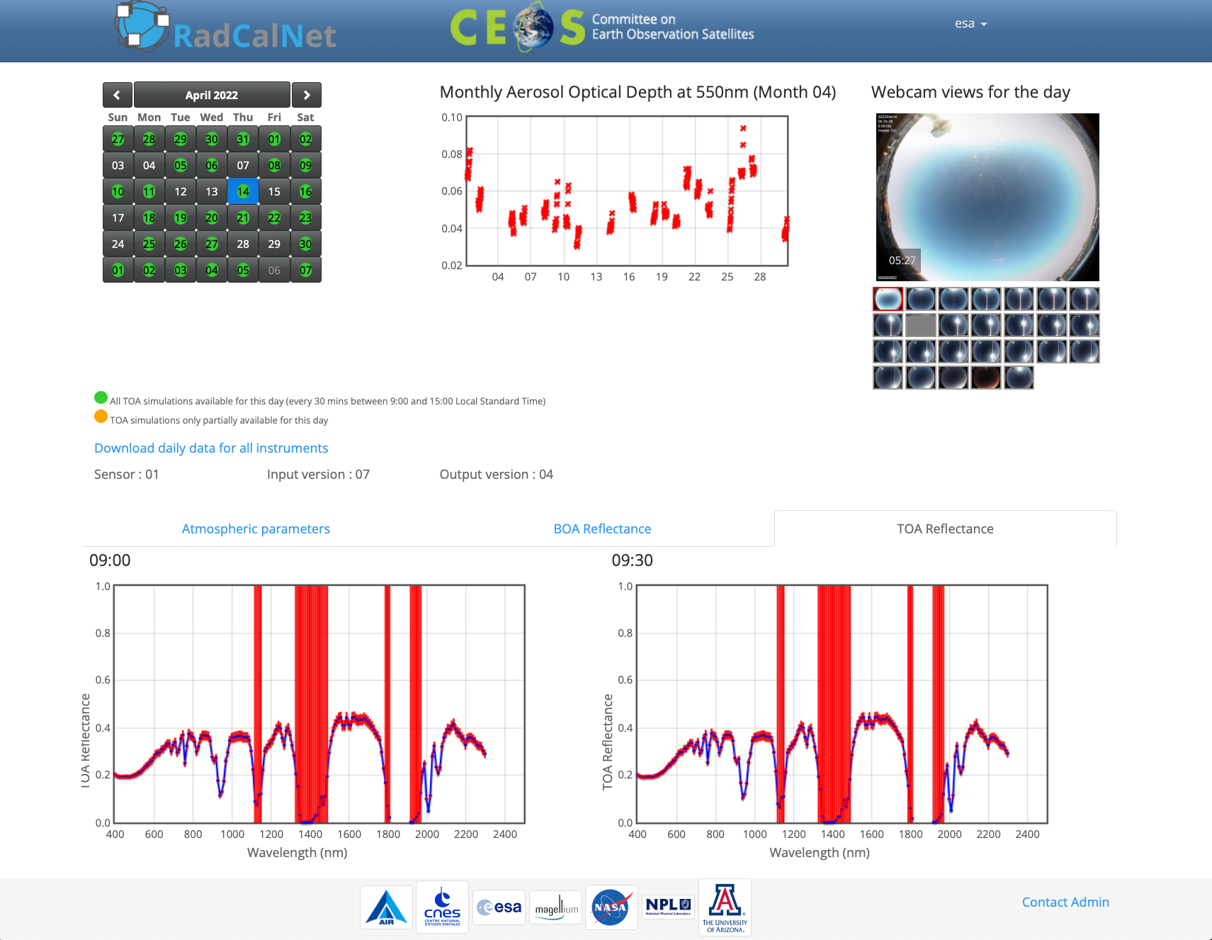
The portal

Slide 6
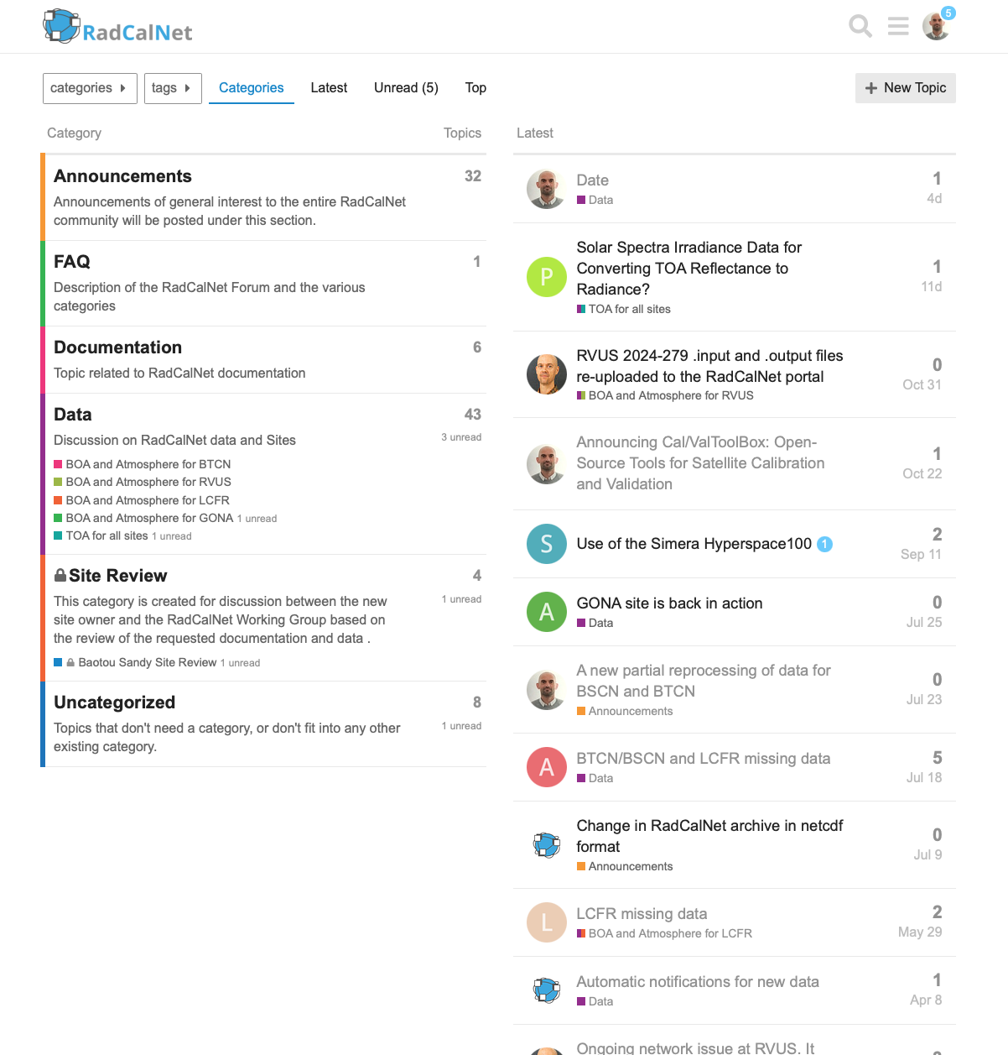
Forum

Slide 7
Data availability overview
The full archive provide more than 7000+ days worth of data from the 5 sites and spanning 13 years. Both ASCII and NetCDF format available
Data availability (requirement: > 90 days / year) generally constrained by weather conditions for non desertic sites.
Number of days/year with RadCalNet data availability at each site
Data latency (requirement: <2 weeks from acquisition) remains a challenge for several sites
Limited instrument availability at Gobabeb in 2025
Operation at Batou should resume in Q2 2026 (like every year after winter).

Slide 8
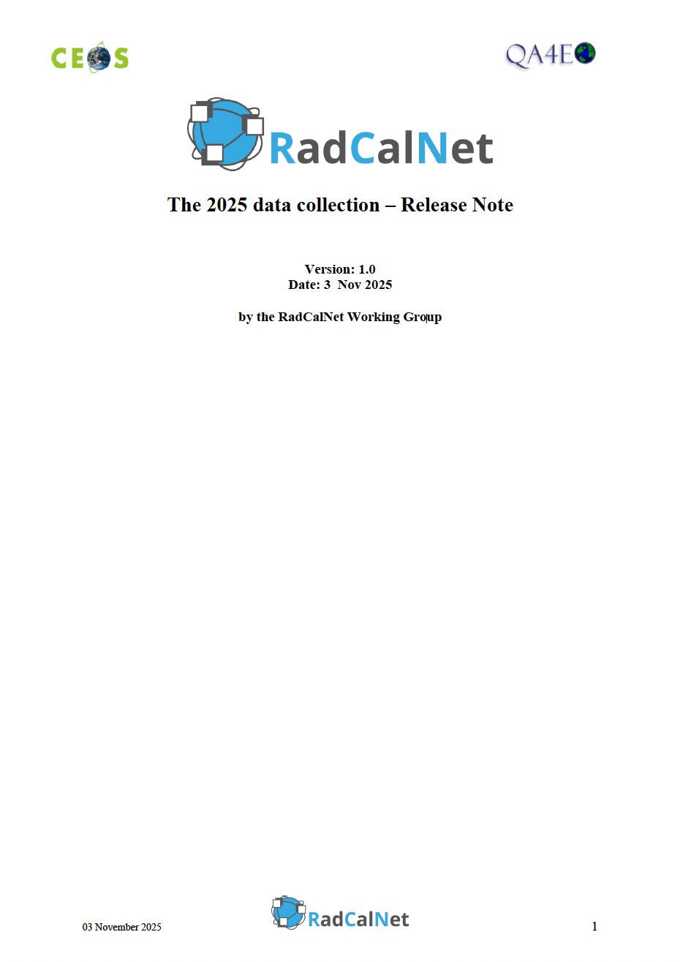
2025 collection release
RadCalNet archive updated on 3rd of Nov 2025
Full reprocessing of Railroad Valley Playa data:
  New NO2 and CH4 input data from Sentinel-5P TROPOMI
  Usage of AERONET Level 1.5 aerosol optical depth (rather than Level 2 data)
  The TSIS-1 v2 HSRS extraterrestrial solar spectrum rather than the Thuillier spectrum.
Reprocessing/modification of only few isolated dates for La Crau, Gobabeb and Baotou.

Slide 9
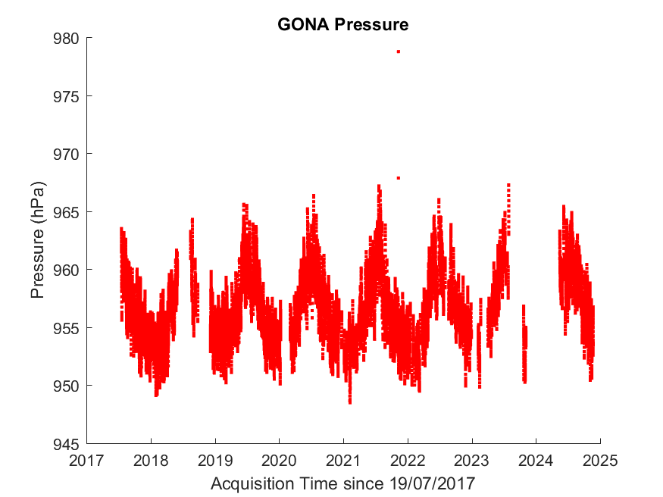
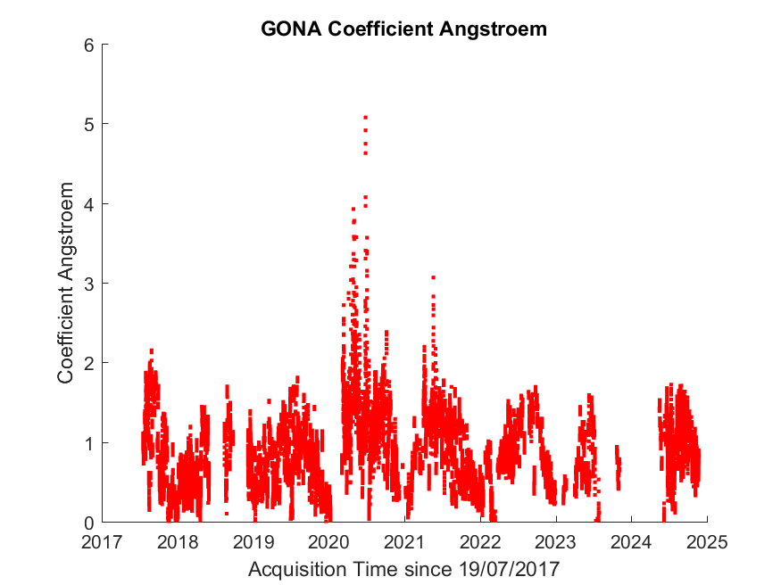
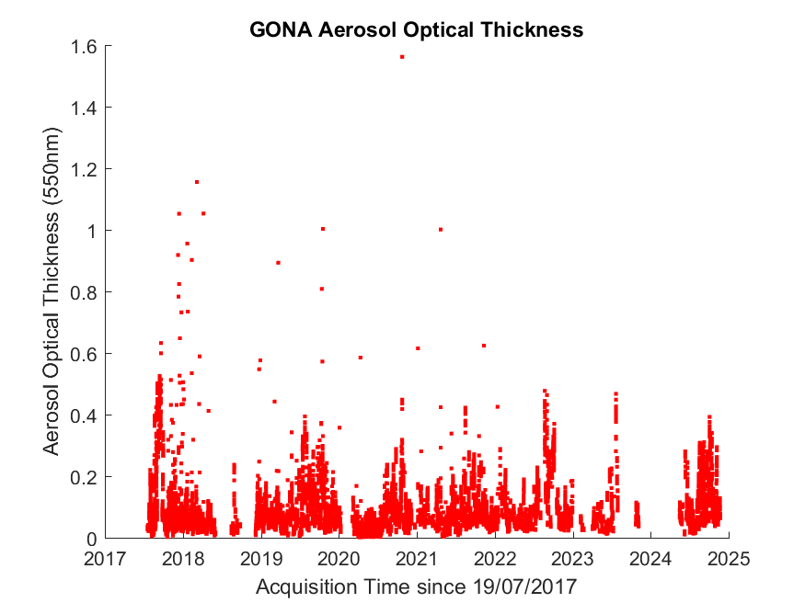
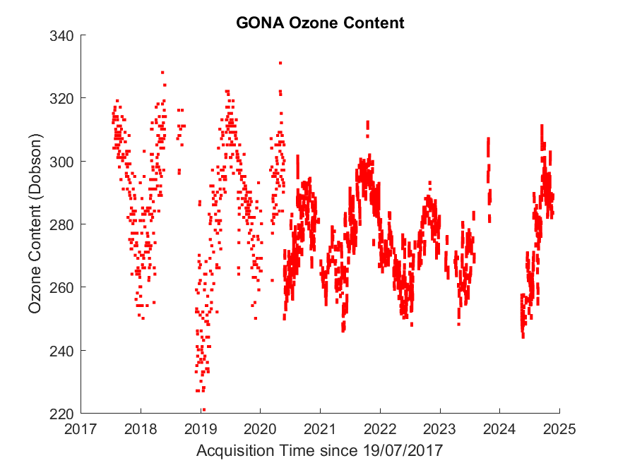
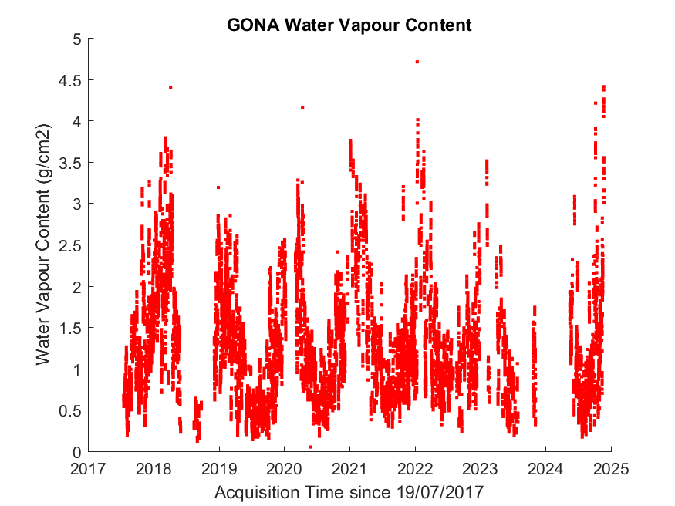
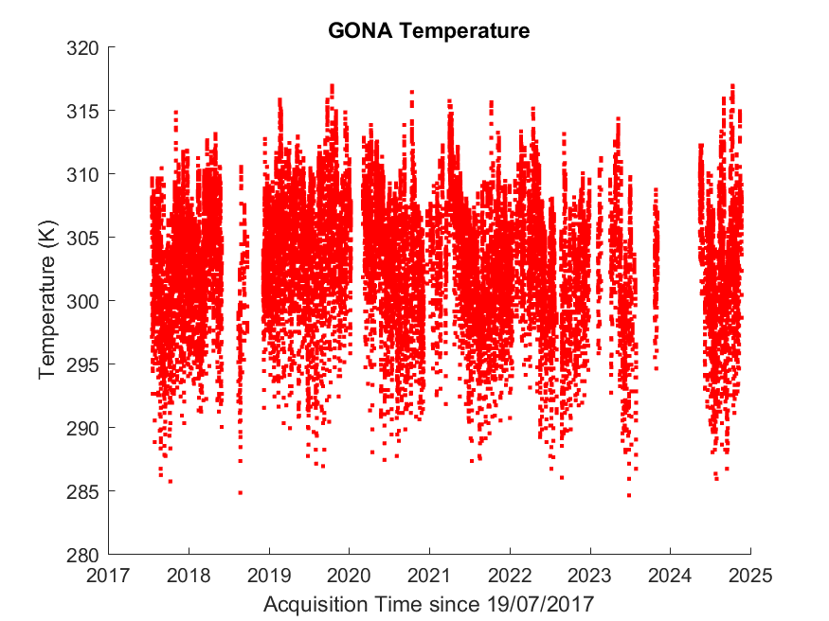
Quality control: an example with GONA atmospheric data

Slide 10
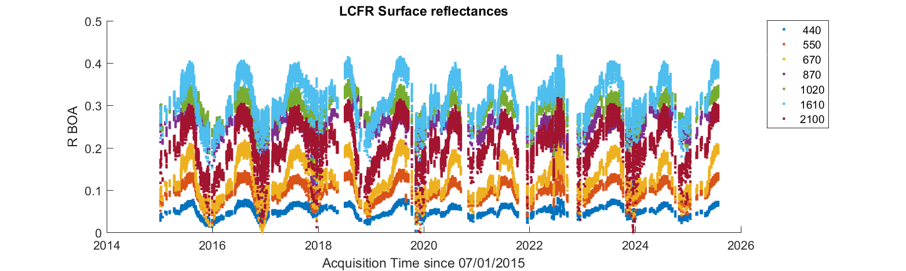
Quality control: LCFR surface reflectance

Slide 11
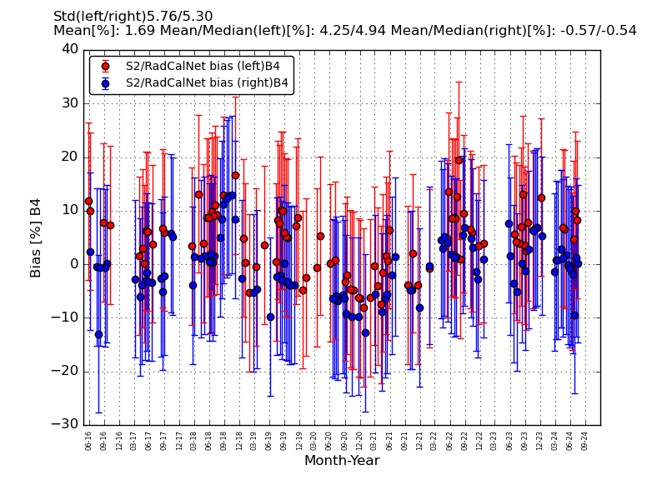
Comparison of Sentinel 2A to RadCalNet TOA at Railroad Valley Playa over archive
RadCalNet TOA reflectance available every 30 mins
Sampled at 10 nm spectral sampling interval
S2A geometry is not exactly nadir
BRDF effects not accounted for

Slide 12
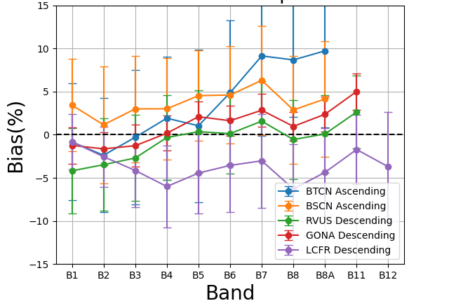
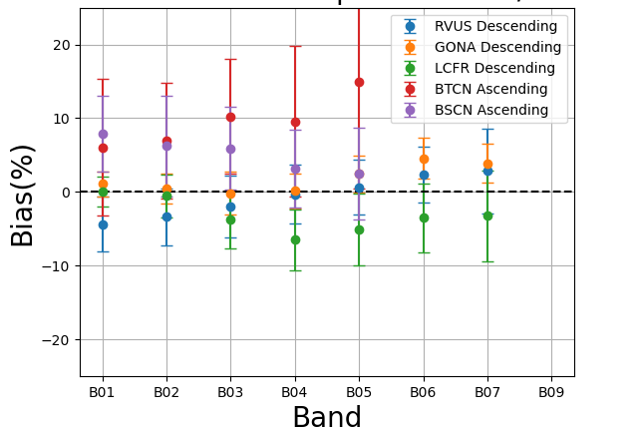
Site Intercomparison – 5 sites spectral synthesis
S2 vs RadCalNet TOA reflectance
L8 vs RadCalNet TOA reflectance
NB: S2/L8 spatial resolution NOT compatible with Baotou artificial target size (=BTCN).

Slide 13
Acceptance process for new sites
Candidate site owners provide 45+ days worth of data, a site description and document their uncertainty budget.
RadCalNet WG members review and a dedicated panel provides final recommendation for acceptance
Final assessment and acceptance by CEOS/WGCV

Slide 14
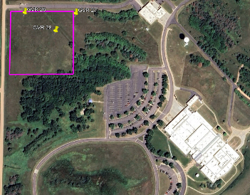
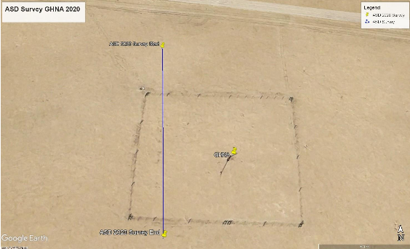
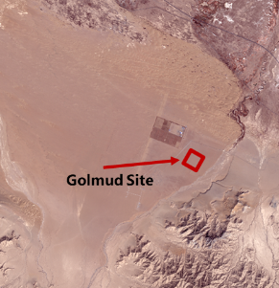
Figure 10: GHNA ASD Site Survey Line March 2020, GHNA mast marked in centre of fence square.
Figure 2: GoogleEarth site zoom
Upcoming sites
3 new sites have submitted their application to RadCalNet
Already prepared a 45+ days of data and site description and uncertainty statements
All gone through two rounds of review and comparisons to S-2 / Landsat data
From left to right: USGS EROS center (US), HYPERNETS Gobabeb (Namibia) and Golmud (China)

Slide 15
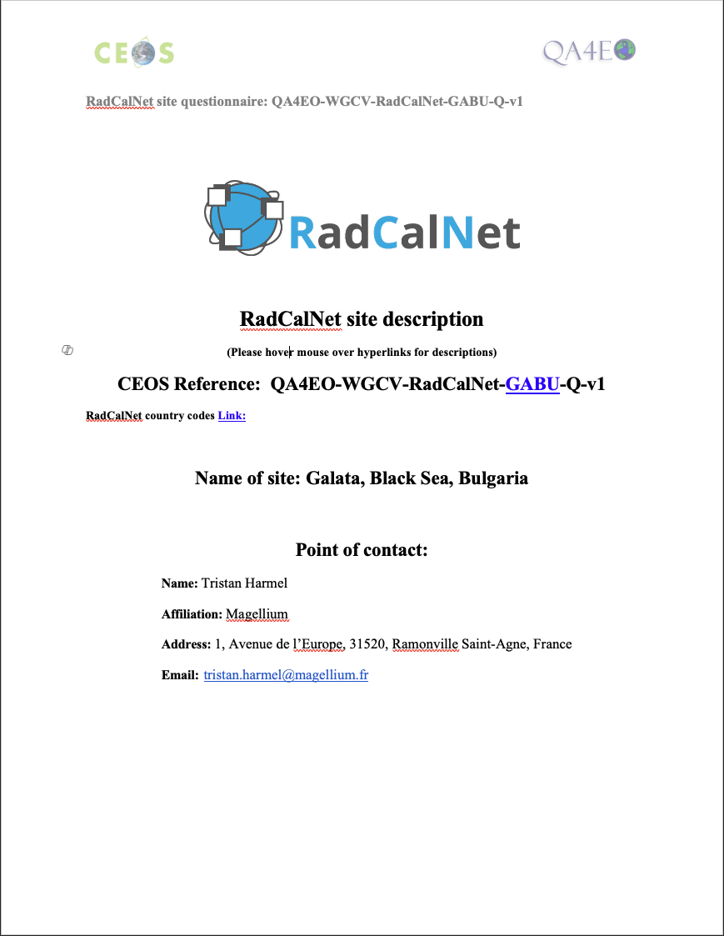
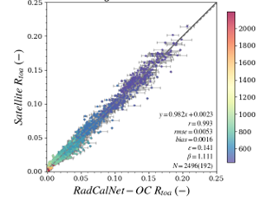
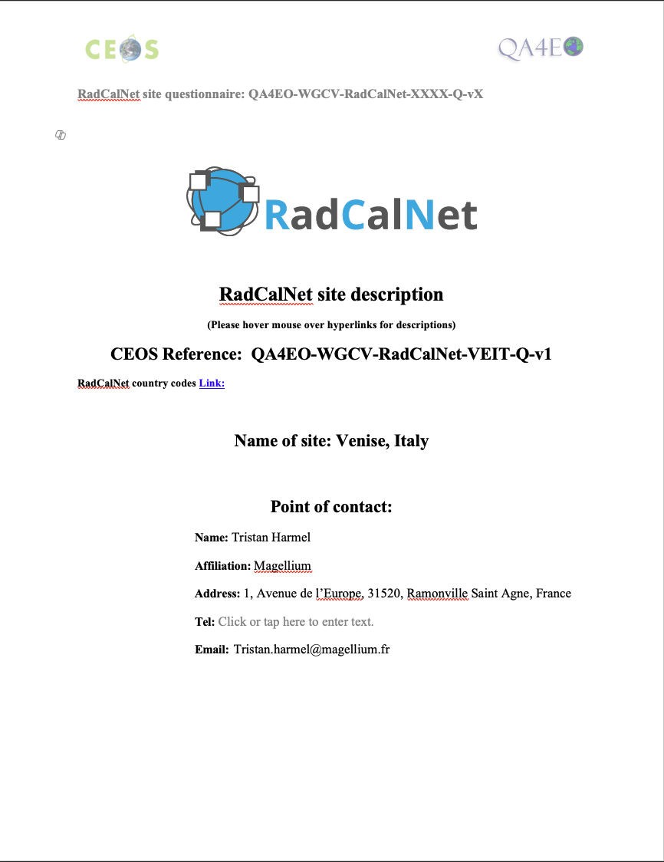
Oceanic sites for RadCalNet – in preparation
Match up comparison Sentinel-2 from 2017 to 2024 at Venice Tower
Development of a processing chain starting from AERONET-OC multipspectral water leaving radiance, generating hyperpespectral water leaving remote sensing reflectance (Rsr) and then TOA reflectance at RadCalNet geometry and temporal sampling.
Expected to be submitted for acceptance for Venice Tower (Italy) and Galata platform (Roumenia)

Slide 16
New Sites Status
Initial concept
Identify location
Set up instruments
Collect data
Prepare draft documents
Prepare submission
Submit application to RadCalNet
First Review
Second Review
Acceptance
Operation
DHCN
GHNA
GSCN
PIAU
ERUS
AERONET- OC sites
BTCN
RVUS
BSCN
LCFR
GONA

Slide 17
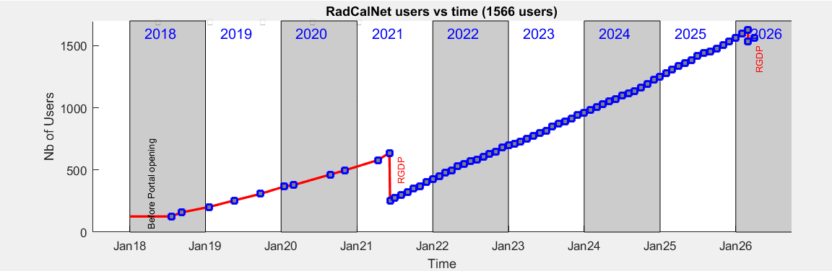
Users

Slide 18
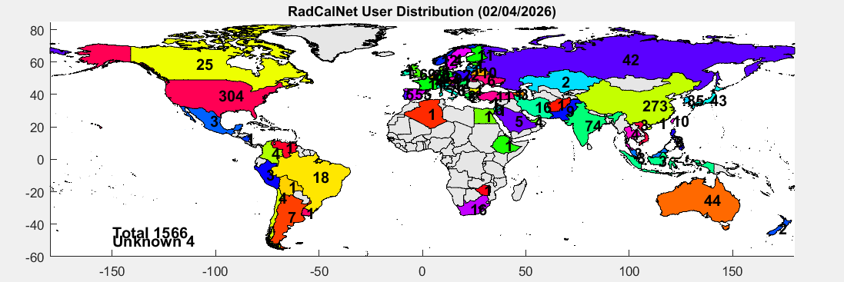
Users
71 countries
Top 3 : US, China, South Korea
18/05/2026
18

Slide 19
Conclusion
8 years of RadCalNet operation
5 sites currently providing data and 3 new sites about to join the network
Golmud submitted for acceptance to WGCV
New 2025 data collection available
An archive spanning 13 years and cumulating 7000+ days of data for EO sensor radiometric assessment
Continuous efforts to maintain data quality and improve timeliness of data
Growing user base

Slide 20

Thank you

