Slide 1


ESA/NASA QA Framework for EO Products
Sam Hunt¹, Leonardo De Laurentiis², Clément Albinet², Jaime Nickeson³, Guoqing Lin³, Philippe Goryl², Dana Ostrenga³, Nigel Fox¹
(1) NPL, (2) ESA, (3) NASA

Slide 2
Outline
Motivation for a QA Framework for EO Products
ESA/NASA QA Framework
Future – Automated Performance Monitoring

Slide 3
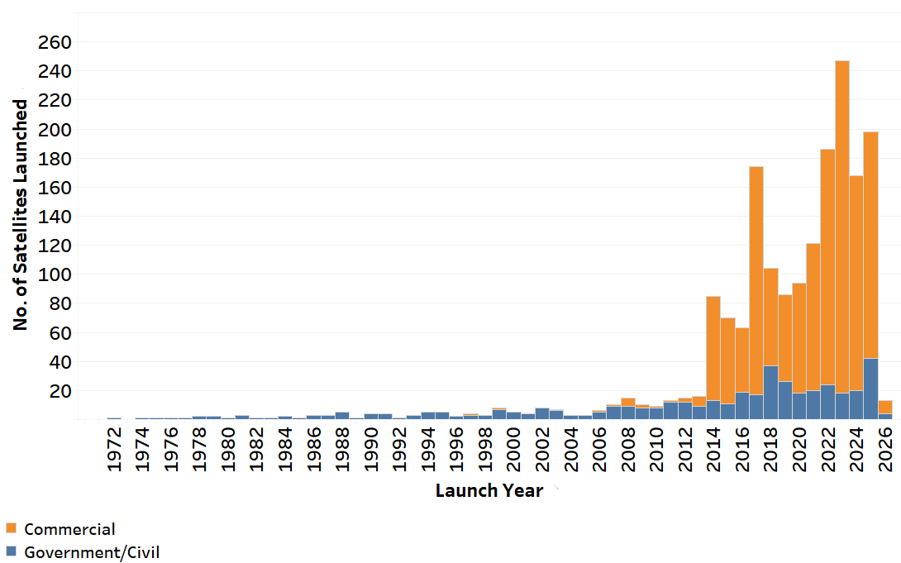

Commercial Satellite Sector Growth
Currently there are around 1000 commercial satellites in orbit in the electro-optical, SAR, hyperspectral, AIS/RF, and hybrid domains from the US, China and other nations.
In 2030, it is projected that there will be over 8000, with the most explosive growth in the hyperspectral and hybrid sensor domains.
The need for systematic evaluation of commercial satellite data will only grow.
(source: the US National Geospatial-Intelligency Agency)

Slide 4
The Value of QA
Mission success is dependent upon quality assurance. Evidencing data quality adds significantly to the value of datasets.
Gives potential customers the confidence data is fit for their purpose.
Many aspects of data quality are aimed at facilitating communication to users → required for e.g. to interoperability.
…

Slide 5
QA Standards
Developing increasingly comprehensive definition of mission quality:
Analysis ready data & interoperability – CEOS ARD
Fiducial reference measurements – CEOS FRM
Traceability – FRMSats
Uncertainty evaluation e.g. Copernicus missions, QA4EO framework
Need identified to define a coordinated, systematic approach to EO QA, to keep up with pace of development, by implementing a QA standard

Slide 6
Assessment Philosophy
The assessment framework is aimed at verifying claimed mission performance and adheres, where applicable, to community best practices to an extent that is “fit for purpose”.
Assessment divided into two parts
  Review of mission quality as evidenced by its documentation
  Validation analysis performed by mission quality assessor

Slide 7
QA Framework Definition
Coordinated NASA/ESA activity to define such a standard:
Generic Guidelines developed to define general framework for satellite mission quality analysis. Results of analysis reported in maturity matrices.
Specific implementations are generated from this framework for separate sensor type requiring different approaches for those specific mission domains
Generic Assessment Framework implemented in detailed domain-specific guidelines. So far there are optical, SAR, atmospheric, DEM (draft), altimetry guidelines.

Slide 8
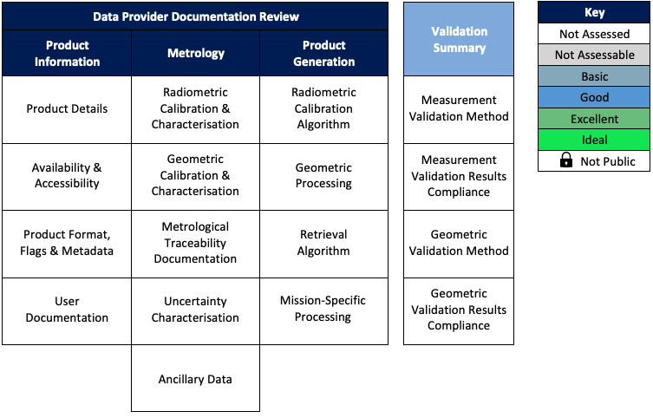
Framework Structure
Validation Summary
Summarises validation activity undertaken by assessor
Data Provider Documentation Review
Review of mission quality as evidenced by its documentation
Product Information
Review of descriptive information accompanying products
Metrology
Review of underpinning evidence for observation quality
Product Generation
Review of “fitness for purpose” of product generation
Notes:
Taking some time to talk through

Slide 9
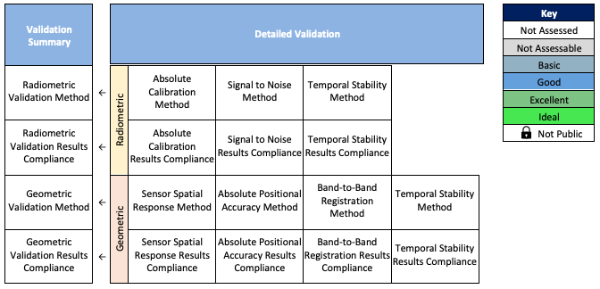
Detailed Validation Matrix – Optical
Provides the expert user more detailed validation information, metrics domain-specific
Validation Areas
Divides been validation activities e.g. radiometric, geometric
Validation Metric
Highlights key metrics in each validation area
Method
Review of quality of method e.g. reference data quality
Compliance
Comparison of validation result and claimed performance
Notes:
=

Slide 10
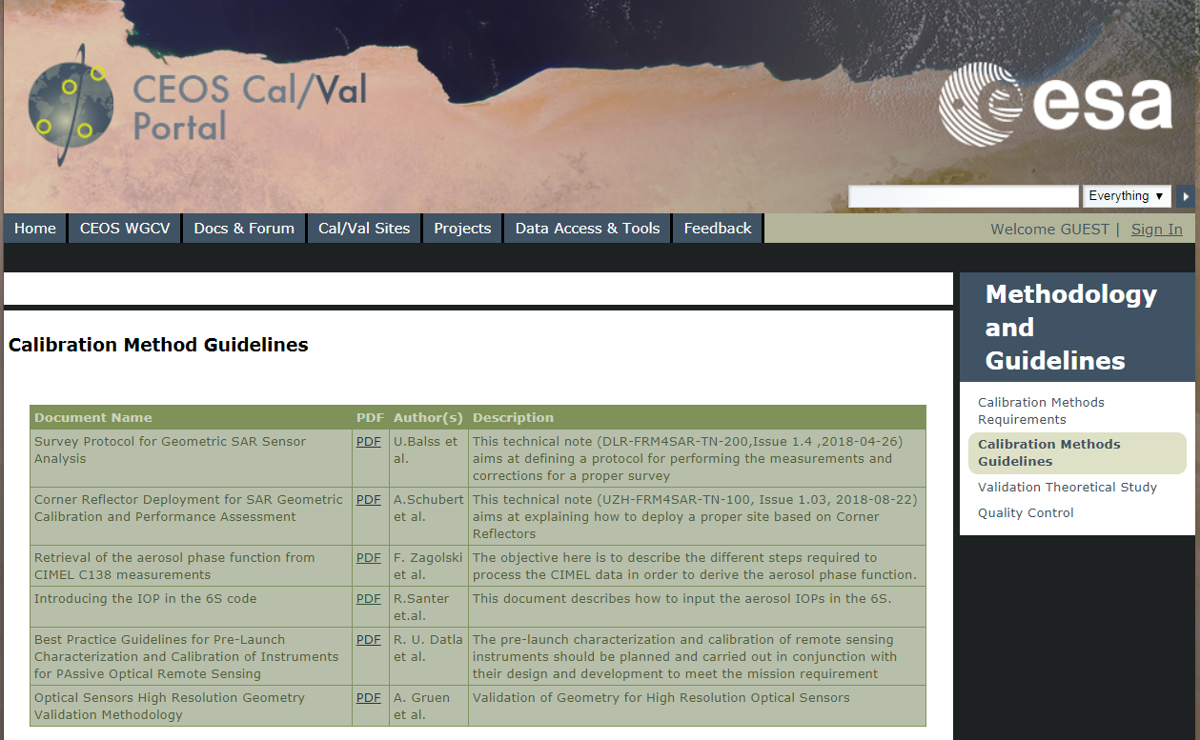
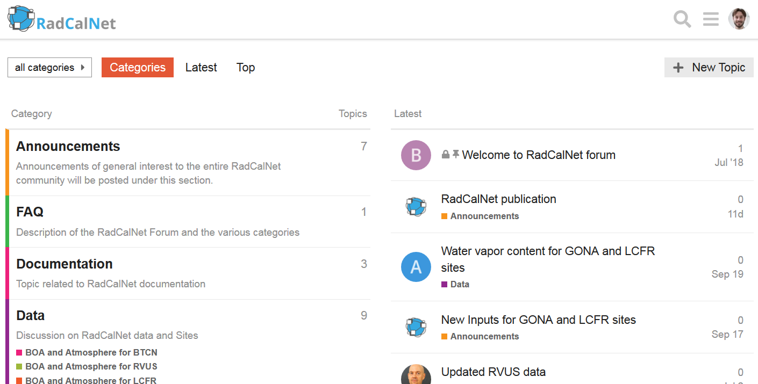
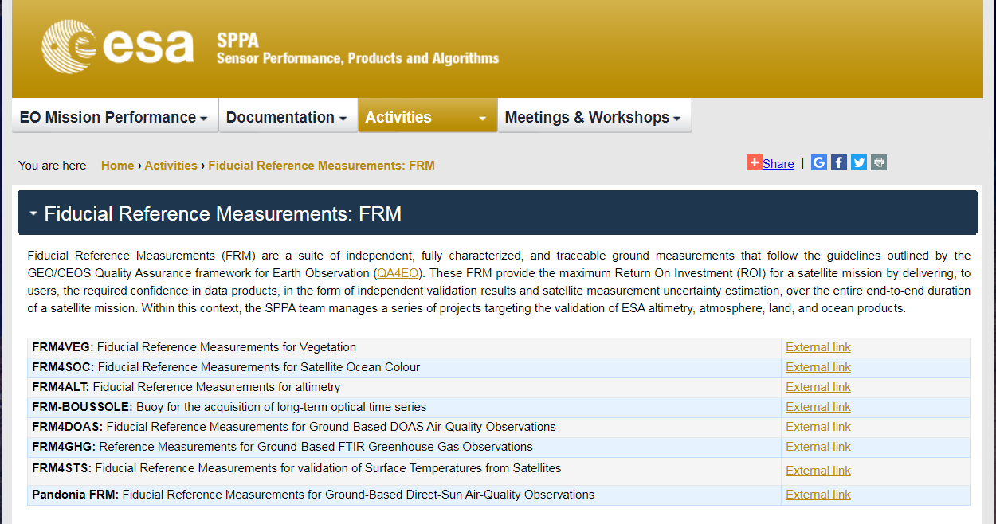
Example of Best Practice
Sensor Characterisation and Calibration
Link to good practice material available from a variety of sources:
CEOS Cal/Val portal, e.g. definition of PICS
RadCalNet portal
ESA FRM Projects
Scientific literature
This framework is a customer of FRM data

Slide 11
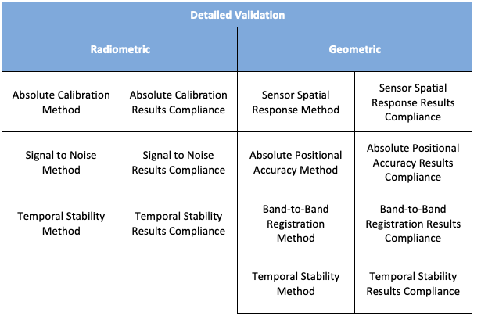
Approach to Assessments
This framework is something data producers can refer to as they define products and evidence themselves.
Assessment process is an interactive activity between assessors and missions.
Not an academic exercise – provides real value to customers. Space Agencies are justifying their data buys on this!

Slide 12
Summary
Comprehensive standard for mission quality defined by ESA & NASA.
Generic Assessment Framework implemented in detailed domain-specific guidelines. So far there are optical, SAR, atmospheric, DEM (draft), altimetry guidelines.
Has been piloted in numerous ESA/NASA commercial mission QA evaluations.

