Slide 1
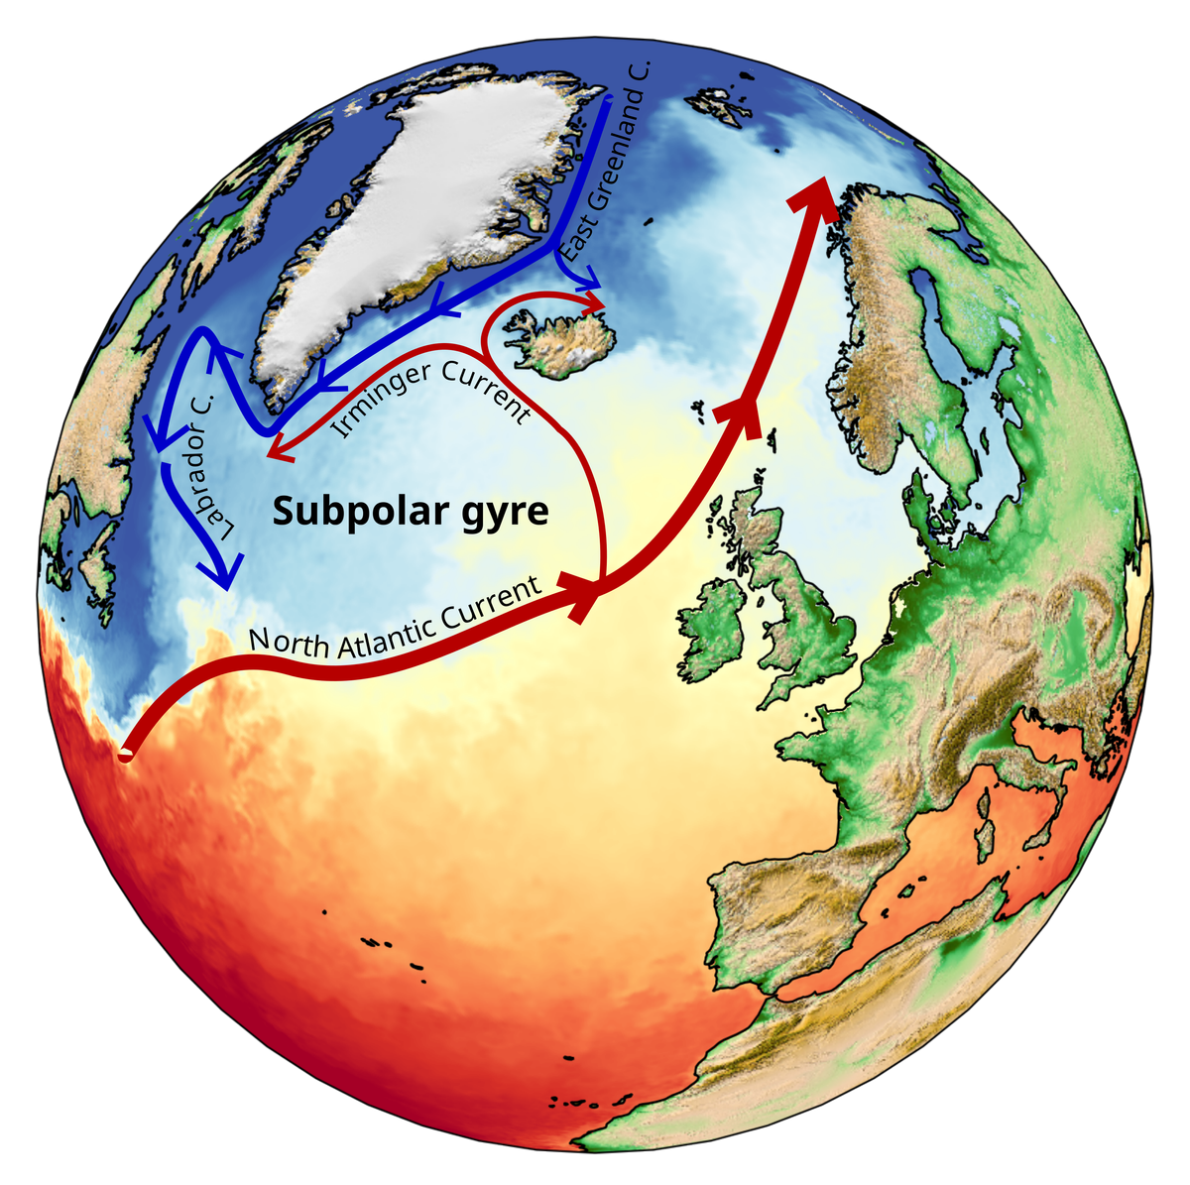
ARIA Forecasting Tipping Points: Experience of using CEOS-FRM framework for non-satellite purposes
Emma Woolliams
Map. © Beatriz Arellano Nava, University of Exeter

Slide 2
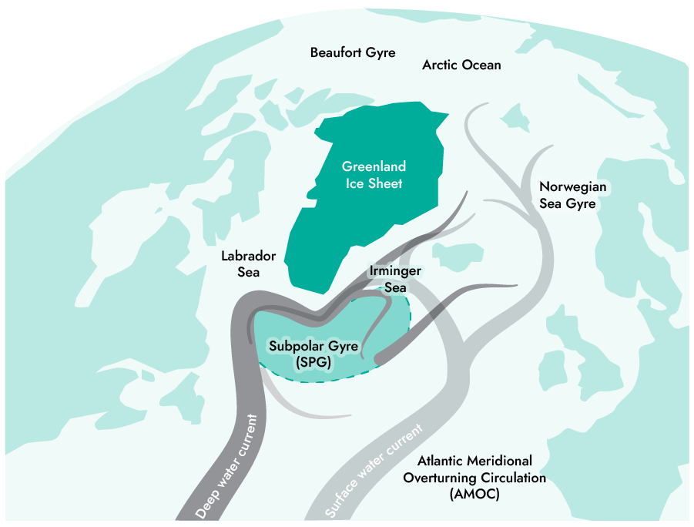
ARIA Forecasting Tipping Points programme
→ Observations
Modelling
Forecasting
www.aria.org.uk/forecasting-tipping-points

Slide 3
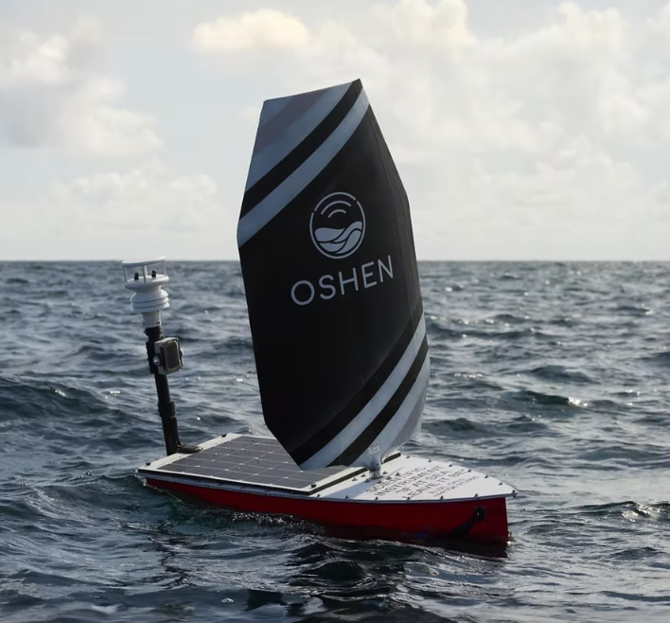

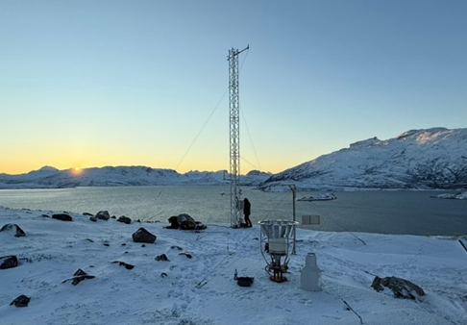
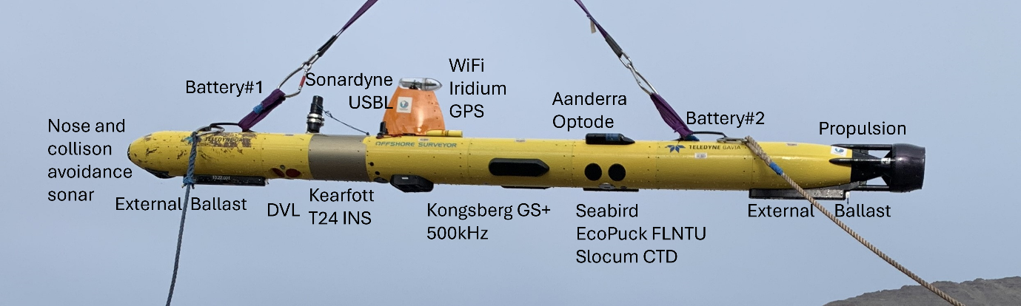
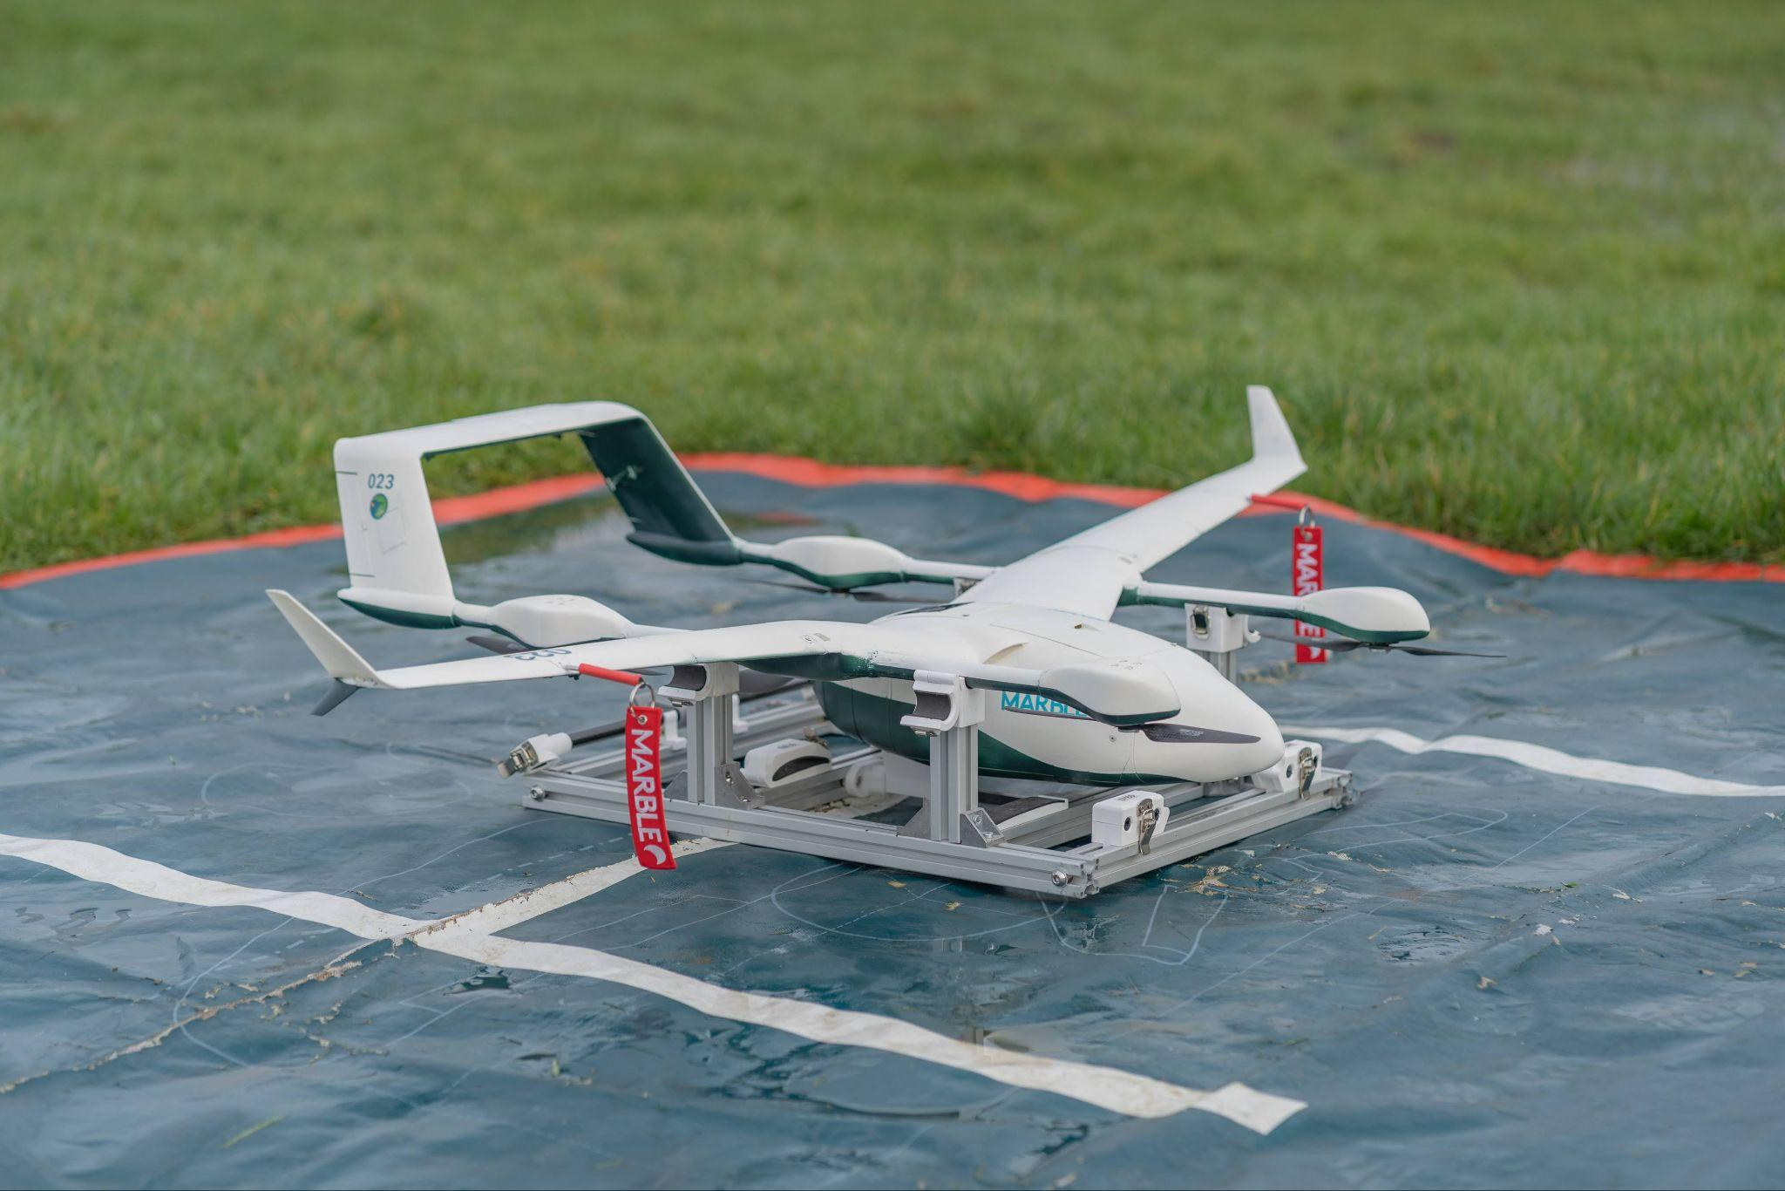
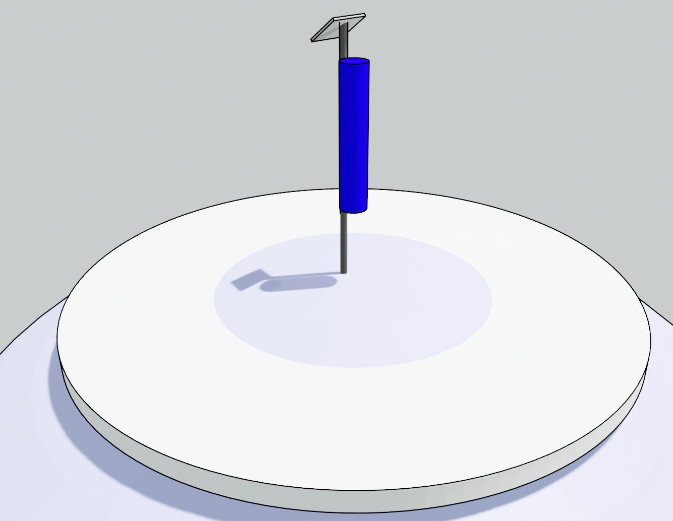
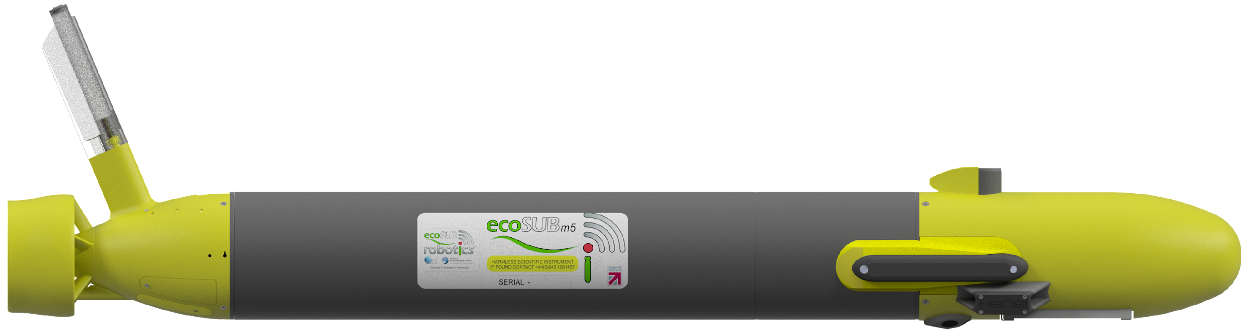
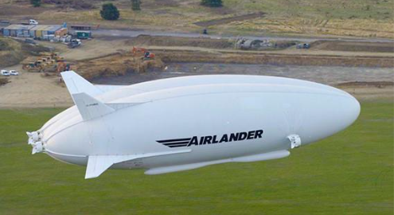
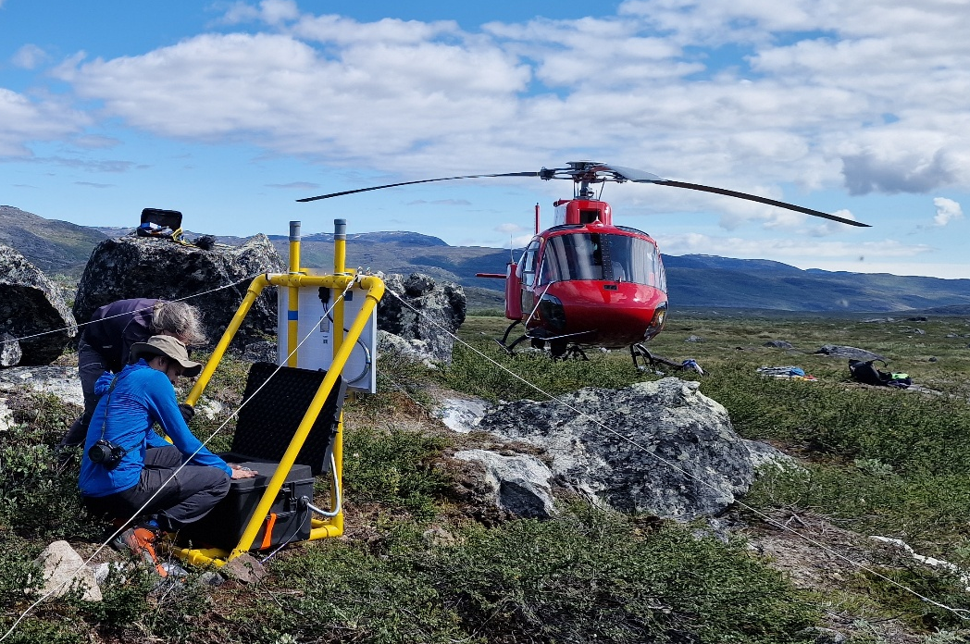
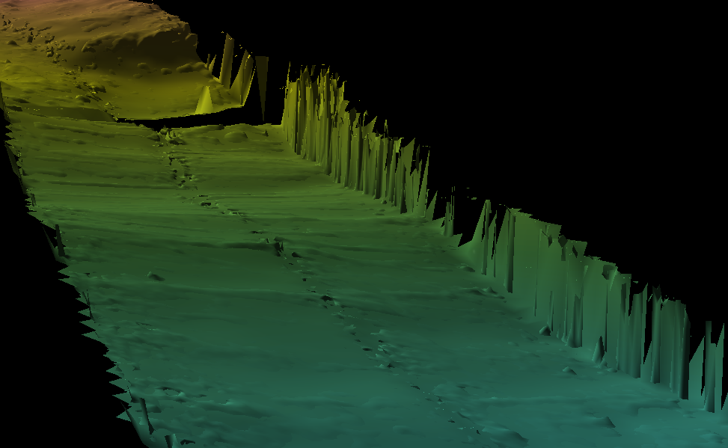
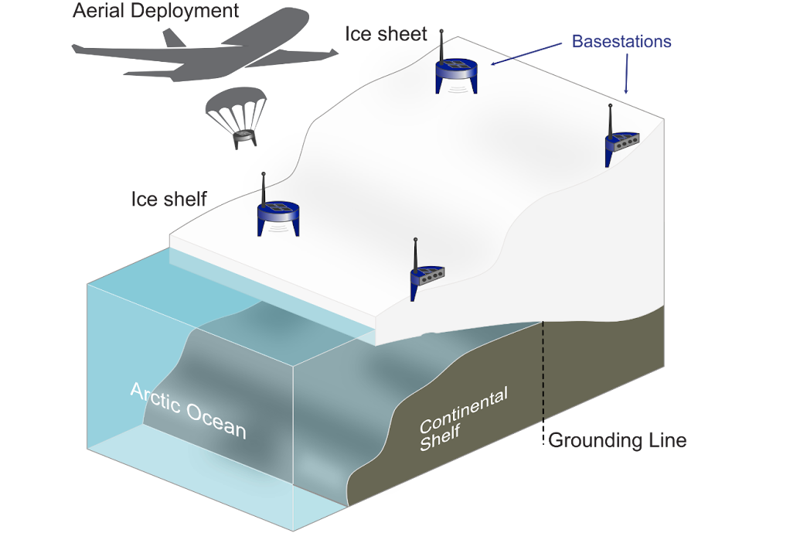
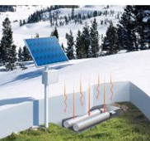


A diverse and challenging set of observational systems
Three types of challenge:
Mature instruments in extreme and remote environments
Measurements on novel platforms
Entirely new sensing approaches
4m long
AIRSHIPS
1m long
HAPS
Ice face sitting on seafloor
Glacier
Ice sculpted seafloor
DRONES
170 m deep seafloor

Slide 4
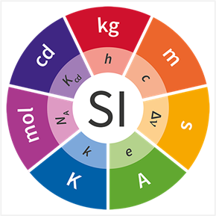
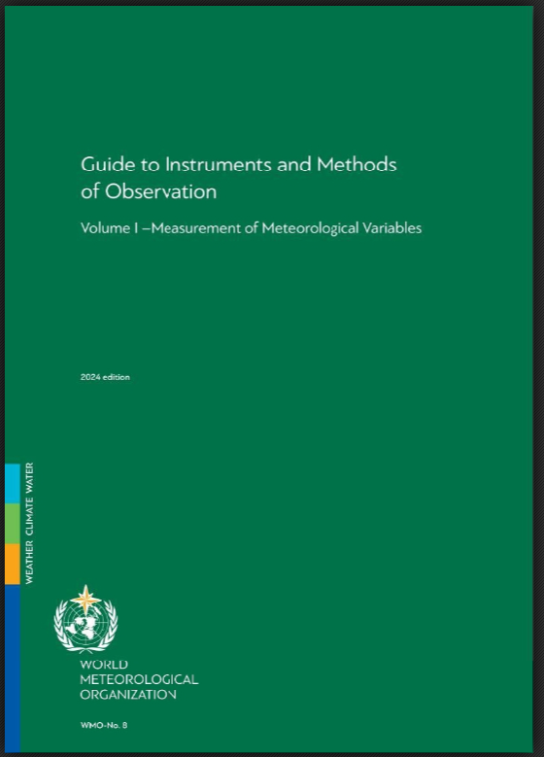
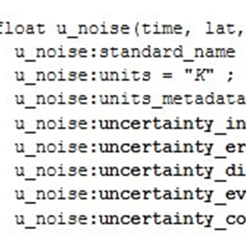
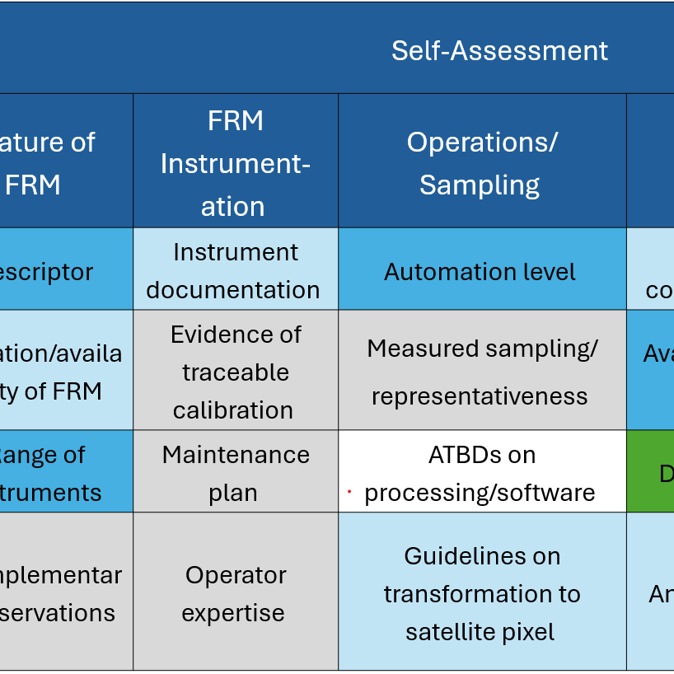
CCT1: Calibration, Validation and Standardisation
Metrological principles
Traceability, uncertainty, validation
Community good practices
Instrument operation, data analysis, QC
Standard document and data formats
Common data and metadata standards
Summary information for dataset users
Clear, useable documentation
Notes:
At the core of our theory of change in the Forecasting Tipping Points programme is that to develop an affordable, sustainable and justified early warning system (EWS), we must unlock the value of low size, weight, power and cost sensing (SWaP-C) instrumentation and capitalise on the phenomenal pace of innovation in artificial intelligence (AI). A core challenge for actionable forecasting is the traceability of uncertainty - how confident can we be in any EWS forecast given the origin and magnitude of the uncertainty? A robust EWS depends on high-quality, interoperable measurements and a deep understanding of the uncertainties inherent in sensing, sampling and modelling processes.

Slide 5

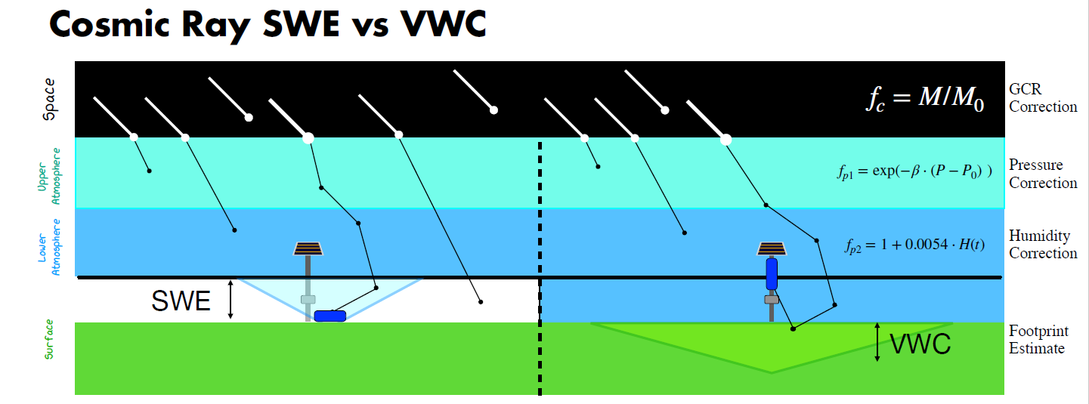
Measuring snow depth with cosmic rays
Novel sensing approach – no established good practice

Slide 6
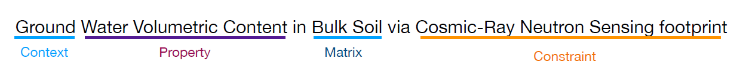
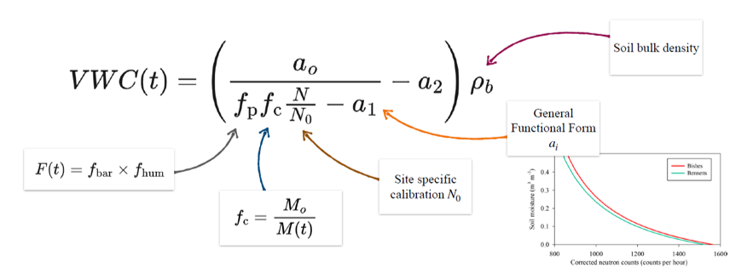
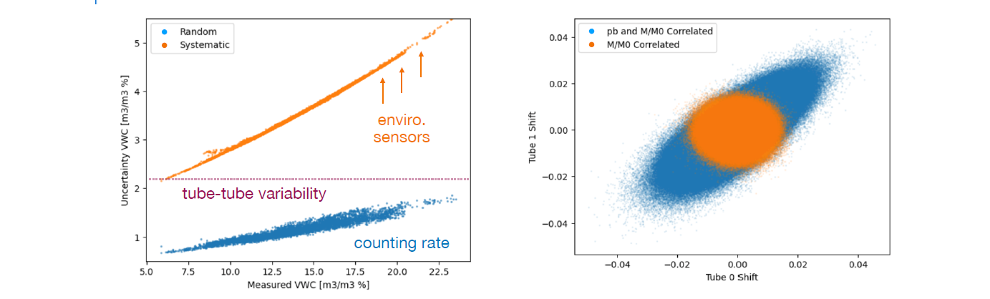
Instrument developer applied the QA4EO Five Steps
Step 1:
Step 2:
Step 3 and 4:

Slide 7
What we learned applying QA4EO Five Steps across different systems
Novel sensing approach
Cosmic Ray Snow Depth
  “Process is long but
  extremely valuable”
  Identified circularity in traceability when adapting soil moisture approach
  Changed laboratory plan for how to calibrate instrument
Standard instrument, novel platform
Oshen boat weather stations
  Standard instrument on
  novel platform
  Able to adapt WMO good practice guidelines to support applying QA4EO Five Steps
  Led to defining two distinct products: temperature at measurement height and temperature at 2 m.

Slide 8
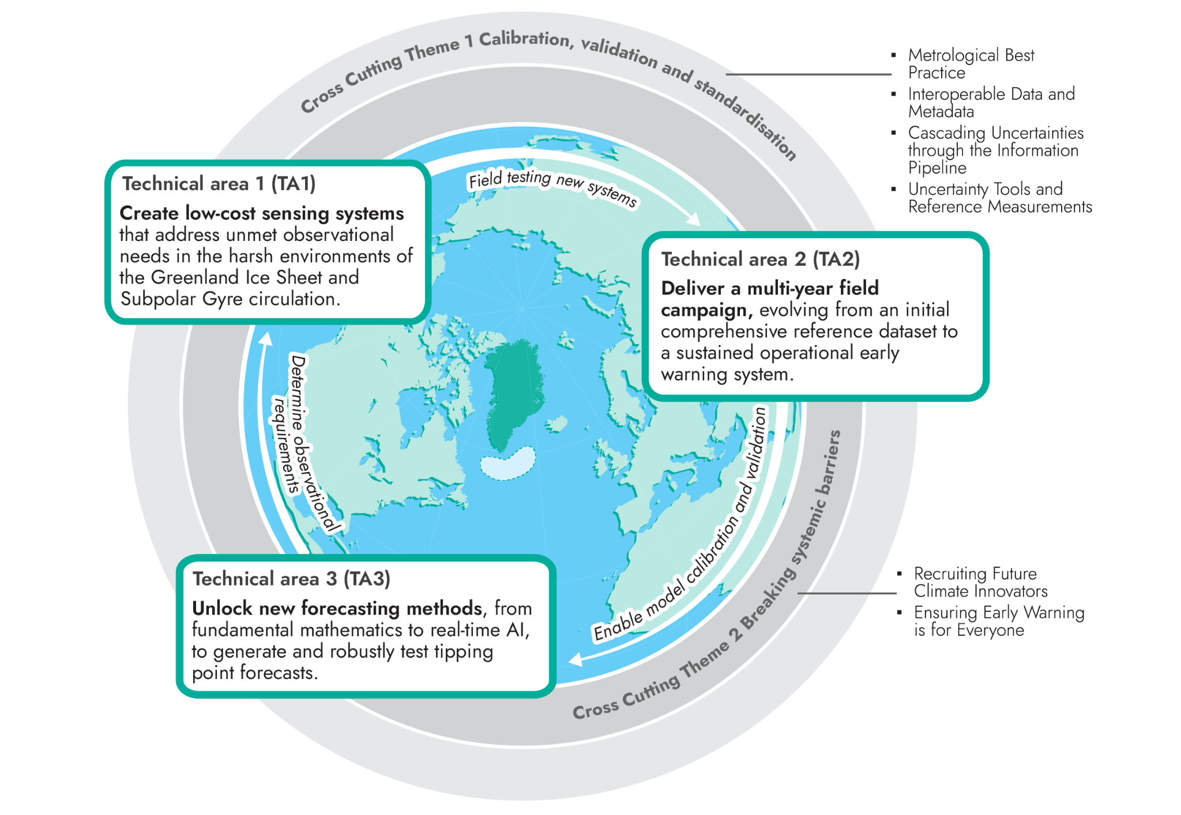
Providing consistency across the programme (CCT-1)
CCT-1 supports:
Observational system providing robust data for societal early warning system
Observational data having long term legacy
Providing consistent information to allow users to assess fitness for purpose
Notes:
So far I’ve focused on applying QA4EO at the level of individual measurements. “But within CCT-1, we’re working at the programme level — across all of these different systems and activities.”

Slide 9
Adequacy depends on intended application
A key principle of CEOS-FRM:
Datasets are judged in terms of how well they meet the requirements of their intended application.
Datasets may be used beyond their intended application → responsibility then lies with user to assess fitness-for-purpose.
For CEOS-FRMs:
Application is to validate, through comparison, a (defined) class of satellite products.
For broader FRMs:
Likely to be a primary application – why data is collected. This may be broader than the requirements for satellite validation.
Notes:
“So while the principle is the same, applying it becomes more complex when the intended application is broader or less tightly defined.”

Slide 10
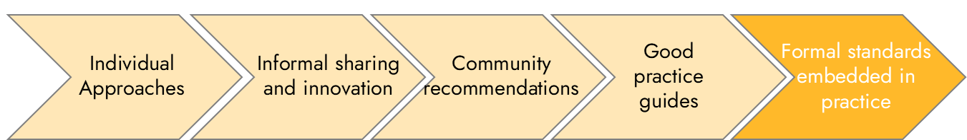
Good practice: from generic to formalised standards
The level of available good practice depends on the maturity of the observational domain
Mature, established good practice
WMO Guide 8: https://community.wmo.int/en/activity-areas/imop/wmo-no_8
Ocean Best Practices System
https://www.oceanbestpractices.org/
Networks - Argo, ACTRIS, …
When specific good practice is not available, generic good practice gives a framework. Is it enough for highest maturity levels?

Slide 11
Aims of the CEOS-FRM framework that are directly transferable
  Is there the information needed for users to assess fitness for purpose?
  Well documented dataset: what was it originally collected for, how to use it for that application, how data were obtained, how facility is operated, maintained.
  Data provider has followed generic good practice, and where available specific good practice
  The dataset is adequate for the intended purpose, and this has been independently assessed.

Slide 12
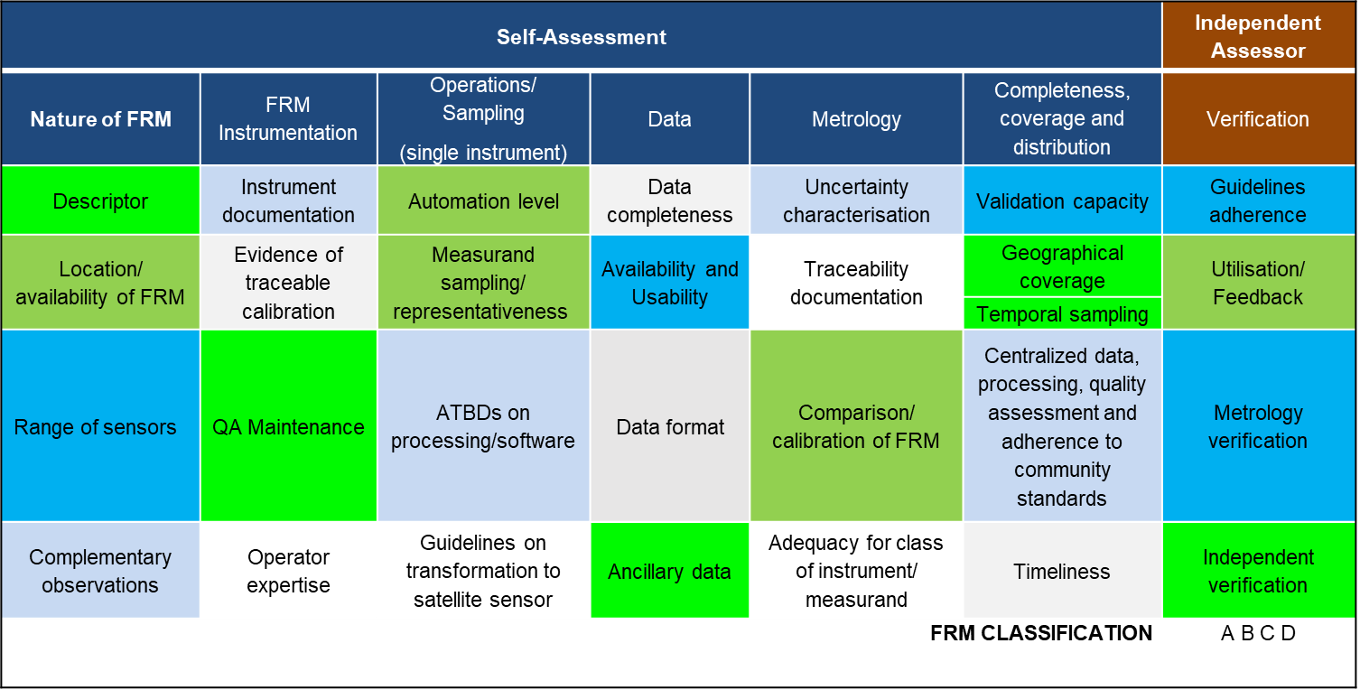
Applying CEOS-FRM beyond satellite systems
Only a few are satellite-specific
Is this well documented?
Is this following good practice?
Is this good enough?

Slide 13
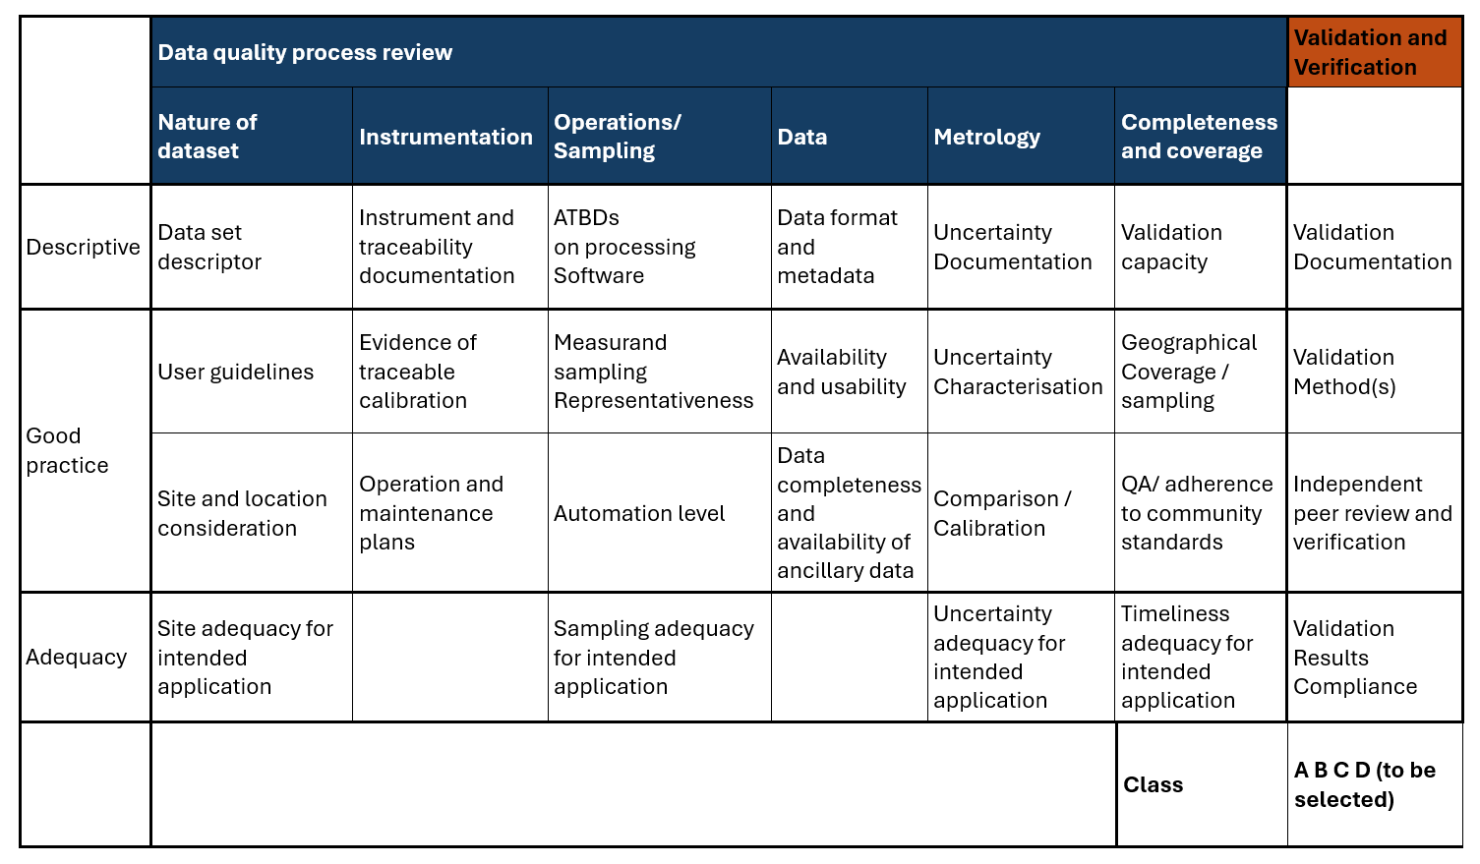
Restructuring and generalising the FRM matrix

Slide 14
Classes for general FRMs
Class | Description
Class D | Prototype data – proof of concept. Intended for use only by original data provider | Likely only generic good practice guidance exists as approach is novel.
Class C | Shared research data. Intended for use by original data provider for research activity. Shared with others, but care required in its interpretation. | Likely only generic good practice guidance exists. Data provider has considered quality aspects and has had a peer review
Class B | Shared operational data. Intended for use by other people. Often part of a network. Data shared on environmental data platforms. | Following good practice guidance for data formats, metadata, site operations, calibration, uncertainties.
Class A | Long-term legacy data. Intended for long-term studies (e.g. climate-relevant datasets) | Following good practice guidance throughout. Evidence of long-term stability.

Slide 15
Summary and conclusions
ARIA is working with a diverse range of observational systems, including novel methods and extreme and remote environments
CEOS-FRM and the QA4EO Five Steps provide a valuable and transferable framework for bringing consistency to these observations
Moving beyond satellite validation introduces greater diversity in intended application, which must be clearly defined to assess fitness-for-purpose
Good practice evolves with system maturity
  Generic principles are essential in early-stage systems
  Assessing higher maturity levels requires context-dependent judgement and may need specific good practice

