Slide 1
FRM data for the Copernicus Programme
José Miguel Rubio Iglesias (EEA), S. Clerc, S. Gremme
ESA/NPL FRM Workshop

Slide 2

FRM for Copernicus
Wide range of In-situ data are used within Copernicus
  “in-situ” or ground-based observations
  Reference geospatial data (administrative, geophysical, socio-economic…)
FRM play a specific role within Copernicus
  Required for Cal/Val activities of satellite data
  Traceability, uncertainty, documentation => building trust
  Operational readiness => required for an operational programme

Slide 3
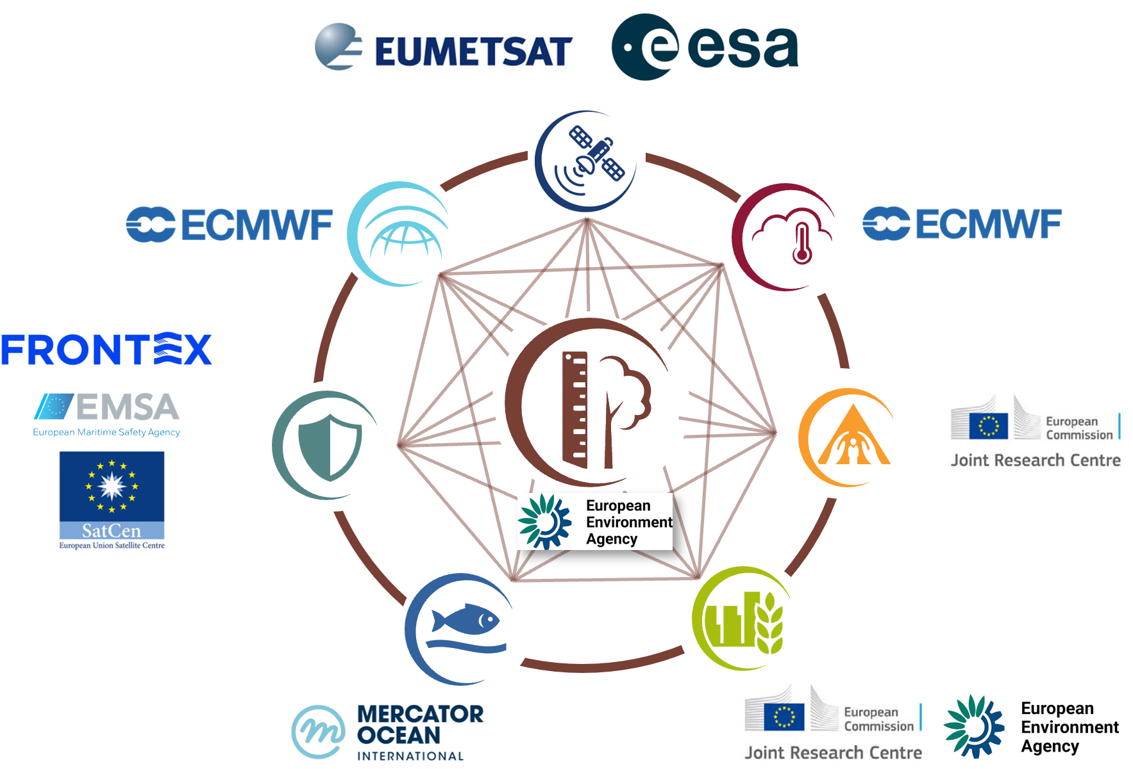
Copernicus In-Situ Component
The Copernicus In-Situ Component comprises all non-space-borne data with a geographic dimension, including observation data from ground-, sea- or airborne sensors as well as reference and ancillary data licensed or provided for use in Copernicus.

Slide 4
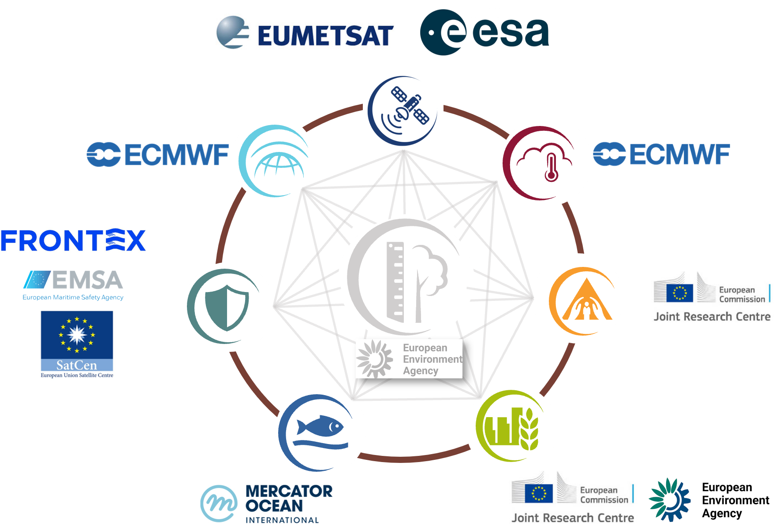
Copernicus In-Situ Component
The Entrusted Entities manage and use in-situ data daily to meet their operational needs.

Slide 5
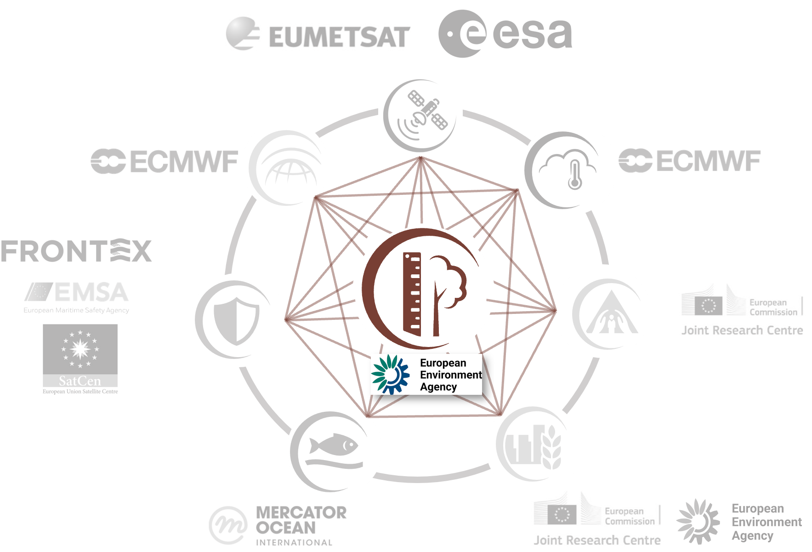
Copernicus In-Situ Component
The EEA steps in when a coordinated, programmatic approach is needed across Copernicus.
“Cross-cutting Coordination of the Copernicus In-Situ Component”

Slide 6
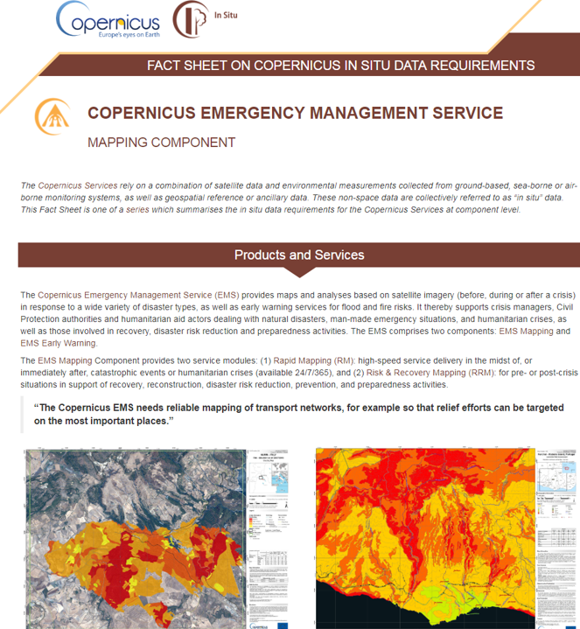

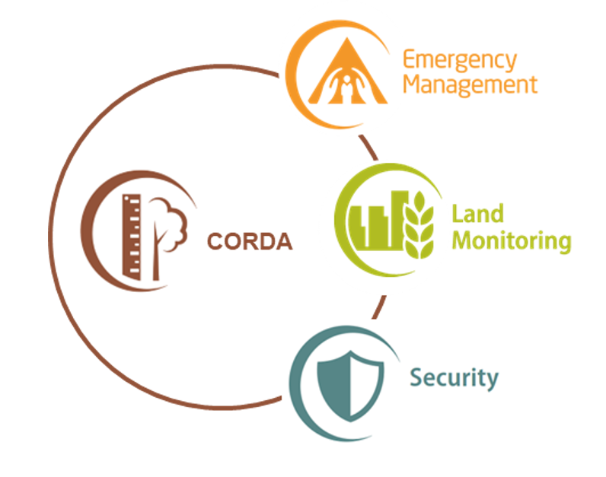

EEA Copernicus In-Situ activities (2021-2028)
  State of Play report
  CIS²
  In-Situ Strategy (2028-2034)
  In-Situ Working groups
  Reports, inventories
  GEO, R&D
State of Play
Support and Advice
Data Access
Engaging
with data providers
  CORDA
  Pilot activities
  Specific in-situ data requests
  Licensing agreements
  Partnerships
  Use Cases

Slide 7

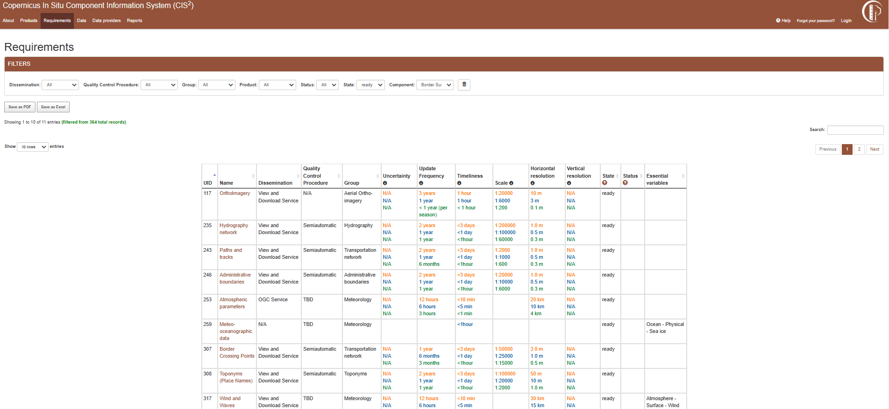
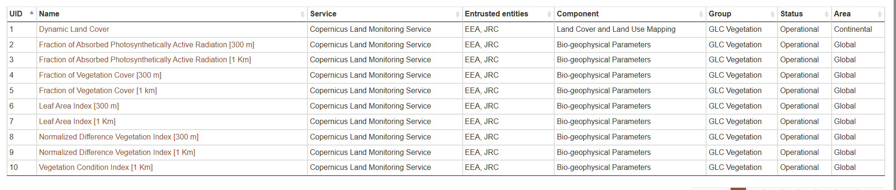
7
Copernicus in-situ data requirements
Capturing data requirements: the CIS² database
Overview of Copernicus in-situ data requirements and how these are met
Comprehensive list of products, data providers and key datasets
(so far only S3 and S5p)
Revamping project ongoing for enhanced QC and exploitation
Ongoing reviews and updates with support from Entrusted Entities, last one in November 2025
https://cis2.eea.europa.eu/
  340 products
  369 requirements
  658 datasets
  905 data providers & networks

Slide 8
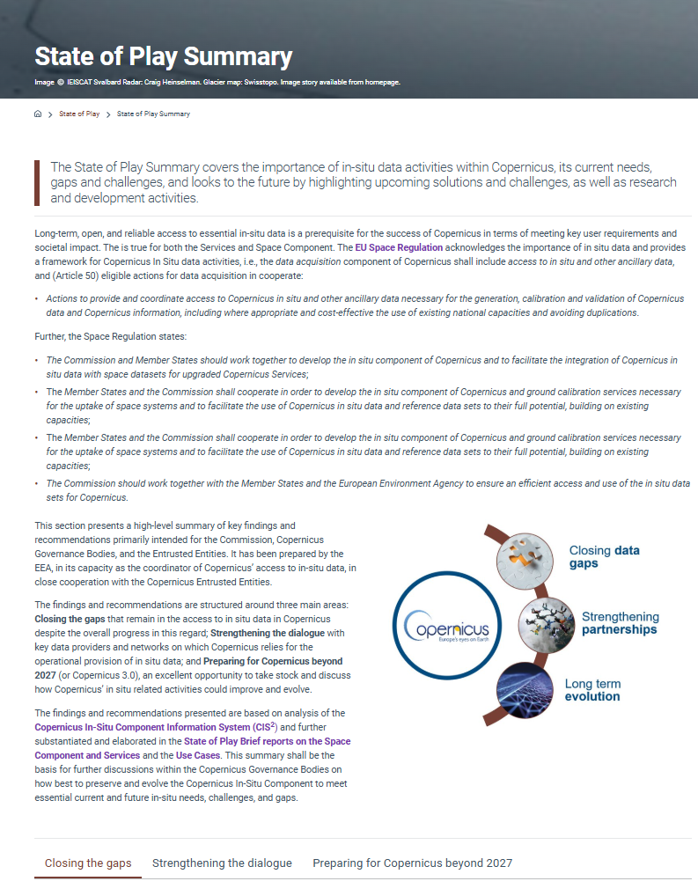
State of Play 2026
State-of-Play Briefs (Copernicus Entities)
Data Provider Report, powered by CIS²
Use Cases
Summary SoP Report (Q2 2026)
Research Infrastructures
State of Play 2026 will be released soon

Slide 9
9
Context - Key challenges identified by State of Play
Access conditions and use restrictions
Insufficient spatial coverage
Uncertain sustainability of critical networks
Fragmentation and heterogeneity
Lack of alignment with data providers
Insufficient acknowledgement
Not long enough
historical high time series
More data needed on specific areas
Increasing demands in frequency and resolution
Rapid accessibility

Slide 10
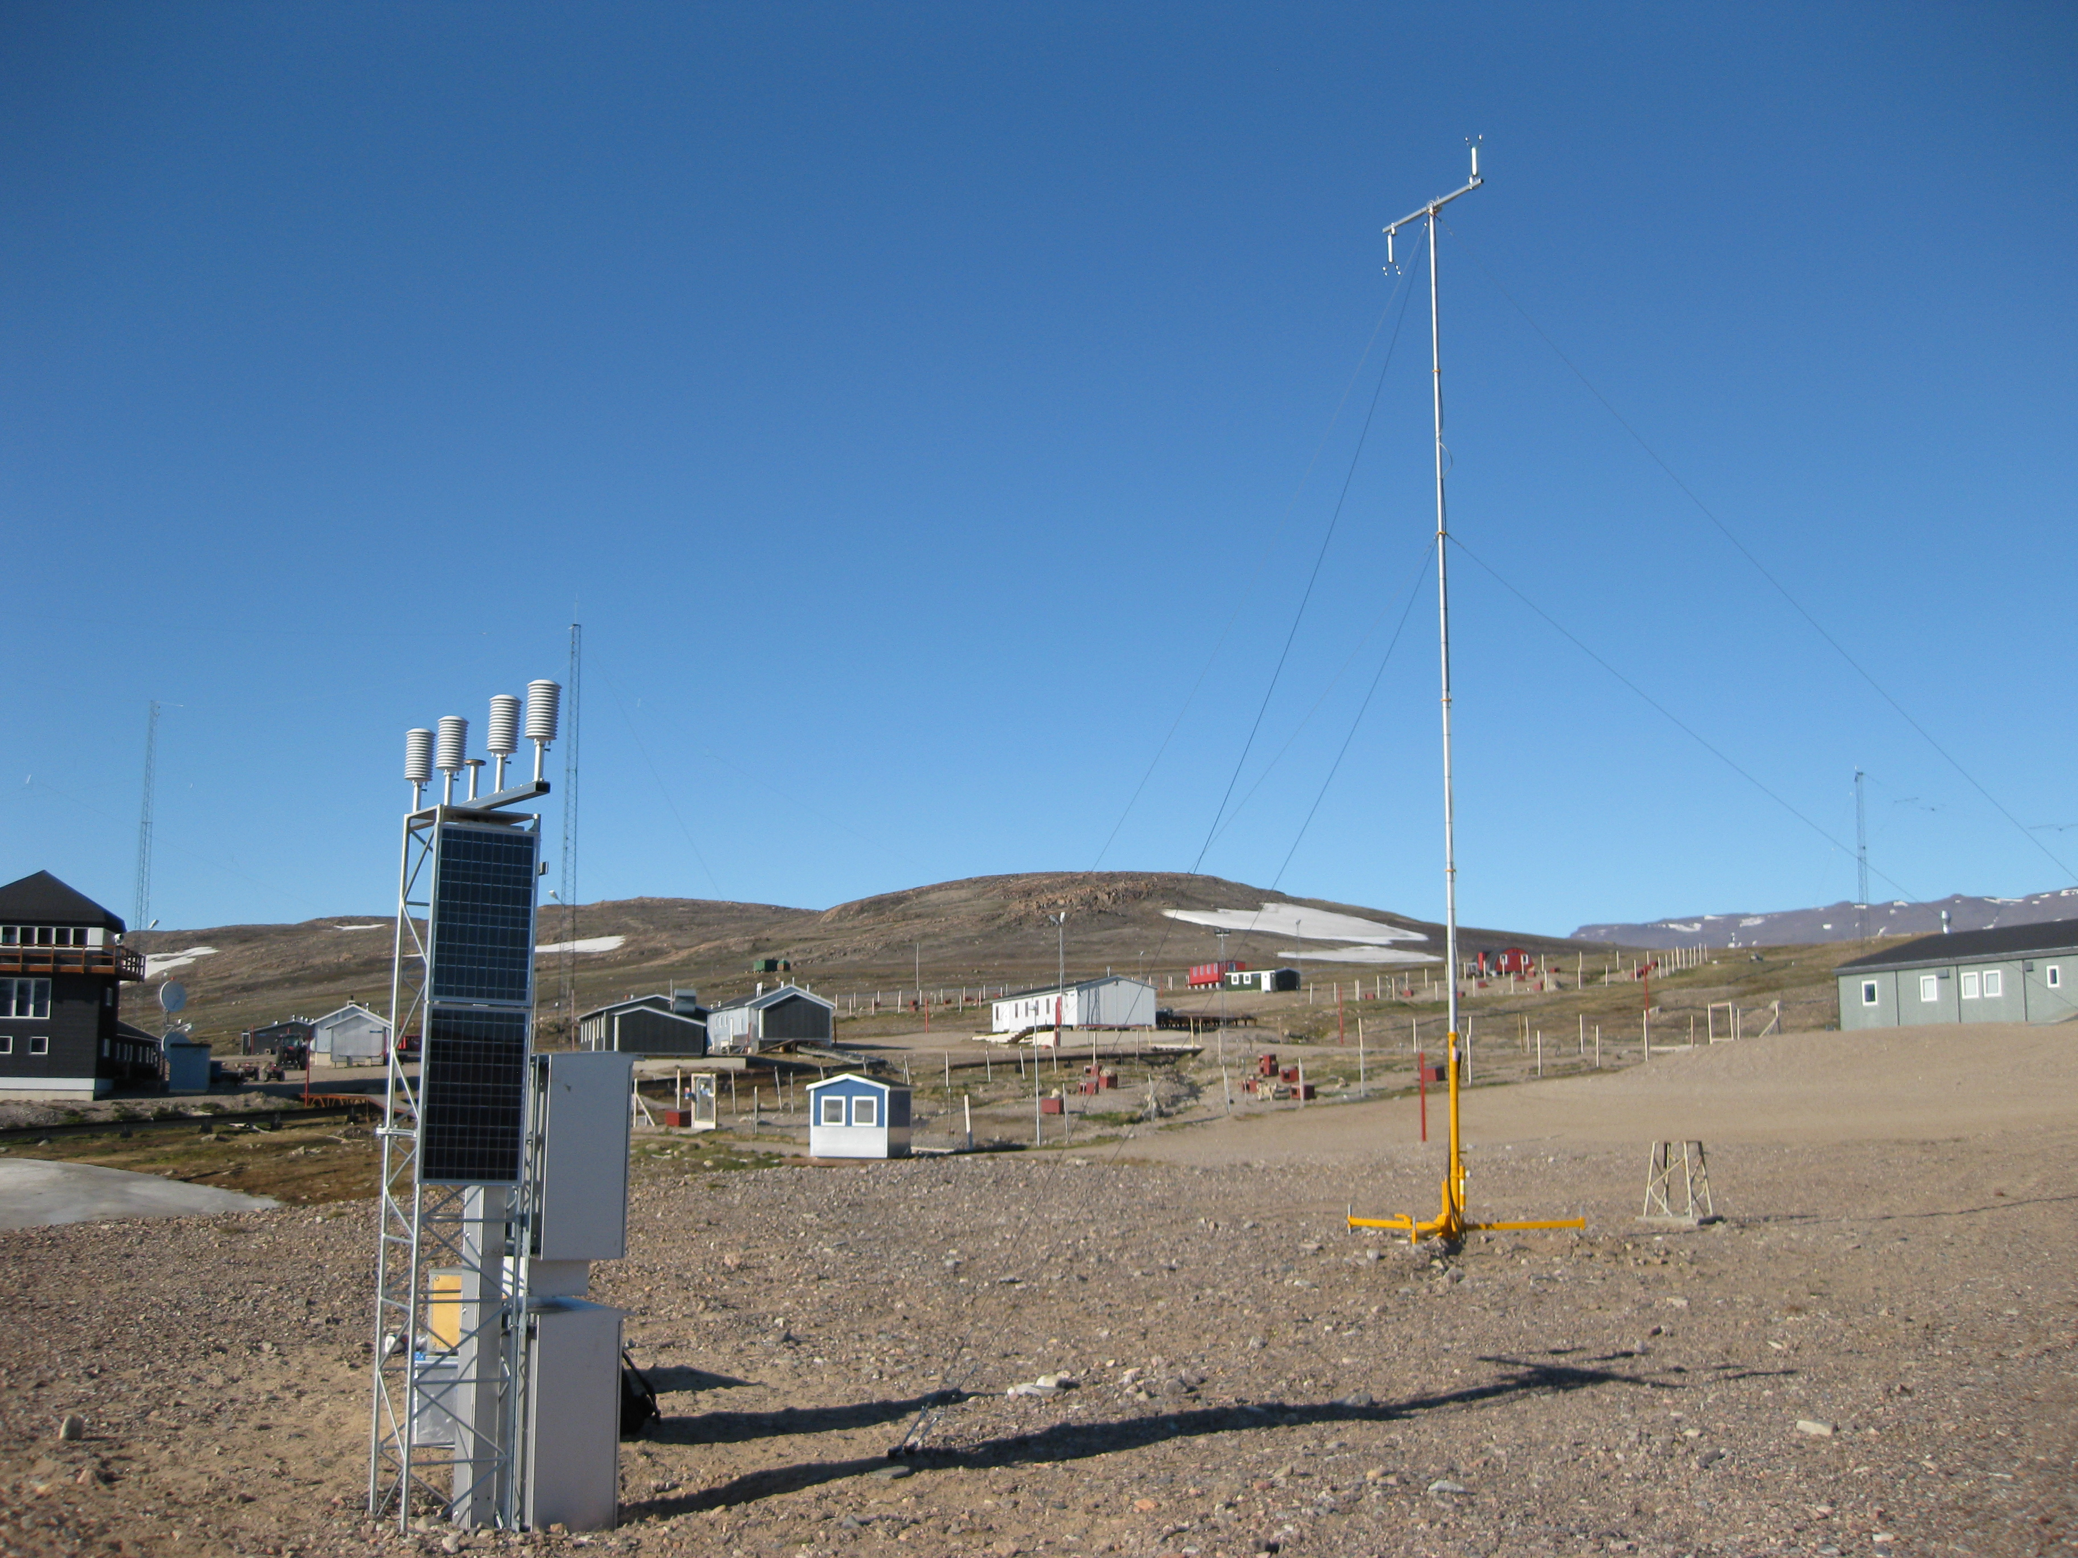

Why an in-situ strategy beyond 2027?
Strengthen in-situ data provision
  Strategic framework for in-situ
  Support EU strategic priorities
  Improve availability of in-situ data to complement, support and validate Copernicus space and service data.
  Guide the development and coordination of Copernicus in-situ activities in the next MFF (2028–2034).
  Contribute to resilience, strategic autonomy, competitiveness and the European data strategy.
  The Strategy provides high-level guidance to support coordinated in-situ action across Copernicus.

Slide 11
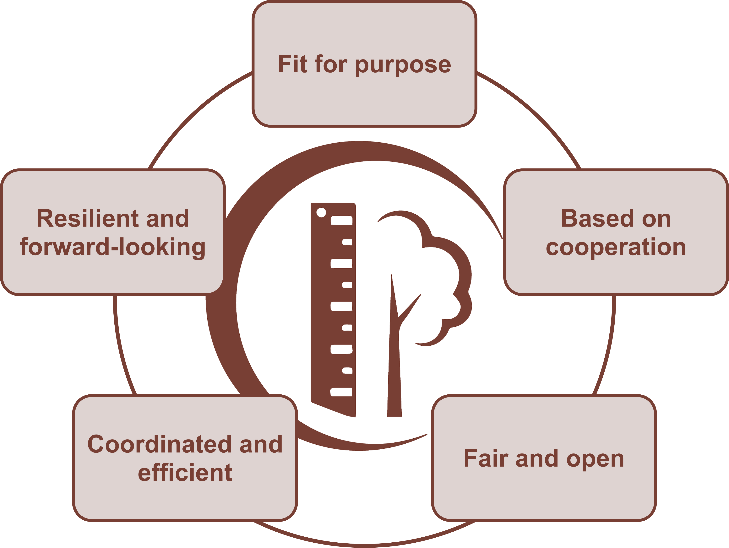
Five Strategic Areas
Notes:
Cooperation: strengthen partnerships with data providers (EU & international)
Fair & Open: promote open access, transparency, metadata & quality standards
Fit for Purpose: sustained, reliable, high-quality in-situ data tailored to service needs
Strategic & Cost-effective: avoid duplication, centralise cross-cutting datasets, optimise resources
Resilient & Forward-looking: embrace innovation (IoT, drones, crowdsourcing) and long-term planning

Slide 12
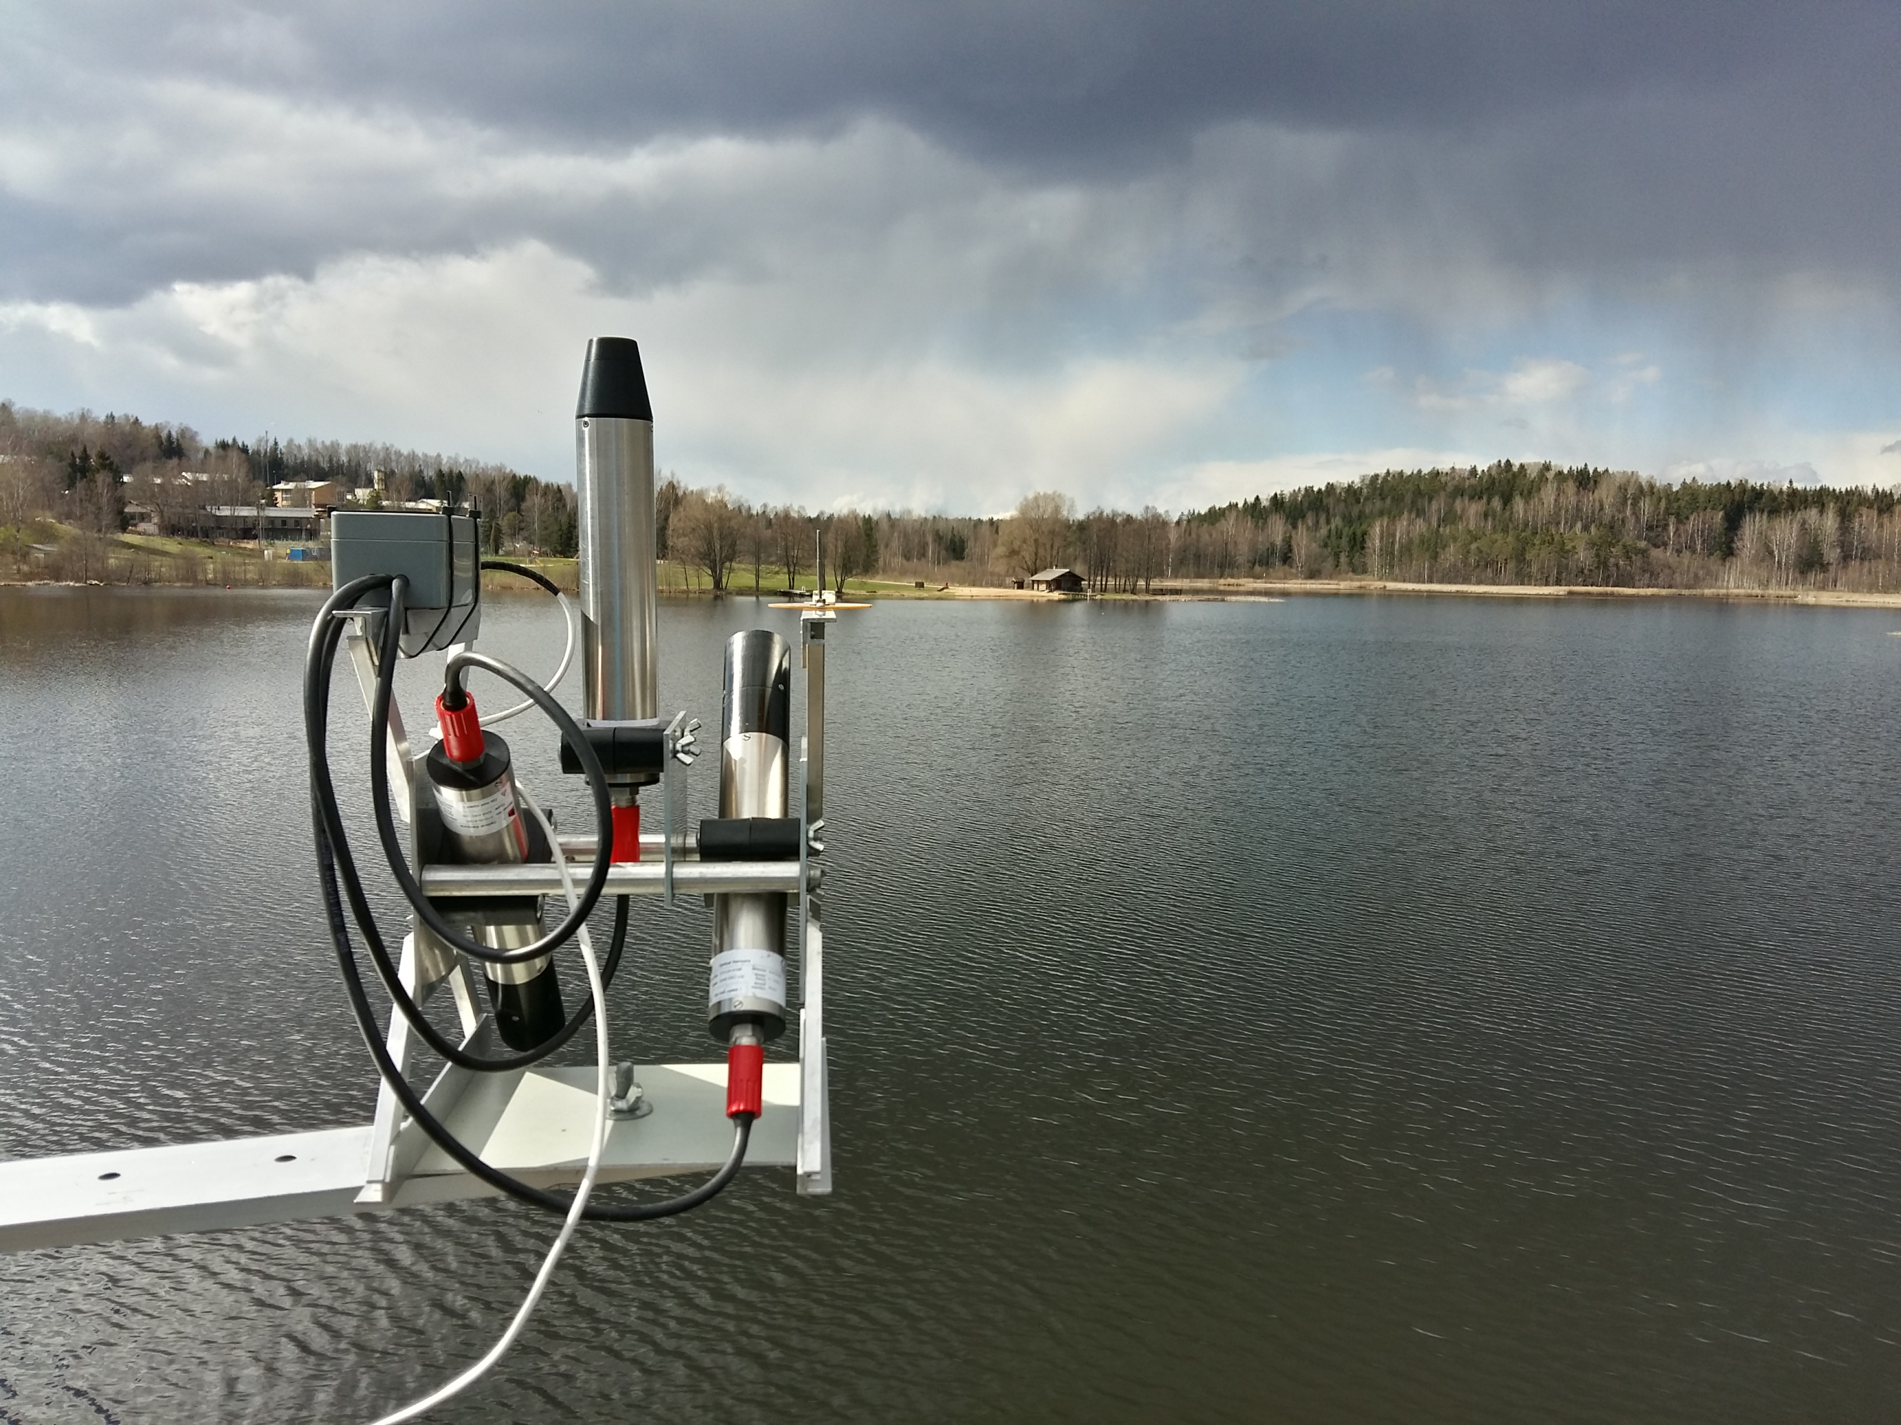
FRM-related strategic recommendations: Fit for purpose
Maintain an overview of in-situ requirements, gaps and challenges
  Identify key FRM requirements, providers and gaps
Support critical calibration and validation infrastructure
  Infrastructure providing critical data can be supported by Copernicus

Slide 13

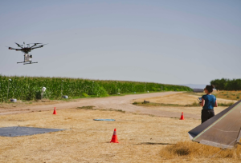
FRM-related strategic recommendations: Fit for purpose
Support data providers to address Copernicus-specific requirements
  E.g.: actions to adopt / improve FRM standards
Plan for emerging data requirements
  Prepare technologies, protocols and standards for new FRMs

Slide 14
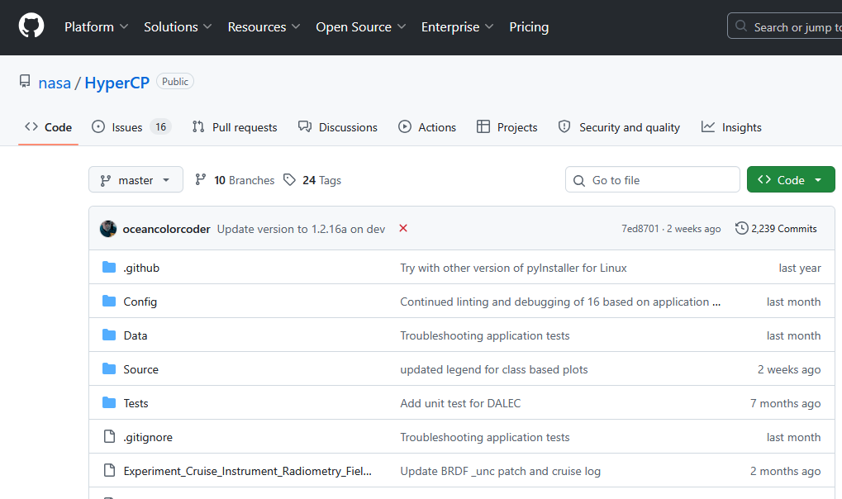

FRM-related strategic recommendations: Based on cooperation
Recognize and acknowledge data providers
  E.g. Copernicus in-situ community label
Optimize data processing and distribution
  E.g. support the development of community processors, data distribution platforms
Promote competitiveness and innovation of European in-situ capabilities
  E.g. Copernicus partnership with private or public data providers

Slide 15


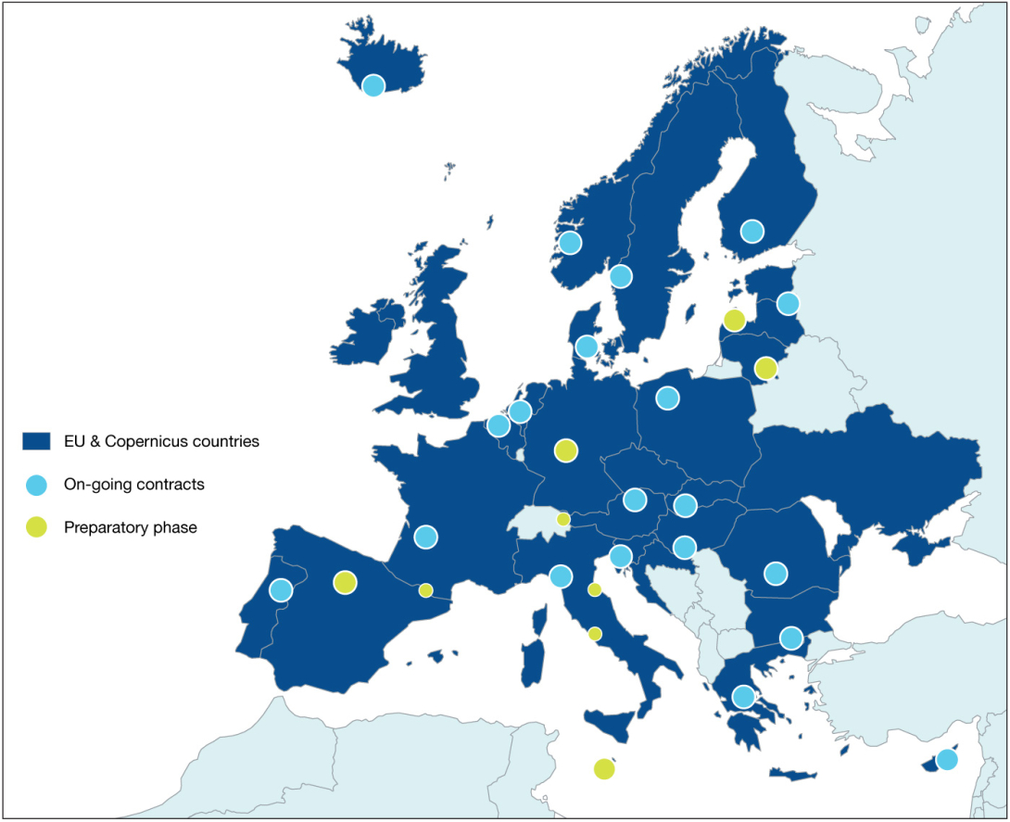
Focus on FRM certification / labelling
CEOS FRM certification initiative
  Adoption of FRM label within Copernicus could foster improvement of in-situ data quality and usability
Copernicus labelling: draft proposal
  Recognize contribution of data providers to the programme
  Recognize network and national contributions
  Label could be used for communication / branding
  Simple labelling mechanism based on the CIS2 database

Slide 16
Conclusions
In-situ data is a key component of the Copernicus programme
Strong need of operational, high-quality FRMs for the calibration and validation of satellite data
The 2028-2034 strategy will deploy several actions targeting FRMs

Slide 17
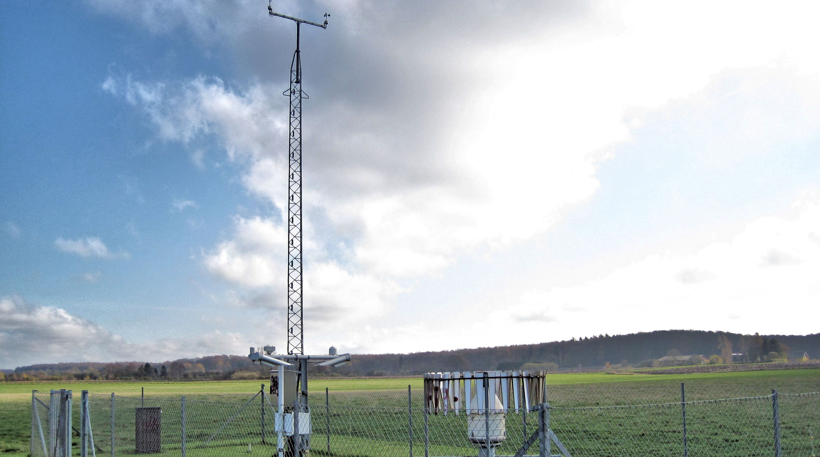

insitu.copernicus.eu
in-situ
copernicus.insitu@eea.europa.eu

