Slide 1
Practical implementation of the QA4EO approach
Emma Woolliams

Slide 2






A Metrological Approach
Uncertainties are evaluated and expressed following QA4EO Five Steps, a framework which employs the principles of metrology.
MEASURAND
1
TRACEABILITY
2
UNCERTAINTY
3
CALCULATE
4
STORE
5
Define the measurand and measurement function
Establish the traceability with a diagram
Evaluate each source of uncertainty and fill in an effects table
Calculate the data product and uncertainties
Record information for users

Slide 3
Define your measurand
This is the most important step
“The quantity intended to be measured”
MEASURAND
01
What are you actually measuring?
How are you processing that?
How does your measurement represent the broader phenomenon

Slide 4
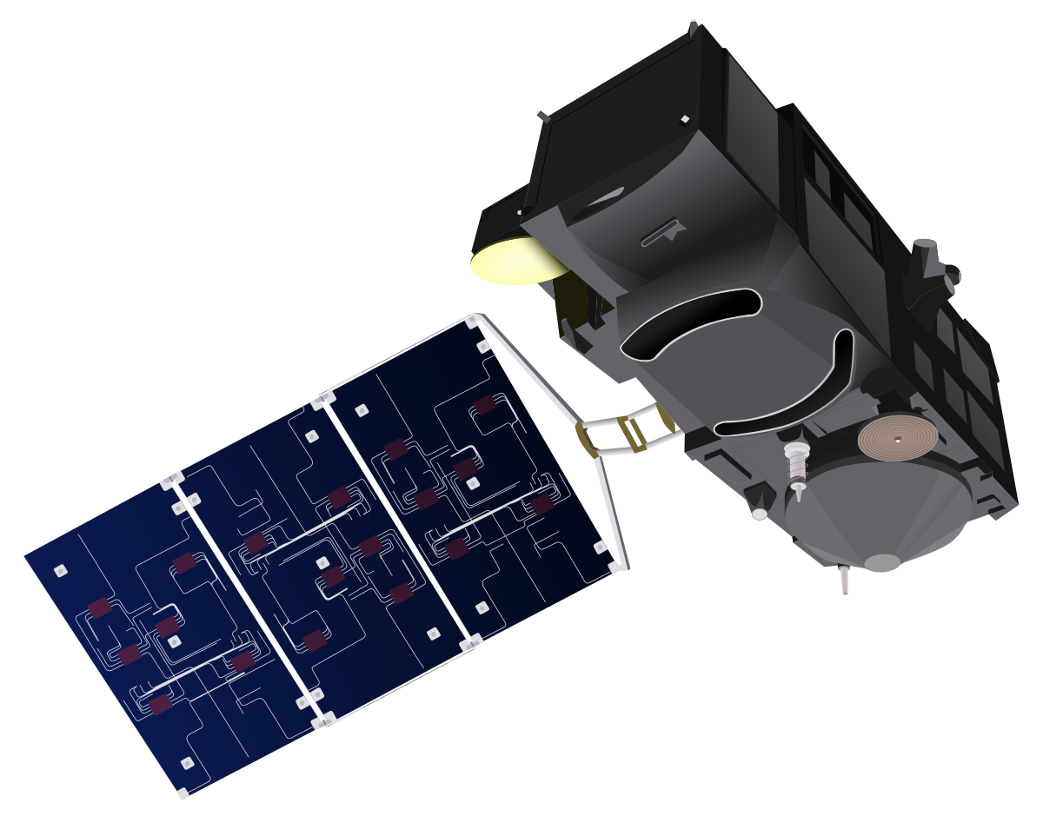
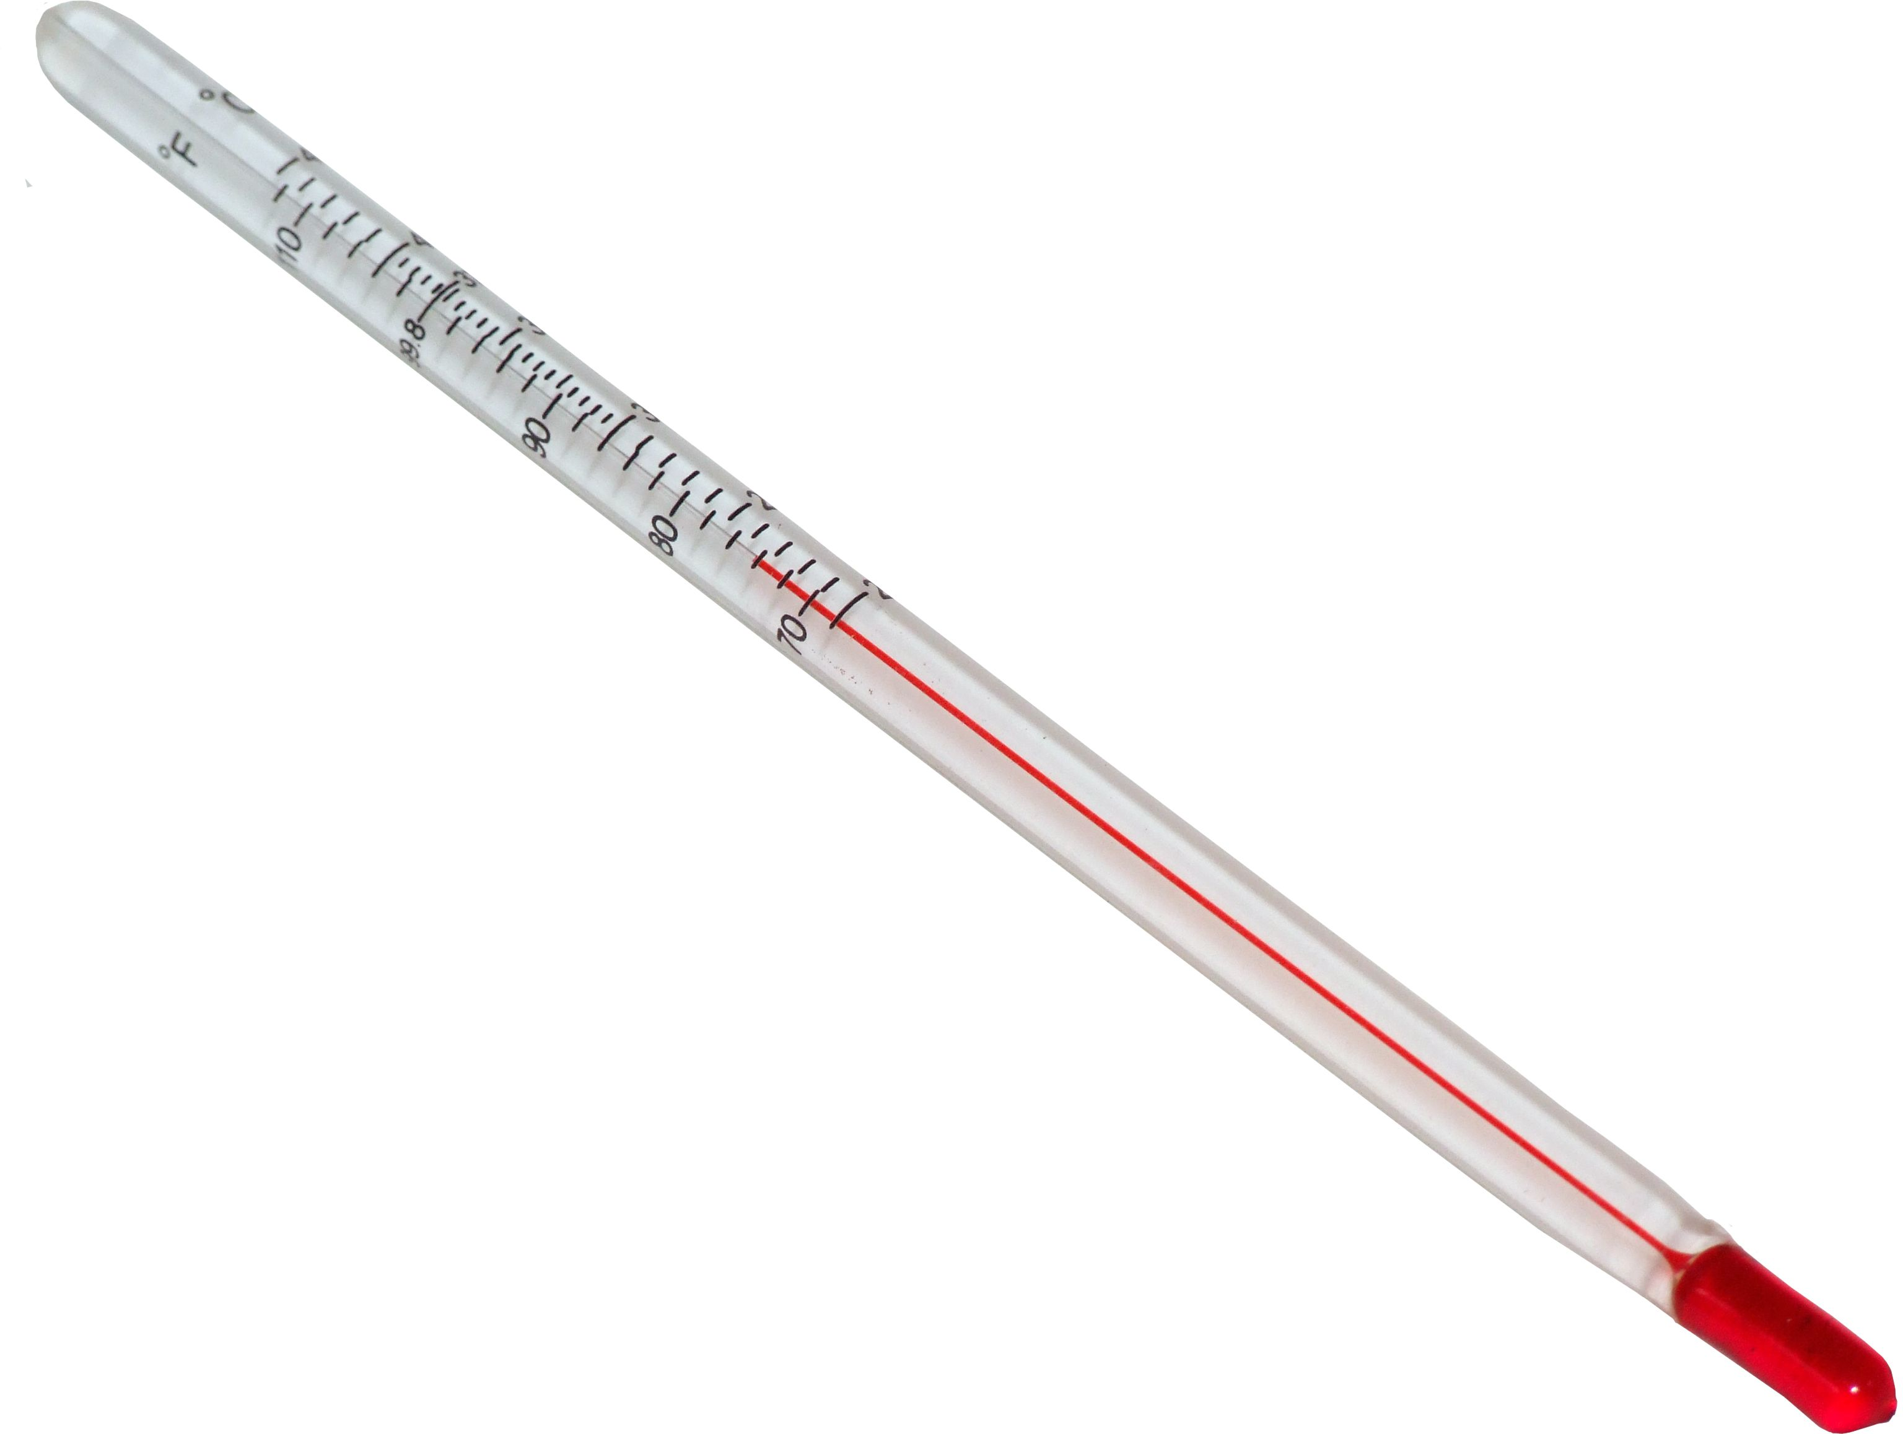
What does a thermometer measure?

Slide 5
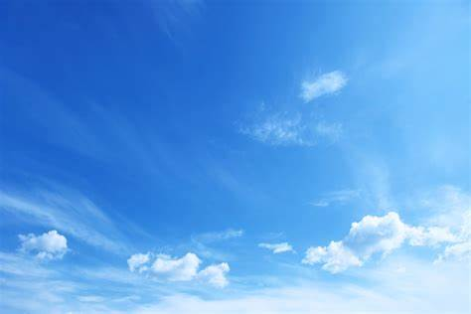
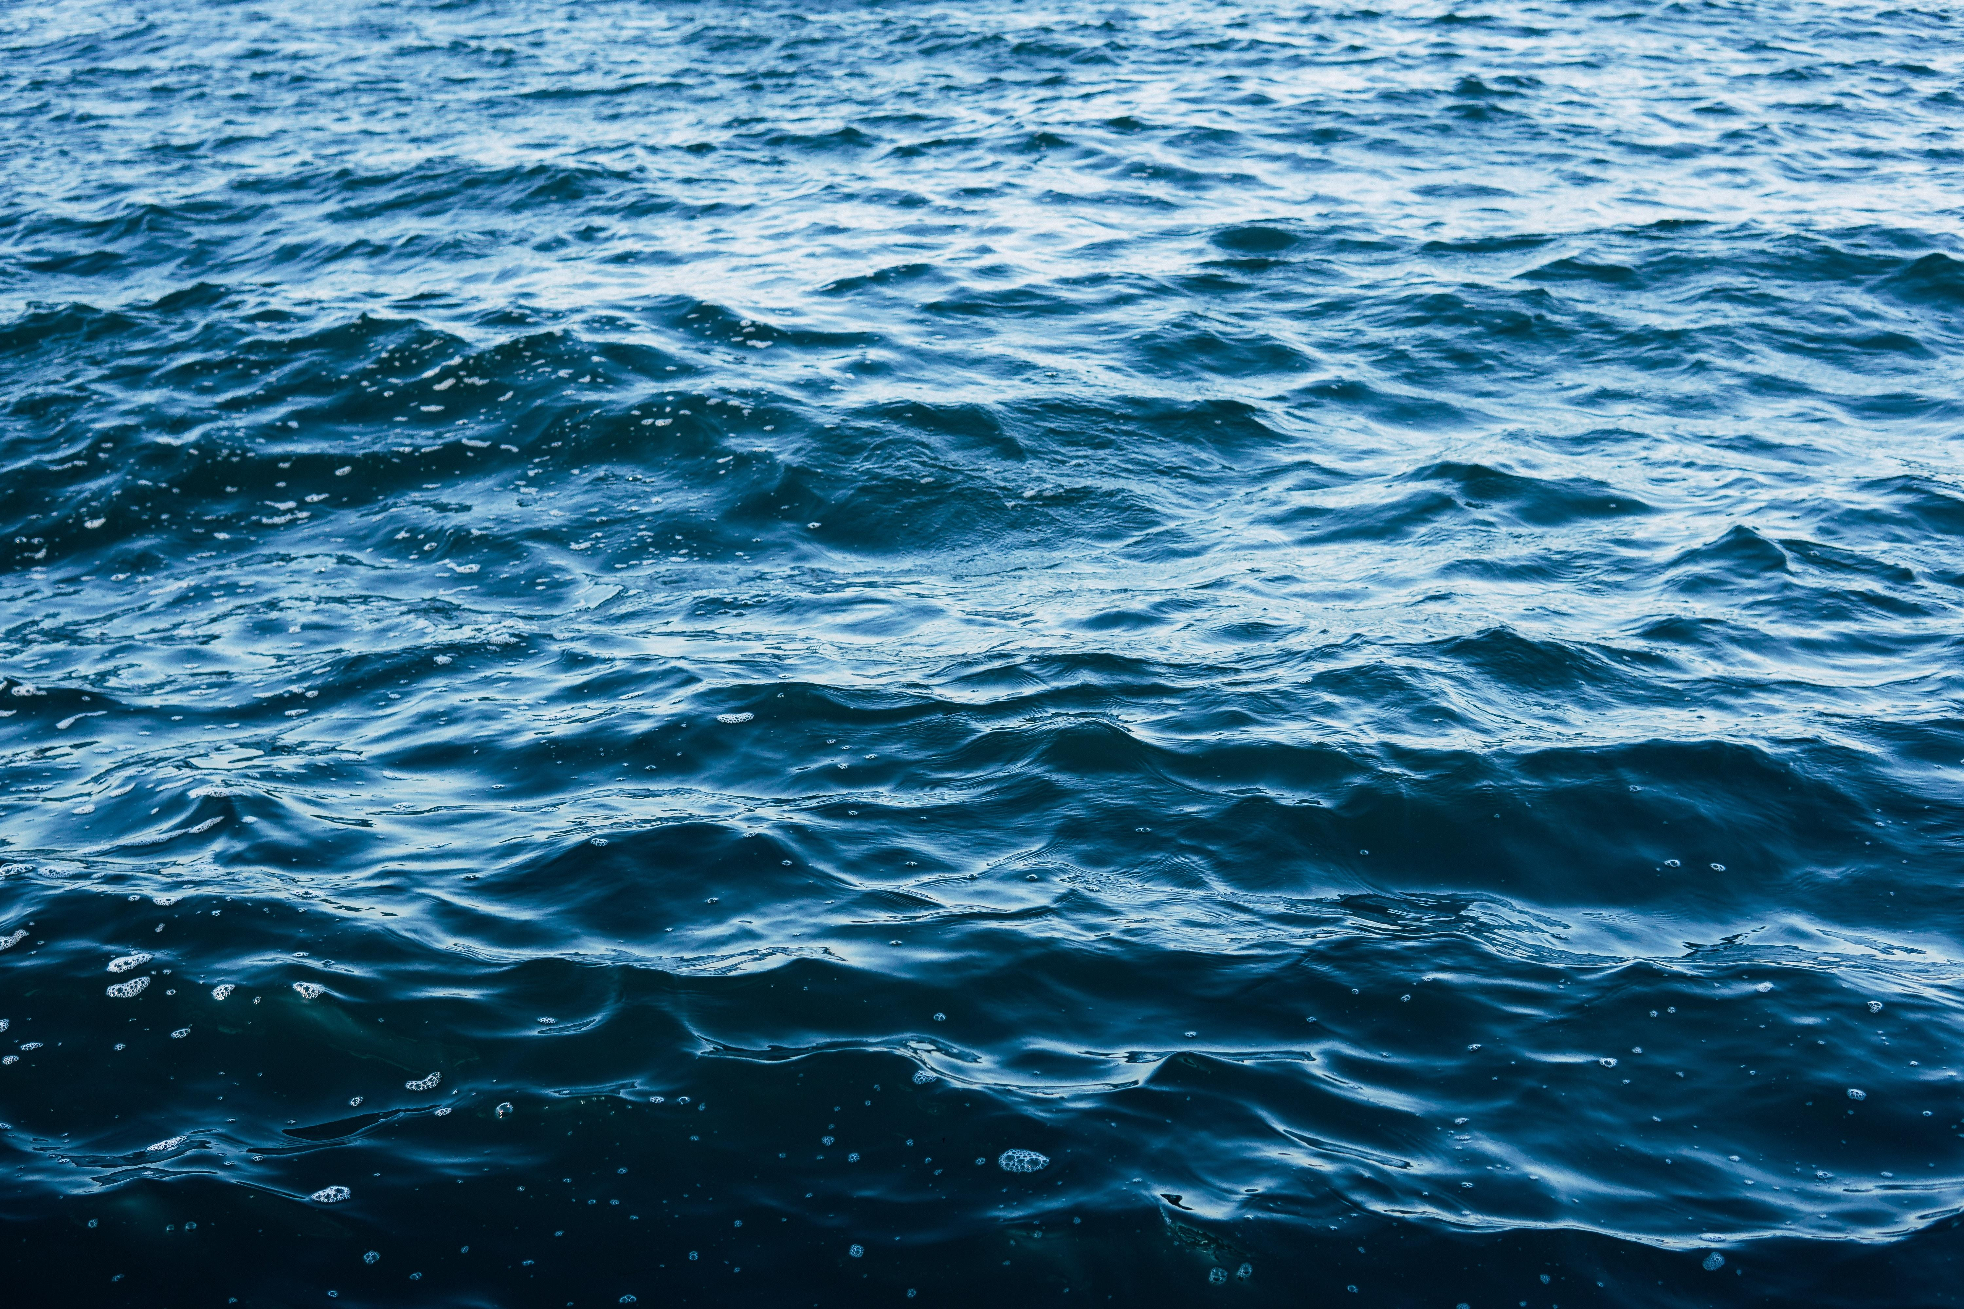
SLSTR
True instrument gain
Perfect signal
Measured signal
True noise / stray light etc
True TOA radiance
True sky absorptance
True sky radiance
True surface radiance
True SST
True emissivity

Slide 6
SLSTR
Assumed instrument gain
Assumed corrections for stray light etc
Measured signal
Measured TOA radiance
Assumed atmosphere composition and profile
Retrieved atmospheric parameters
Retrieval algorithm based on a model
Retrieved SST

Slide 7
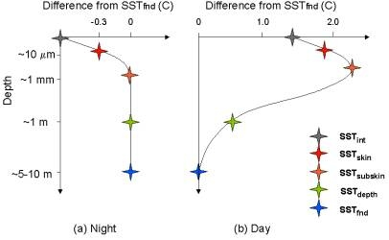
GHRSST – definition of sea surface temperature
SST-int : ‘interface’
SST-skin: 10 – 12 μm
SST-depth: defined depth
SST-subskin: ~1 mm deep
SST-fnd: base of diurnal thermocline

Slide 8
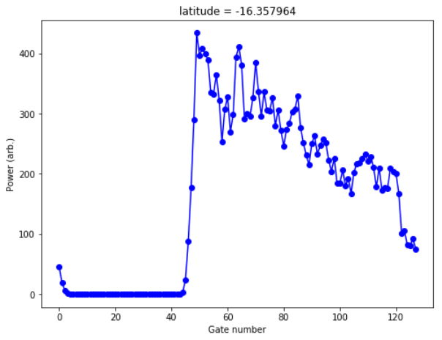
Altimeter
Measured waveform
Radar pulse back
Radar pulse down

Slide 9
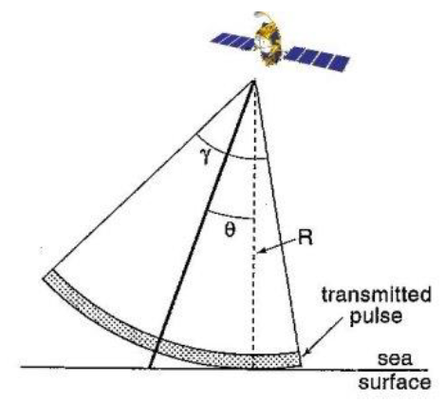
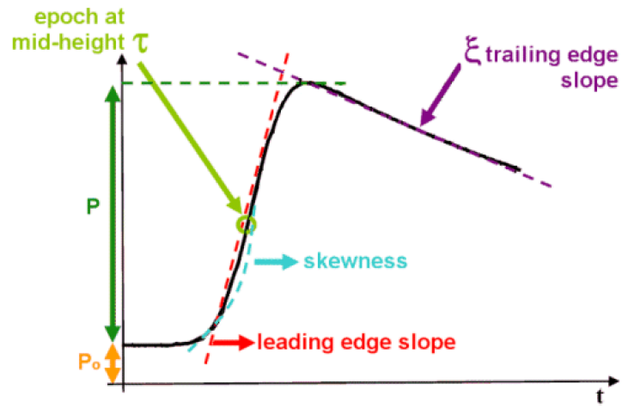
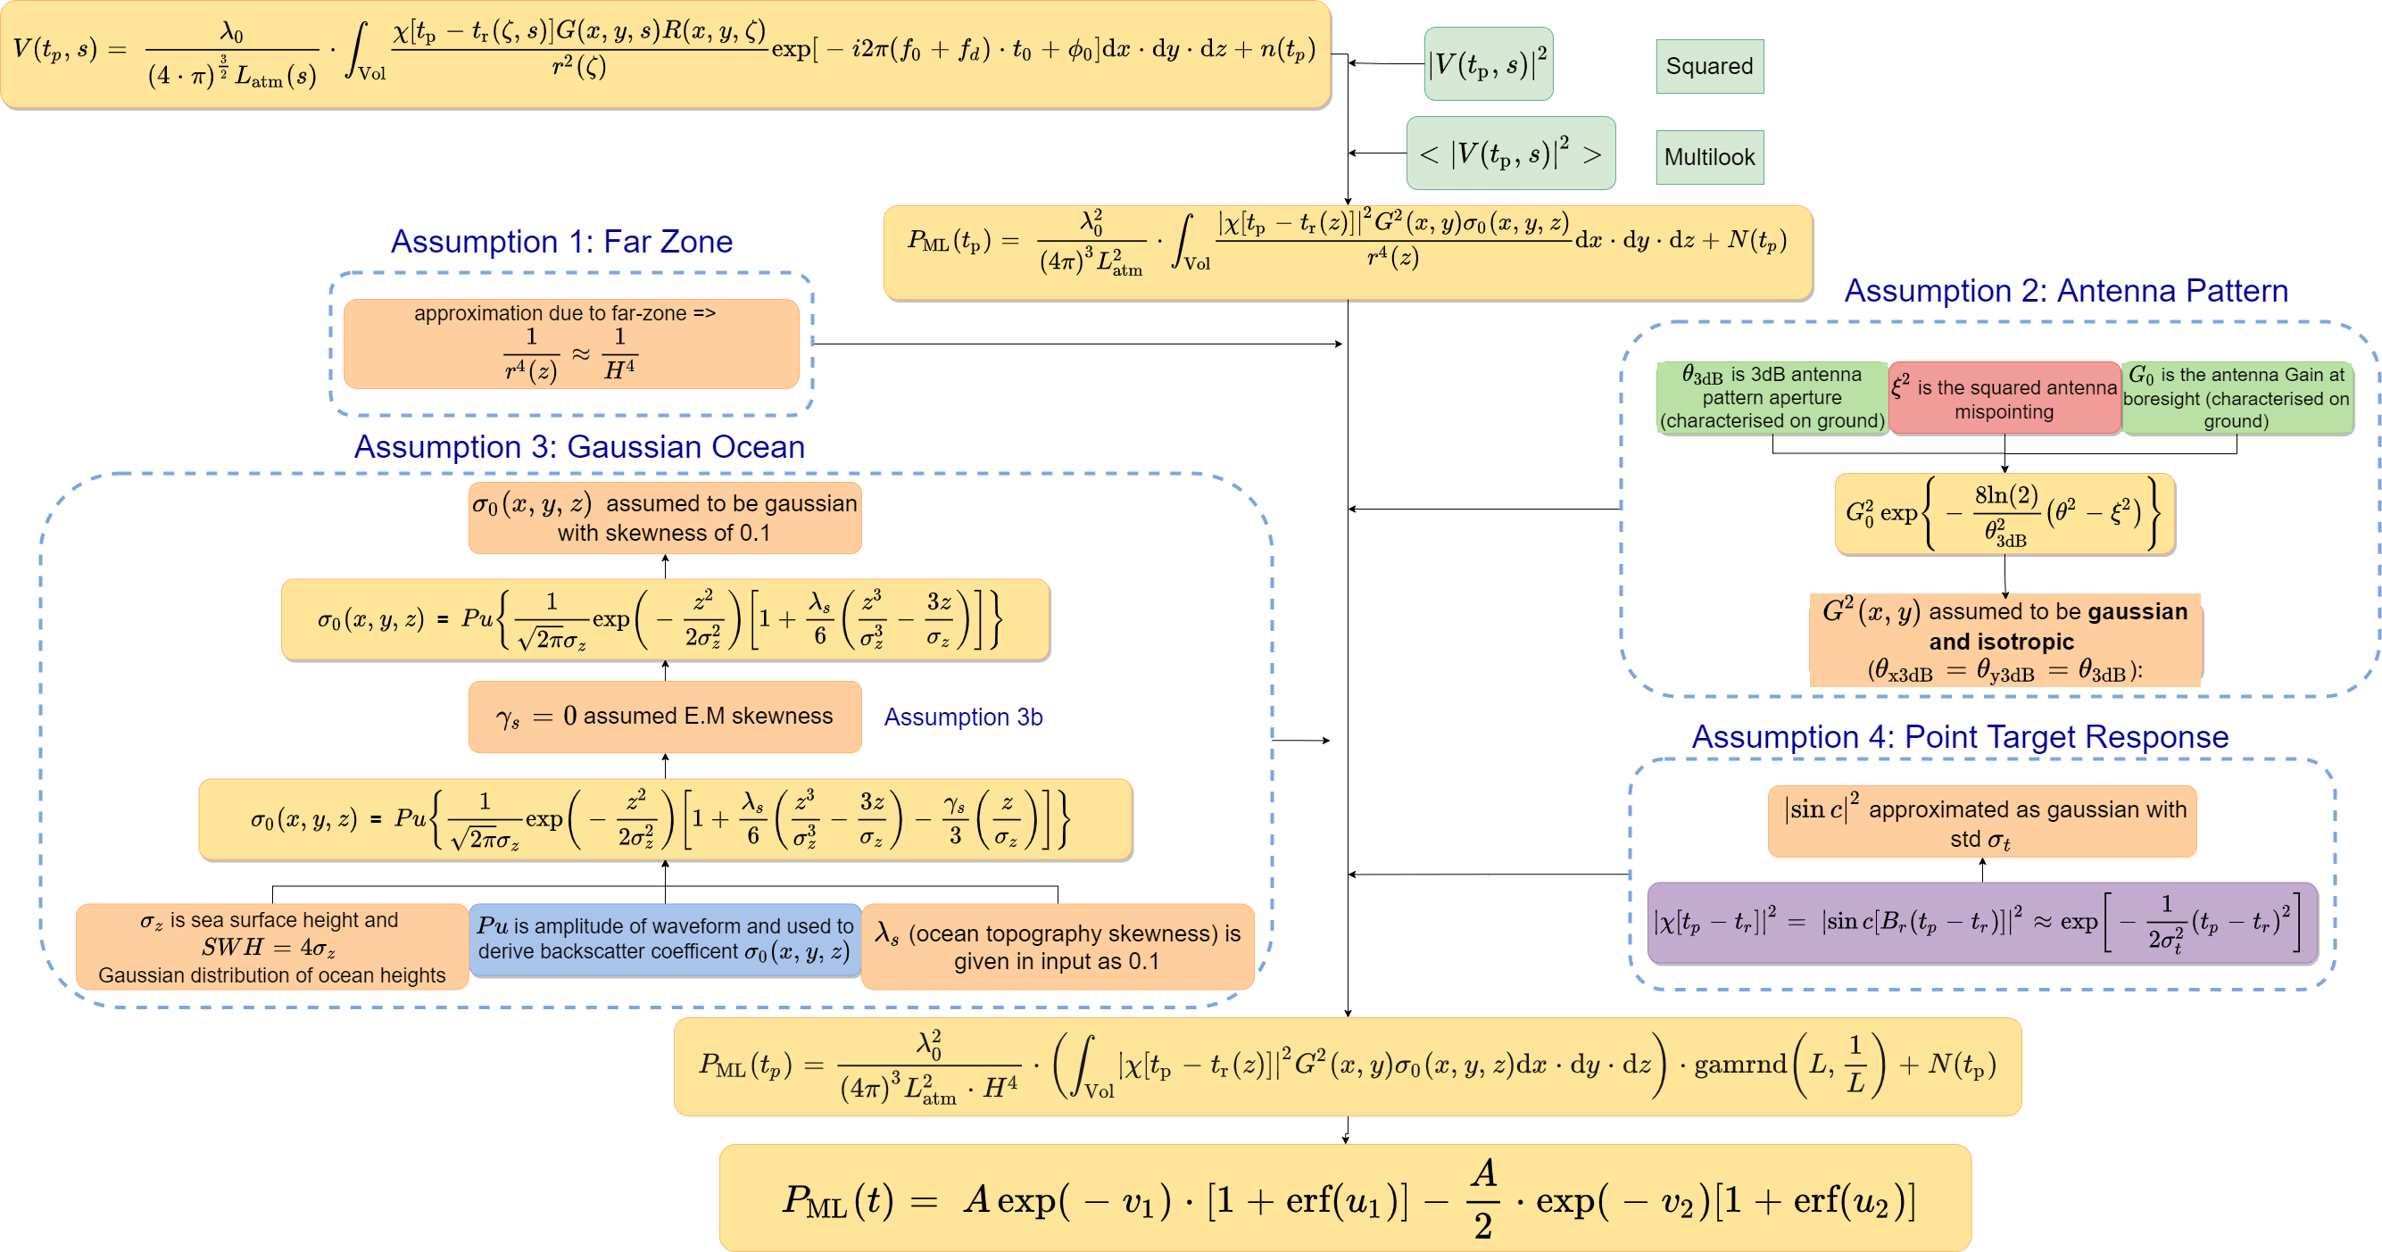
Form of the waveform
ASELSU Project

Slide 10
ASELSU Project
Derivation Diagram
Notes:
The method involves developing lots of diagrams, and here I’ll only show a couple. This first diagram is showing the current derivation of the Brown model that the waveforms are fit to in retracking from, at the top, the complete radar equation, for LRM mode. What we bring out and emphasise in this diagram are the approximations that go into this derivation. In order to integrate the power equation analytically, we need to approximate all the terms with Gaussians. Some of these, especially assumption 4, are partially corrected later in the processing, but others aren’t. As we move towards trend uncertainties of 0.1 mm, we must rethink each of these approximations, how the uncertainty associated with the approximation may lead to biases or trends. I’m aware now that new methods are being developed to replace the fourth assumption.

Slide 11
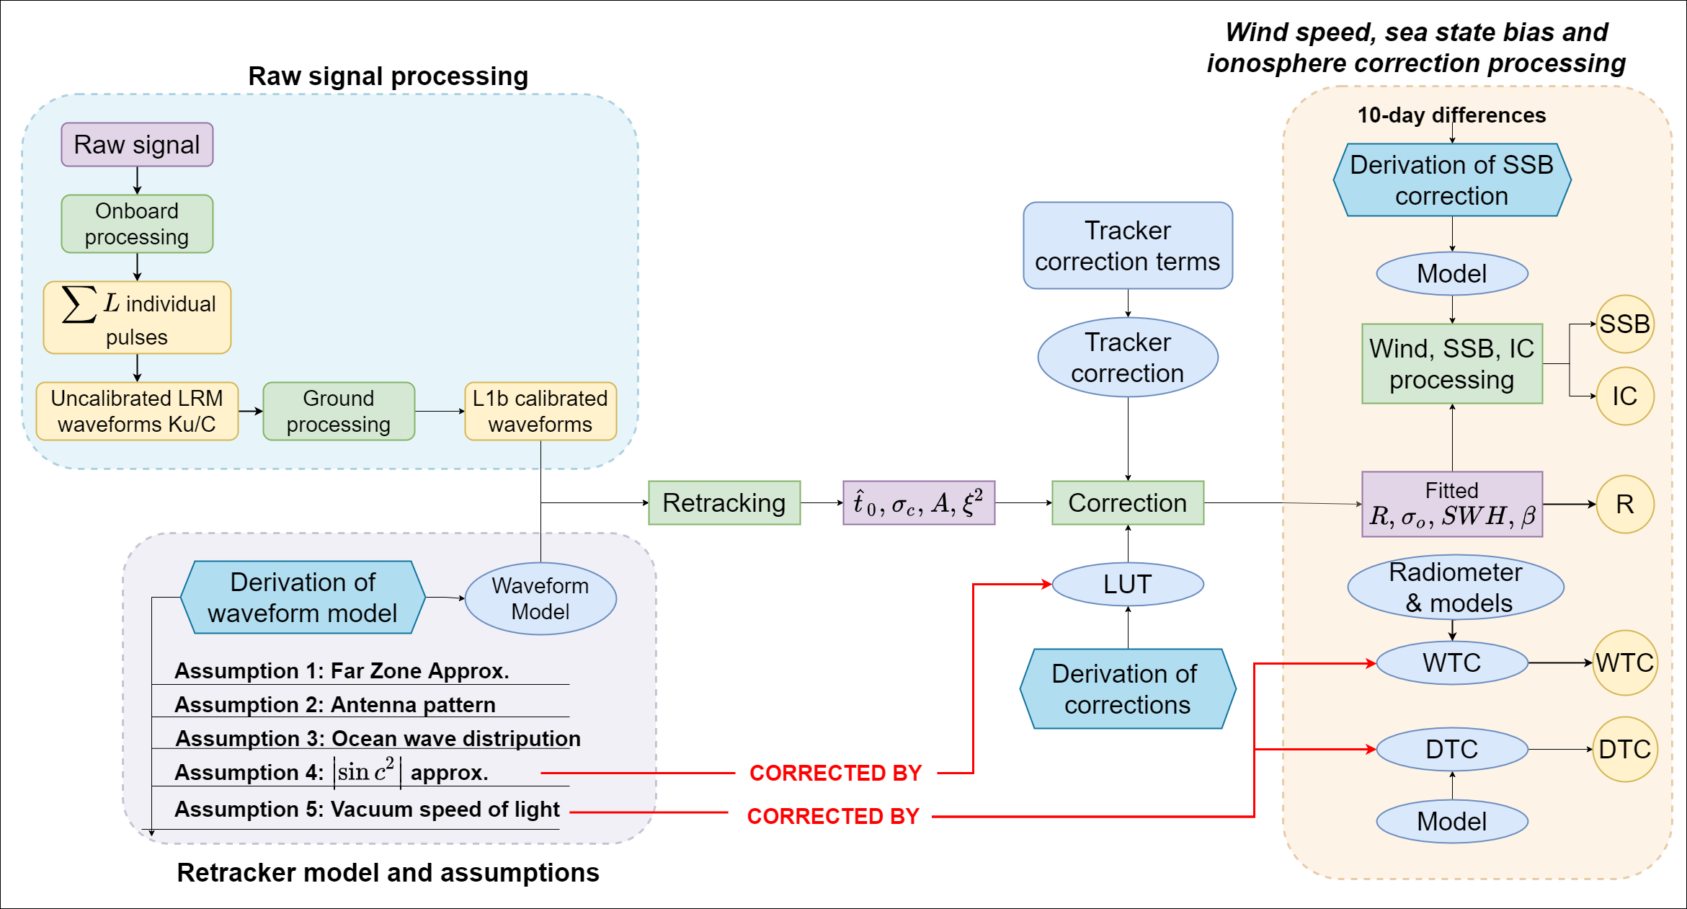
Sea Level Anomaly: Process diagram
Notes:
Once we’ve derived a waveform model, we can look at the overall process from raw signal to the range, SSB and IC. This diagram shows some of the main steps in that, and we can investigate each of these and think about the propagation of uncertainties through this process.

Slide 12
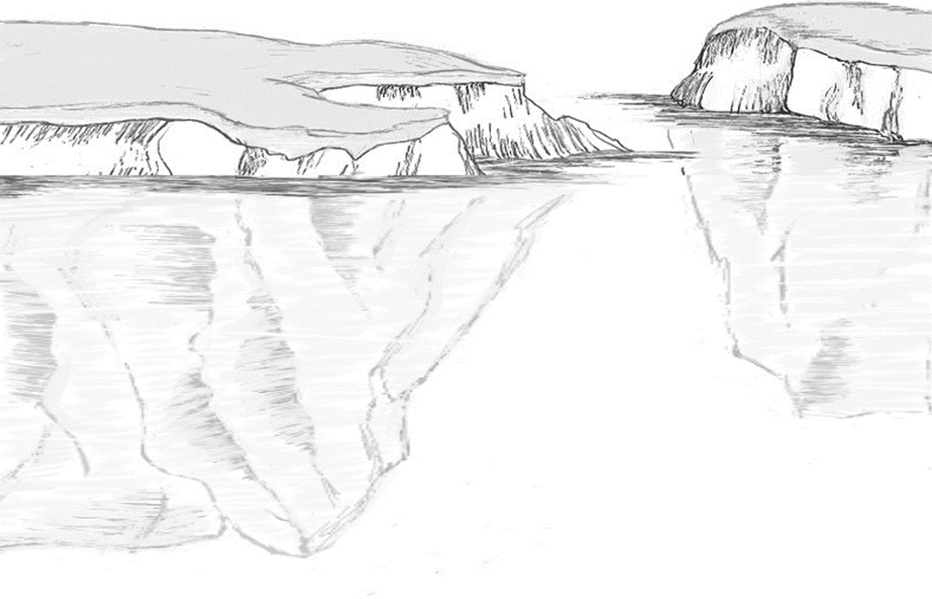
Step 1: defining the measurand
MEASURAND
01
“The measurand is the quantity intended to be measured”.
(VIM-3: International Vocabulary of Metrology)
RADAR
LIDAR
Total freeboard
Ku freeboard
Ka freeboard
Total freeboard
Ice freeboard
Sea ice thickness
Snow depth
Ice & snow densities
Sea ice thickness
Draft
Which are assimilated into models?
Who is best able to make the corrections?
Figure: Sajedeh Behnia
Notes:
The first step is to define the measurand, and for sea ice this is particularly complex for multiple reasons. The VIM defines the measurand as the “quantity intended to be measured”. Now, the first thing to be realised is that the measurand does not necessarily need to be measured directly – indeed almost no measurement instrument directly measures a measurand – even a simple thermometer is measuring the expansion of a liquid not the room’s temperature! Metrology has the concept of a “multi-stage measurement model” where we recognise that there is often a chain of calibrations, or a processing chain. With sea ice, the most direct measurement is of the Ku-band (radar) freeboard. This can be converted into total freeboard, ice freeboard or sea ice thickness with knowledge of other parameters such as snow depth and the densities.
Which is the measurand? From a metrological perspective you could call any of these measurands. But I also have sympathy with a desire to call the Ku freeboard a ‘measurand’ – as it’s directly measured, and the sea ice thickness – which requires auxiliary information – as a derived quantity.
The important thing is to be extremely clear which quantities you are actually deriving – and more importantly giving to downstream users. And different users might want to have intermediate steps so that they can do their own derivation of the more complex quantities. We could ask, for example, whether the radar expert or the oceanographic modeller is the best person to do the conversion – should we assimilate thickness or freeboard into the model, for example?

Slide 13
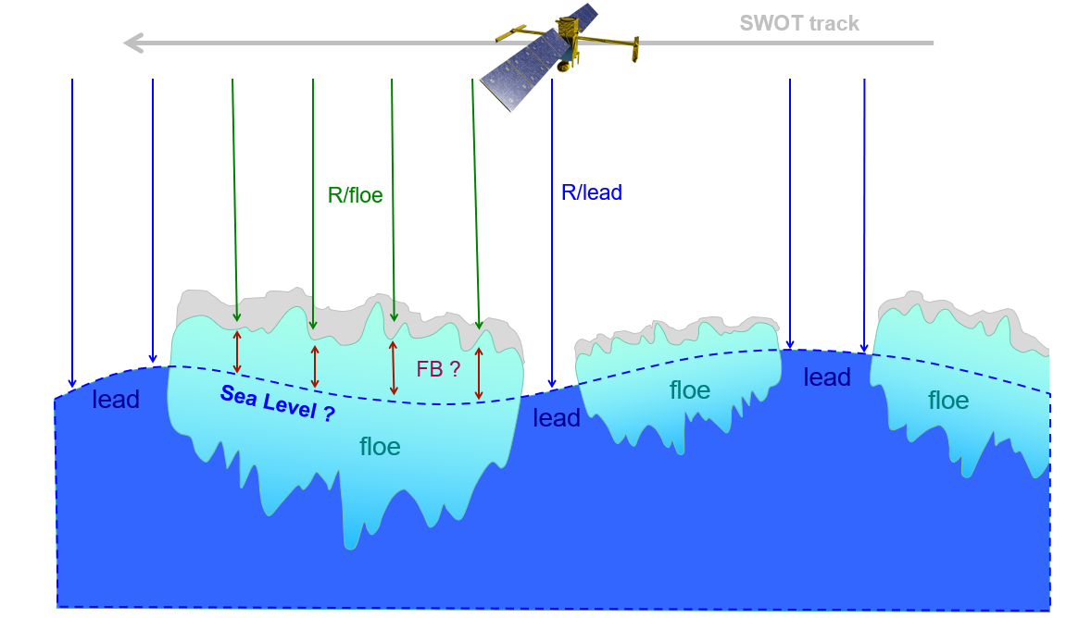
Step 1: defining the measurand
MEASURAND
01
Figure: Sara Fleury
Notes:
But that’s not the only reason why it’s complex to define the measurand. We also have to think about what the freeboard is. The sea is not completely flat and even the freeboard quantity needs to be derived based on assumptions about the behaviour of the sea level across the floe.

Slide 14
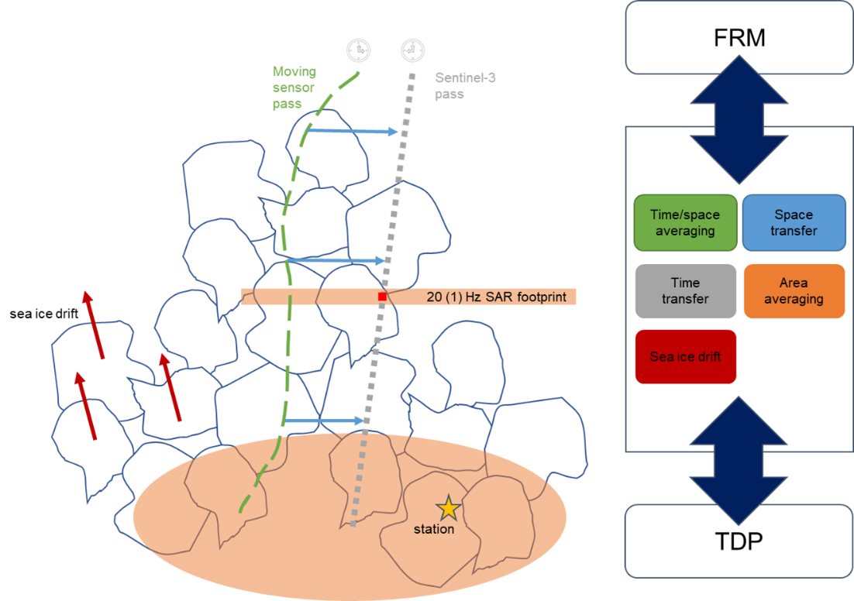
Step 1: defining the measurand
MEASURAND
01
Instantaneous
Averaged
Representation
Figure: Renée Mie Fredensborg Hansen
Notes:
Finally, we have to think about what our measurement represents. Is it a single measurement at an instantaneous point and time, or is it some zonal or temporal average? Sea ice moves, and so two measurements in nominally the same location, even taken just a short time apart, can be of different sea ice floes. We see this with drone measurements from a boat – there is no fixed reference. Different instruments will also have different footprints relative to the size of the ice floes.
There isn’t a right answer in any of these questions – the important thing is to be extremely clear what the measurand really represents. And if we are using products others have made, to ensure that we understand what there measurand is.

Slide 15
Establish traceability with a diagram
TRACEABILITY
02
Establish the traceability with a diagram
Covered in the workshop after the break

Slide 16
Step 3: The effects table
This is where people often get stuck!
How do you assess individual sources of uncertainty? (Do you need to assess individual sources of uncertainty?)
What can I say about the error correlation structure?

Slide 17
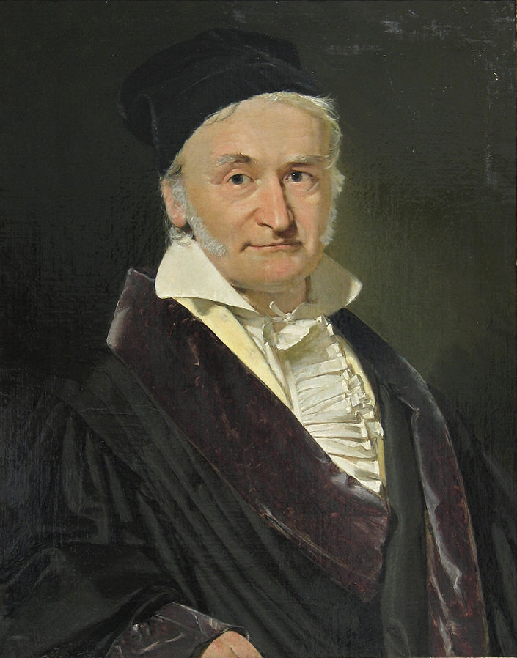
Random, stochastic processes (noise)
May be white noise (unpredictable)
Or “coloured” noise (with some knowledge of its own history)
Caused by random physical processes, e.g.: thermal fluctuations (thermodynamics), chaos, quantum processes,
Carl Friedrich Gauss
1777 – 1855

Slide 18
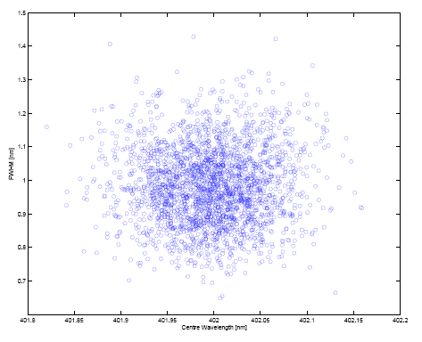
Type A methods to determine uncertainty (and covariance)
Statistical analysis of standard deviation (and covariance)
  Usually from experimental data
  Can sometimes be from simulated data

Slide 19
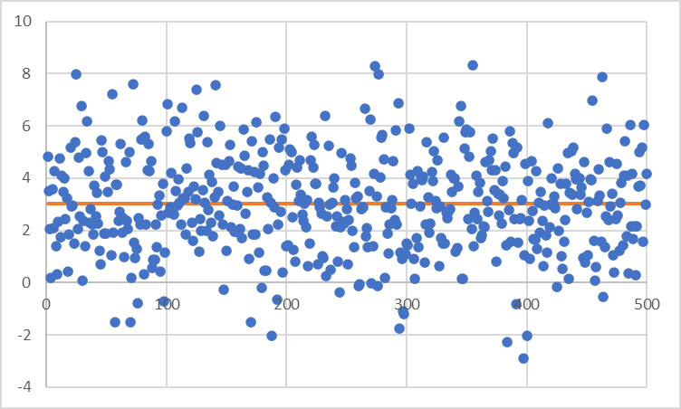
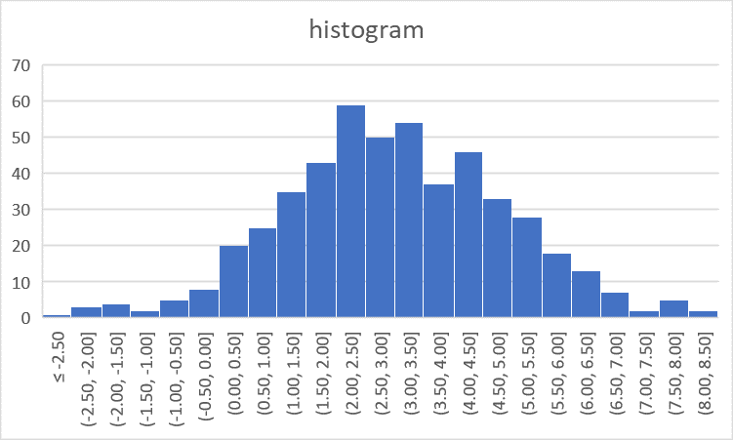
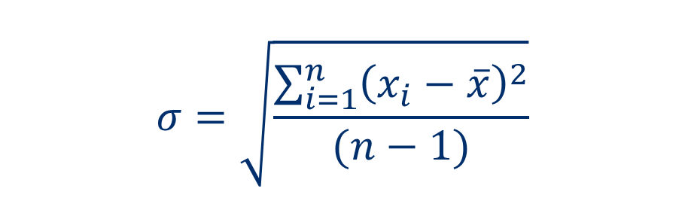
Type A methods for evaluating uncertainty
$$σ=\sqrt{\frac{\sum_{i=1}^{n}{{\left(x_{i}−\overline{x}\right)}^{2}}}{(n−1)}}$$
Standard deviation (of the sample)

Slide 20
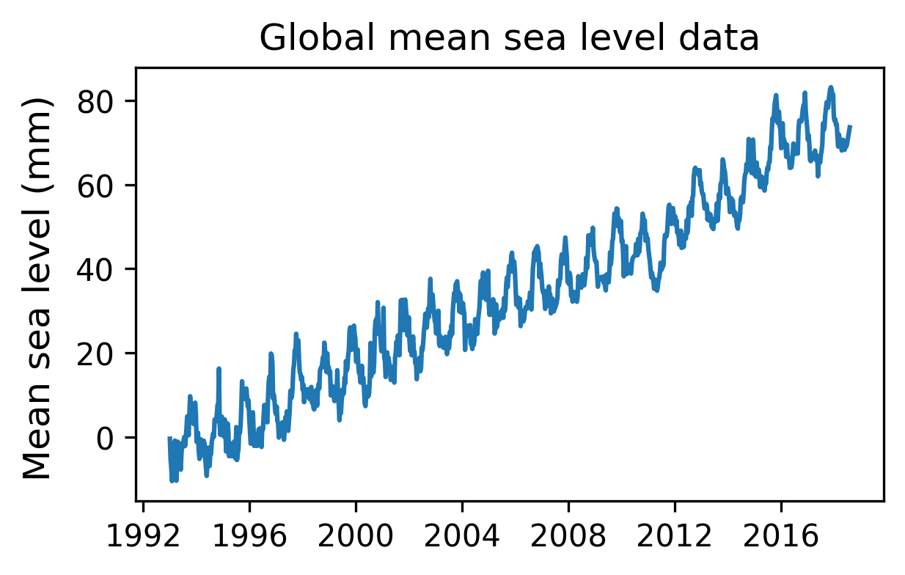
Autocorrelated noise
Noise can be autocorrelated
Autocorrelated noise (e.g., pink noise, or 1/f noise) is ubiquitous:
  Astronomy^{[1]} • Electrical engineering^{[2]}
  Audio^{[3]} • Deep-ocean measurements^{[4]}
However! Noise is typically assumed to be white (uncorrelated)
Assuming noise is white (i.i.d.) → Incorrect uncertainties!!!

Slide 21
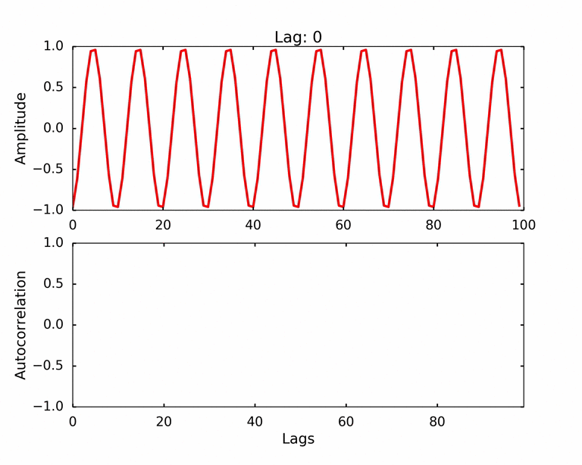
Figure credit: qingkaikong.blogspot.com

Slide 22
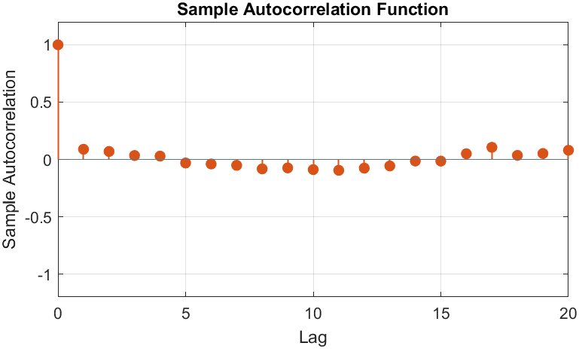
What is Autocorrelation?
Correlation of a signal and a lagged copy of itself:
R_{X}(k) = corr(X(t), X(t–k))
R_{X}(0) = 1
–1 ≤ R_{X}(k) ≤ 1
Function of “time lag” k
Describes temporal structure
Summarised using autocorrelogram

Slide 23
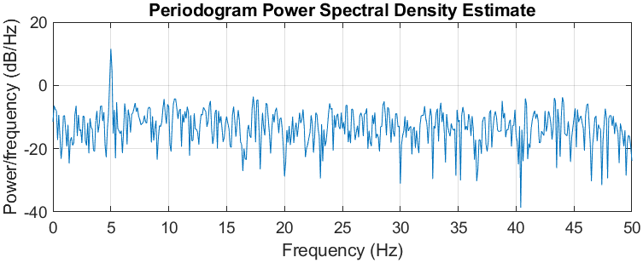
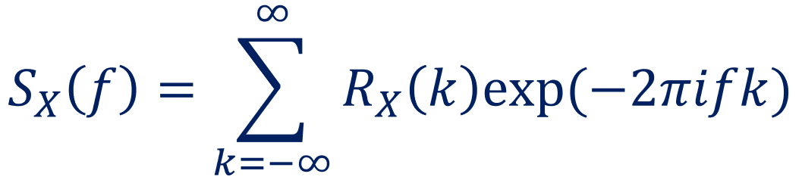
What is Power Spectral Density (PSD)?
Signal’s distribution of power at different frequencies
Power per unit frequency
Fourier transform of autocorrelation function (Wiener–Khinchin theorem)
Makes autocorrelation observable in frequency domain

Slide 24
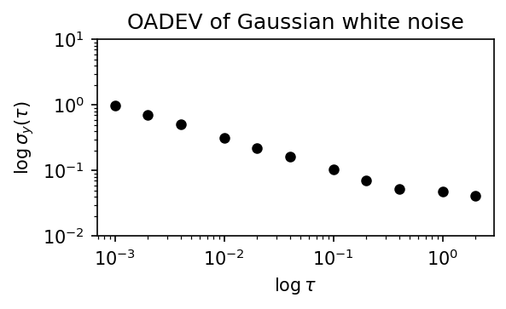
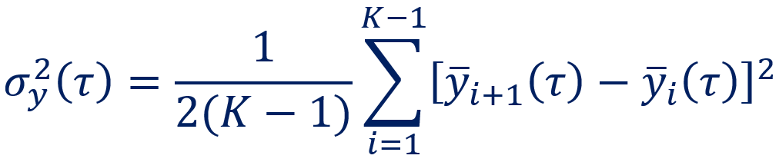
What is Allan Deviation & Allan Variance?
Modifications of standard deviation and variance which:
Quantifies how spread changes over different timescales
Commonly used to measure frequency stability analysis in time domain
Complements PSD!

Slide 25
Visualisations

Slide 26
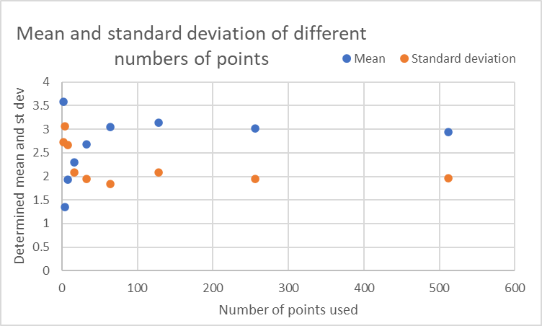
What if I only have a small number of measurements?
“Good maths can’t resolve poor laboratory work” – Emma’s first law of metrology
How can I gather better statistics?

Slide 27
But … what about natural variability?
Is natural variability noise?
  Define your measurand! It might be…
“One scientist’s noise is another scientist’s signal”: Emma’s second law of metrology
If you treat it as noise
  Timeseries analysis (standard deviation or, better, power spectral density / Allan variance)
If it is signal, then you may need to separate instrument and natural effects (not always easy)

Slide 28
Type B methods
Type B methods are about assessing uncertainties “by other means”.
Can be seen as a Bayesian interpretation.
Expert judgement
Ranges
Calibration certificates
Modelling
Comparison with a different measurement system with lower uncertainty

Slide 29
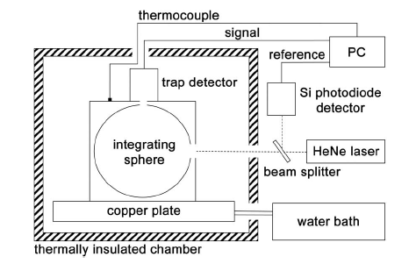
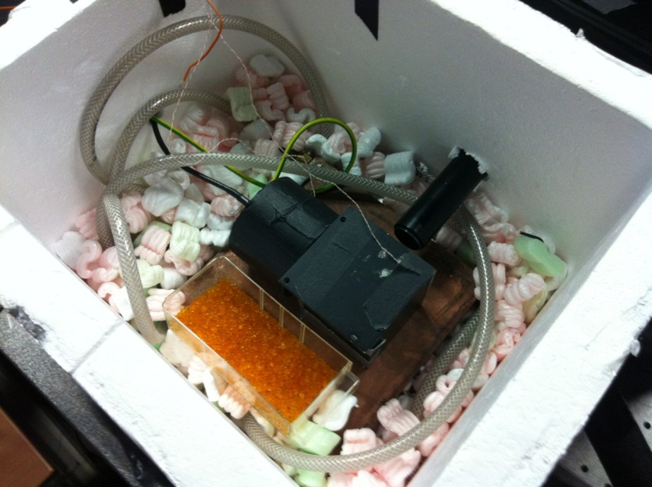
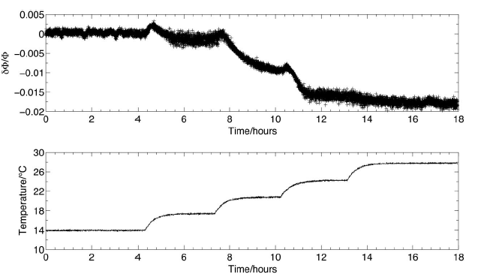
PTFE Sphere phase transition
1.5 %
6 °C
Notes:
Ball, Christopher P., Andrew P. Levick, Emma R. Woolliams, Paul D. Green, Martin R. Dury, Rainer Winkler, Andrew J. Deadman, Nigel P. Fox, and Martin D. King. "Effect of Polytetrafluoroethylene (Ptfe) Phase Transition at 19 Degrees C on the Use of Spectralon as a Reference Standard for Reflectance." Applied Optics 52, no. 20 (2013): 4806-4812.

Slide 30

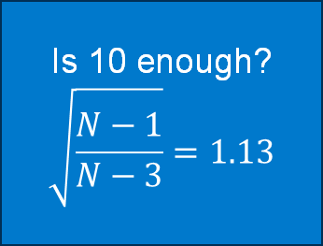




Do I need to identify all the subcomponents?
What I did in my laboratory days to assess uncertainties for my lamp calibrations
Is 10 enough?
$$\sqrt{\frac{N−1}{N−3}}=1.13$$
Dark signal – electronic noise standard deviation
10 repeat readings without turning the lamp off
10 repeat readings, turning lamp on and off but not realigning
10 repeat readings, realigning lamp each time
3 repeat readings on different days, having transported the lamp
$$u^{2}\left(V_{\text{elec}}\right)=σ_{0}^{2}$$
$$u^{2}\left(V_{\text{noise}}\right)=σ_{1}^{2}−σ_{0}^{2}$$
$$u^{2}\left(V_{\text{stab}}\right)=σ_{2}^{2}−σ_{1}^{2}−σ_{0}^{2}$$
$$u^{2}\left(V_{\text{repeat}}\right)={σ_{3}^{2}−σ}_{2}^{2}−σ_{1}^{2}−σ_{0}^{2}$$
$$u^{2}\left(V_{\text{reprod}}\right)={σ_{4}^{2}−σ_{3}^{2}−σ}_{2}^{2}−σ_{1}^{2}−σ_{0}^{2}$$

Slide 31
Is Type A/B the same as random/systematic?
What is the origin of the uncertainty?
  Stochastic processes
  Imprecise knowledge
What method have you used to assess the uncertainty?
  Type A methods (statistical timeseries analysis)
  Type B methods (anything else)
Is the error in one observation related to the error in another observation:
  Fully predictable
  Partially predictable
  Not predictable

Slide 32
Going beyond ‘random’ and ‘systematic’
Confusion between origin, method to analyse and impact
Some things are in between (partial correlation)
Can be different in different dimensions (spatial, temporal, spectral, instrument type, …)
Instead use:
  Independent error / effect
  Structured error / effect
  Common error / effect
The uncertainty associated with independent effects.

Slide 33
Step 3: Evaluate each source of uncertainty and fill out an effects table
What we need to know about each source of uncertainty:
Magnitude / probability distribution function of errors
Sensitivity coefficient to convert uncertainty in effect into uncertainty in measurand
Any error correlation with other terms (common errors with other parts of the diagram)
Error correlations in the dimensions that matter (spatial, temporal, spectral)
UNCERTAINTY
03
We will work on real examples in the practical sessions

Slide 34
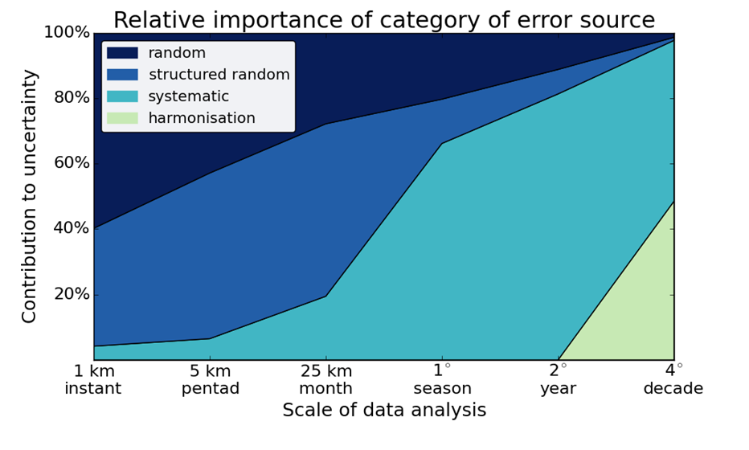
Why does error-correlation matter?
SST Example, C. Merchant (UoR)
Notes:
Mention why this shows one component of uncertainty isn’t enough

Slide 35










AVHRR operation: beyond systematic and random
Sea surface temperature – TIR Radiometer – Example
BB VIEW
$$G_{7}$$
SPACE VIEW
$$G_{6}$$
$$G_{5}$$
$${\overline{G}}_{2}$$
$$G_{4}$$
$$G_{3}$$
$$G_{2}$$
$${\overline{G}}_{1}$$
$$G_{1}$$
EARTH VIEW
BB
COUNTS
EARTH
COUNTS
SPACE
COUNTS
GAIN

Slide 36
Uncertainties in SST radiometer: Error correlation scales in different dimensions
UNCERTAINTY
03
Source of uncertainty | Error correlation across track | Error correlation along track | Error correlation from spectral band to spectral band
Emissivity of the blackbody target (measured before launch) | Fully correlated | Fully correlated | Fully correlated
Temperature of the BB target (measured every 50 scan lines) | Fully correlated | Partially correlated – dropping in triangular fashion over 50 scanlines | Fully correlated
Signal (counts) when looking at the BB | Fully correlated | Partially correlated – dropping in triangular fashion over 50 scanlines | Uncorrelated
Signal (counts) when looking at the Earth | Uncorrelated | Uncorrelated | Uncorrelated

Slide 37
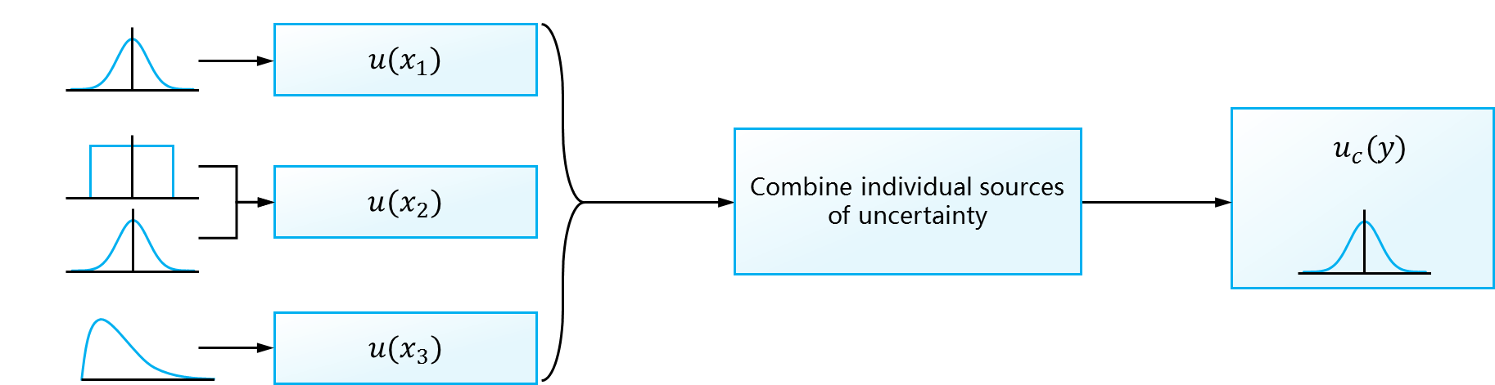
Step 4: Propagating quantified uncertainties
Follow the principles of the Guide to the Expression of Uncertainty in Measurement (GUM)
1. The Law of Propagation of Uncertainties
  Approximate by locally-linearised model
2. Monte Carlo Methods
Approximate by sampling the distribution
CALCULATE
04
Effects
Sources of Uncertainty
Uncertainty propagation
Combined uncertainty
CoMet toolkit does both approaches with multi-dimensional analysis

Slide 38
Step 1: defining the measurand
MEASURAND
01
“The measurand is the quantity intended to be measured”.
(VIM-3: International Vocabulary of Metrology)
RADAR
LIDAR
Total freeboard
Ku freeboard
Ka freeboard
Total freeboard
Ice freeboard
Sea ice thickness
Snow depth
Ice & snow densities
Sea ice thickness
Draft
Which are assimilated into models?
Who is best able to make the corrections?
Figure: Sajedeh Behnia
Notes:
The first step is to define the measurand, and for sea ice this is particularly complex for multiple reasons. The VIM defines the measurand as the “quantity intended to be measured”. Now, the first thing to be realised is that the measurand does not necessarily need to be measured directly – indeed almost no measurement instrument directly measures a measurand – even a simple thermometer is measuring the expansion of a liquid not the room’s temperature! Metrology has the concept of a “multi-stage measurement model” where we recognise that there is often a chain of calibrations, or a processing chain. With sea ice, the most direct measurement is of the Ku-band (radar) freeboard. This can be converted into total freeboard, ice freeboard or sea ice thickness with knowledge of other parameters such as snow depth and the densities.
Which is the measurand? From a metrological perspective you could call any of these measurands. But I also have sympathy with a desire to call the Ku freeboard a ‘measurand’ – as it’s directly measured, and the sea ice thickness – which requires auxiliary information – as a derived quantity.
The important thing is to be extremely clear which quantities you are actually deriving – and more importantly giving to downstream users. And different users might want to have intermediate steps so that they can do their own derivation of the more complex quantities. We could ask, for example, whether the radar expert or the oceanographic modeller is the best person to do the conversion – should we assimilate thickness or freeboard into the model, for example?

Slide 39
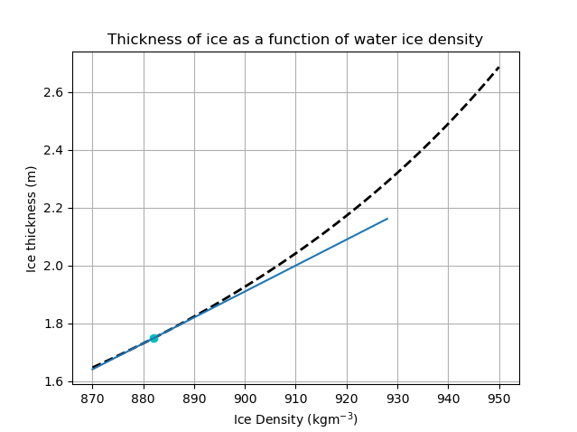
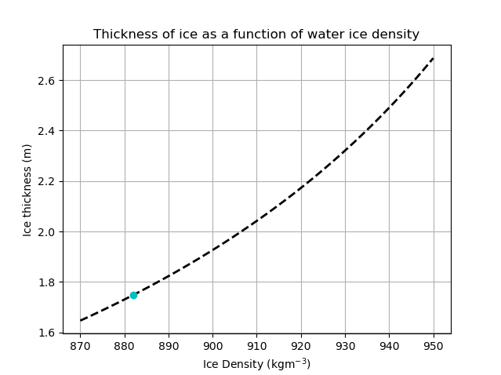
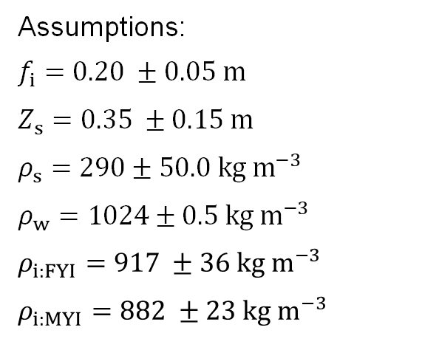


LPU – approximation with locally linearized model
Assumptions:
$f_{i}=0.20 ±0.05 m$
$Z_{s}=0.35 ±0.15 m$
$ρ_{s}=290±50.0 {kg m}^{−3}$
$ρ_{w}=1024±0.5 {kg m}^{−3}$
$$ρ_{i:FYI}=917 ±36 {kg m}^{−3}$$
$$ρ_{i:MYI}=882 ±23 {kg m}^{−3}$$
$$Z_{i}=\frac{f_{i}ρ_{\text{w}}+ρ_{\text{s}}Z_{\text{s}}}{ρ_{\text{w}}−ρ_{\text{i}}}$$
≈13 cm
These are limitations of the LPU. The LPU is based on a linearization of the model and if we have a strictly non-linear model which covers a large range, then the uncertainties will only be applicable to the localized area of interest and not to the whole model.
$$2σ$$
Notes:
First, the model itself is quite non-linear. Here you have ice thickness as a function of ice density. Of course, as ice density approaches water density – this heads to infinity, so in this region is is extremely non-linear. The LPU models uncertainty propagation with a linear model, so if you put a large uncertainty on your ice density (which you might want to, because it can vary a lot with air pockets), you can find that this underestimates the effect of that uncertainty.
So, the second approach we tried was Monte Carlo analysis – but this ran into exactly the same problem – actually even worse, because with enough Monte Carlo trials, you can get samples that are far more than two standard deviations out and those made the problem unstable.

Slide 40
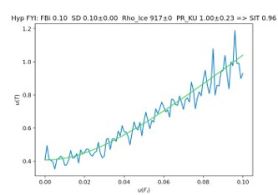

Uncertainty propagation with MCM
Assumptions:
$f_{i}=0.20 ±0.05 m$
$Z_{s}=0.35 ±0.15 m$
$ρ_{s}=290±50.0 {kg m}^{−3}$
$ρ_{w}=1024±0.5 {kg m}^{−3}$
$$ρ_{i:FYI}=917 ±36 {kg m}^{−3}$$
$$ρ_{i:MYI}=882 ±23 {kg m}^{−3}$$
Notes:
Instead, we built a more complex model and distinguished “ice in water” from “ice in air” – because ice in water has a more consistent density than ice in air – which can have air pockets. With this more complete model, we also created asymmetrical distributions (the pink rather than blue symmetrical ones), that, simply didn’t let the ice density get too close to the water density. We then ran multiple Monte Carlo trials for different uncertainty distributions.

Slide 41
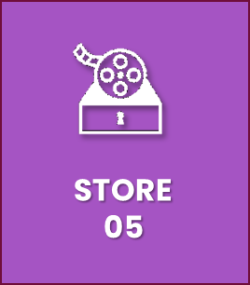
Step 5: Store relevant information for users
Providing users information about uncertainty
Users combine data from different times, locations (and maybe wavelengths, instruments)
  They need to have access to error correlation information in those dimensions
This must be provided in ways that are computationally manageable and can be simplified for more straightforward applications
CoMet toolkit can also be used by users to propagate that information forward
This is where the UNC metadata standard is needed.

Slide 42
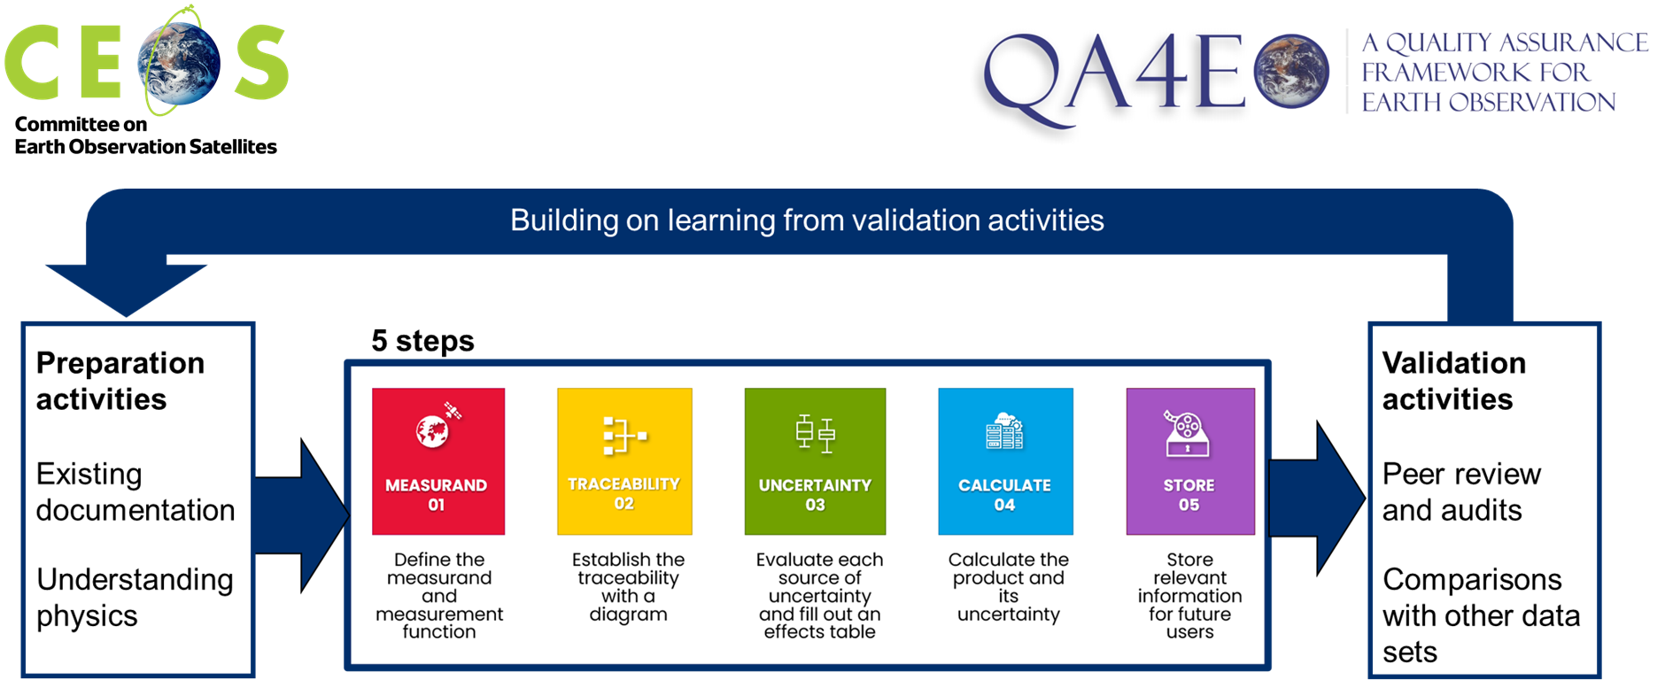
Iterating the QA4EO Five Steps and validating uncertainty analyses
Learn more at www.qa4eo.org

Slide 43
Example of a community coming together to get a check-list
Part of the table
CCT WG-Non-contact thermometry
https://www.researchgate.net/publication/338406352_UNCERTAINTY_ESTIMATION_IN_PRIMARY_RADIOMETRIC_TEMPERATURE_MEASUREMENT
Uncertainty Component |  | Normal Uncertainty | Best Uncertainty | Notes
Filter Radiometer Calibration
Wavelength scale |  | 100 pm | 0.1 pm | Normal uncertainty for monochromator and best for laser system.
Stray light in calibration |  | 0.01 % | 0.0003 % | Based on the stray light values reported in [69].
Responsivity of trap detector |  | 0.07 % | 0.013 % | Absolute calibration traceable to cryogenic radiometer.
Out-of-band effects |  | 0.025 % | 0.01 % | Based on the OOB values reported in [69].
Amplification of photocurrent |  | 0.0026 % | 0.001 %
Geometric factor | Distance | 0.1 % | 0.004 % | All expressed as uncertainties in radiance, as per Table 3.
 | FR aperture radius | 0.02 % | 0.01 %
 | Source aperture radius | 0.02 % | 0.01 %
 | Transfer/trap aperture radius | 0.02 % | 0.01 %
 | Aperture co-alignment | 0.01 % | 0.0001 %
 | Aperture non-roundness | 0.004 % | 0.001 %
 | Aperture change | 0.02 % | 0
Noise |  | 0.05% | 0.01%
FR spatial uniformity |  | 0.02 % | 0.02 % | Only for the power method since the FR is calibrated under-filled and used overfilled.

Slide 44
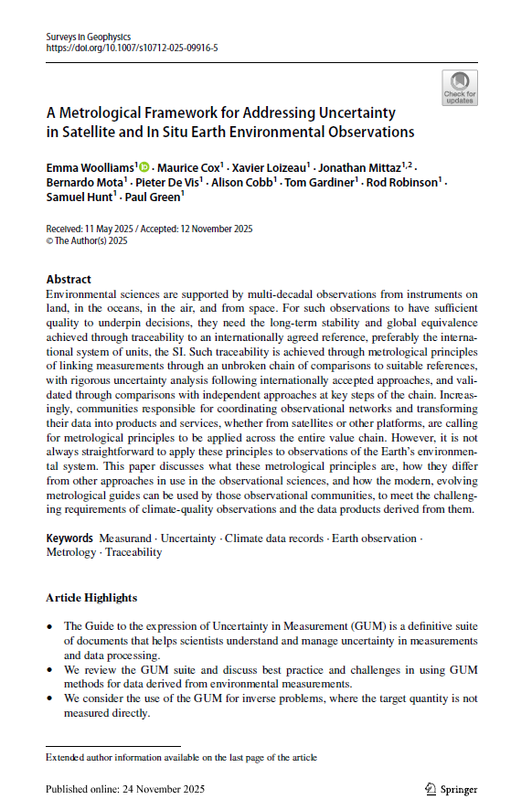
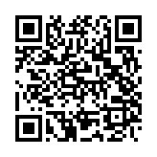
Plug for the paper I’ve recently published
Woolliams, E., Cox, M., Loizeau, X. et al. A Metrological Framework for Addressing Uncertainty in Satellite and In Situ Earth Environmental Observations. Surv Geophys (2025).
https://doi.org/10.1007/s10712-025-09916-5
Emma Woolliams, National Physical Laboratory
Emma.Woolliams@npl.co.uk

