Slide 1
MetEOR Toolkit
Sam Hunt, Pieter De Vis, Maddie Stedman, Jacob Fahy, Samantha Malone, Joe Riordan, & Nigel Fox

Slide 2
Topics
Open-Source Software Initiatives
  CoMet
  MetEOR
CEOS-PVP
  RadVAL Service
QA Reporting
  EODH

Slide 3


Open-Source Software Initiatives
Python tools for uncertainty propagation and covariance handling in measurement models.
Projects: Hypernets, NMS, QA4EO
Python tools for EO-specific metrology, including comparison workflows.
Projects: EOCIS, Met4EO

Slide 4






Open-Source Software Initiatives
UNC Specification
+ others
Notes:
Emphasize the number of projects these packages are used in now
Upskilling metrology in the wider EO

Slide 5
Open-Source Software Initiatives
UNC Specification
+ others
Notes:
Emphasize the number of projects these packages are used in now
Upskilling metrology in the wider EO

Slide 6
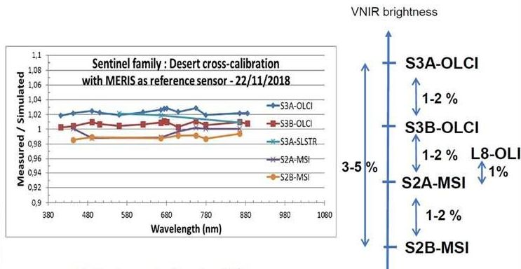
Calibration Status Quo
Set of datasets traceable to no common reference.
Limits utility for integration of high and low resolution data (downscaling)
Limits interoperability & coverage (temporally/spatially) achievable for global climate datasets
Comparison of ESA/NASA imaging sensors with respect to simulated reference (prepared by: A. Meygret, CNES)

Slide 7
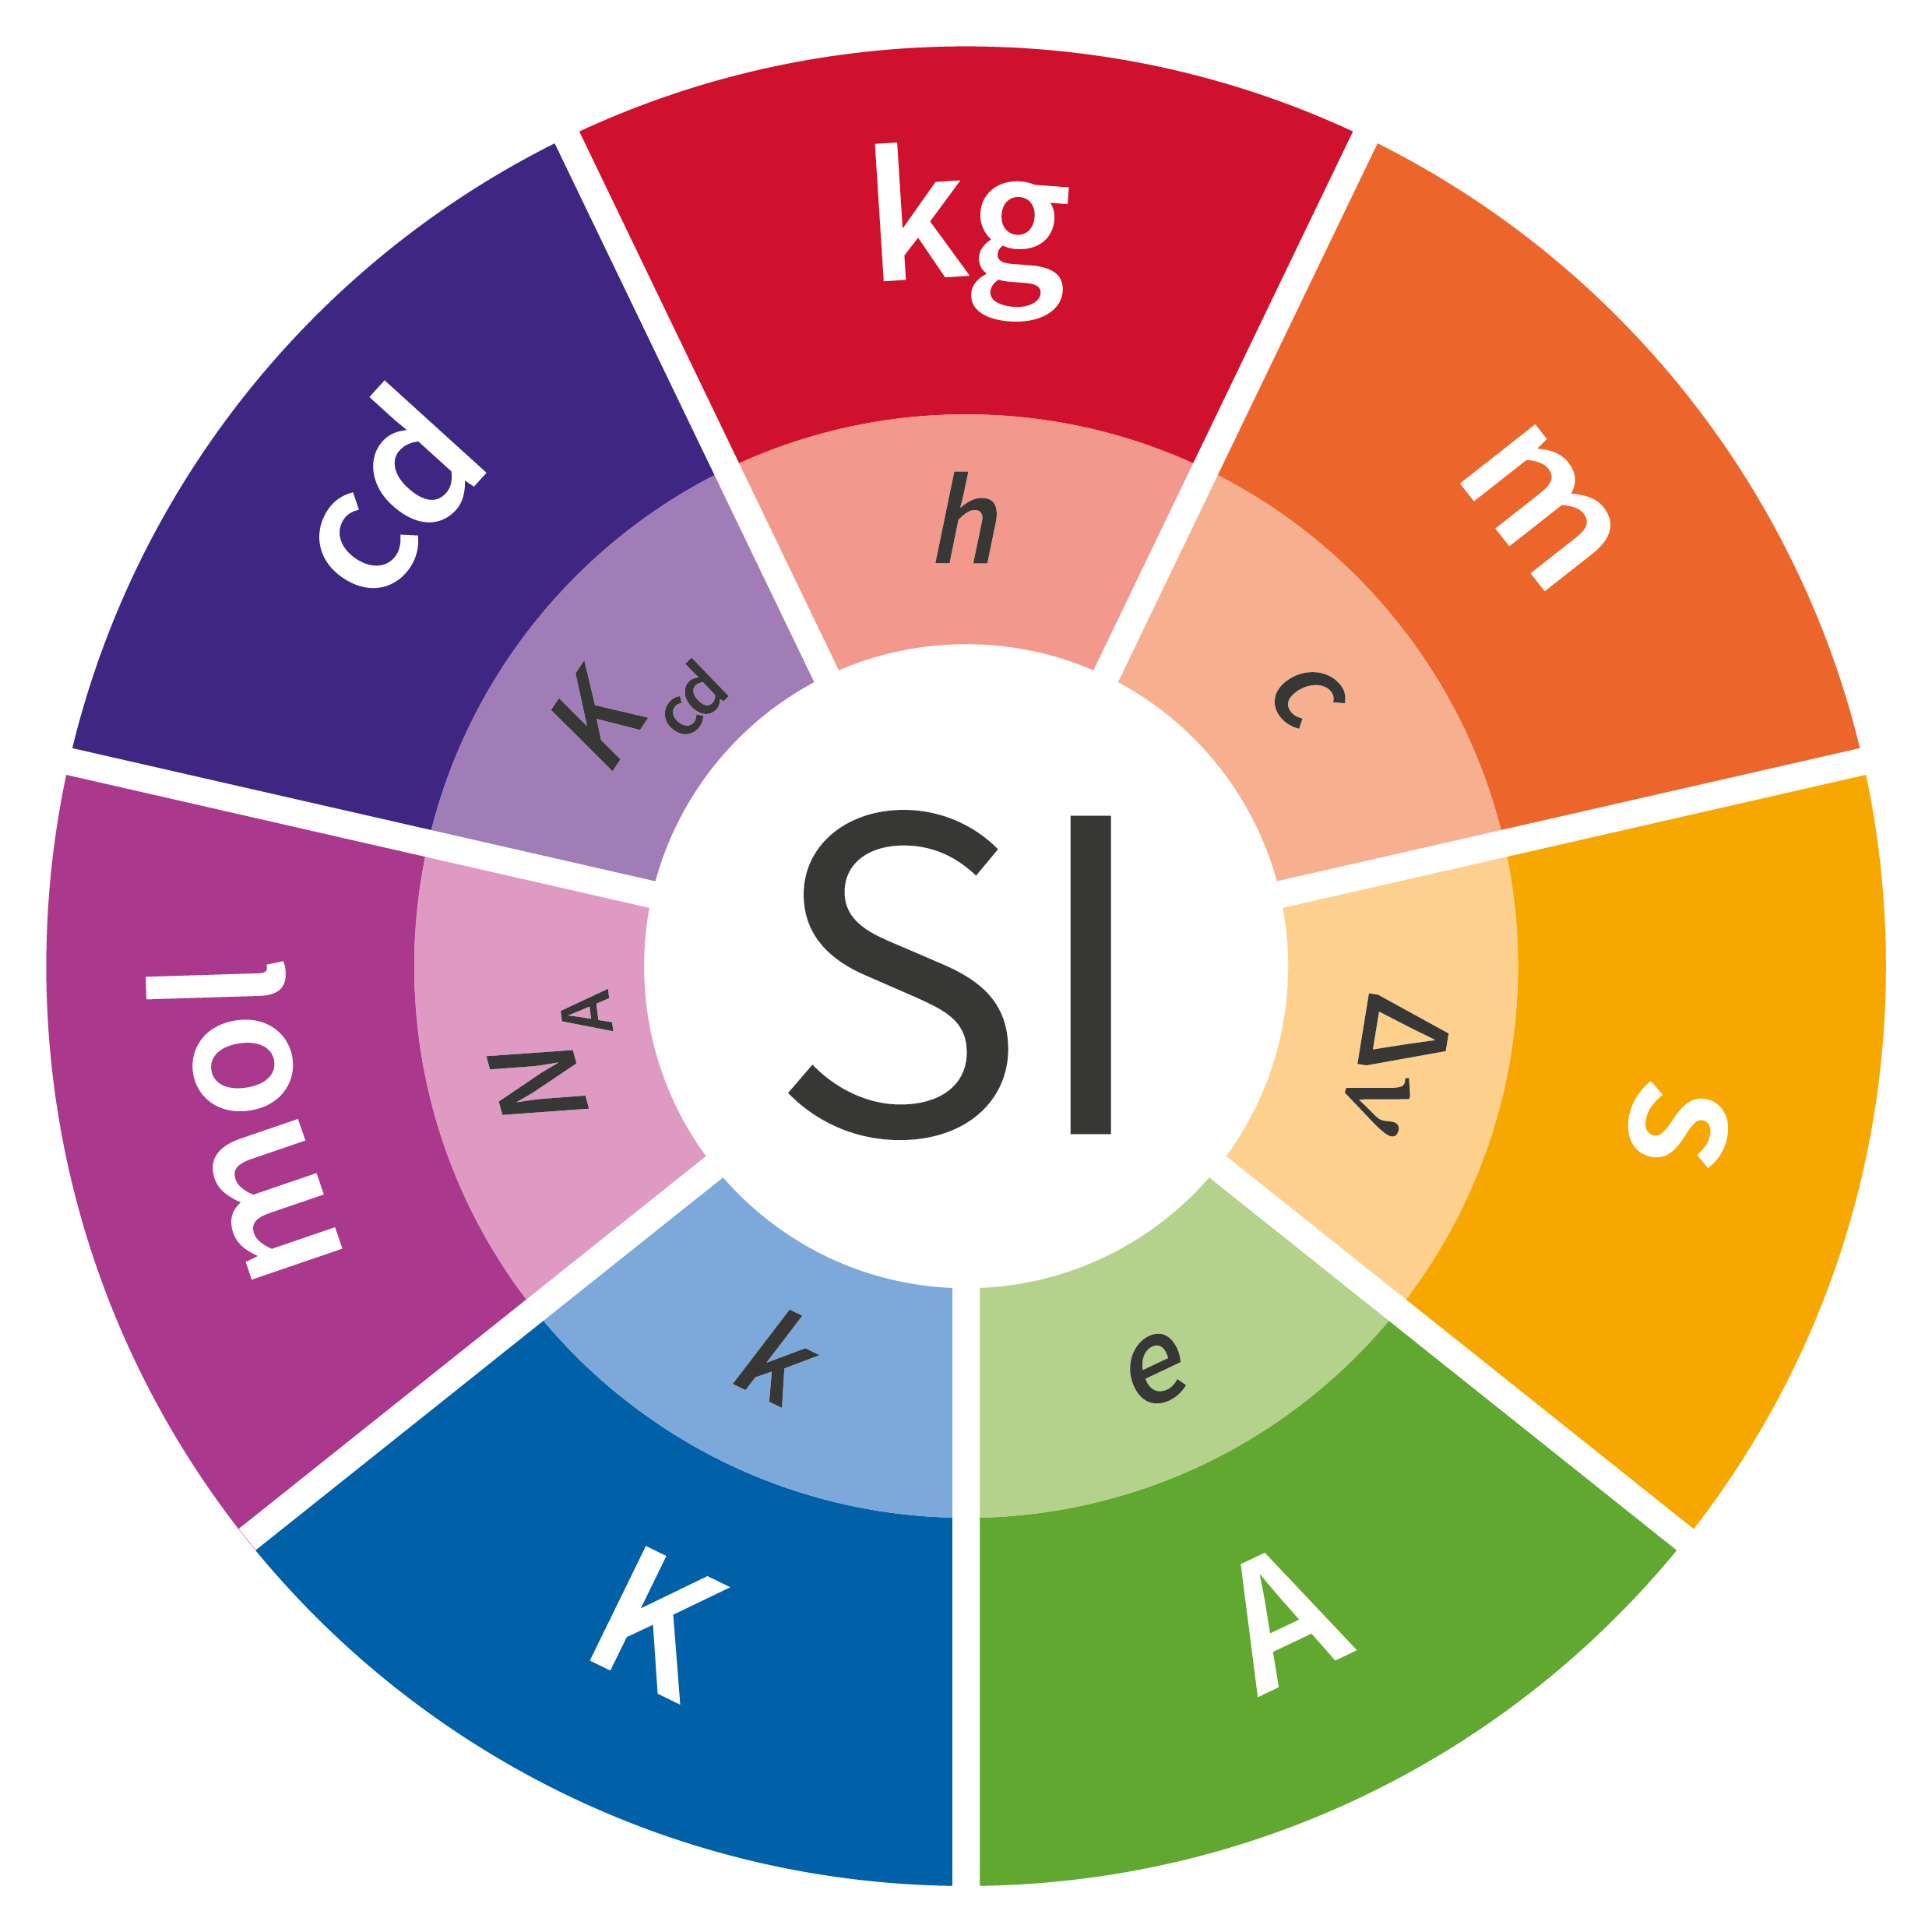
Space Reference
EO System of Systems
Opportunity to develop the means to properly integrate the EO system of systems
Supports data providers and users to get maximum value out of available observations
Space
Agency Missions
Commercial
Missions
Ground Reference

Slide 8








Satellite Match up Comparison
Analysis of matchups is a key technique to compare and cross-calibrate EO sensors in flight.
A number of aspects of satellite match up comparison make this challenging, e.g.,
  Observation-related effects:
    Viewing geometry mismatch
    Temporal mismatch
  Sensor-driven effects:
    Spectral response function differences & knowledge
    Spatial sampling differences
    Geolocation uncertainty
$$λ$$
$$λ$$
$$θ_{s_{1}}$$
$$θ_{s_{2}}$$
$$φ_{s_{2}}$$
$$φ_{s_{1}}$$
Notes:
Matchup defined as event where two satellite sensors observe approximately the same location at approximately the same time
Use matchups to compare & cross-calibrate EO sensor
Fundamental assumption = measurements are comparable
Challenges in this comparison (spectral/spatial/geometry/temporal)

Slide 9
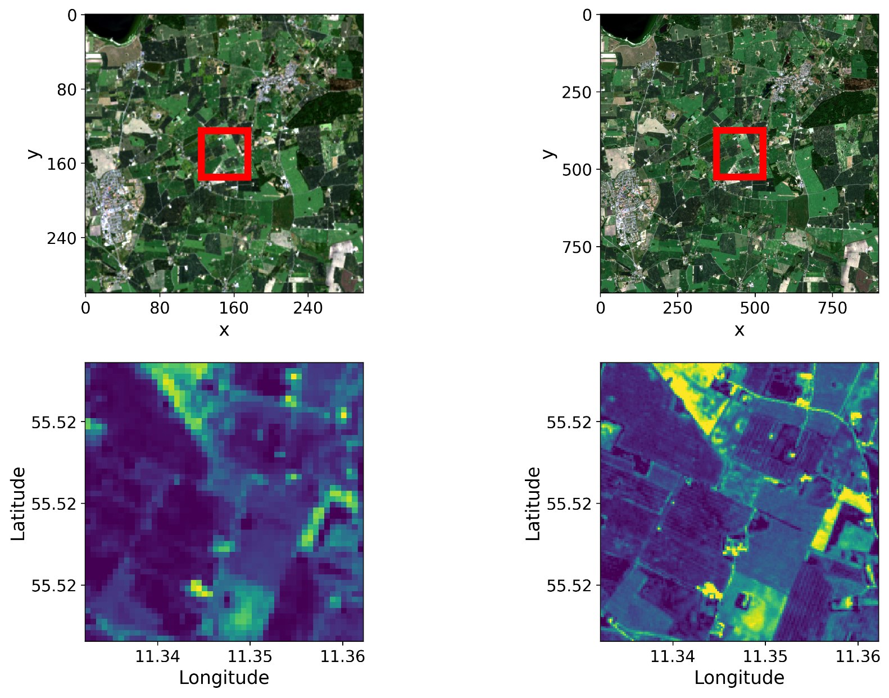
Purpose of MetEOR
Matchup Analysis
Sensor 1
Sensor 2
1. Find overlapping observations
30 m
10 m
30 m
10 m

Slide 10

Purpose of MetEOR
Matchup Analysis
Sensor 1
Sensor 2
1. Find overlapping observations
30 m
10 m
2. Put data on a common basis
e.g., spectral band adjustment, BRDF-correction, spatial resampling to common grid
30 m
10 m
210 m
210 m

Slide 11
Purpose of MetEOR
Matchup Analysis
Sensor 1
Sensor 2
1. Find overlapping observations
30 m
10 m
2. Put data on a common basis
e.g., spectral band adjustment, BRDF-correction, spatial resampling to common grid
30 m
10 m
3. Compare and summarise differences
+ Uncertainty propagation!

Slide 12
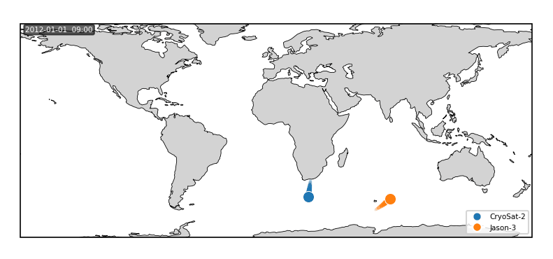

: Orbit Matchup Event Identification
orbitx enables users to find the time and location of matchup events between sensor pairs.
Orbits parameterised by per platform TLE data
Uses can define maximum temporal window
Build on orbit propagation software orekit
Example satellite cross-over identification between CryoSat-2 & Jason-3 in 2012

Slide 13
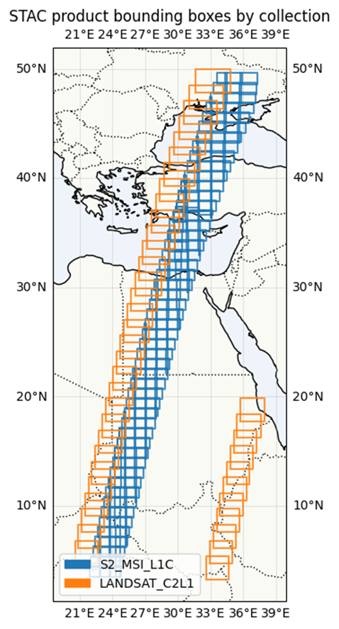
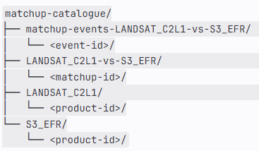
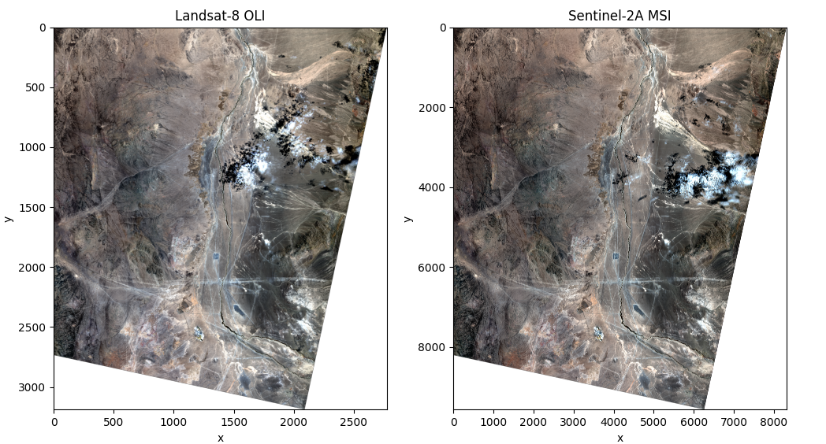

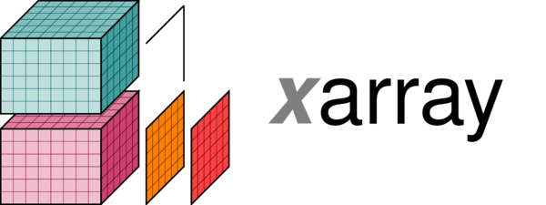





eomatch: Matchup Data Management
Query satellite products in identified Matchup Events
Persist identified matchups in STAC
Pull collocated pixels for analysis
…

Slide 14
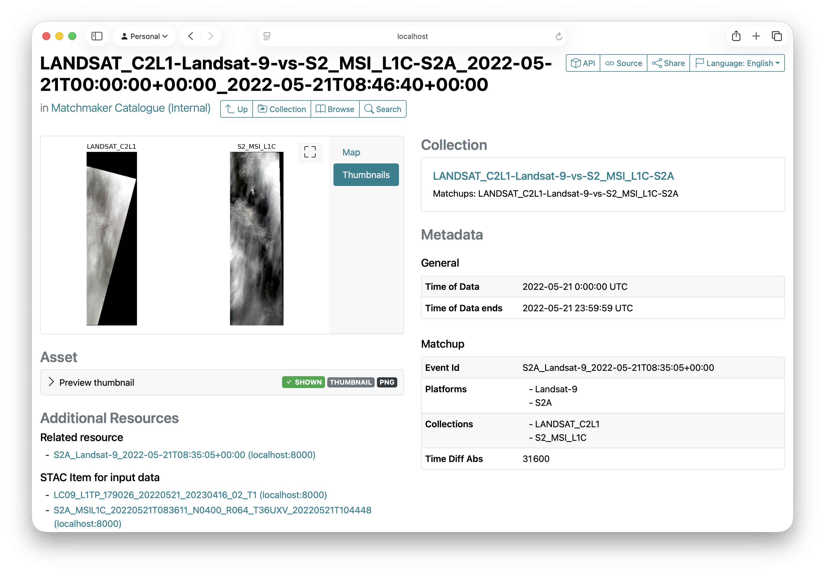



eomatch: Matchup Data Management
Query satellite products in identified Matchup Events
Persist identified matchups in STAC
Hosted catalogue to serve user queries

Slide 15
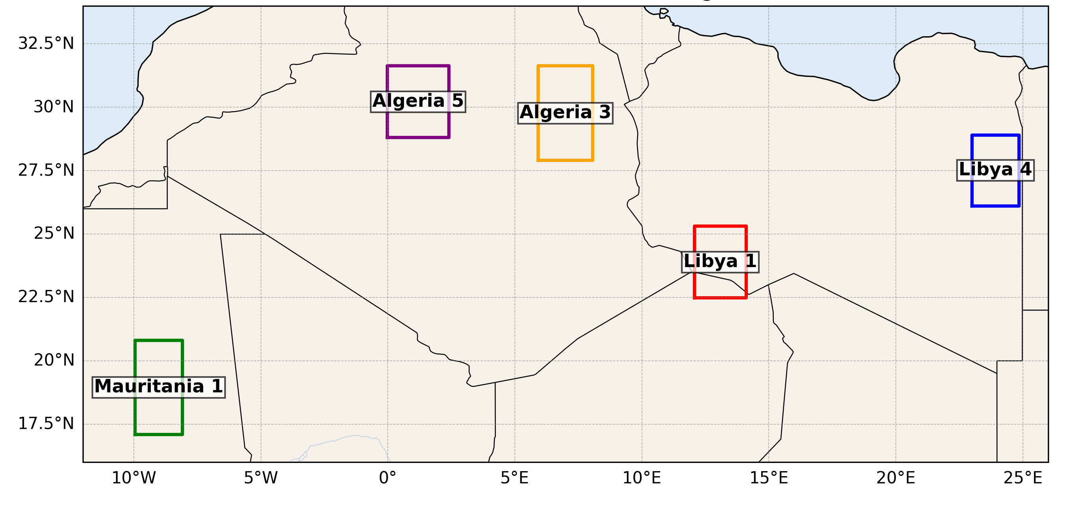
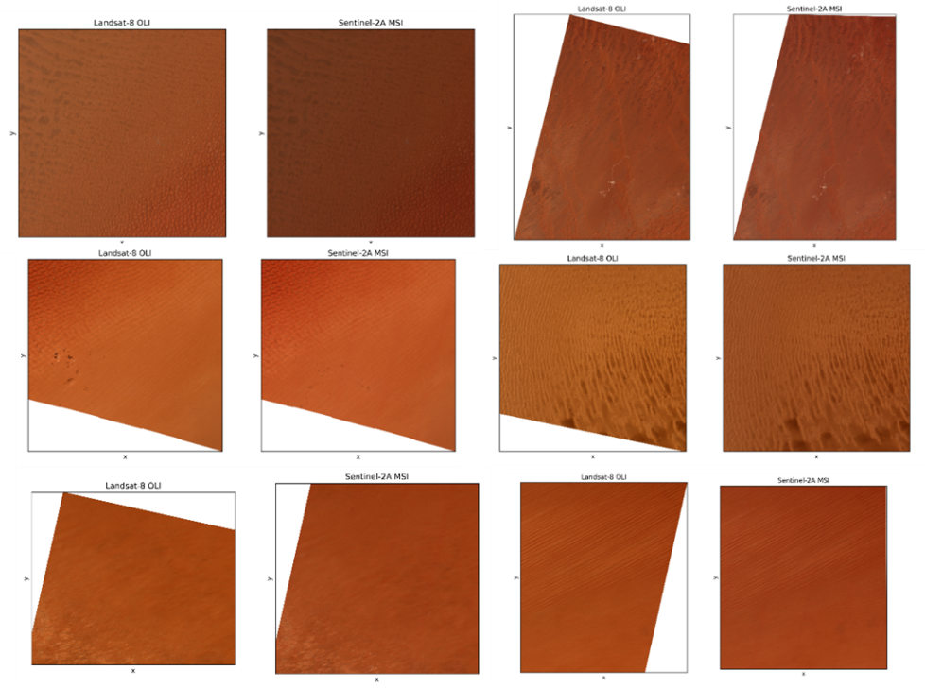
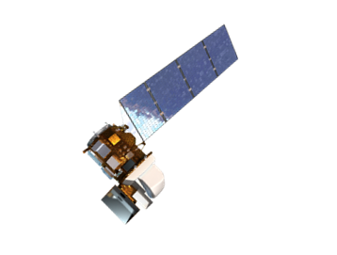
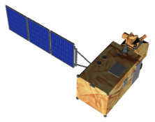
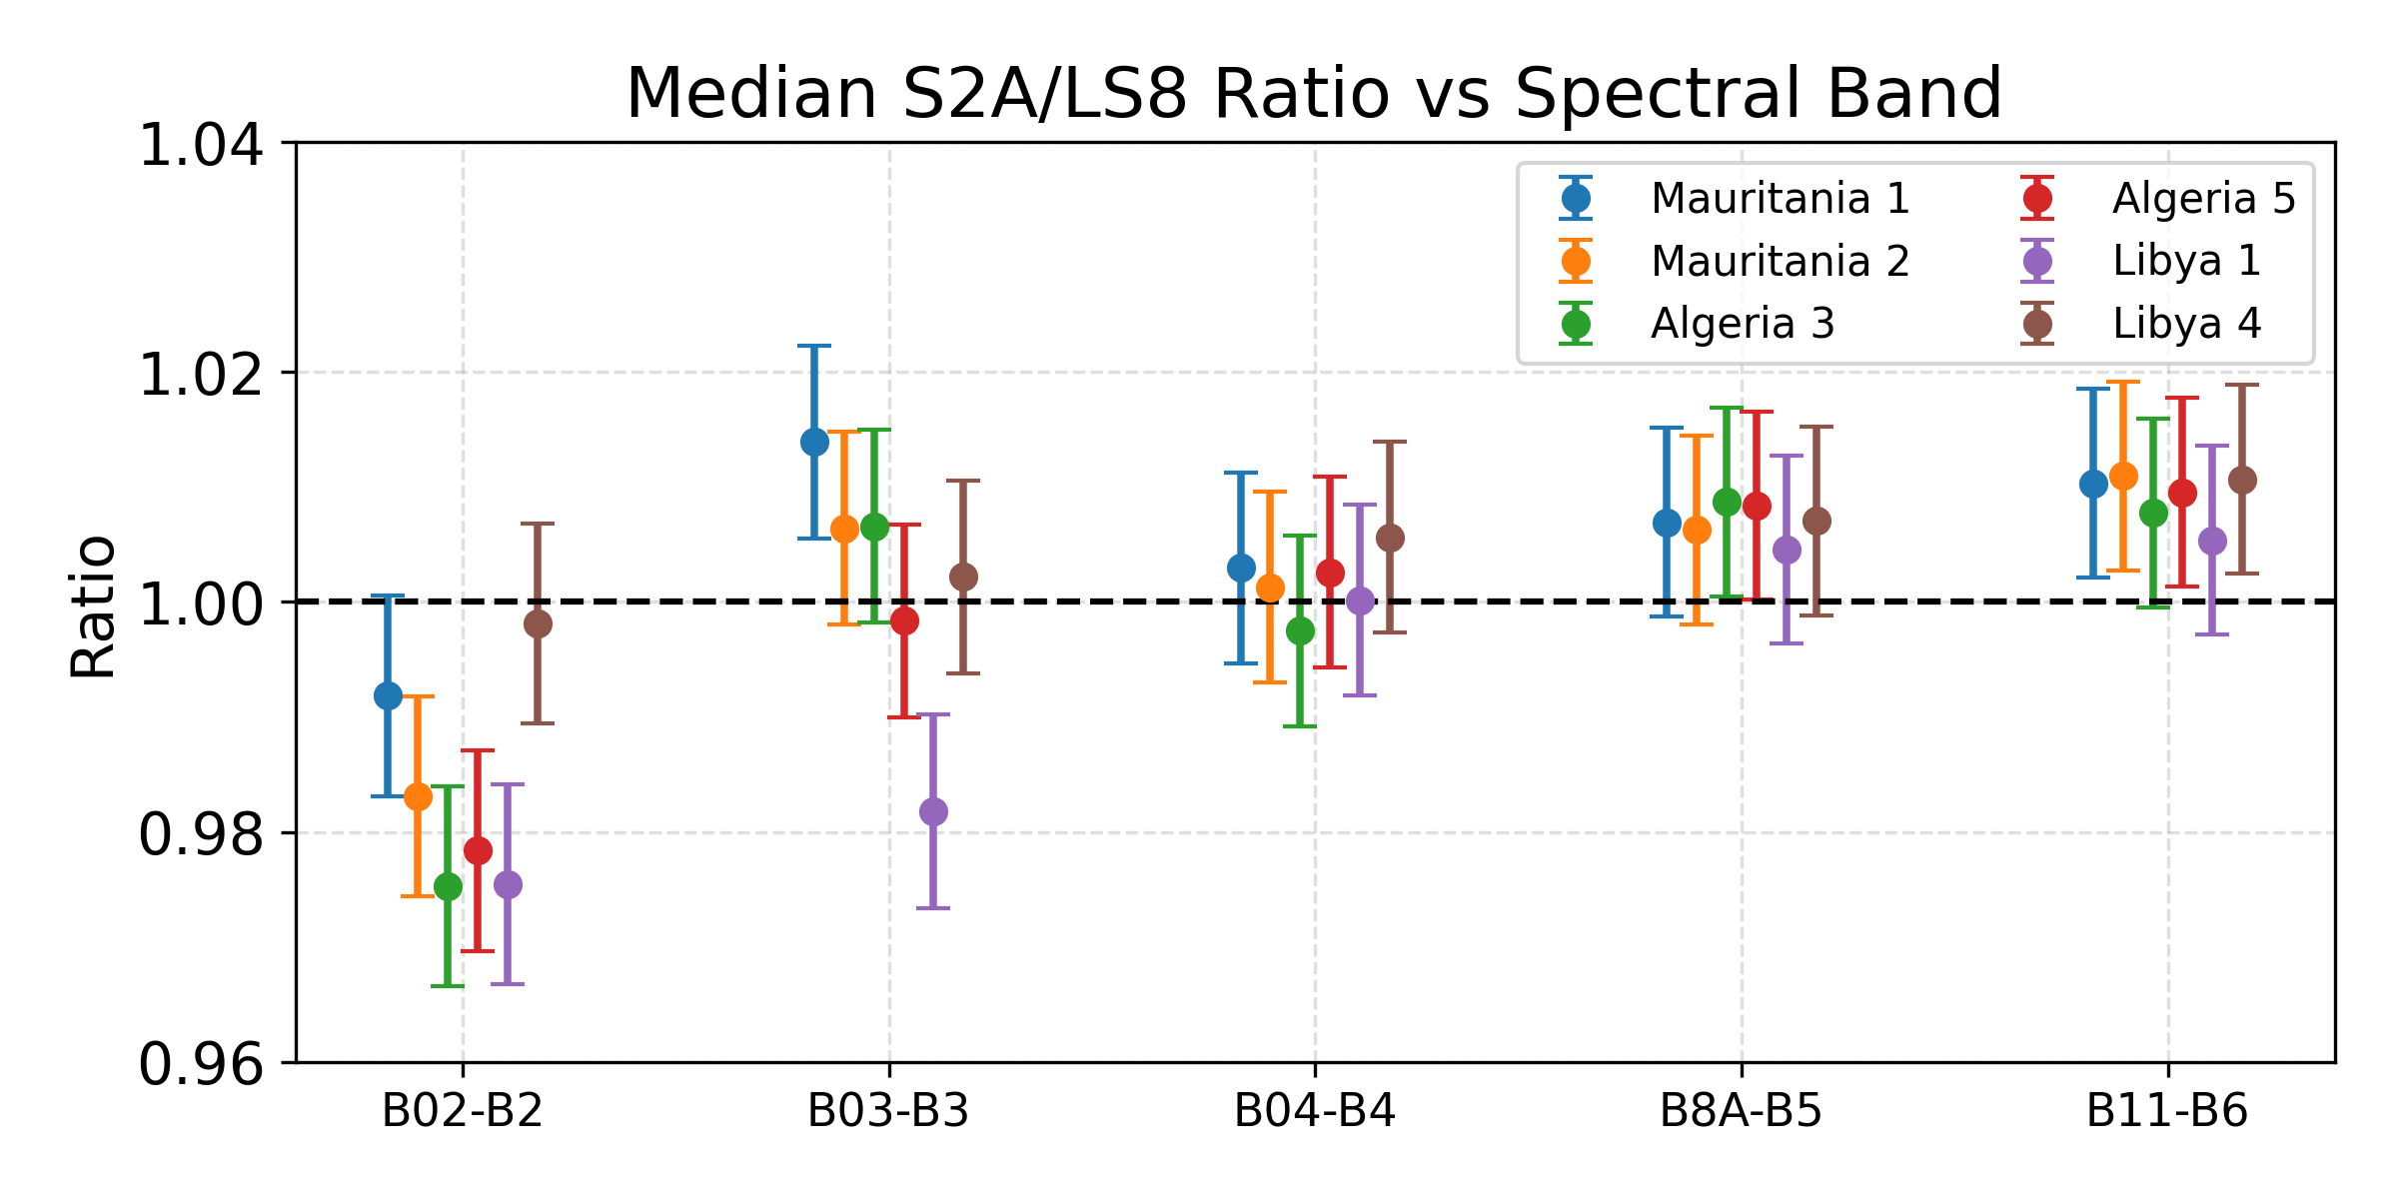
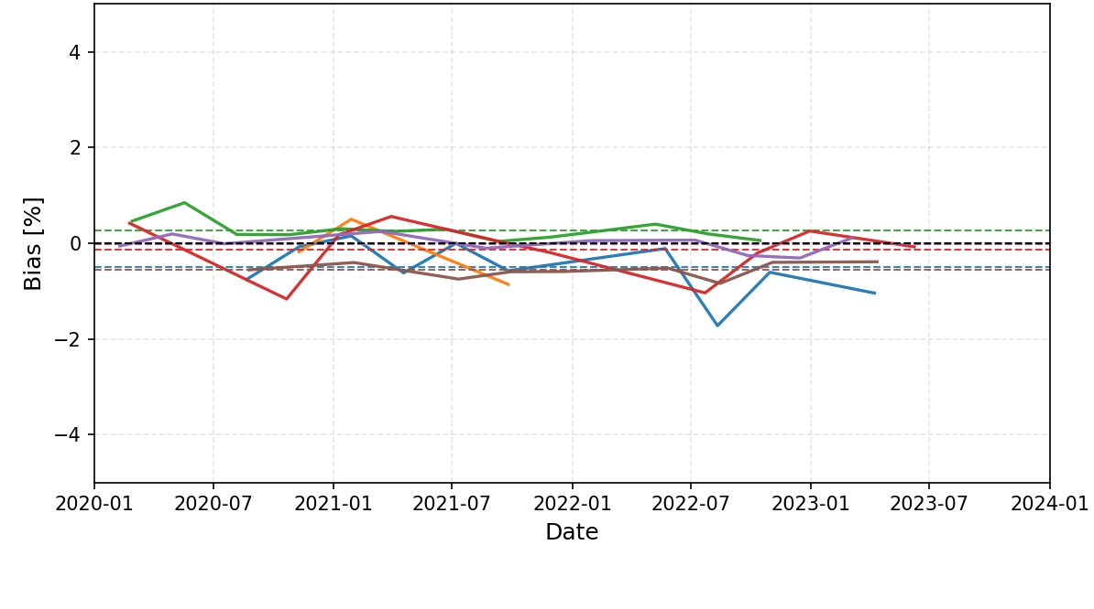
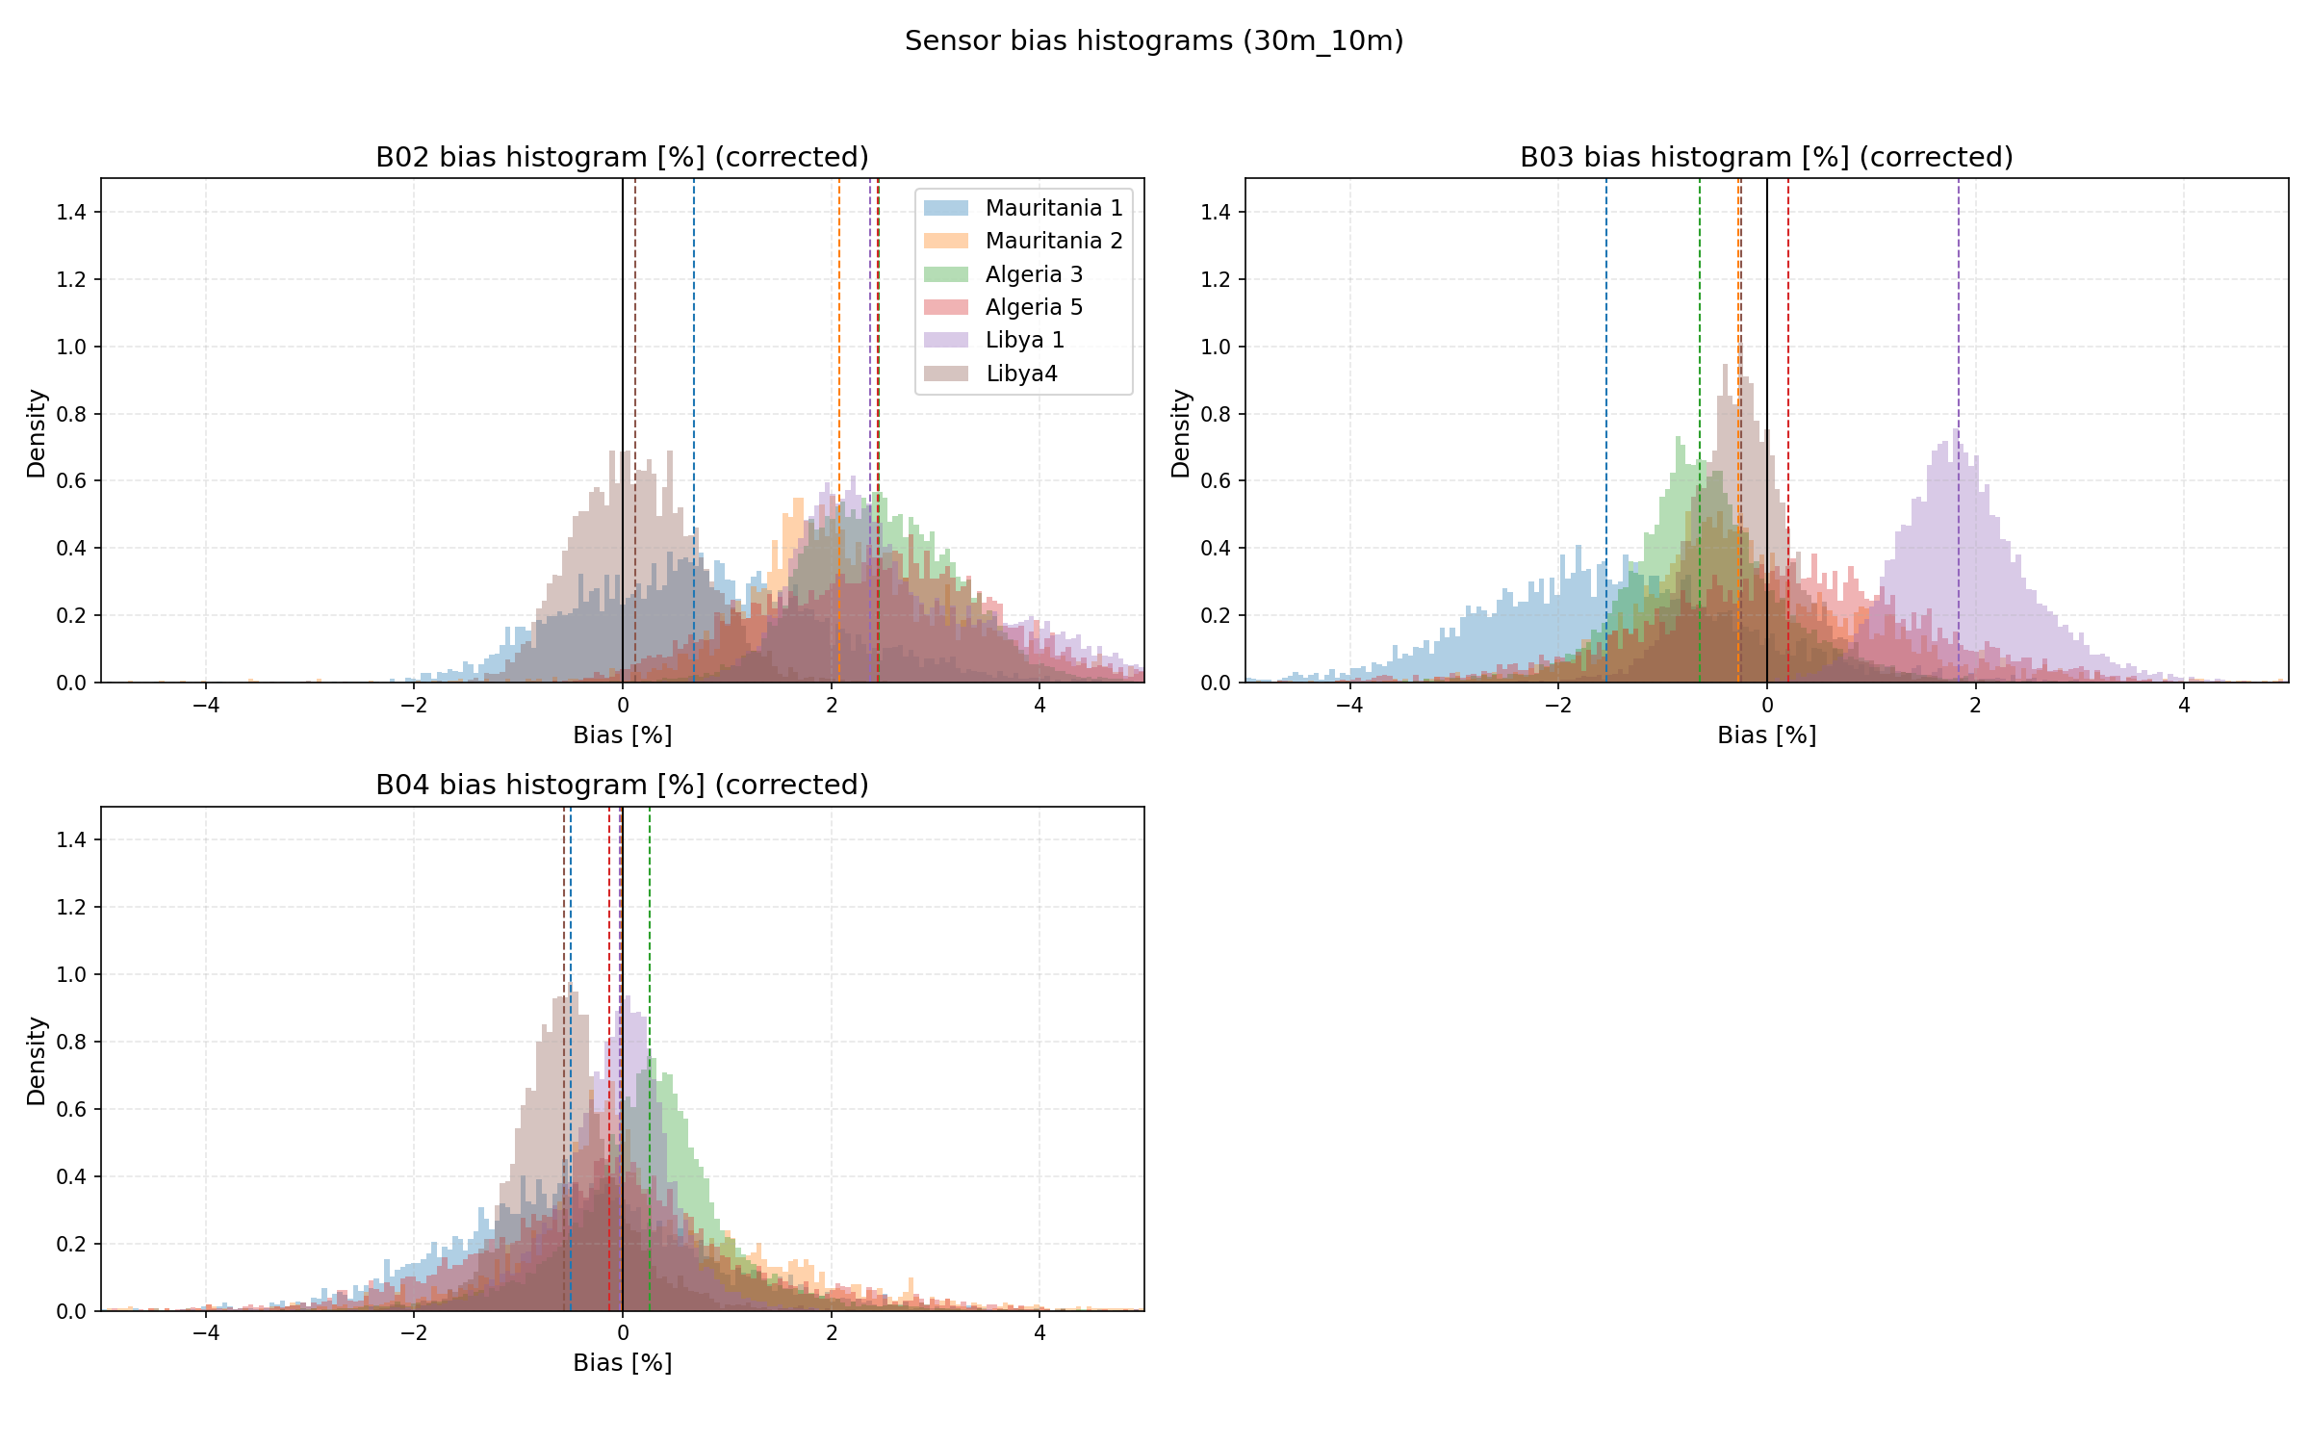
S2A/LS8 Case Study
By aggregating many matchups over longer time periods we can quantify sensor agreement, characterise bias, and monitor temporal stability.
Stable, characterised target sites, e.g. CEOS PICS, can reduce comparison uncertainties
Results from Sentinel-2A / Landsat-8 over CEOS PICS (2020-2024):
~500 cloud-free matchups over >50 matchup events
Time series can reveal seasonal behaviour and drift
Distributions summarise overall bias
Total uncertainty is a combination of measurement and comparison uncertainties
Notes:
Time series & histograms included show Band 4 results (red band ~665 nm).

Slide 16
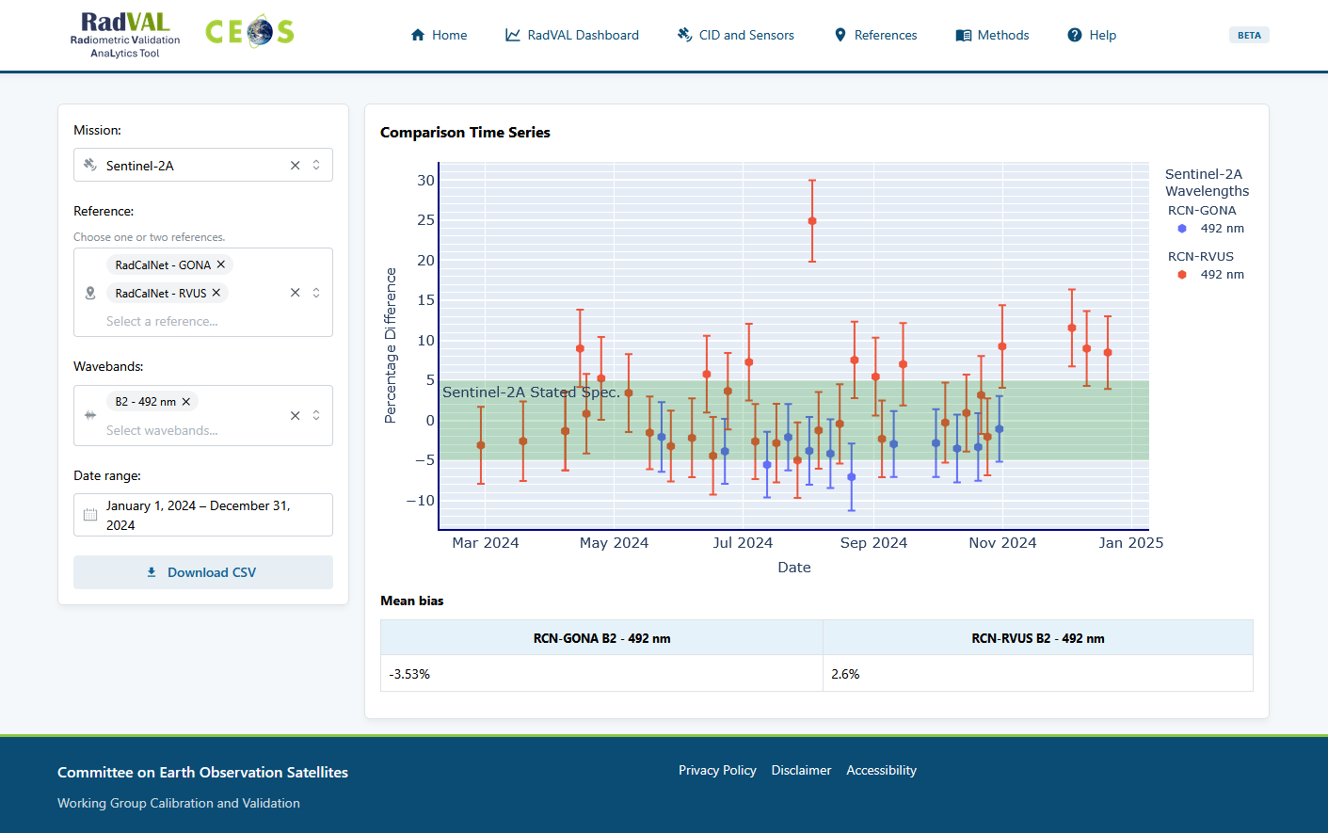

Slide 17
Status
Packages being open-sourced and distributed via the python package index
  https://github.com/meteor-toolkit
Software in beta – you’re welcome to test, feedback, contribute ☺

Slide 18

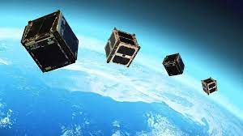
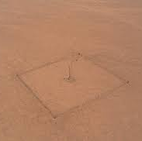
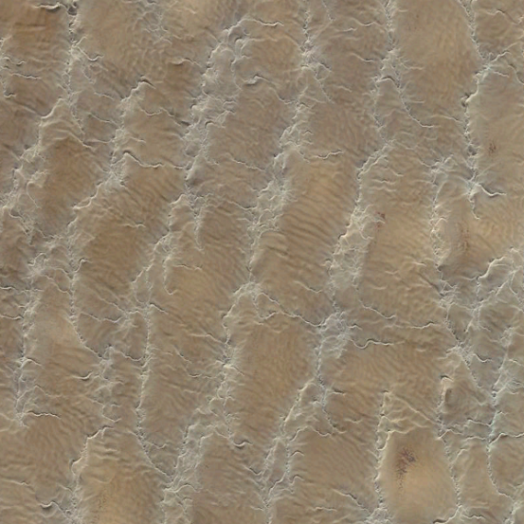
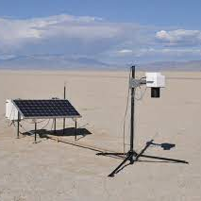
CEOS-PVP
Product Validation Platform
Notes:
CEOS (Committee on Earth Observation Satellites) is an international coordinating body that brings together space agencies and organizations to optimize the use of Earth observation satellite data.
Follow up action from previous VH-RODAs
Add ceos.org/pvp url to slides
Update slides to use vh-roda slide deck

Slide 19
PVP – Product Validation Platform
The CEOS-PVP will host services that provide information mission performance to:
  Provide users with actionable information on the performance of different mission products – is data fit for purpose?
  Provide vendors with an independent mechanism to demonstrate the quality of their products.
Notes:
Product vendors happy

Slide 20

PVP – Product Validation Platform
The CEOS-PVP will host services that provide information mission performance to:
  Provide users with actionable information on the performance of different mission products – is data fit for purpose?
  Provide vendors with an independent mechanism to demonstrate the quality of their products.
First PVP service RadVAL: radiometric performance monitoring of
participating missions vs. CEOS references
Notes:
Radval…

Slide 21
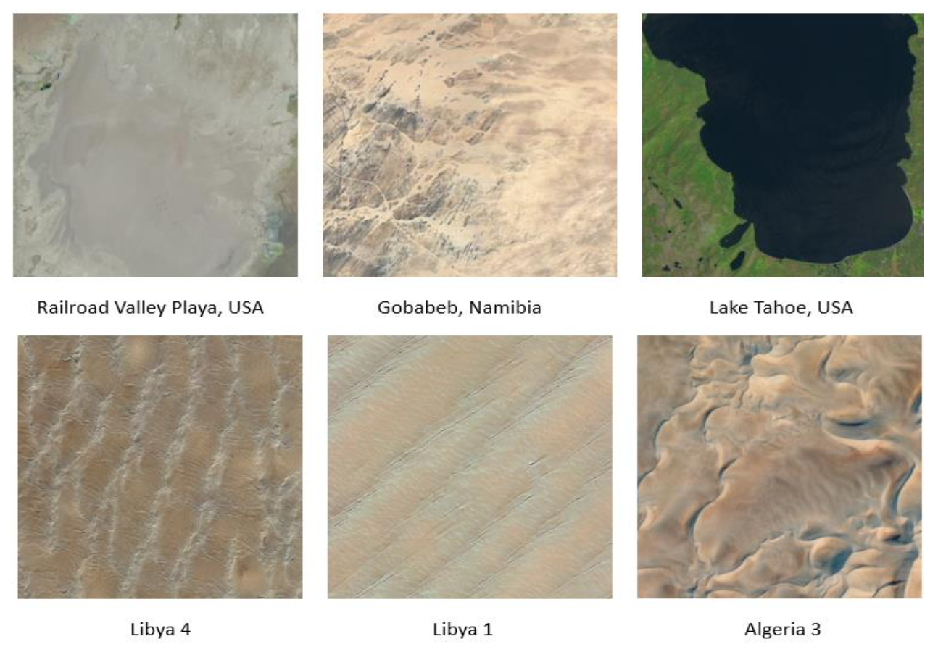

Core References
Combination of CEOS-developed references
  Gobabeb, RadCalNet
  Railroad Valley, RadCalNet
  PICS
Integrated together to form
average CEOS “virtual reference”
  Concept to be developed in future to reduce reference uncertainty
CEOS Minimal References Sites for Radiometric Monitoring
Notes:
We currently have comparisons with…
Planning to engage with data providers to add more to CID over CEOS references
Sam H presented VirRef yesterday

Slide 22
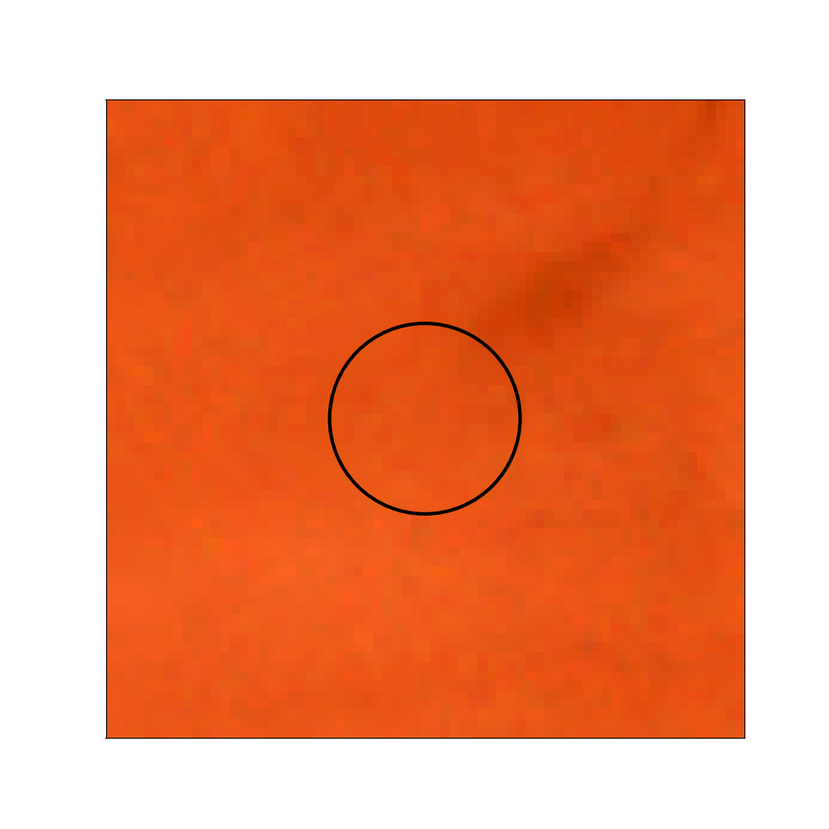
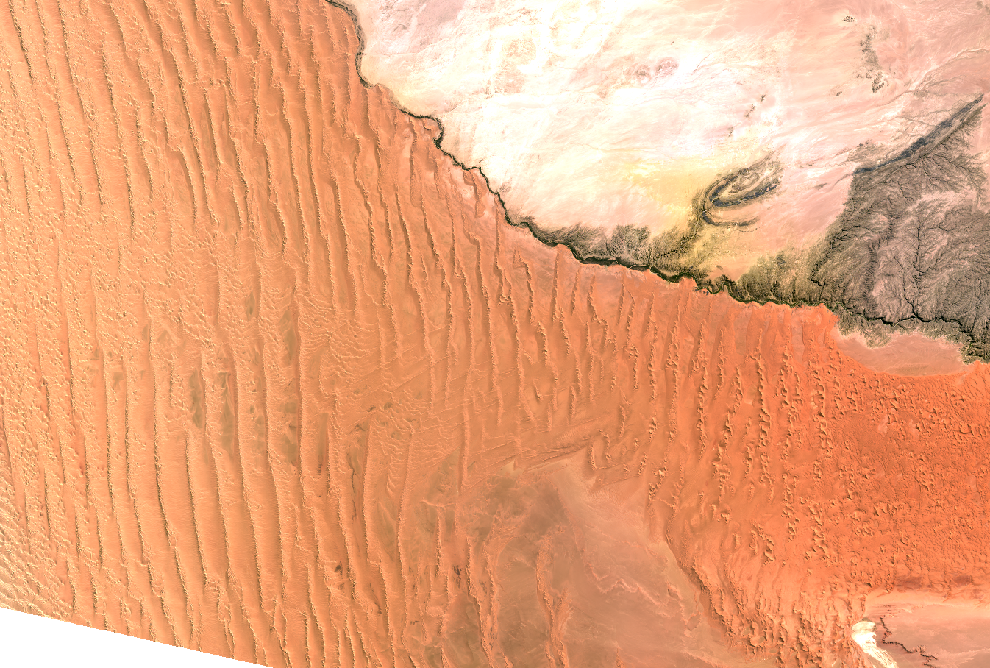
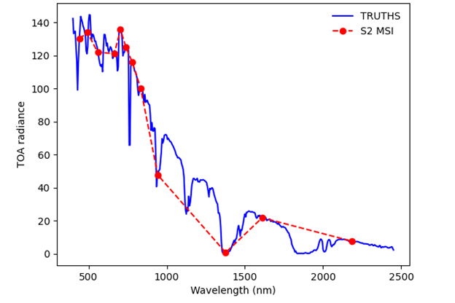
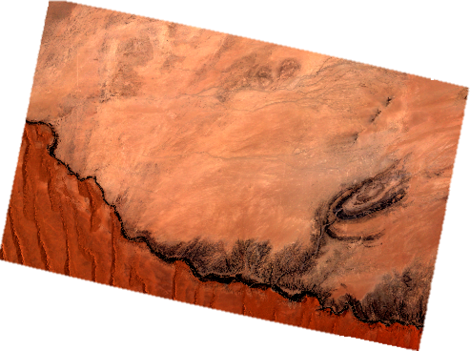


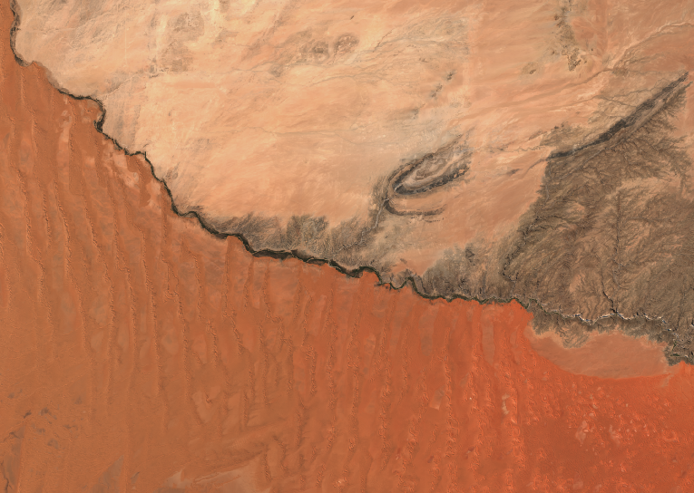
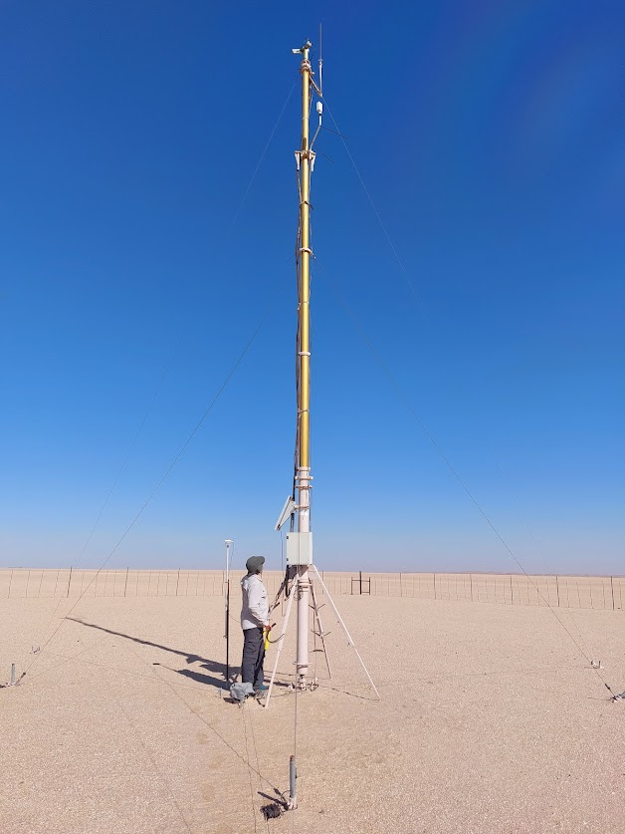

Automated Radiometric Monitoring
Data Collection
Temporal, Spatial, Spectral Matching
Comparison
Comparison
Image Database (CID)
RadVAL Comparison
Database
RadVAL
Comparison
Dashboard
Radiometric sites
Notes:
Processed using our internal matchup pipeline, for:
Spectral band integration of reference data
Temporal interpolation of reference data to match satellite time
Spatial aggregation of satellite data over ROI
Method will be made open-source – publicly can review etc

Slide 23
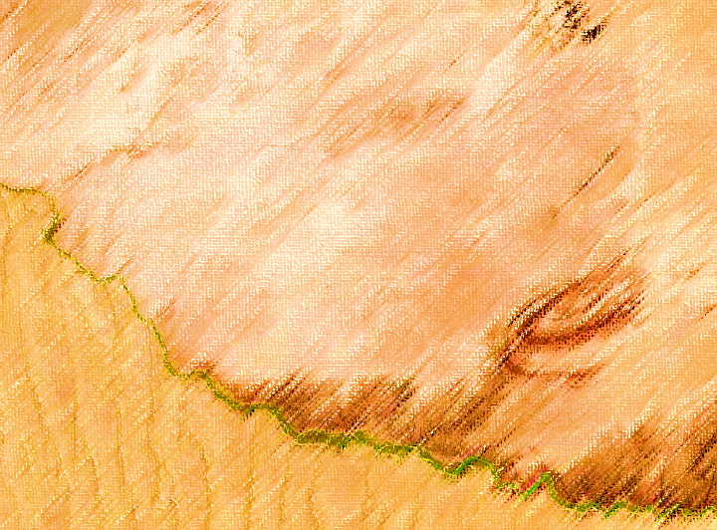

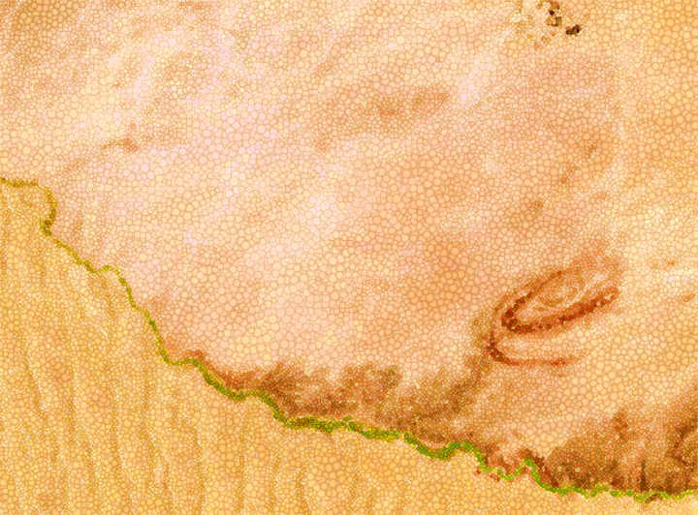
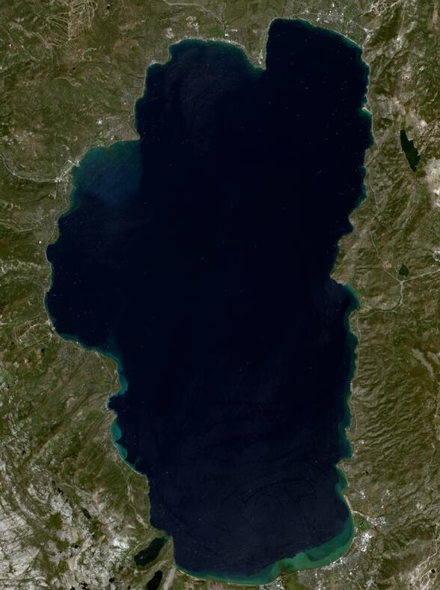
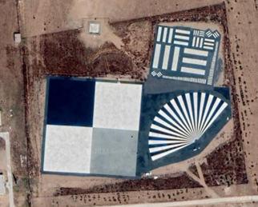
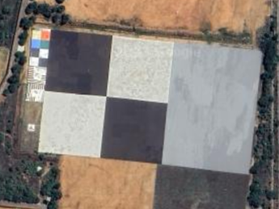
Automated Radiometric Monitoring
Data Collection
Temporal, Spatial, Spectral Matching
Comparison
Comparison
Image Database (CID)
RadVAL Comparison
Database
RadVAL
Comparison
Dashboard
& future contributing missions…
Radiometric sites
Geometric sites
Thermal
sites
Notes:
Looking to add more mission data
Idea that the CID will hold data collected over geo sites too

Slide 24
Comparison Imagery Database (CID)
To hold data over the CEOS Core References
  In future, plan to extend to cover, e.g. geometric, thermal sites…
The UK’s Earth Observation Data Hub infrastructure hosting an archive participating satellite matchups over CEOS references
Mechanism of automated data transfer to be established
Can be set up as a STAC catalogue to allow users to easily access datasets of interest
Notes:
Geometric e.g. Baotou, Shadnagar…

Slide 25
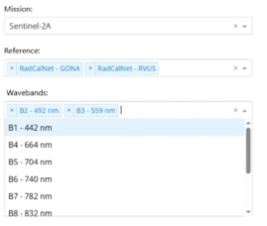
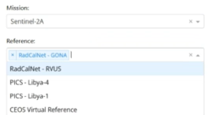
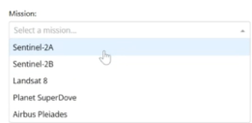
RadVAL Dashboard
Built from MetEOR toolkit
Started with an initial implementation:
  Sensors – Sentinel-2, Landsat, Planet (via EODH)
  CEOS References – RCN GONA, RCN RRV
    Potentially add to list but maintain a minimum core to constrain effort
    Combine results to form “virtual reference”
Notes:
beta version out & currently updates being made to UI…
Which datasets are currently in there, which are in progress
Demo of deployed site
Take new video

